Slide 1
Jumping for JS
Day 8
April 13, 2016
Notes:
I want to welcome everybody to our second javascript class

Slide 2
Today’s Class
Notes:
Today we will learn about the for loop. We will utilize the for loop along with the concept introduced last time like arrays and conditional logic to create more complex control flow ultimately leading us to our last activity of the day where we will create our first game!

Slide 3
Objectives
In today’s class we’ll be covering:
Array Assignments
The Concept of For-Loops
The Art of Pseudo-Coding
Building Our First Game
Notes:
Today we will learn about the for loop. We will utilize the for loop along with the concept introduced last time like arrays and conditional logic to create more complex control flow ultimately leading us to our last activity of the day where we will create our first game! WOOT!

Slide 4
Basics Recap
Notes:
Let’s start with a quick recap

Slide 5
Deep Philosophy
What is Javascript?
(And what is it used for?)
Notes:
Pick Student:

Slide 6

Javascript Definitions
Javascript is the third of the three fundamental programming languages of the modern web (along with HTML, CSS)
Javascript allows developers to create dynamic web applications capable of taking in user inputs, changing what’s displayed to users, animating elements, and much more.
Notes:
Javascript can manipulate the DOM, we control javascript, we are master of the DOM

Slide 7
Please… Don’t Pick Me.
What is a Variable?
(And how do we declare one?)
Notes:
Pick student:

Slide 8
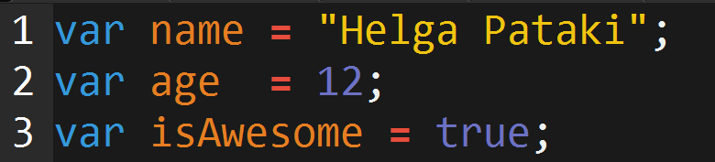
Basic Variables
Variables are the nouns of programming.
They are “things” (Numbers, Strings, Booleans, etc.)
They are composed of variable names and values

Slide 9
Please… Don’t Pick Me.
What is meant by console.log?
(And how does it differ from an alert, prompt, or confirm?)
Notes:
Pick Student:

Slide 10
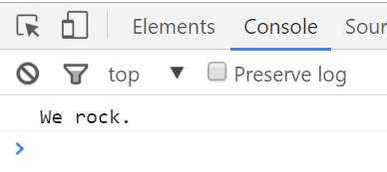

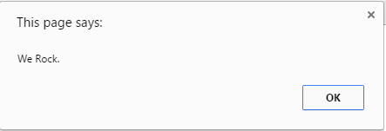

Basic Variables
Console.log displays discreetly to the debugger
Alert displays a pop-up message to the user
Notes:
Choose your own adventure

Slide 11
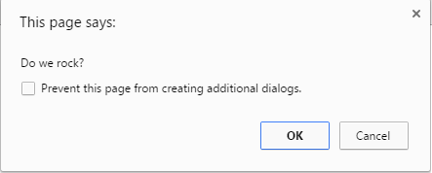
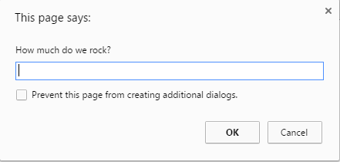

Basic Variables
Confirm displays a True/False popup.
Alert displays a prompt with a text-box input.

Slide 12
Please… Don’t Pick Me.
How do you “write” text to the HTML itself?
Notes:
Pick Student:

Slide 13
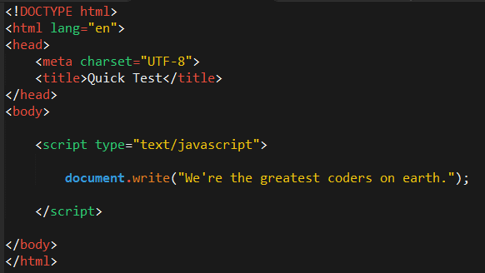

Writing to HTML
We can also use Javascript to directly write to the HTML page itself using document.write( ).
Later we will go over much more advanced approaches for writing HTML using Javascript and jQuery.
Test.html (chrome)
Test.html (sublime)
Notes:
Now this isn’t a very sophisticated way to write content to the DOM but it works, and we will learn other methods

Slide 14
Please… Don’t Pick Me.
How do you check conditions?
Notes:
Pick Student:

Slide 15
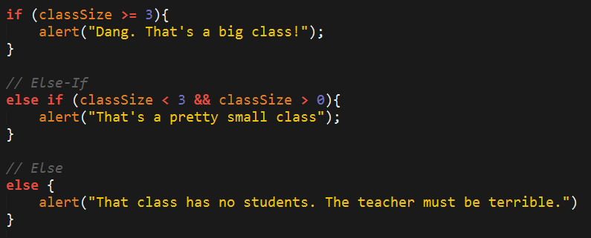
If-Then Statements
If-Then statements are critical.
Each statement is composed of an if, else-if, or else (keyword), a condition, and the resulting code in { } curly brackets.
Notes:
We learned how to make decisions, using the conditional if/then, here for example we are examining the value of the variable classSize, and making decsions based upon that value using comparison operators like <> >=. Other comparison operators? == === != We also used logical operators like && - and What other logical operators? || !+ What does all this comparison really break down to? True or False, the great duality, the perception of the senses, existence or non-existence, infinity and eternity.

Slide 16
Please… Don’t Pick Me.
What is an array?
Notes:
Pick Student:

Slide 17
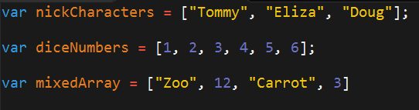
Basic Arrays
Arrays a type of variable that are collections.
These collections can be made up of strings, numbers, Booleans, other arrays, objects, anything.
Each element of the array is marked by an index. Indexes always start with 0.
Notes:
Arrays are collections, collections of what? Bits of primitive data, like stings, integers, or Booleans, as well as other arrays and more complex things like objects. [switch to code] We learned to select an array item using bracket notation based on its index number. We also learned we can use javascript methods like indexOf to preform different operations against our array.

Slide 18
> YOUR TURN!!
Activity: 1-JS Dissect | Suggested Time: 3 min
Code Dissection: Basic JS
Re-examine the file sent to you during yesterday’s class.
See if you can better understand how it works – after having gone through today’s class.
Prepare to share once the time is up.
Notes:
We are gathering some vars from the user, then setting our own global vars, check if confirmCats is true and alert, check if petIsCat is true and alert, alerting if the petAge var does not equal 7, checking conditions against the pet age and alerting, replacing the entire doc with a welcome concat to the username var, using prompt to reassign the var catAge, attempting to alert the value of catAge plus 2 and then finally alerting the value of catAge plus 2 but parseing catAge before attempting addition. Put this badboy on the appstore!

Slide 19
> YOUR TURN!!
Activity: 2-CoolPeopleArray | Suggested Time: 5 min
Code Creation: Array Logging (If Needed)
Follow the instructions provided in the file to console.log each of the names in the “coolPeople” variable.
Hint: You should be repeating the same line 6 times.
Prepare to share once the time is up.

Slide 20
> YOUR TURN!!
Activity: 3-ArraySetting | Suggested Time: 7 min
Code Creation: Array Setting
Follow the instructions in the file provided to modify each of the elements in the array variable to make them lower case.
Only add in lines of code where told.
Hint: You will need to use the method .toLowerCase(). Research - GIYF.
Prepare to share once the time is up.

Slide 21
For Loops

Slide 22
Back to The Zoo Pen
Array Name: zooAnimals
Zebra
Rhino
Giraffe
Owl
Index 0
Index 1
Index 2
Index 3
Notes:
So we remember our zoo array

Slide 23
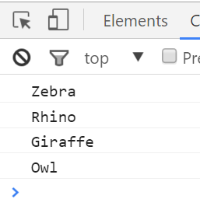
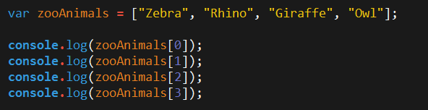
Back to The Zoo Pen (Logging)
Array Name: zooAnimals
Zebra
Rhino
Giraffe
Owl
Index 0
Index 1
Index 2
Index 3
Notes:
We can log the content of the array individually to the console

Slide 24
Please… Don’t Pick Me.
What’s wrong here?

Slide 25
Don’t Repeat Yourself (DRY)
Repeated Code!
Let’s be more efficient
Notes:
DRY – one of the laws of coding, etched into the tablets, brought down the mountain, by Ada Lovelace herself, daughter of lord Byron! Whats the oppisote of DRY? WET write everything twice, we enjoy typing, waste everyones time, any others?

Slide 26
> YOUR TURN!!
Activity: 4-MyFirstLoop | Suggested Time: 5 min
Code Creation: For Loop Dissection
With a partner, spend a few moments trying to dissect the code sent to you.
Try to explain to one another what is happening with each line of code.
Feel free to do a bit of research to help. As a hint, look into the phrase: “For-Loop”
When time is up, feel free to explain.
Notes:
Great, so lets discuss whats happening here:

Slide 27
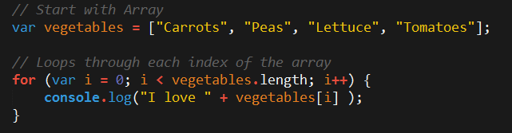
Enter the For-Loop
For loops are critical in programming.
We use for loops to run repeated blocks of code over a set period.
Each for loop is composed of a:
Variable declaration or counter (iterator)
A loop condition
An iteration (addition)
Notes:
Loops allow us to run specific code multiple times

Slide 28
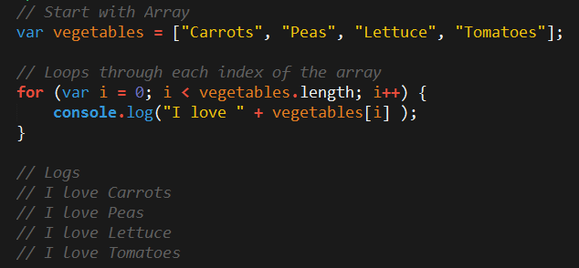
Enter the For-Loop
Iterator. Condition. Increment.
Notes:
We set a var as the iterator, set a loop condition, and then an increment using ++, what would the opposite of an increment?

Slide 29
Enter the For-Loop
Code between the { } gets repeated each time the iterator is smaller than the condition. (i.e. in this case i < 4)
Notes:
For as long as the condition I < the length of our array we run the code inside the curley brackets, similar to the code we place inside the curley brackets of our conditional IF/THEN

Slide 30
Enter the For-Loop
Running the code “loops” through and prints each element in the array.

Slide 31
Run That Loop
When i = 0 … console.log(“I love Carrots”)
Carrots
Peas
Lettuce
Tomatoes
Index 0
Index 1
Index 2
Index 3

Slide 32
Run That Loop
When i = 1 … console.log(“I love Peas”)
Carrots
Peas
Lettuce
Tomatoes
Index 0
Index 1
Index 2
Index 3

Slide 33
Run That Loop
When i = 2 … console.log(“I love Lettuce”)
Carrots
Peas
Lettuce
Tomatoes
Index 0
Index 1
Index 2
Index 3

Slide 34
Run That Loop
When i = 3 … console.log(“I love Tomatoes”)
Carrots
Peas
Lettuce
Tomatoes
Index 0
Index 1
Index 2
Index 3
Notes:
After its done, the loop exits, any code below will run afterwards

Slide 35
> YOUR TURN!!
Activity: 5-ZooLoop | Suggested Time: 15 min
Code Creation: For-Loop Zoo
Spend a few moments, re-writing the code below using a for-loop.
Feel encouraged to use the code from the previous example as guide.
Then try to explain to the person next to you how the code works.

Slide 36
> YOUR TURN!!
Activity: 6-AnotherLoop | Suggested Time: 15 min
Code Creation: Another Loop (Time Permitting)
Starting from scratch, create a for loop that prints the following lines: I am 0 I am 1 I am 2 I am 3 I am 4
Don’t use an array in this case.
Start from scratch :-P

Slide 37
> YOUR TURN!!
Activity: 7-HardLoop | Suggested Time: 30 min
Code Creation: Hard Loop (Time Permitting)
Starting from scratch, create code that loops through the following array:
And prints out the names of the animals on the farm.
Then using the .charAt() method (research it) check if the first letter in the animal’s name begins with a “c” or “o”. If it does then create an alert saying: “Starts with c or an o!”

Slide 38
Rock Paper Scissors
Rest of Class!

Slide 39
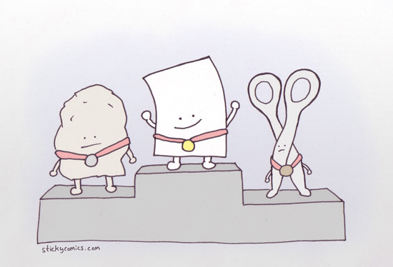
I’ma Beat You…
Play Rock Paper Scissors with the Person Next to You! Play 5 Rounds

Slide 40
> YOUR TURN!!
Activity: 8-PseudoCode | Suggested Time: 8 min
Code Creation: Pseudocode
With a partner, spend a few moments outlining all the steps and conditions that go into rock paper scissors.
Try to break it down into steps that you could “code out”
Think of basic elements like loops, if-then statements, arrays, alerts, etc.
Be prepared to share your outlined approach.
Notes:
Lets all play rock, paper scissors, this is that idea of preparing to code by running an experiment or building a model. Lets try to break the steps down into logic that can be expressed in real human language, and then think of this login in our conditions we have covered.

Slide 41
Basically a Coder!
You just pseudocoded!
Notes:
Congrats! Show my pseudocode.

Slide 42
Basically a Coder!
Now… for the rest of the class YOU will be coding it out.

Slide 43
Basically a Coder!
Don’t worry. We’ll be here to help you along the way.

Slide 44
Demo Final Solution
Instructor: Demo
(rps-9.html | 9-RPS-Coded)
Notes:
SO lets look at the final product. Open in browser. Now using what I know about probability and that there is a slight bias for a random selection to repeat, (the reason there is a 0 and 00 in roulette (not red or black - green), I can attempt to beat the computer.

Slide 45
> YOUR TURN!!
Activity: 9-RPS-Coded | Suggested Time: 1 hour 10 min
Code Creation: Coding out RPS
With groups of 4, begin the process of coding out the Rock-Paper-Scissors Game.
Do as much as you can, on your own but raise your hand regularly to ask a TA or Instructor to help.
Note: Don’t worry. We know this will be very challenging. We also know that you won’t know where to start. In fact, we haven’t shown you EVERYTHING you need yet. But that’s okay. Accepting the confusion is a HUGE first step in becoming a coder.
Note to Instructor/TAs: Use the files in RPS-Coded to help guide students through the process. Feel free to bits of code that are relevant on the projector.
Notes:
So this project is going to be like turning you out to the wolves, you need to be resourceful, we have given you the pieces but not all of them, some research will be required, this is ciritcal to the process of becoming a developer. Please follow the logic from my pseudocode, there are many ways to build a rock, paper and scissors game, but I don’t want you guys regurgitating something you found on codepen. Although I would completely want you to do something the easy/smart way once you are out there working. Throughout the assignment I will be progressing the solution on the projector, feel free to reference back to my solution as you create yours.

Slide 46
Recap Activity
Time Permitting

Slide 47
Demo Questions
Let’s fill in the Missing Code (Together)
(Recap_UNSOLVED | 10-Recap)

Slide 48
Questions

