Slide 1
jQuery $(Begins)
Day 10
May 9, 2016
Notes:
Jquery $(Begins) – we will learn that the $ is a shortcut for jquery

Slide 2
Admin Items

Slide 3
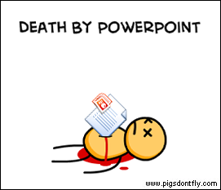
Not the Way to Learn Coding
Notes:
As we move forward the slideshows will become less important. Sorry guys we are programmers now, pretty pictures are for… designers!

Slide 4
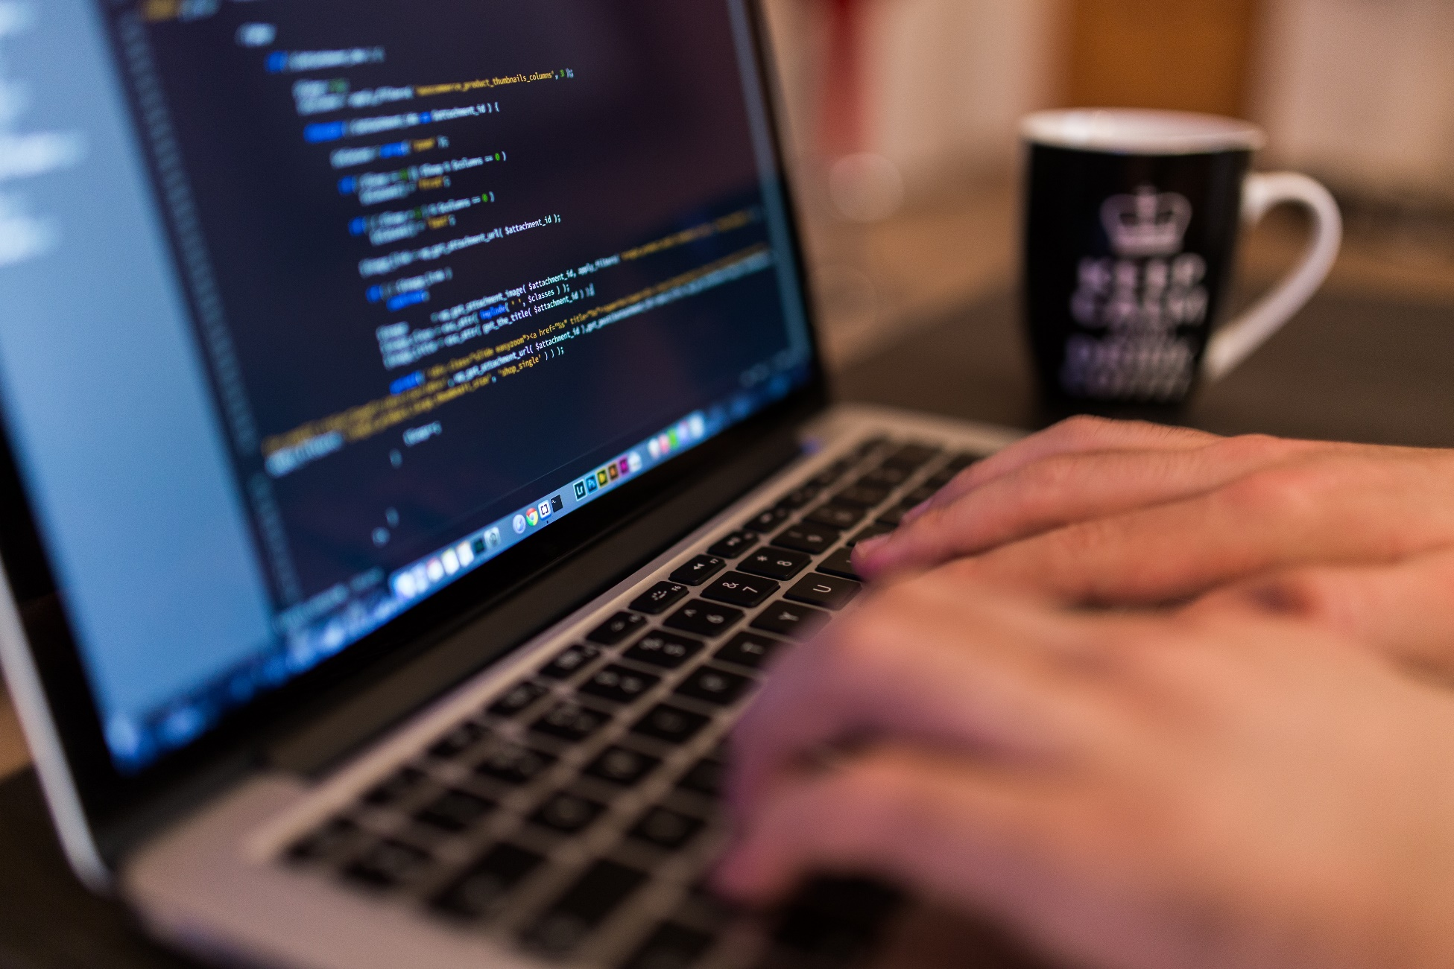
True Way to Learn Coding
Notes:
The best way to code is to code… duh.
A monk asked Master Haryo, “What is the way?” Haryo said, “An open-eyed man falling into the well.”
There is no way but to dive right in! – the way to perfection in something is to commit fully in spite of not knowing what will come
It is important that tonight, if you get completely lost after we have demoed code and you have then worked through an activity. Let us know and we will get right on keeping you up with the material.

Slide 5
A New Era of Class
Be prepared to have classes that are increasingly “just code”
You will appreciate it in the long-run
Notes:
What does this mean for class? It means we are going to have more and more code-focused classes.

Slide 6
Today’s Class

Slide 7
Objectives
In today’s class we’ll be covering:
DOM Manipulation using Plain Javascript
DOM Manipulation using jQuery
Responding to click events
Notes:
Lots of manipulating that DOM today, crack whip First using plain-ole vanilla js and then our new superhero library jQuery. And responding to events like click.

Slide 8
DOM Manipulation

Slide 9
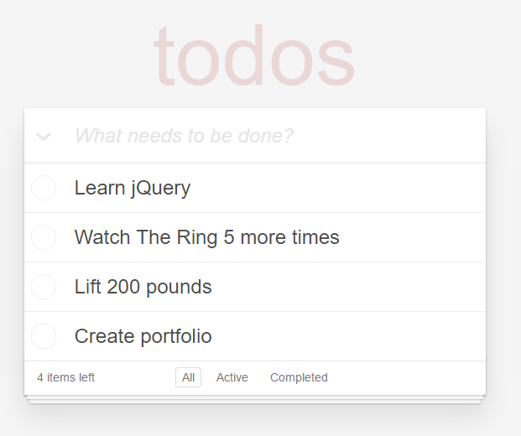
Understanding the “DOM”
Every HTML page begins as static content..
However, with Javascript / jQuery we can “modify the DOM” and change this static content in real-time.
This allows us to build dynamic sites.
Basic Example: http://todomvc.com/examples/jquery/#/all
Notes:
So what is happening here, javascript is being used to manipulate the DOM. Or these objects in our document (including the document itself). Lets take a deeper look. Open source, click over to app.js. Scroll down, and discuss binding events area. Ask questions but be ready to quickly answer yourself and move on. Then look deeper into the edit function. Ask if anyone can guess whats happening in the lines of the function.

Slide 10
Demo Time
Instructor: Demo
(1-5.html | 1-JSGenerators)
Notes:
Ok I have an empty div, lets do something to it, I have to select the object first, the value of the selector is stored in the var, I then want to add some text to that onject using the innerHtml method.

Slide 11
> YOUR TURN!!
Activity: 2-JSDrinkList | Suggested Time: 15 min
Code Creation: Generating HTML with Javascript
Using the file sent to you as a starting point, add the missing code such that your Javascript generates HTML content that displays all of the drink options.
HINT: You will need a for-loop. Inside your for loop you will need to use each of the following methods: createElement, innerHTML, and appendChild.

Slide 12
Intro to jQuery

Slide 13
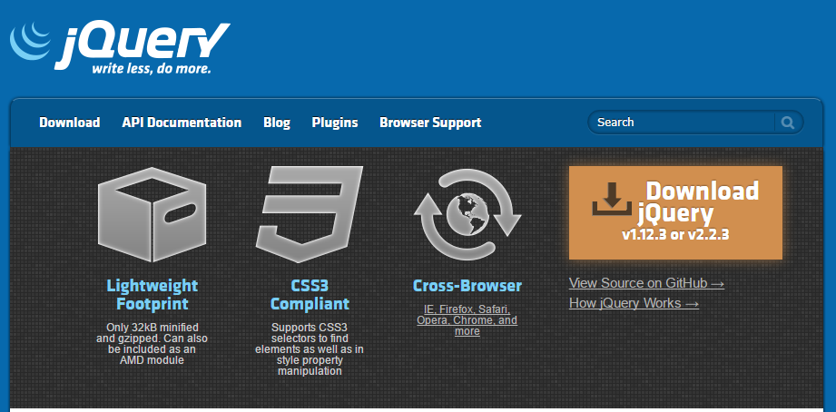
Intro to jQuery
https://jquery.com/
jQuery is a cross-platform Javascript library for easier of client-side HTML scripting.
Notes:
Let talk about jquery, it is a “library” of useful javascript functions built to smooth over some of the rougher aspects of plain ole vanilla js,

Slide 14

jQuery Helper Library
jQuery can be useful for tasks like:
Dynamically Inserting, Updating, or Removing HTML
Registering click or other change events
Animating HTML elements
Download data from databases
And much more!
Notes:
Literally developers started making libraries for painful and long code they were rewriting, DRY, then they shared these libraries and some smart people like John Resig, creator of jquery and, the proud recipient of the Rochester Institute of technologies “Innovator of the Year” –YAH he got a rochie! SO he took all these useful methods/functions/other libraries, Like the sizzle library (the selection engine of jquery) and combined them.

Slide 15


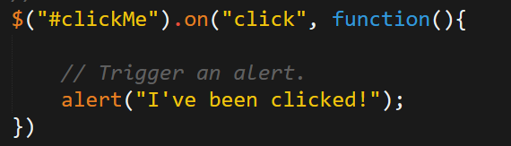
Working with jQuery generally involves…
1. Including a CDN Link to the jQuery script…
2. Utilizing the jQuery specific ($) selector…
3. Then applying jQuery methods on the selected elements.
Notes:
SO like bootstrap, we can use this code as a base for our further development. We link to it or download it and link to it locally. Then we utilize the jquery selector $ which is a shortcut that kinda says, with all this jquery behind us… do this or that.

Slide 16
Demo Time
Instructor: Demo
(1-3.html | 3-jQueryGenerators)
Notes:
Notice the methods are similar but different enough to matter.

Slide 17
> YOUR TURN!!
Activity: 4-jQueryDrinkList | Suggested Time: 12 min
Code Creation: Generating HTML with jQuery
Re-factor (re-write) your previous drinkList code from earlier, but this time use jQuery to complete all of the same tasks.
Your final code should NOT have any of the following methods: createElement, innerHTML, or appendChild.
HINT: Don’t forget to “incorporate” jQuery before you begin.
Notes:
SO just like I refactored my plain ole vanilla js with jquery you can now refactor your drink list code. If you finish the conversion then see about using a jquery method to loop and display the drinks.

Slide 18
Demo Time
Instructor: Demo
(OnClick.html | 5-OnClickBasic)
Notes:
Lets see how we handle clicks on objects in the dom. These are events, in this case the Click event. It starts with a slector, then the .on method which attaches event handlers to that selector, the first paramerter of .on is the event whics is click, next parameter is what to do when the click from this element is detected, which in this case is immediately run a function which alerts the text

Slide 19
> YOUR TURN!!
Activity: 6-SandwichClick | Suggested Time: 20 min
Code Creation: Click Events with jQuery
Add in the missing code such that clicking any of the sandwiches causes…
An alert message to popup saying something snarky about the sandwich type.
A second alert message that displays to the user the number of that specific sandwich they’ve eaten.
HINT: You will need counter variables.
Notes:
The snarkier the better! So before you start lets disicuss the document ready or ON document ready. Yep its another event (but not a user event, what do you thing?), running all our jquery inside this event handler will allow us to make sure that js doesn’t run before the elements we are running our code on exist. Not really needed here but good practice. We will need a counter… how do we increment, operator? If you finish early then as a bonus create a new element that will hold a changing image of the most recently selected sandwich.

Slide 20
> YOUR TURN!!
Activity: 7-TriggerRandom | Suggested Time: 12 min
Code Creation: Generating Numbers with jQuery
Add in the missing code such that clicking the big blue button triggers a random number (between 1 and 1000) to be selected and prominently displayed in the randomNumber div.
Hint: None. You got this.
Notes:
Ok let’s all try this one on our own, you can do it!

Slide 21
> YOUR TURN!!
Activity: 8-LotteryGenerator | Suggested Time: 20 min
Code Creation: Lottery Numbers with jQuery
Using the code from the previous random number generator as a starting point, create a lottery generator.
In our case, the lottery number should pick 9 random numbers (and always 9 numbers). As an example 886563264.
Display this number in the randomNumber div.
Then when a user clicks again, have the code create a new row with the latest number at the top.
Notes:
Ok now a more difficult activity where we can work as partners…

Slide 22
Questions?

Slide 23
Extra!

Slide 24
> YOUR TURN!!
Activity: 9-NumberChecker | Suggested Time: 20 min
Code Creation: Checking Numbers with jQuery
Using the displayed application as an example, create code in which:
A computer picks a random number between 1 and 4
Users then “click” buttons numbered 1 – 4.
If the user’s number matches the computer’s number display text informing them of this in the Result panel. Otherwise, display text informing them they lost.
If you finish early, try to improve the aesthetics.

Slide 25
Questions

