Slide 1
JS Catch Up!
Day 15
May 16, 2016

Slide 2
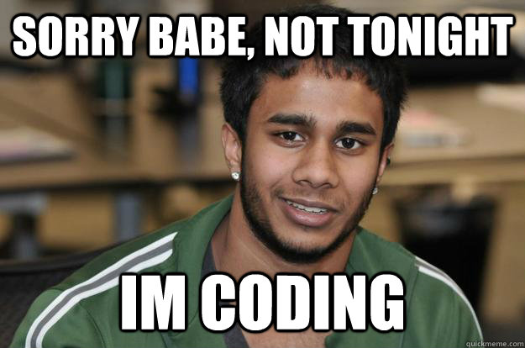
Today’s Plan
We will go over any lingering questions (15 mins)
I will outline the most important topics through today (30-40 mins)
Break into groups for a heavily supported coding session (2 hours)
Notes:
Go over schedule, Start with poll anywhere, get subjects the students still feel unsure about? General Questions? Offer some answers. Break class into teams.

Slide 3
Recap of Subjects
Notes:
Its like, um at this point I cant even remember what I have questions about??? So lets very quickly recap what we have covered and take this time to think of more specific questions you may have and write them down.

Slide 4
The Important Stuff…
HTML / CSS:
Basic Parts of an HTML Document (<html>, <doctype>, <p>, <h1>, etc.).
Using in-line, internal, and external CSS stylesheets.
Using relative pathways to link CSS and other assets.
Using html ids (#), classes (.), and element names to attach css styles.
Git:
The advantages of using Git and source control management.
Using Git Bash or Terminal to perform basic Git commands.
Understanding how to use Git clone, add/commit, push.
Understanding branching via Git branch, checkout, and pull-requests
Notes:
Ask questions of the low to mid,

Slide 5
The Important Stuff…
Bootstrap / Mobile Responsiveness
The concept of using a pre-built CSS library.
The steps to include Bootstrap CSS into your existing website.
The process of dissecting a layout into the Bootstrap grid system.
A general understanding of how to use Bootstrap components (e.g. panels, Jumbotron, navigation bars, etc.)
A general understanding of @media queries and mobile responsiveness.

Slide 6
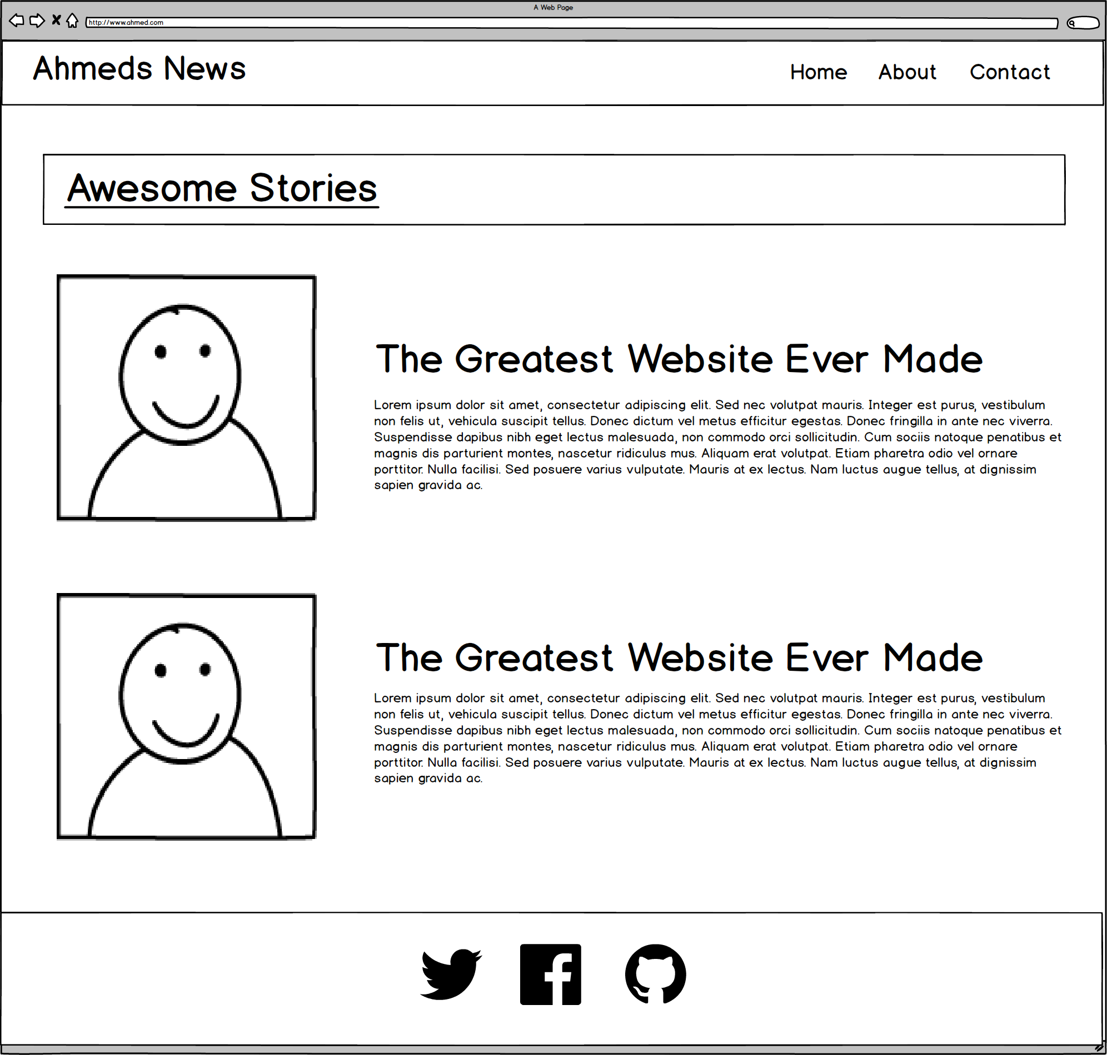
Bootstrap Layouts!
ROWS
1
1
1
4
1

Slide 7
Bootstrap Layouts
1
2
2
1
Total Not relevant

Slide 8
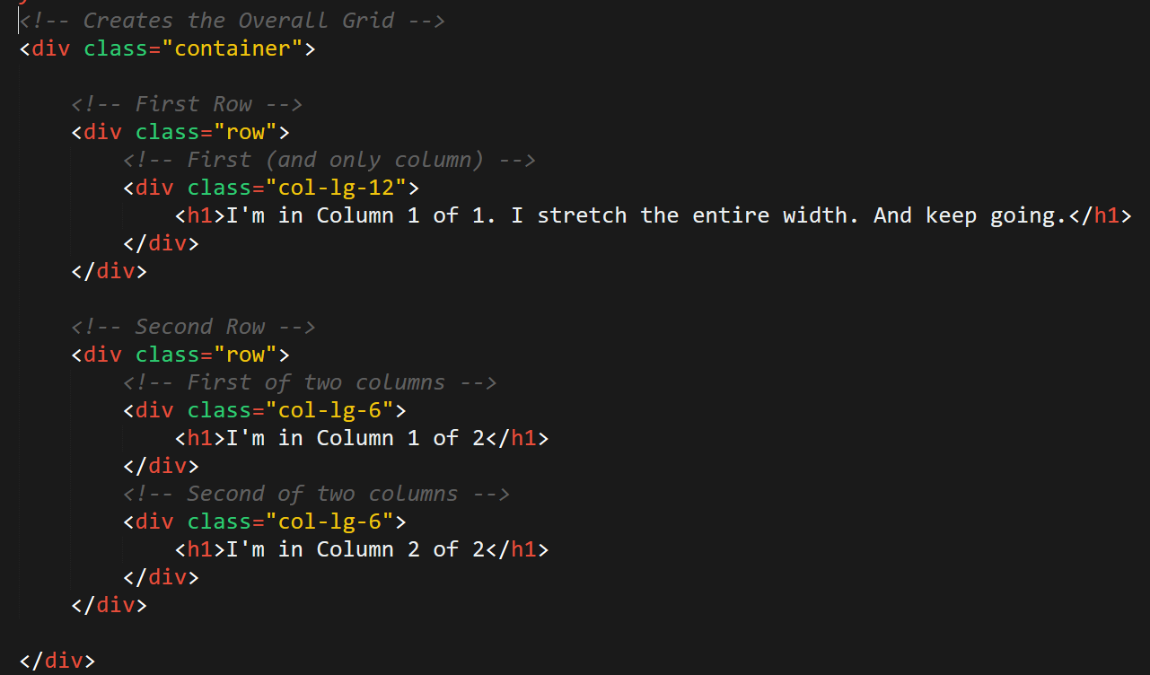
Bootstrap Grid
Note the rows, columns (col-lg-6), and containers

Slide 9
The Important Stuff…
Javascript
Understand what purpose Javascript serves in relation to HTML and CSS
Understand both the uses and syntax for creating the below:
Variables
Arrays
Console.log, Alerts, Confirms, and Prompts
If-Then Statements
For Loops
Functions
Objects
Scope
Methods

Slide 10
The Important Stuff…
Javascript continued…
Understand how to organize a Javascript program with regards to global variables, functions, and function calls.
Be able to use old Javascript code to capture keyclicks.
Be able to use old Javascript code to generate random numbers.
jQuery
Be able to explain why we might use a Javascript library like jQuery
Be able to explain what the jQuery $(_) syntax means.
Be able to use jQuery to capture button clicks.
Be able to provide a few examples of jQuery methods for changing HTML.
Be able to use jQuery and Javascript to change HTML in response to code.

Slide 11
<h1> Your Turn!!! </h1>
Spend a few moments to seriously look over the “important topics” we’ve covered.
Then write down any of the following:
What still seems fuzzy or challenging to you?
What specific questions do you have about these topics?
What conceptual topics do you have about these topics?
Once you’ve written them down:
Turn to the members of your group and ask if they know the answers to your questions or if they can explain a topic:
Write down any questions or topics that are still left unanswered (or weren’t answered well).

Slide 12
Group Work!

Slide 13
Where to Start…
Can you and each person in your group…
Comfortably build the Hangman Game (HW 3) from scratch?
No? Then start with Hangman
Explain conceptually how “Captain Planet The Game” works?
No? Then start by dissecting Captain Planet the Game.
Comfortably use jQuery to modify HTML based on clicks?
No? Then start with Lottery Generator.
Comfortably create a grid-based design with Twitter Bootstrap?
No? Then start with Twitter Bootstrap Assignment.

