Slide 1
Project Week and a Lookback
Day 26
June 11, 2016

Slide 2

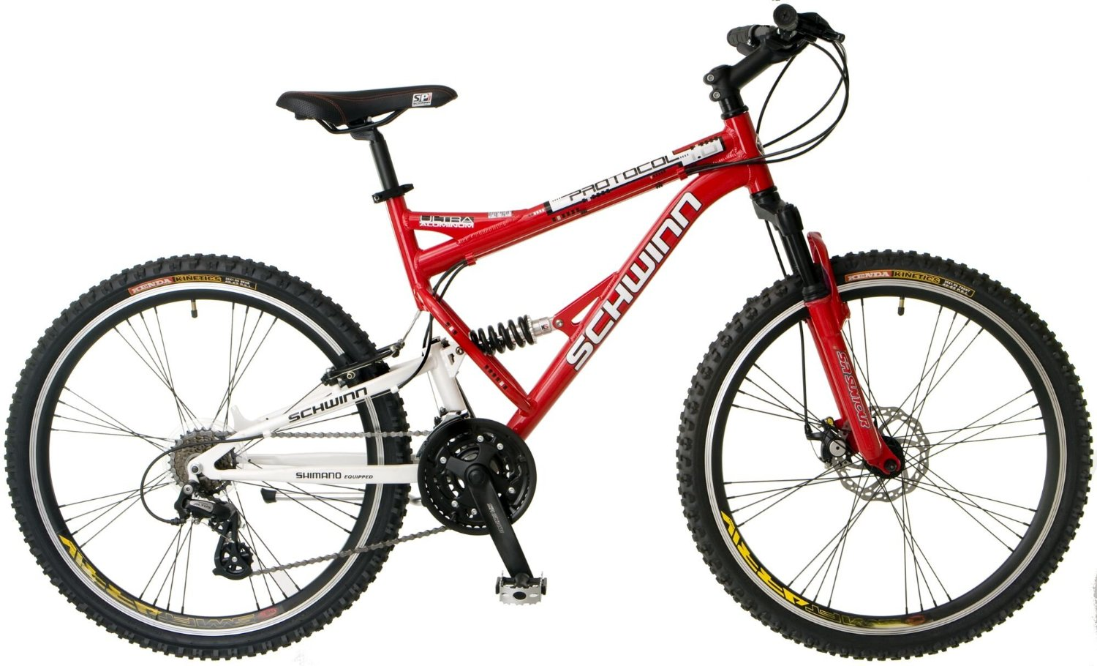
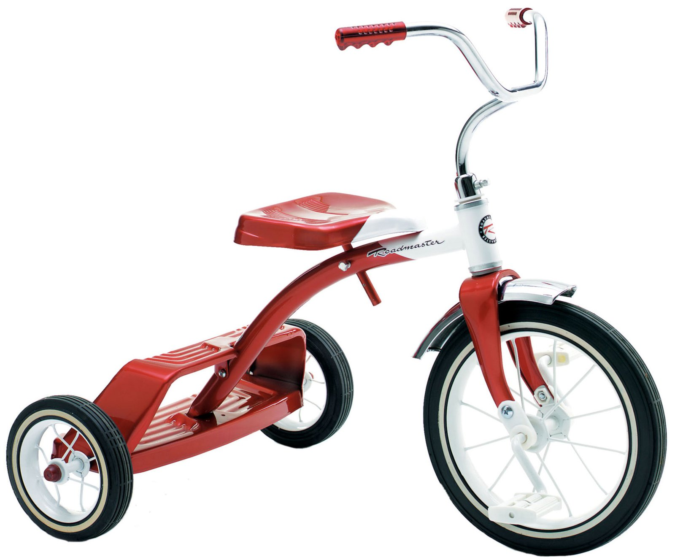
The Path
Dependent
Interdependent
Independent
Limited Range
Smooth Terrain
Single Gear
Longer Range
Smooth/Rugged
Adjustable Gear
Longest Range
Smooth/Rugged
Transmission

Slide 3
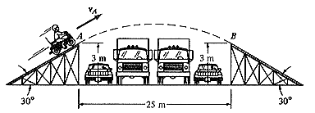
The Job Hunt (May Seem Like)

Slide 4
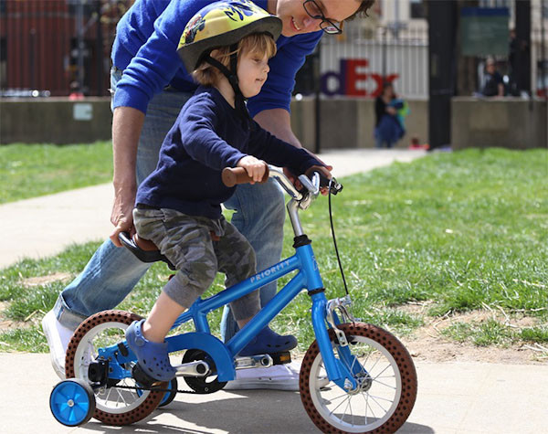
Present day
We’re between
Dependent
and Interdependent
We still have our
training wheels on

Slide 5
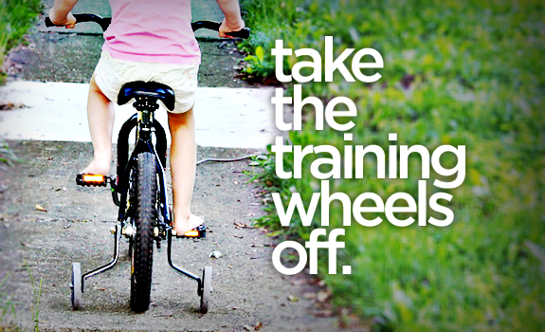
By Next Saturday we will …

Slide 6
New Academic Staff Member

Slide 8

“Code Companion”

Slide 9
How to use your Rubber Ducky
Procedure:
Step 1) Beg, borrow, steal, buy, fabricate or otherwise obtain a rubber duck (bathtub variety)
Step 2) Place rubber duck on desk and inform it you are just going to go over some code with it, if that's all right.
Step 3) Explain to the duck what your code is supposed to do, and then go into detail and explain your code line by line
Step 4) At some point you will tell the duck what you are doing next and then realize that that is not in fact what you are actually doing.
Source: http://www.rubberduckdebugging.com/

Slide 10
How to Ask Questions starting June 20
Procedure:
Talk to your Code Companion
Ask Google/Stack Overflow
Ask each other (your classmates)
Ask an academic staff member

Slide 11
Project Week (Next Week)
Next Week (M/T):
Interview Questions (Class Lecture)
Hardcore Development
Next Week (W/Th)
Debug Work (Class Lecture)
Hardcore Development
Presentation Prep
Saturday’s Class:
Presentations!

Slide 12
The Great Push
Be serious about project week!
Use this as an opportunity to push yourself and prove what you know.
Because you DO KNOW shiz.

Slide 13
Groups
Team #1
Bill Kernan, Fatma Tarlaci,
Roy Hinjosa
Team #2
Adam Camacho, Geegana Wickremasiri, Philip Cooke
Team #3
Conor Mullen, Matthew White, Peter Guerro
Team #4
Jessica Hurst, Mike Henry, Monica Szabo
Team #5
Booth Kittson, Christopher Crawford, Joshua Carroll
Team #6
Andrew Heinke, Cherie Shedd, Herbert Gutierrez
Team #7
David Quinlan, Kayla Martin, Lance Martin
Team #8
Lisa Watkins, Megan King, Rhea Rivera
Team #9
Jack Walker, James Bazan, Justin LeBlanc

Slide 14
Task

Slide 15
Coding Requirements
Must uses at least two APIs
Must use AJAX to pull data
Must utilize at least one new library or technology that we haven’t discussed
Must have a polished frontend / UI
Must meet good quality coding standards (indentation, scoping, naming)
Must NOT use alerts, confirms, or prompts (look into modals!)
Must have some sort of repeating element (table, columns, etc)
Must use Bootstrap or Alternative CSS Framework
Must be Deployed (Heroku or Firebase)
Must have User Input Validation

Slide 16
Coding – Nice To Haves
Utilize Firebase for Persistent Data Storage (Consider this basically a requirement).
Mobile Responsive
Use an alternative CSS framework like Materialize

Slide 17
Presentation Requirement
You will also be responsible for preparing a 10 minute presentation.
This will be a formal presentation.
One in which you explain in detail:
Your overall application’s concept
The motivation for its development
Your design process
The technologies you used (and briefly how they work)
A demonstration of its functionality
Directions for future development
Treat the presentation seriously!
Talking intelligently about tech > doing tech sometimes.

Slide 18
Be Glam for the Camera
All presentations will be recorded…
So treat it seriously!
These can be great portfolio pieces if you invest the time.

Slide 19
Metrics

Slide 20
Metrics
Concept
Design
Functionality
Collaboration
Presentation

Slide 21
Awards Yay!
Most Awe-Inspiring
Most Useful
Most Creative
Best Use of Tech
Best UI/UX
Most Hilarious
Most Disruptive
Most Socially Conscious

Slide 22
API Suggestions

Slide 23
API Suggestions
Stick to APIs that do all of the following:
Allows CORS
Simple or no authentication
JSON response returned
Well documented

Slide 24
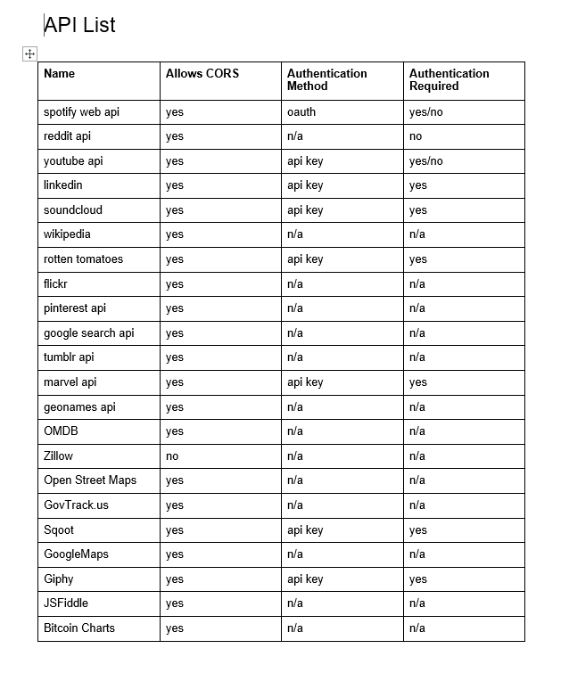
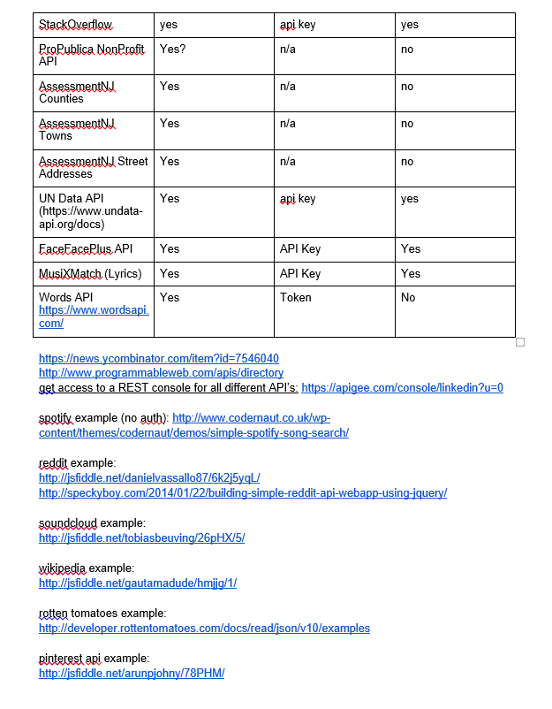
API Suggestions

Slide 25
Tools

Slide 26
Collaboration is Critical!
Steering a project with remote developers like this one can be challenging.
Consider using the following tools…

Slide 27
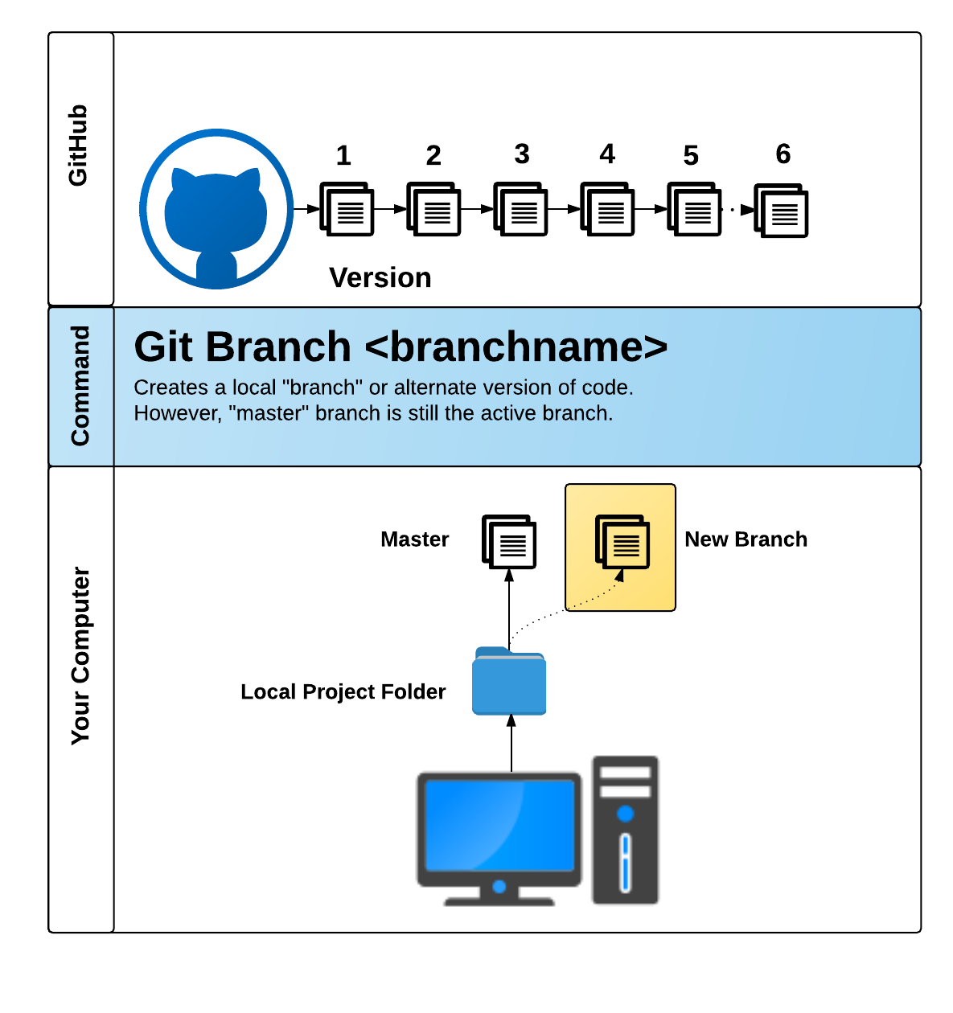
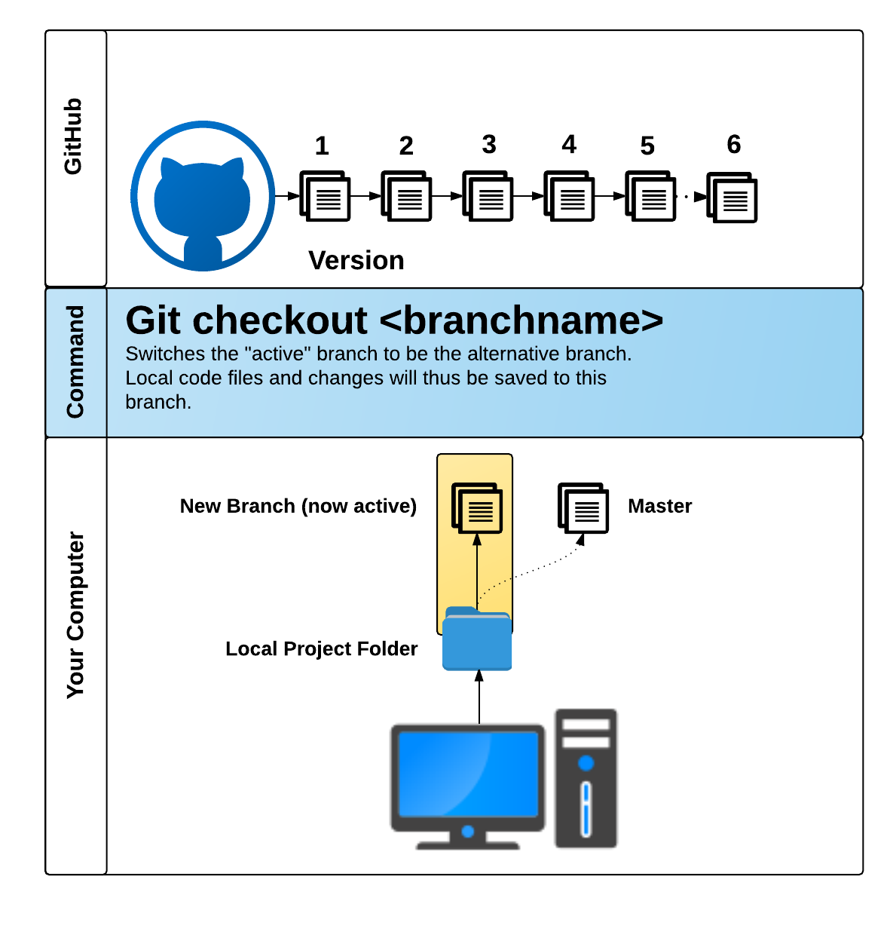
GitHub Pull Requests
GitHub Pull Requests are a great way to “combine” code when multiple users are working on the same files.
We’ll show you how to use this feature in the next class.

Slide 28
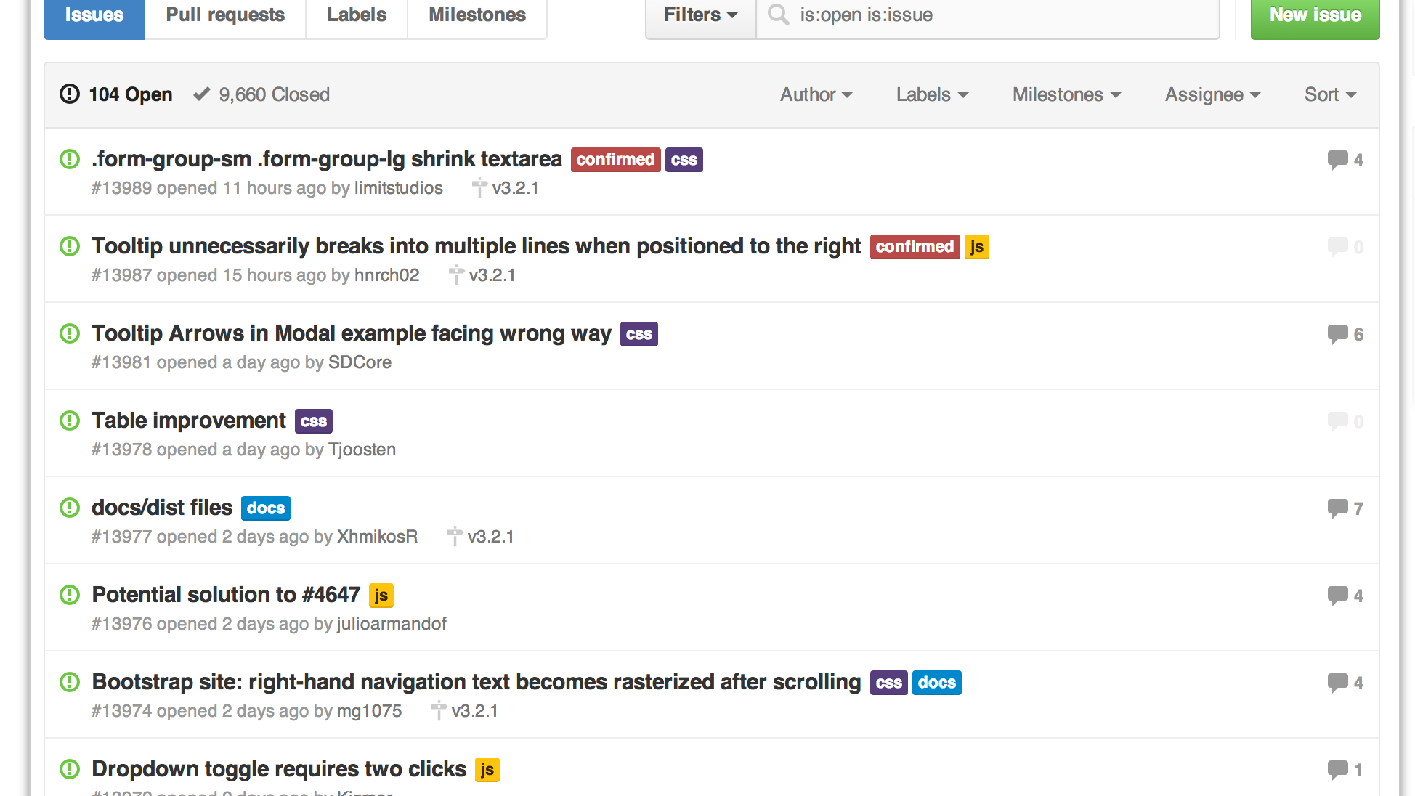
GitHub Issues
GitHub Issues are a great way to keep track of bugs, feature requests, etc.

Slide 29
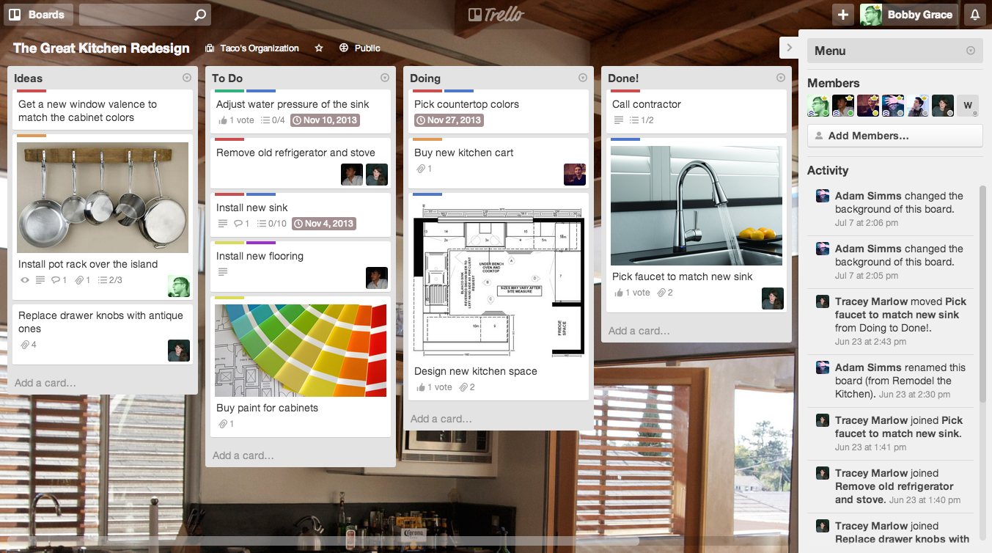
Trello
Trello is a great project management tool for creating to-do lists and communicating updates.

Slide 30
Example Project Ideas

Slide 31

Event Searcher
Users type in the name of their favorite sporting team.
Then using the SeatGeek API, your web application points them to the next game and location where the team is playing.
The web application also provides them a link to Ebay where they can purchase memorabilia associated with the team.

Slide 32

UN Data API
Use the Unofficial UN Data API to search a user specified country’s health records.
Then use a secondary data source (Google Maps, Flickr, YouTube, etc.) to provide additional context or data.
Examples: Per Capita Govt Expenditures on Health, # of Physicians, Deaths due to HIV, Malaria Cases etc, low birth weight newborns

Slide 33

Facial Recognition
Use the Face++ API
Allow users to provide a URL link to a facial image then provide viewers with information on the image’s gender, race, whether they are wearing glasses, and their age
Use Firebase to update ALL users of the site about the current search

Slide 34
Or…
Just do your own thing.
Be creative! Be ambitious!

Slide 35
Today’s Focus

Slide 36
By End of Day - Today
Brainstorm possible ideas
Begin API Research
Create an initial draft / sketch of the final design
Create a short 1 page proposal listing out each of the following:
Project Title
Team Members
Project Description
Sketch of Final Product
APIs to be Used
Rough Breakdown of Tasks

Slide 37
Questions

