Slide 1
Project Week and a Lookback
Day 26
June 11, 2016

Slide 2

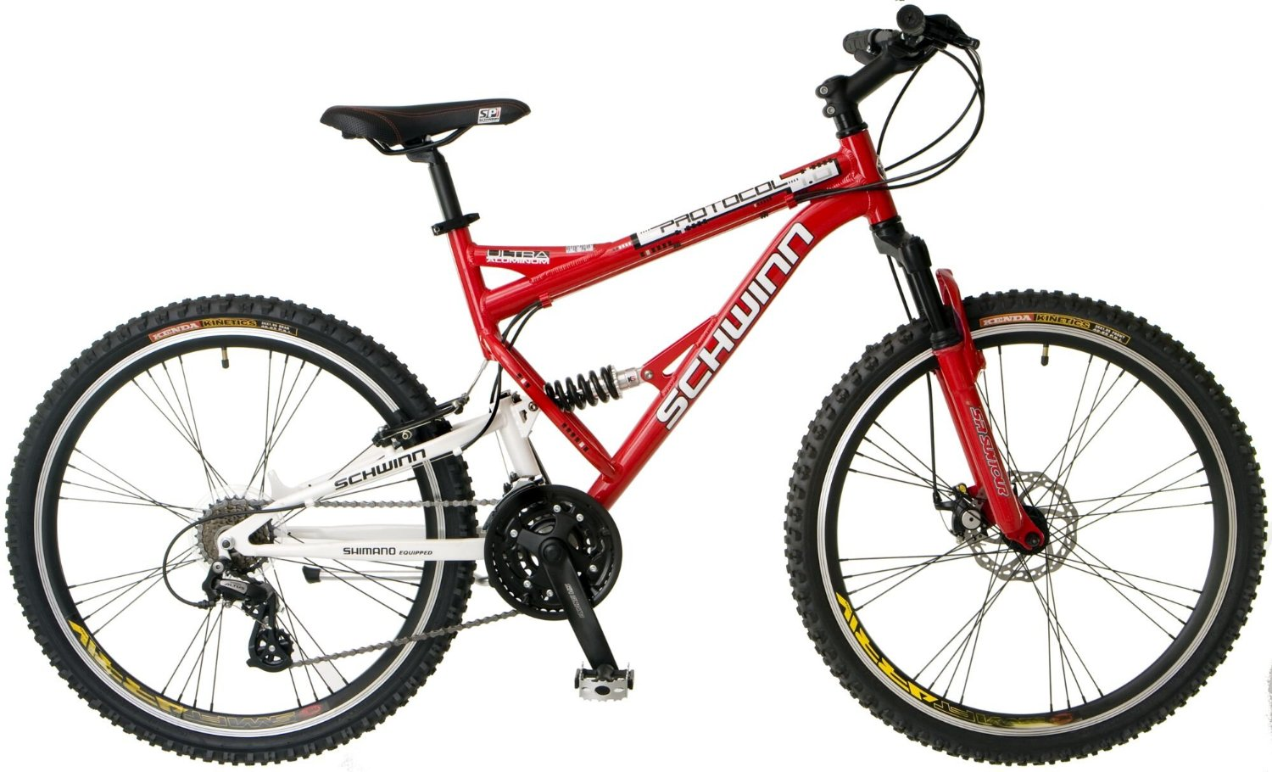
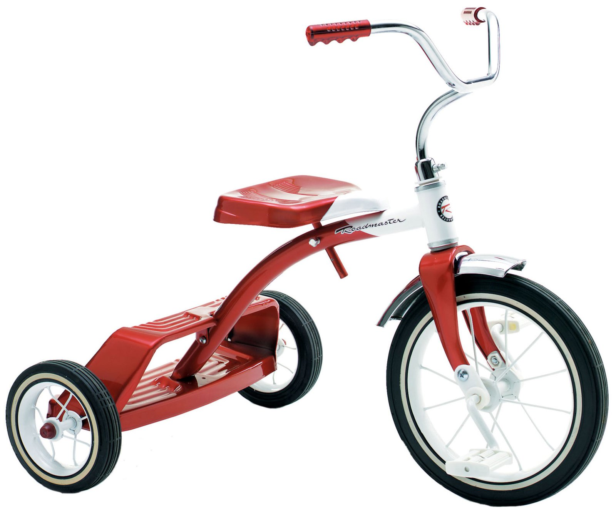
The Path
Dependent
Interdependent
Independent
Limited Range
Smooth Terrain
Single Gear
Longer Range
Smooth/Rugged
Adjustable Gear
Longest Range
Smooth/Rugged
Transmission

Slide 3
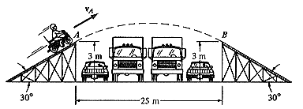
The Job Hunt (May Seem Like)

Slide 4
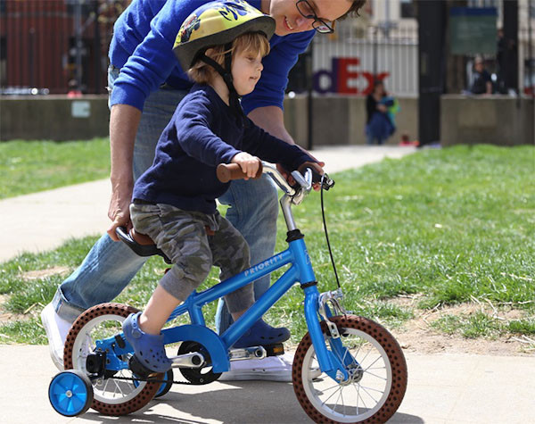
Present day
We’re between
Dependent
and Interdependent
We still have our
training wheels on

Slide 5

By Next Saturday we will …

Slide 6
New Academic Staff Member

Slide 8

“Code Companion”

Slide 9
How to use your “Code Companion”
Procedure:
Step 1) Beg, borrow, steal, buy, fabricate or otherwise obtain a rubber duck (bathtub variety)
Step 2) Place rubber duck on desk and inform it you are just going to go over some code with it, if that's all right.
Step 3) Explain to the duck what your code is supposed to do, and then go into detail and explain your code line by line
Step 4) At some point you will tell the duck what you are doing next and then realize that that is not in fact what you are actually doing.
Source: http://www.rubberduckdebugging.com/

Slide 10
How to Ask Questions starting June 20
Steps:
Talk to your Code Companion
Ask Google/Stack Overflow (including creating a question on SO)
Ask each other (your classmates)
Ask an academic staff member
Requirements to ask a staff member:
Steps to Reproduce Issue* AND
Link to your SO question/what you Googled OR who did you already talk to?
Critical * We won’t take the question without steps to reproduce

Slide 11
What This Looks Like
All questions welcome before, during and after lecture
Homework/Projects
Follow new procedure
Slack Direct Messages
Follow new procedure

Slide 12

The Overarching Goal
Sharpening each Other
Rolodex of Solutions
Training you to be QA

Slide 13
Asking an Academic Staff Member a Question
Assumptions:
At least 2+ people don’t know the answer.
The question is now clearly articulated via Google search/Stack Overflow post
Steps to reproduce issue are clearly defined.
It is highly likely not a syntax error

Slide 14
Questions

