Slide 1
Express Yourself
Day 42
July 12, 2016

Slide 2
Early Concerns…

Slide 3
Comment #1 - Concern
“This is all so confusing…”

Slide 4
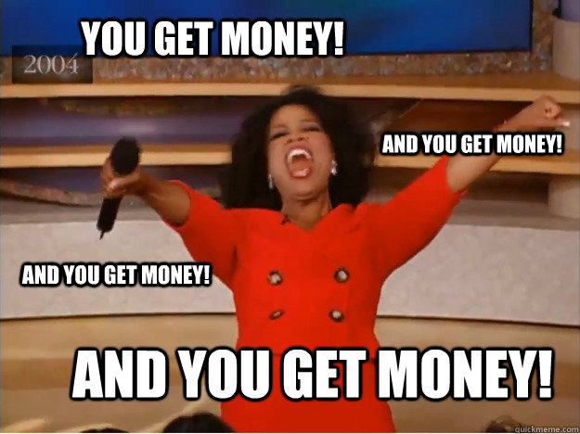
Comment #1 - Response
And it will be for your employer as well.

Slide 5
Comment #2 - Concern
“I feel like I’m just copying and pasting”

Slide 6
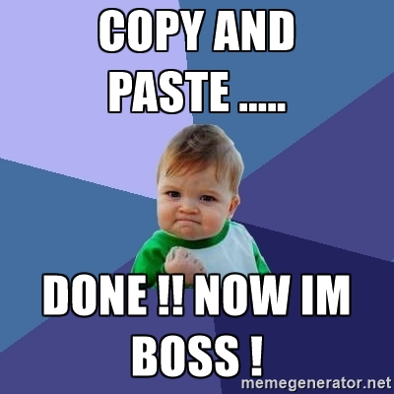
Comment #2 - Response
Backend code libraries mean YOU have to code less.
Often you are just copying “best-practices” over and over again.

Slide 7
Today’s Class

Slide 8
Your Objectives
Before you walk out the door you should…
Know how to create a generic Express Server (copy and paste is fine).
Know how to create a basic Express GET route
Know how to create an Express POST route
Know what POST Man is for
Understand “conceptually” how to use AJAX to GET and POST data to an Express server

Slide 9

Focus!
Node + Express Servers and Routing are two of the
MOST IMPORTANT CONCEPTS
in the ENTIRE program.
Seriously… Try to learn this now.

Slide 10
FOCUS!
Relax. That doesn’t mean its hard.

Slide 11
A Moment to Refresh

Slide 12
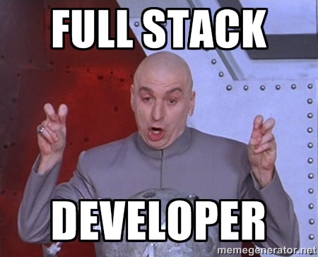
Full-Stack Development?

Slide 13
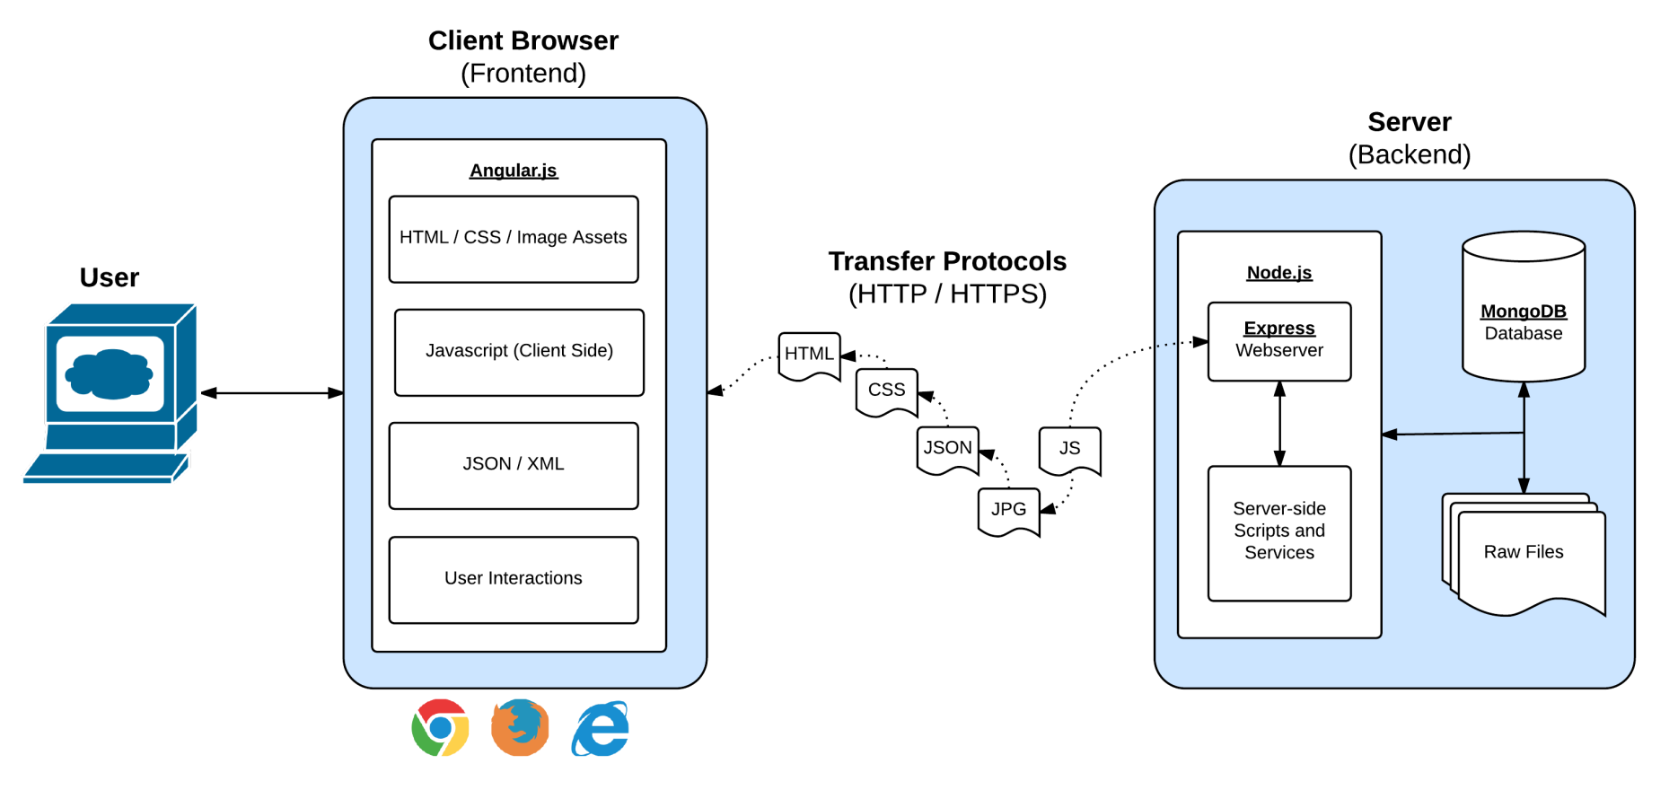
Full-Stack Development
In modern web applications there is a constant back-and-forth communication between the visuals displayed on the user’s browser (frontend) and the data and logic stored on the server (backend).

Slide 14
Remind me again…
What is a server?
In modern web applications there is a constant back-and-forth communication between the visuals displayed on the user’s browser (frontend) and the data and logic stored on the server (backend).

Slide 15
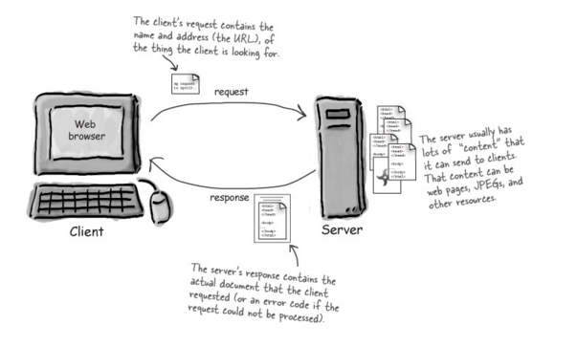
Server Definition
Server: Code that handles requests and respond to them.

Slide 16
Remind me again…
What are examples of server-side functions?
In modern web applications there is a constant back-and-forth communication between the visuals displayed on the user’s browser (frontend) and the data and logic stored on the server (backend).

Slide 17
Server-Side Code in Action!
API that parse URL parameters to provide selective JSONs
Firebase methods that provide a timestamp back to users
Clicking an invoice that provides a PDF report
Image processing software that takes an image applies a filter, then saves the new version
Google providing “results” relevant to your searches on other sites.

Slide 18
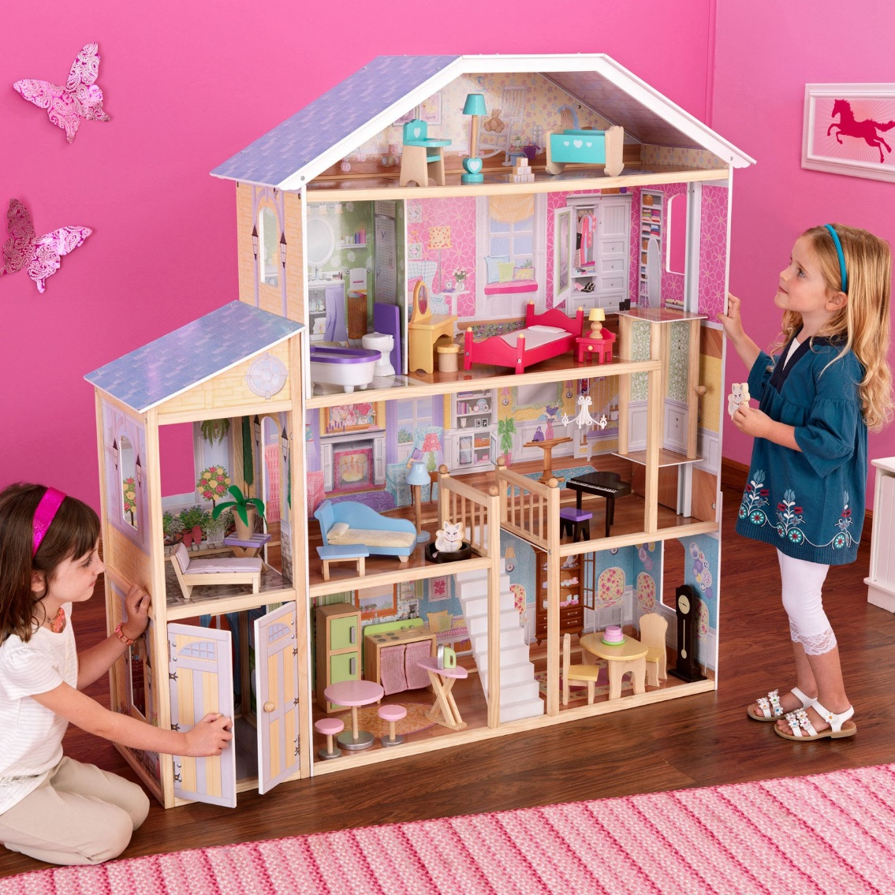
Remind me again…
Where does the server live?
In modern web applications there is a constant back-and-forth communication between the visuals displayed on the user’s browser (frontend) and the data and logic stored on the server (backend).

Slide 19



Servers Live
Servers live in dedicated hardware intended to handle ALL the requests and responses of many clients.
Servers can live most often live on cloud platforms like AWS, Heroku, Google Cloud, etc.

Slide 20
Express

Slide 21
Remind me again…
What is Express?
In modern web applications there is a constant back-and-forth communication between the visuals displayed on the user’s browser (frontend) and the data and logic stored on the server (backend).

Slide 22
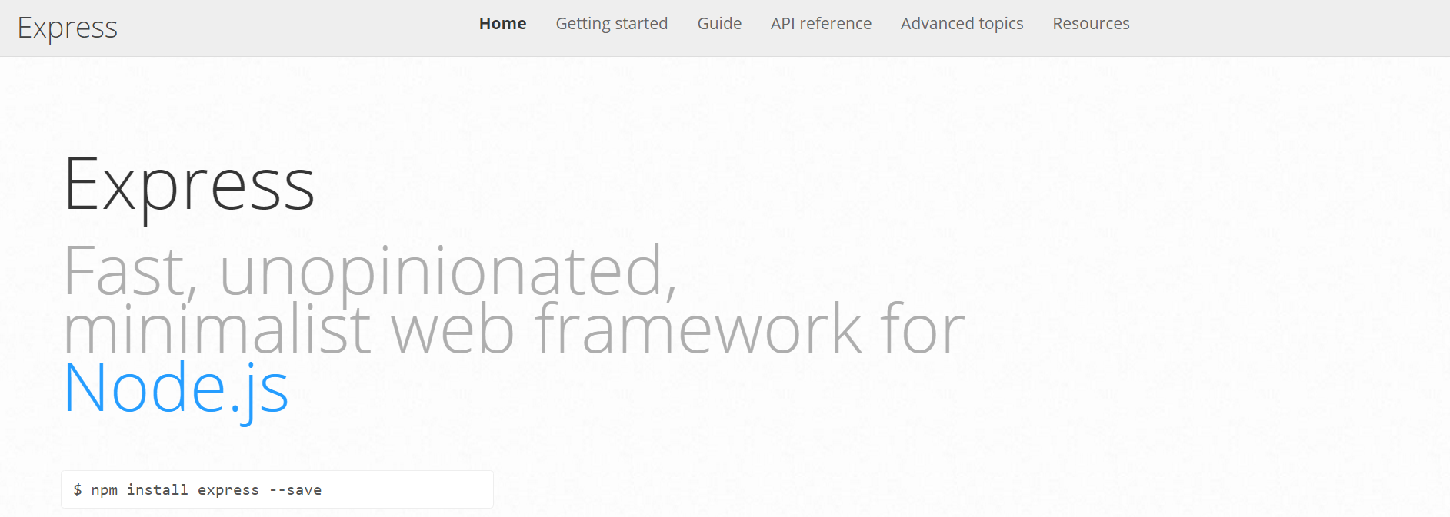
Express.JS
Web framework for node to make creating code for server much simpler
In modern web applications there is a constant back-and-forth communication between the visuals displayed on the user’s browser (frontend) and the data and logic stored on the server (backend).

Slide 23
Remind me again…
What is a route?
In modern web applications there is a constant back-and-forth communication between the visuals displayed on the user’s browser (frontend) and the data and logic stored on the server (backend).

Slide 24
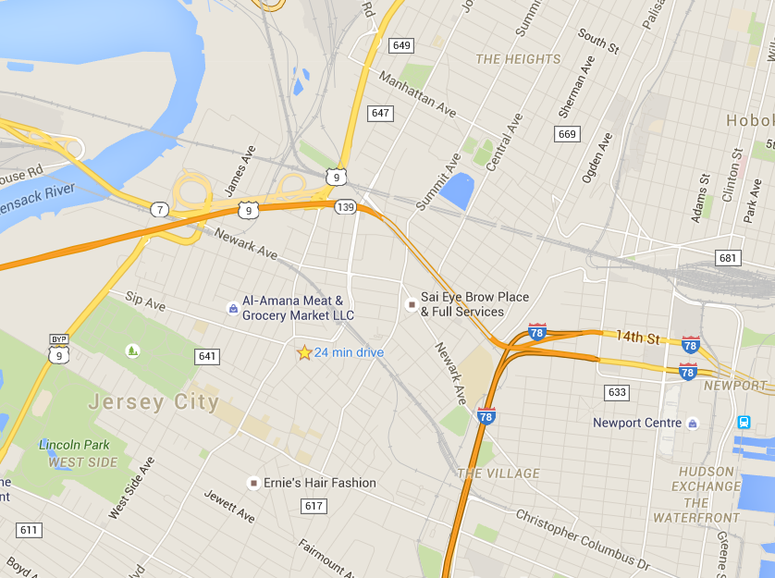
Routes = Maps
In modern web applications there is a constant back-and-forth communication between the visuals displayed on the user’s browser (frontend) and the data and logic stored on the server (backend).

Slide 25
Routes = Maps
/join
User is shown the “Join” Page
/add
User is shown the “Add” Page
User visits a link…
/search/:name
User is shown the “search” page with just the results relevant to the name.

Slide 26
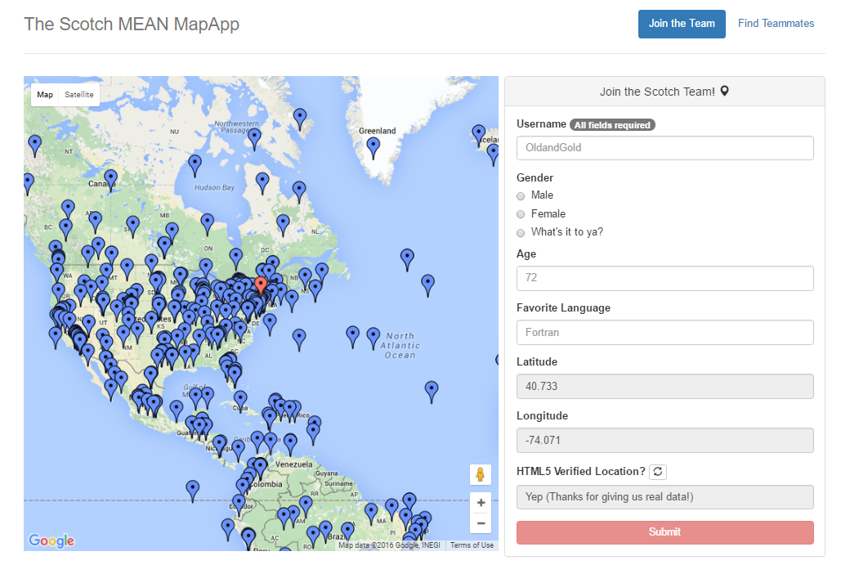
Quick Example
https://mean-google-maps.herokuapp.com/

Slide 27
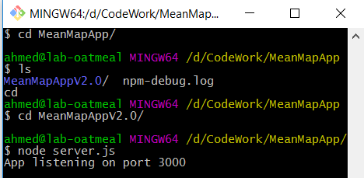
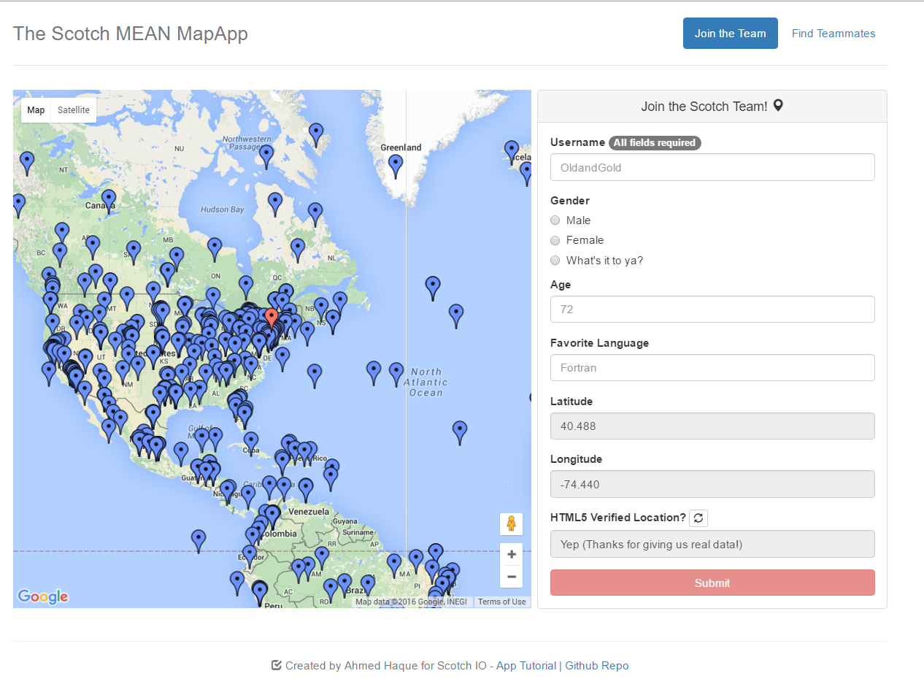
Client-Server Communication (GET)
Client Browser
Node Server
1) User visits /join
(GET Request)

Slide 28
Client-Server Communication (GET)
Client Browser
Node Server
1) User visits /join
(GET Request)
3) Server responds by providing HTML with web form data
2) Request triggers the code in the Server route. The server then finds the relevant HTML content and data

Slide 29
Client-Server Communication (POST)
Client Browser
Node Server
1) User submits form entry
(POST Request)

Slide 30
Client-Server Communication (POST)
Client Browser
Node Server
1) User submits form entry
(POST Request)
3) Server responds by providing HTML with web form data
2) Request triggers the code in the Server route. The server then adds the user to the map and database.

Slide 31
Activity Time!

