Slide 1
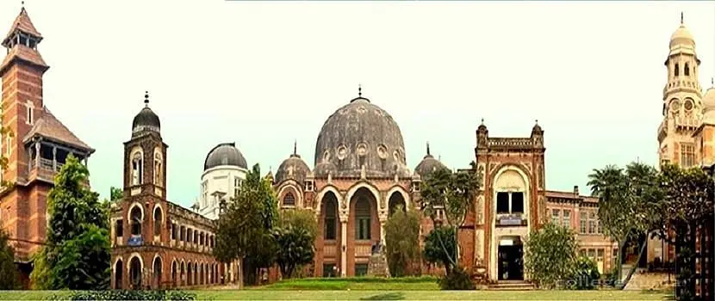

The Maharaja Sayajirao University of Baroda
Faculty of Science
Department of Statistics

Slide 2
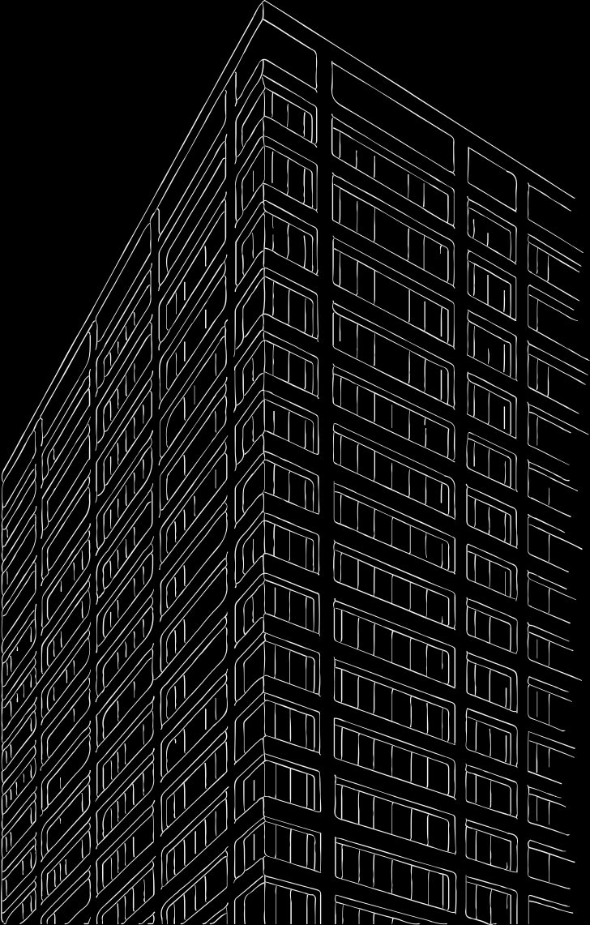
Modeling Urban Inequality in Vadodara: A Spatial Data Science Approach
A Spatial Analysis of Opportunity, Risk, and Access to essential public services
Bhagyashree Bhate
Bhavya Savalia
Dipanshu Narang
Rupesh Pandey
Ms. Sheetal Prasad

Slide 3
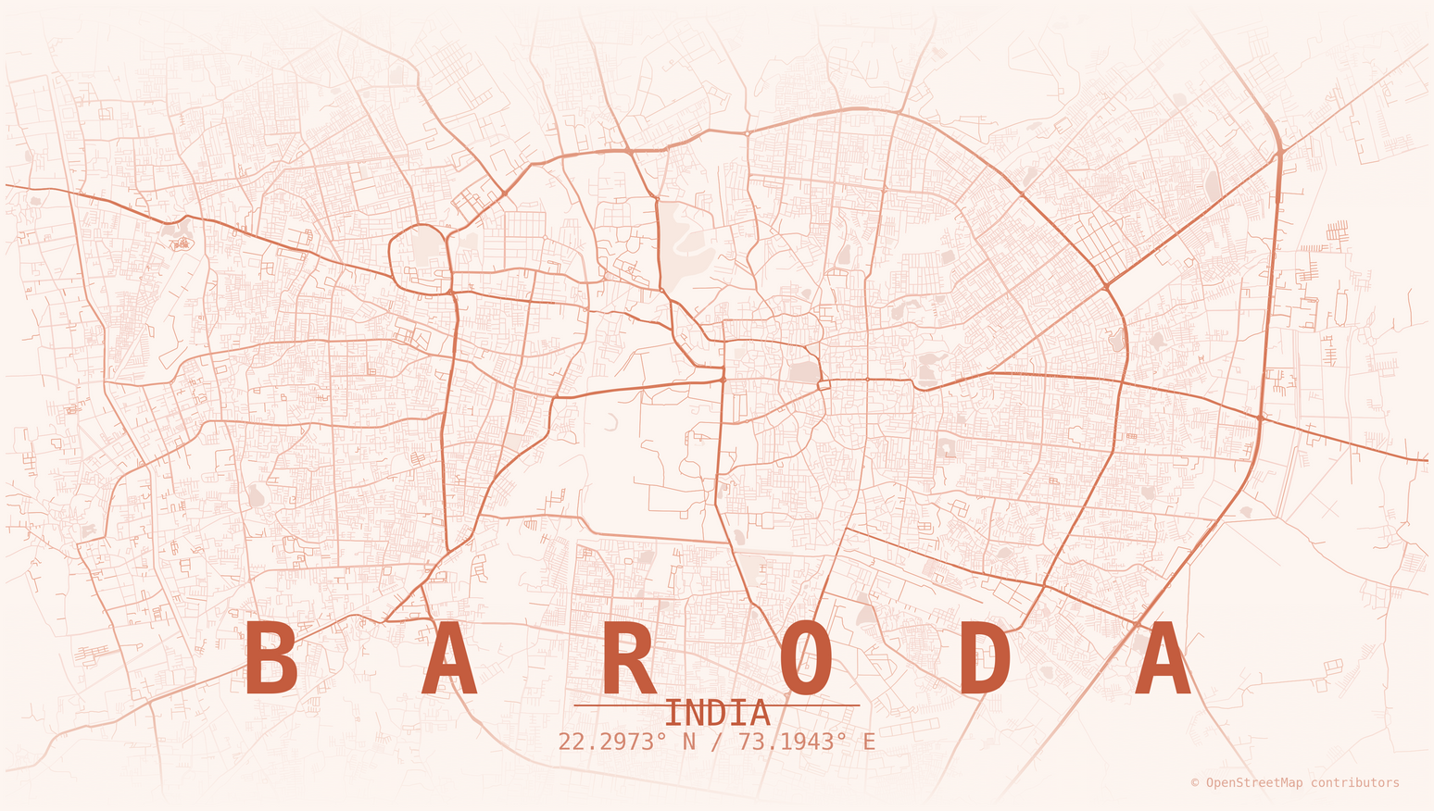
Contents
01
INTRODUCTION
02
OBJECTIVES
03
OVERVIEW
04
METHODOLGY
06
RESULTS

Slide 4
Why Study Urban Inequality ?
For the almost 2,500 years since Plato wrote that “any city however small, is in fact divided into two, one the city of the poor, the other of the rich,”
Urban inequality has been a defining feature of cities for over two millennia, with scholars noting persistent divisions between rich and poor populations within dense urban spaces.
Survey of basic services in the urban slums of Vadodara identified 96,000 families (2.8 lakhs) as falling below the poverty line i.e. the families were drawing an income of Rs 373 per capita per month.
Studies on travel behavior in Vadodara show that women have lower mobility than men, and this mobility decreases further for low-income groups. Low-income individuals, regardless of gender, are "forced walkers" or dependent on public transit, while higher income correlates with private vehicle ownership.
Sources: Glaeser et al., Harvard Kennedy School (2009),
VMC, 2 in 1 in-depth analysis of existing situation.

Slide 5
Motivation
Cities grow fast, but not everyone benefits in the same way.
In Vadodara, some neighborhoods have good schools, hospitals, transport, and jobs nearby, while others struggle to access even basic services.
These differences are often visible on the ground, but rarely measured clearly or mapped in one place.
Without clear evidence, planning decisions risk helping already advantaged areas and leaving vulnerable communities behind.
This study aims to turn everyday urban experiences like reaching a bus stop, a hospital, or a safe area into measurable insights that can guide fairer urban planning in Vadodara.

Slide 6
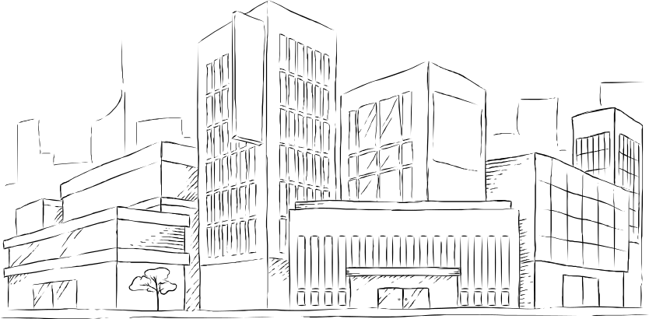
Network
Here’s an assortment of alternative resources whose style fits the one of this template:
Photos
Analog landscape of city with buildings I
Analog landscape of city with buildings II
Sunny urban landscape I
Sunny urban landscape II
Sunny urban landscape III
Vectors
Sketches modern city background

