Slide 1
URBAN INEQUALITY
IN VADODARA
Geo-Spatial Analysis of Opportunity, Risk & Accessibility
M.Sc. Statistics · Vadodara Municipal Corporation · 32 Wards · 2024–2026
GCN + BYM2 + SWMM + city2graph
1 / 16

Slide 2
Thesis pipeline
Five interconnected analytical stages
1
Data collection
2
UOI construction
3
Spatial statistics
4
Hydrodynamics
5
GNN + BYM2
OSMnx · GTFS · SRTM DEM · VMC wards
Normalised composite: Health 30% · Edu 30% · Transit 20% · Flood 20%
Moran's I · LISA · OLS → SLM/SEM → GWR → BYM2
SWMM DYNWAVE 4-hour cloudburst · ward flood road %
GCN embeddings → ICAR spatial model · hybrid inference
2 / 16

Slide 3
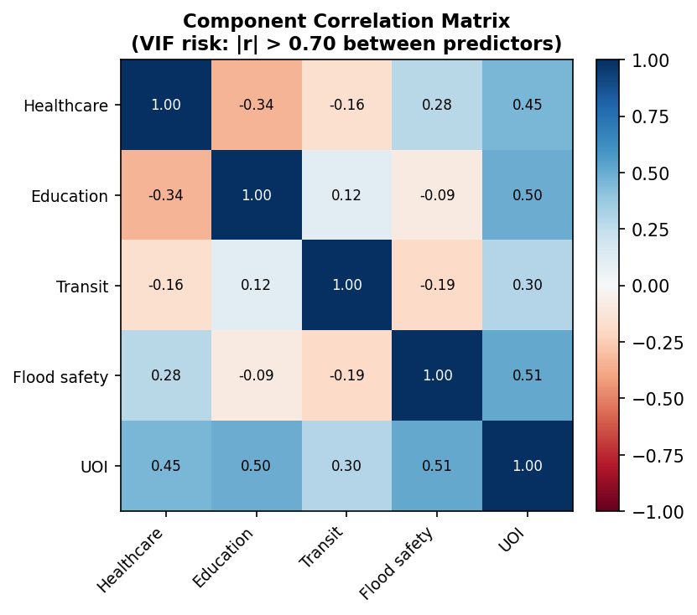
Urban Opportunity Index
Formula, weights, and normalisation
UOI_i = 0.30 · Ĥ_i + 0.30 · Ê_i + 0.20 · T̂_i + 0.20 · (1 − F̂_i)
Ĥ Healthcare
Ê Education
T̂ Transit
1−F̂ Flood (inv.)
Weight: 30%
Weight: 30%
Weight: 20%
Weight: 20%
Drive-time isochrone to nearest hospital/clinic via OSMnx road network
Walk-time isochrone to nearest school/university via OSMnx
GTFS bus stop density + route coverage (city2graph travel_summary_graph)
1 − flood exposure % from SWMM DYNWAVE simulation
All components min-max normalised to [0,1] across 32 wards. Final scale 0–100.
3 / 16

Slide 4
Sensitivity analysis
OAT · Monte Carlo (Dirichlet, N=10,000) · Sobol' · Kolm–Pollak κ-sweep
Component
Weight
OAT Rank Shift
MC 95% CI Width
Sobol' S₁
Rank Stability ρ
Healthcare
30%
±1.44
±17.5
0.34
0.977
Education
30%
±1.41
±16.8
0.32
0.974
Transit
20%
±1.16
±12.4
0.19
0.981
Flood Risk
20%
±1.31
±14.2
0.27
0.979
Key findings
Dirichlet MC rationale
Healthcare & Education are highest-sensitivity drivers (rank shift ~1.4)
9/32 wards achieve classification robustness (≥80% quintile agreement)
EDE Spearman ρ ≥ 0.99 across full κ range [0.1–2.0]
Monte Carlo CI width correlates with ward peripherality
Dirichlet(α) is the natural distribution for weight vectors that sum to 1 (simplex). It produces physically valid weight combinations without post-hoc renormalisation. Concentration parameter α controls spread: α→∞ gives equal weights, α→0 gives corner solutions. The symmetric Dirichlet(1,1,1,1) used here is equivalent to uniform sampling over the simplex.
4 / 16

Slide 5
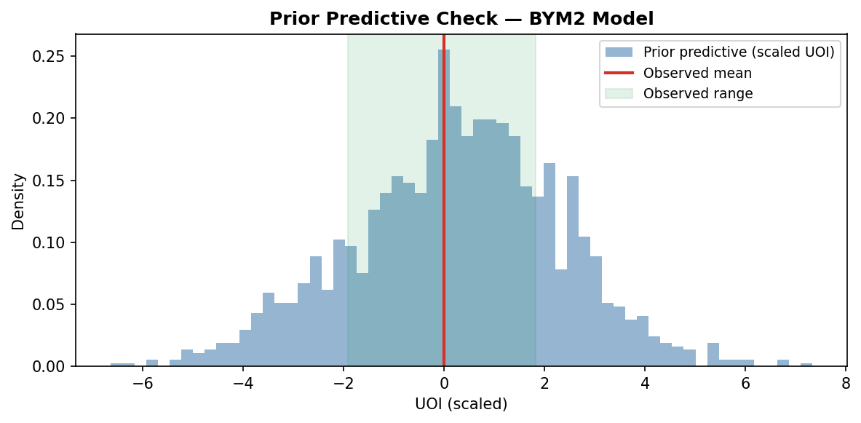
BYM2 Bayesian spatial model
ICAR prior · PC hyperpriors · PyMC 5 NUTS
Model specification
σ_b ~ HalfNormal(0.5) [PC]
P(σ_b > 1.0) = 0.01
y_i ~ Normal(μ_i, σ_ε²)
φ ~ Beta(0.5, 0.5) [PC]
μ_i = α + Σ βⱼ xᵢⱼ + bᵢ
Mildly favours structured
α ~ Normal(0, 1)
bᵢ = σ_b · (√φ · u*ᵢ + √(1−φ) · v*ᵢ)
Weakly informative intercept
u* ~ ICAR(W) [scaled]
β ~ Normal(0, 1)
Per-component coefficient
v*ᵢ ~ Normal(0, 1) [IID]
Critical: do NOT use pm.CAR
pm.CAR(alpha=0.99) approximates ICAR but hardcodes τ=1 and produces biased σ_b. Use explicit ICAR log-potential via pm.Potential('icar', icar_logp(...)).
NUTS: 4 chains × 2000 draws, tune=1000, target_accept=0.90 | Adjacency: city2graph Queen contiguity
5 / 16

Slide 6
SWMM: why it took 17 minutes (and the fix)
4 compounding root causes in build_swm.py
1
Network scale
→
Network scale
BROKEN: 18,000 nodes (full drive)
FIXED: ~700 nodes (major roads)
2
Inflow rate
→
Inflow rate
BROKEN: 0.05 CMS × 18k = 900 CMS constant
FIXED: 0.005 CMS peak / node storm TS
3
Elevations
→
Elevations
BROKEN: np.random.uniform(30,40) → 50% uphill
FIXED: Synthetic DEM slope toward Vishwamitri
4
MaxDepth & outfalls
→
MaxDepth & outfalls
BROKEN: MaxDepth=0, 1 dummy outfall
FIXED: MaxDepth=2.0m, 5 boundary outfalls
Result: 17+ minutes → <30 seconds
6 / 16

Slide 7
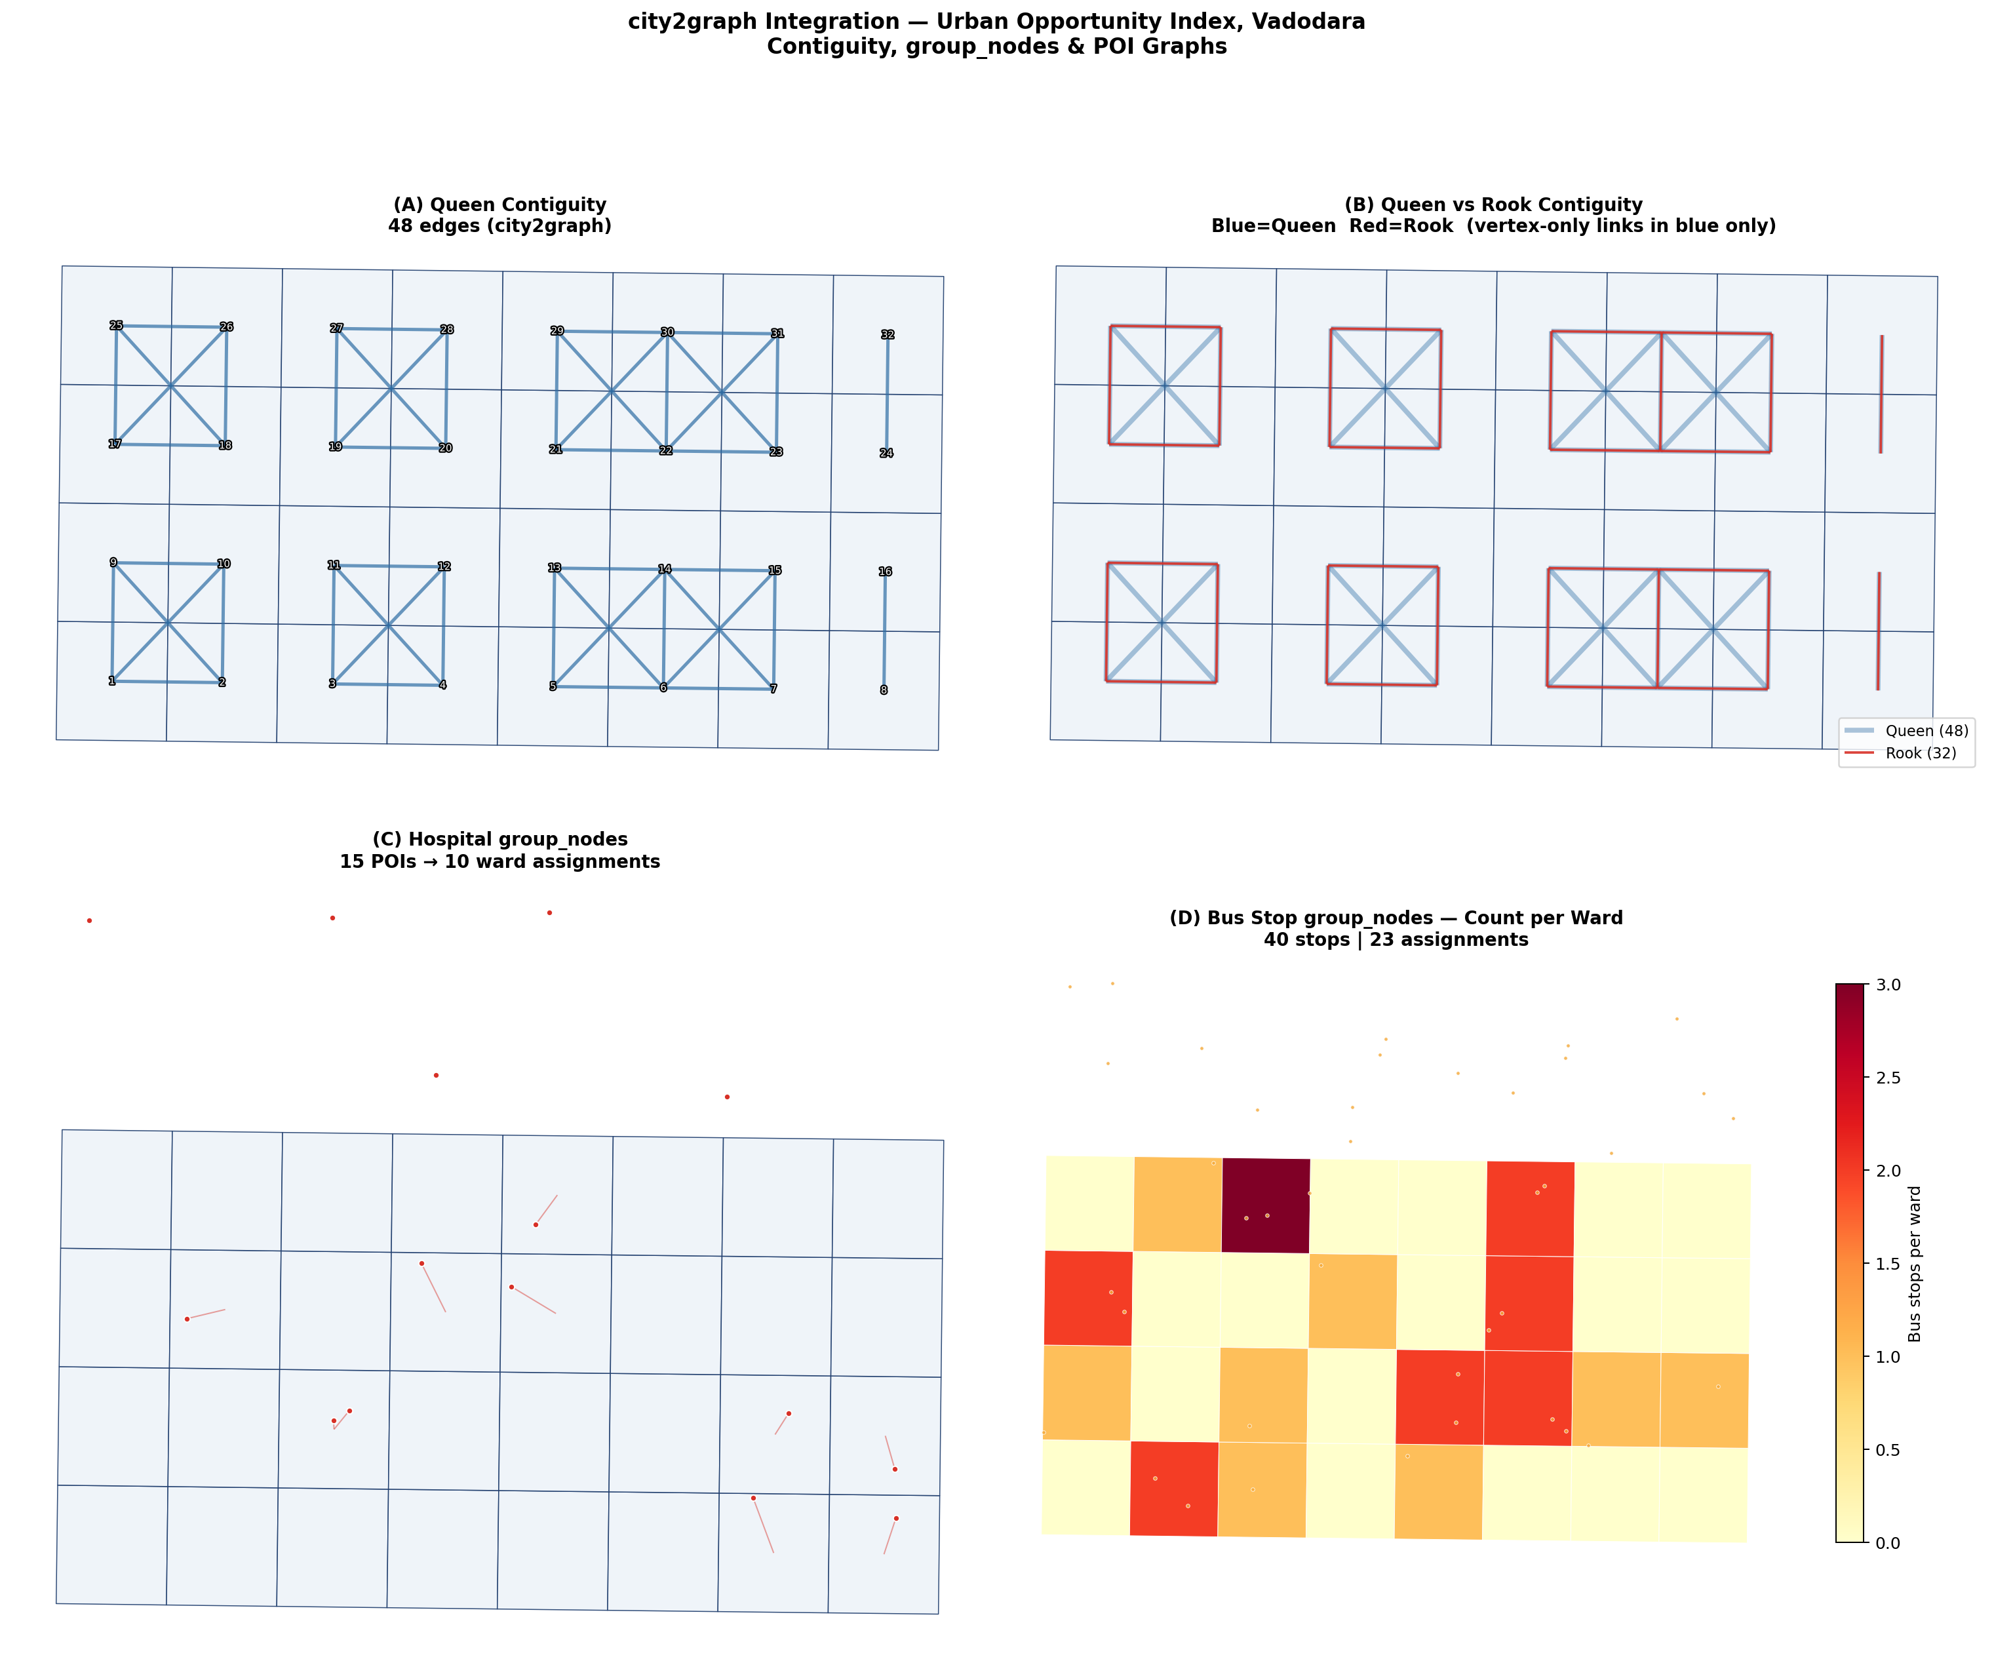
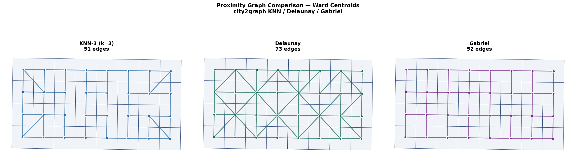
city2graph integration
Replacing libpysal with the Sato (2025) geospatial graph library
Key principle: edges have MultiIndex (src_idx, tgt_idx) — directly usable as BYM2 node1/node2 arrays
Function
Use case
Note
contiguity_graph(wards,'queen')
BYM2 adjacency W
Extract via edges.reset_index()['level_0']
group_nodes(wards, hospitals)
Ward→POI bipartite edges
predicate='covered_by'
knn_graph(centroids, k=3)
KNN spatial proximity
Robust alternative to Queen
delaunay_graph(centroids)
Delaunay triangulation
Always connected, unlike Queen
gdf_to_pyg(nodes, edges)
PyTorch Geometric HeteroData
Requires city2graph[cpu]
load_gtfs(path) + travel_summary_graph
GTFS transit graph
Needs vadodara_gtfs.zip
GraphML export: strip CRS attrs before nx.write_graphml() | PyG: c2g.gdf_to_pyg() returns HeteroData | GTFS: requires pip install 'city2graph[cpu]'
7 / 16

Slide 8
GNN + BYM2 hybrid: critical bugs and fixes
5 bugs in GNN.py that invalidate posterior inference
CRITICAL
pm.CAR instead of ICAR
Fix: Use pm.Potential('icar', icar_logp(u_raw, node1, node2)). CAR≠ICAR; biased σ_b and φ.
CRITICAL
GNN predictions as fixed covariate
Fix: Use LOO-CV predictions or penultimate embeddings. Fixed array → attenuation bias in β_gnn.
WARN
Informative β_gnn prior N(1, 0.2)
Fix: Use N(0,1). Forces model to trust GNN even if miscalibrated on n=32 wards.
WARN
target_accept=0.99
Fix: Use 0.90. 0.99 forces tiny step sizes → effective sample size collapses.
WARN
No spatial CV on GNN
Fix: LOO-CV: 32 fits on 31 wards. In-sample predictions double-dip and inflate confidence.
8 / 16

Slide 9
Spatial model selection hierarchy
OLS → LM tests → SLM/SEM → GWR → BYM2
OLS
Always run first. Check LM tests on residuals.
Benchmark
SLM
LM-Lag sig & RLM-Lag > RLM-Error. ρ captures spillover.
Spatial Lag
SEM
LM-Error sig & RLM-Error > RLM-Lag. λ absorbs confounders.
Spatial Error
GWR
After global model. Maps β(u,i) — does flood risk suppress opportunity uniformly?
Local coefficients
BYM2
Full Bayesian. φ measures spatial fraction. 95% CrI per ward. city2graph adjacency.
Primary model
9 / 16

Slide 10
Reproduction: clean pipeline
11 steps in order · data requirements · environment setup
Step
Script
Action
1–2
Data acquisition
OSMnx download (internet) + GTFS zip from Open Vadodara + SRTM DEM tile
3
Risk assessment
04_risk_assessment.py → flood exposure % per ward
4
UOI composite
05_calculate_uoi.py → vadodara_final_uoi_balanced.gpkg
5
BYM2 data prep
05b_prepare_bym2_inputs.py → bym2_inputs.npz
6
city2graph graphs
10_city2graph_integration.py → contiguity + POI graphs + bym2_node1/2.npy
7
BYM2 model
06_bym2_pymc_model.py → wards_bym2_results.gpkg + bym2_idata.nc
8
SWMM build
build_swm_fixed.py → vadodara_overland.inp (major roads, storm TS)
9
SWMM run
run_swmm_fixed.py → swmm_flood_road_pct added to .gpkg
10
GNN hybrid
GNN.py (fix 5 bugs first per §7.2) → gnn_bym2_results layer
11
Dashboard
streamlit run dashboard.py → :8501
10 / 16

Slide 11
SWMM ERROR 200 — root cause and patch
5 missing junction nodes in [CONDUITS] but not in [JUNCTIONS]
Error: swmm_open() raises ERROR 200: one or more errors in input file
Root cause
Fix (two parts)
build_swm_fixed.py identifies the 5 lowest-elevation nodes as outfalls. It excludes them from [JUNCTIONS] but the OSMnx edge list still contains conduits where they appear as Node1 (source). SWMM cannot route flow from an undefined node.
Immediate: use vadodara_overland_fixed.inp — 5 missing nodes added to [JUNCTIONS] with elevation = outfall + 0.5m.
In build_swm_fixed.py: NEVER skip nodes from [JUNCTIONS]. Instead, keep all nodes in [JUNCTIONS] and add explicit DRAIN_i conduits from each outfall-candidate junction to OUTFALL_N.
Missing node IDs: 1315969825 · 6010666895 · 6010666896 · 6244797023 · 6244797098
Corrected node writing pattern in build_swm_fixed.py
# CORRECT: write ALL nodes to [JUNCTIONS], no exclusion
for node_id, row in nodes.iterrows():
f.write(f'{node_id} {row["elevation"]:.3f} 2.0 0 0.5 200\n')
# Then in [CONDUITS]: add drain conduits from outfall candidates
for i, (nid, row) in enumerate(candidate_outfalls.iterrows()):
f.write(f'DRAIN_{i} {nid} OUTFALL_{i} 50.0 0.016 0 0 0 0\n')
11 / 16

Slide 12
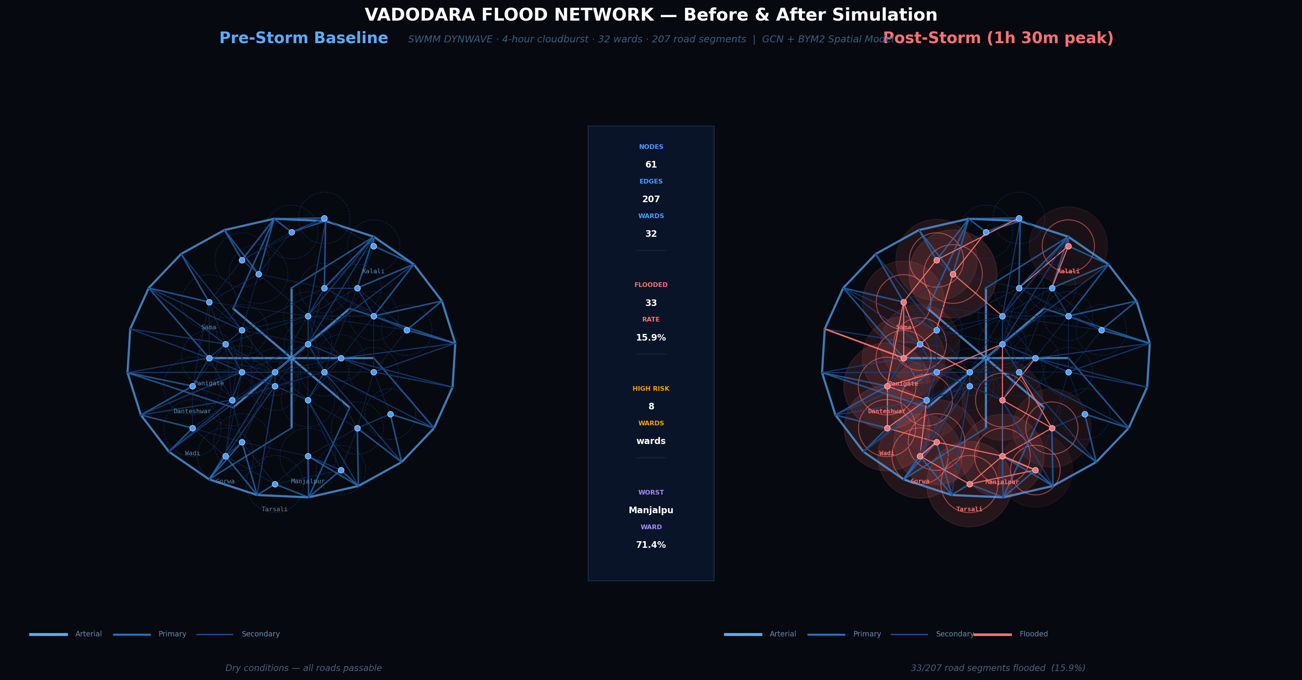
Interactive flood network visualisation
vadodara_network.html — self-contained, 142KB
Pre/Post/Diff modes
Storm timeline
Layer toggles
Three-way toggle: dry baseline, post-storm flooded, and difference mode (green=passable, red=impassable)
8-step slider 0h→4h with animated intensity bar. Animate Storm button plays at 700ms/step
Ward zones · intersection nodes · labels · flooded roads only · flow particles (animated dots on flooded edges)
Pan & zoom
Hover tooltips
Click detail panel
Scroll-wheel zoom, click-drag pan. Three zoom buttons + reset. Canvas auto-resizes to container
Ward centroid: UOI, flood risk, population, flooded %. Road segment: type, length, depth, threshold
Click any ward to open a 5-metric detail panel (UOI, flood risk, roads flooded, access lost, population)
Open: simply double-click vadodara_network.html in your file manager, or run: python -m http.server then open localhost:8000
12 / 16

Slide 13
Theory: composite index design
Kolm–Pollak EDE · Gini · LISA · spatial equity frameworks
OCCIM framework
Kolm–Pollak EDE
Source: Das & Mistri tradition; Eastern India GIS studies
Source: Kolm (1976), Pollak (1971)
Composite index integrating GIS with synthetic indices to measure spatial variation in urban conditions across multiple dimensions. Model consistency assessed via R² of regression analysis. The UOI extends OCCIM by adding flood risk and transit dimensions with explicit inequality adjustment.
EDE_κ = −(1/κ) log[(1/n)Σᵢ exp(−κ·xᵢ)]. At κ→0, EDE→mean. At κ→∞, EDE→min. The κ-sweep from 0.1 to 2.0 tests whether inequality-adjusted rankings change with aversion parameter — if Spearman ρ≥0.95 throughout, the rankings are robust to the κ choice.
Spatial equity supply–demand
LISA spatial typologies
Source: Wang et al. 2022; Beijing Sixth Ring Road study
Source: Anselin (1995)
Spatial equity occurs when service allocation aligns with the level of demand. The supply–demand mismatch framework identifies areas where high demand is not met by sufficient supply. For Vadodara, the UOI measures the gap between healthcare/transit supply and the 32-ward population distribution.
Local Indicators of Spatial Association decompose global Moran's I into four quadrant types: High-High (spatial clusters of opportunity — policy reinforcement zones), Low-Low (deprivation clusters — intervention priority), High-Low and Low-High (spatial outliers). The LISA map is the primary policy-communication output of Chapter 4.
13 / 16

Slide 14
Theory: BYM2 · INLA · DYNWAVE CFL
Penalised Complexity priors · GMRF · Courant condition
BYM2 Penalised Complexity priors (Riebler et al. 2016)
GMRF and INLA
PC priors penalise deviation from the base model (constant risk). For σ_b: P(σ_b > U) = a with U=0.5/0.31, a=0.01. This places 99% prior probability that σ_b < 1.6 — appropriate for ward-level UOI variation. For φ: P(φ < 0.5) = 0.5 (neutral prior on spatial fraction). Validated in COVID-19 spatio-temporal analysis: BYM2 outperforms BYM (lower DIC, WAIC) across spatial and temporal structures. INLA computes posterior in minutes; MCMC (PyMC 5) takes 10–30 min for 4 chains × 2000 draws.
INLA exploits sparse GMRF structure for fast approximate Bayesian inference. The ICAR precision matrix Q=D−W is a GMRF with log-prob ∝ −u'Qu/2. Sum-to-zero constraint: rank(Q)=n−1. Scaling factor from eigendecomposition makes σ_b comparable across graphs.
SWMM DYNWAVE: St Venant equations and CFL condition
DYNWAVE solves the full Saint-Venant equations: continuity ∂A/∂t + ∂Q/∂x = q and momentum ∂Q/∂t + ∂(Q²/A)/∂x + gA(∂H/∂x + S_f) = 0. CFL stability requires Δt ≤ Δx / c where c = √(gA/T) is wave celerity. For Vadodara major roads: shortest segment ~50m, wave speed ~3.1 m/s → CFL dt ≤ 50/3.1 = 16s. Original 30s routing step violated CFL for short segments → DYNWAVE internally substepped to <1ms → 17-minute execution. Fixed 5s routing step provides 3× safety margin. Physical storm: 50mm/hr × 500m² catchment × C=0.70 → Q_peak = 0.0049 CMS per node.
14 / 16

Slide 15
Complete file inventory
All deliverables produced in this project
File
Type
Purpose
Status
uoi_sensitivity_analysis.py
Python
OAT · Monte Carlo · Sobol · Kolm-Pollak
Complete
05b_prepare_bym2_inputs.py
Python
BYM2 data preparation bridge
Complete
06_bym2_pymc_model.py
Python
BYM2 ICAR model in PyMC 5 (correct implementation)
Complete
10_city2graph_integration.py
Python
Contiguity / proximity / POI graphs
Complete
build_swm_fixed.py
Python
SWMM .inp builder (major roads + storm timeseries)
Complete
run_swmm_fixed.py
Python
SWMM runner + ward aggregation + CFL fix
Complete
GNN.py
Python
GCN + BYM2 hybrid (5 bugs documented)
Needs fixes
dashboard.py
Python
Streamlit dark-theme 5-KPI dashboard
Complete
vadodara_network.html
HTML
Self-contained interactive flood network viz (142KB)
Complete
vadodara_overland_fixed.inp
SWMM
Fixed .inp — 5 missing junction nodes patched
Complete
UOI_Bayesian_SpatioTemporal_Proposal.docx
Word
Spatio-temporal extension proposal
Complete
vadodara_thesis_summary.docx
Word
This document — definitive technical summary
Complete
15 / 16

Slide 16
References and next steps
Key citations · remaining tasks · spatio-temporal extension
Key references
Remaining tasks
Anselin, L. (1988). Spatial Econometrics. Kluwer.
Fix GNN.py: 5 bugs (see §7.2)
Besag, York, Mollié (1991). BYM model. Ann. Inst. Stat. Math. 43.
Obtain real VMC ward shapefile
Add SRTM DEM for real elevations
Riebler et al. (2016). BYM2 PC priors. Stat. Methods Med. Res. 25.
Get Open Vadodara GTFS zip
Rue, Martino, Chopin (2009). INLA. JRSS-B 71.
Run BYM2 draws=2000, chains=4 (full)
Fotheringham, Brunsdon, Charlton (2002). GWR. Wiley.
Spatio-temporal extension
Sato, Y. (2025). city2graph. doi:10.5281/zenodo.15858845.
Knorr-Held model: BYM2 spatial + RW1/RW2 temporal + Type II interaction. Requires T≥3 time points. Use Geofabrik OSM historical extracts: 2016, 2019, 2021, 2024. Implementation in R-INLA proposed in UOI_Bayesian_SpatioTemporal_Proposal.docx.
Boeing, G. (2025). OSMnx. Geogr. Analysis 57.
Anselin (1995). LISA. Geogr. Analysis 27.
Kolm (1976); Pollak (1971). EDE measure.
16 / 16

Slide 17
Flood network map — pre-storm vs post-storm
Vadodara · 32 wards · 207 road segments · SWMM DYNWAVE 4-hour cloudburst
Red edges = flooded roads · Red halos = high-risk ward zones · Blue = ward centroids

Slide 18
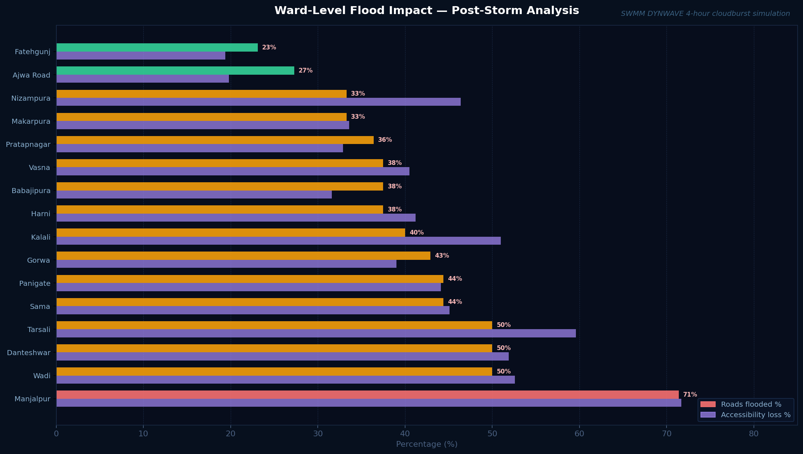
Ward-level flood impact — roads flooded vs accessibility loss
SWMM hydraulic output aggregated to ward level · road-type thresholds applied

Slide 19
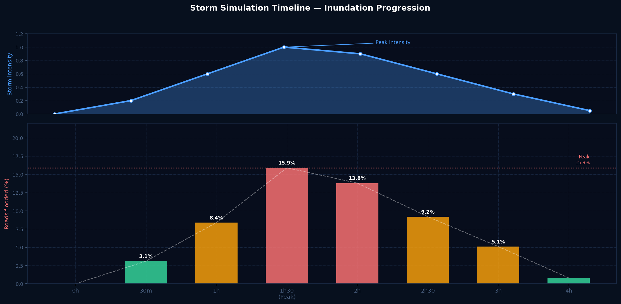
Storm simulation timeline — intensity and inundation
8 time steps · 0h–4h · peak at 1h30m · CFL-stable 5s DYNWAVE routing step

