Slide 1
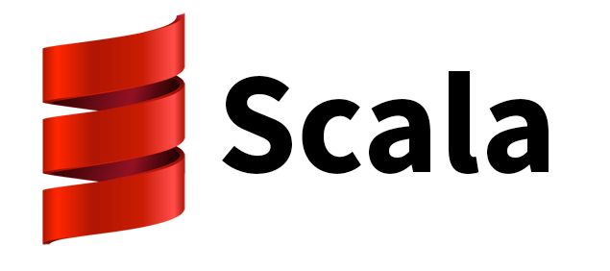

Scala, Spark and Machine Learning
Dan Meany
Java and More
2015-11-12

Slide 2
Scala – why
“We are a Scala shop because they told us it was better” - reddit comment

Slide 3
Scala
What - an open (BSD-like license), JVM-based language that can import and use Java classes
Why - bugs require a fertile ground to arise. They must be made impossible to create, like removing direct memory access in Java did for memory corruption and security issues.

Slide 4
Why not
Ruby
Python
Javascript/node.js
Groovy
Is it the latest fad?
1 million lines of interconnected weakly typed code?
Ide help, refactoring, compile time check, runtime optimization

Slide 5
How
Collections - declarative vs procedural, becoming SQL-like for sets
Functional
Errors (Either, Optional, getOrElse)
Mutability val/var vs final
Syntax/dsl/overloaded operators
Case class
Can import and use Java libraries, classes and objects
Traits
Case classes, tuples ._x
Implicits, partial functions, generics subtypes

Slide 6
Experience
Experience: code runs first time more often (because theres less of mine)
Learning curve. Take it slow. Just start coding.
Too powerful/flexible. Potential of being too clever with syntax.
Number of Java programmers (like number of C programmers), Java libs

Slide 7
Spark
Spark is an in-memory cluster compute engine
Spark written in Scala, functional needed for distributed code. Can use Java with it but why. Even with Java 8 lambdas
Spark - part of an expanding Hadoop ecosystem

Slide 8
Clusters
Computation on distributed in-memory data sets (HD x10 SSD x10 ram)
Must understand network cost, locality, topology
Data-centric. Bring data to code vs code to data
Node failures/degradation expected for large number of nodes
Cluster sizes:
3 VMs on a laptop
10-100
100-1000
10000+
Ram 16-256G per node

Slide 9
Example
Example: word count, diffs, joins on files. ETL, log or sensor streaming from Kafka
Replaces old Map Reduce programs written in Java. *Much* easier to write and runs faster.
Repeated iterative calculations required on same data set for machine learning
Large data sets that won't fit in a single machines memory
Low latency queries on large data for web apps.

Slide 10
Also MLLib, GraphX
MLLib – implementation of popular ML components in cluster-scalable Spark implementaitons
GraphX – same for graph data (e.g. Neo4J is not really cluster friendly)

