Slide 1
COMP-250
Computer Programming II
Instructor: Brandon Dave

Slide 2
Thus far…
What we’ve discussed so far:
Foundations of Programming
Java Syntax
Today’s agenda:
ArrayLists, Collections
Class Objects
OOP Technique: Encapsulation
Data Hiding
Inheritance: Parent-Child Relationship

Slide 3
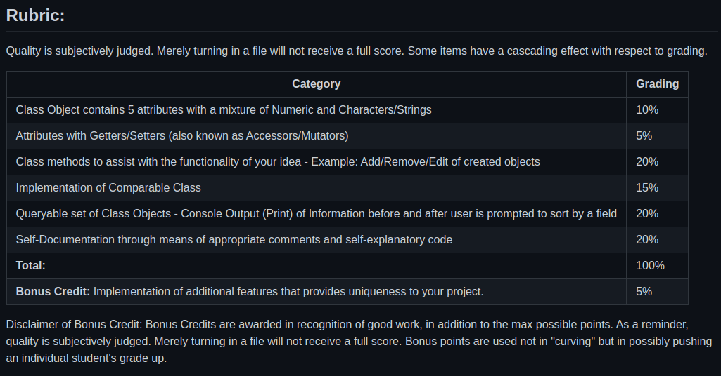
Final Project: https://github.com/threefinbdd/comp250/blob/main/Assignments_and_Projects/comp250_Project.md

Slide 4
Definitions: Basics of Programming
Objects: Anything that contains data - Variables.
Classes: User-defined Objects to express complex data types.
Someone is represented by their:
String name; int age; String majorOfStudy;
A Person Object is a single variable that represents the above 3 fields.

Slide 5
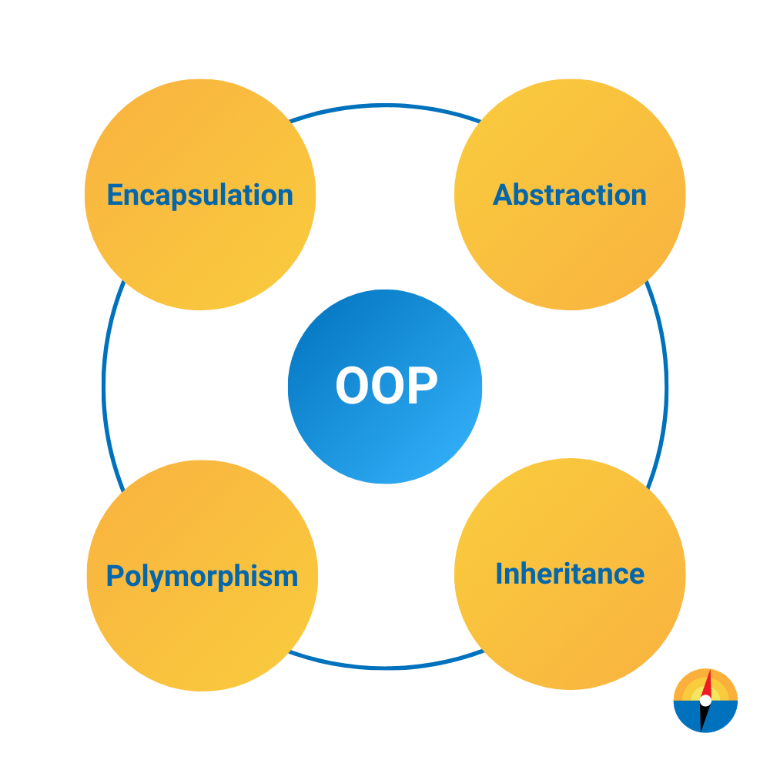
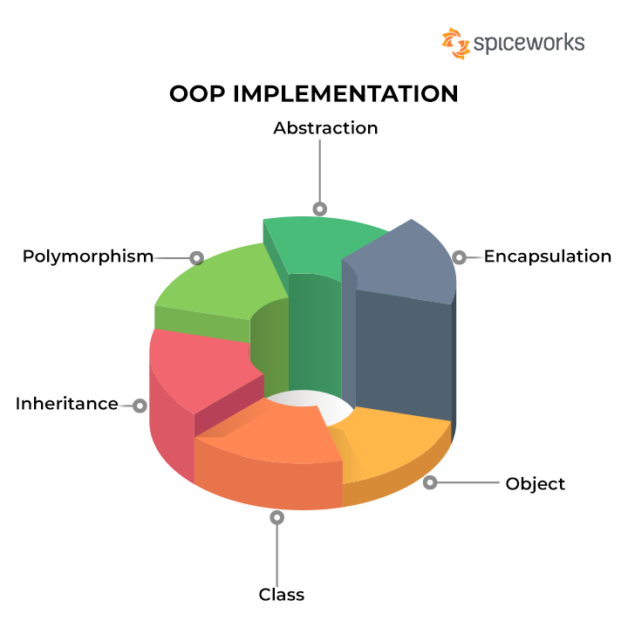
Welcome to Object-Oriented Programming

Slide 6
Definitions: Object-Oriented Programming
Polymorphism: Allowing existence of many forms. Data, functions, objects existing in multiple forms.
Encapsulation: Also known as Data Hiding; Design technique (or paradigm) to group similar procedures (or methods) into one area to reduce code complexity.
Abstraction: Hiding data from the user. Imagine the black box concept or wysiwyg (what you see is what you get), pronounced: whizzy whig
Inheritance: Parent-Child Relationship between Classes. Parent also known as Super Classes; Children refers to Sub Classes (subsumptions)
Additional Reading: https://www.nerd.vision/post/polymorphism-encapsulation-data-abstraction-and-inheritance-in-object-oriented-programming

Slide 7
Definitions: Object-Oriented Programming
Polymorphism: Allowing existence of many forms. Data, functions, objects existing in multiple forms.
Example: method/function overloading; Class Constructors
Encapsulation: Also known as Data Hiding; Design technique (or paradigm) to group similar procedures (or methods) into one class to reduce code complexity.
Example: using private and protected instead of public/global

Slide 8
Definitions: Object-Oriented Programming
Abstraction: Hiding data from the user. Imagine the black box concept or wysiwyg (what you see is what you get), pronounced: whizzy whig
Inheritance: Parent-Child Relationship between Classes. Parent also known as Super Classes; Children refers to Sub Classes (subsumptions)
Example: Shape is a top-level definition of some “thing”.
Squares, Triangles, Pentagons are all Shapes.

Slide 9
Demonstration of DefinitionExamples.java
Key notes:
Example of most definitions within an application
Templatized DataTypes

Slide 10
Definitions
Extends: Deriving one class as the base for another. Extended class acts as the superclass (parent) into the new class which acts as the child (subclass). Only one Extension from a superclass allowable.
Implements: Deriving of the special-type of classes of Interfaces into the other class. Resolves the issue of one superclass extension by allowing multiple interfaces. Allows complete abstraction of superclass functions.
Additional Reading: https://www.geeksforgeeks.org/extends-vs-implements-in-java/

Slide 11
Tying it together
From nerd.vision:
“Inheritance allows you to create class hierarchies, where a base class gives its behavior and attributes to a derived class. You are then free to modify or extend its functionality. Polymorphism ensures that the proper method will be executed based on the calling object’s type. “
“Polymorphism allows program code to have different meaning or functions while Encapsulation is the process of keeping classes private so they cannot be modified by external codes.”
Abstraction is making things less complex for users (UI/UX).
Encapsulation makes things less complex for developers.

Slide 12
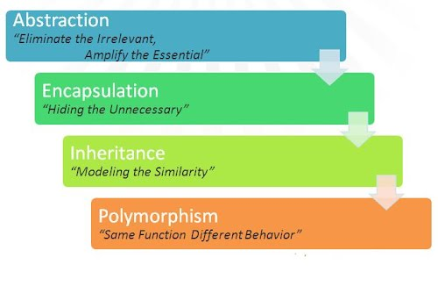
Tying it together v2
https://sites.google.com/site/cs4217jan2011team2/programming-paradigms/object-oriented-paradigm

Slide 13
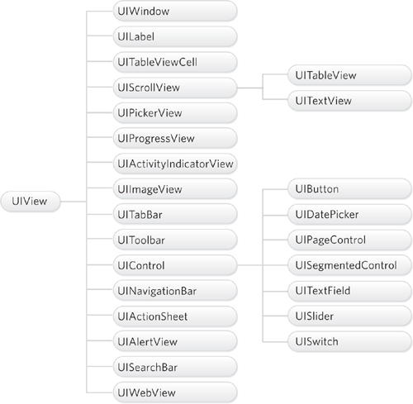
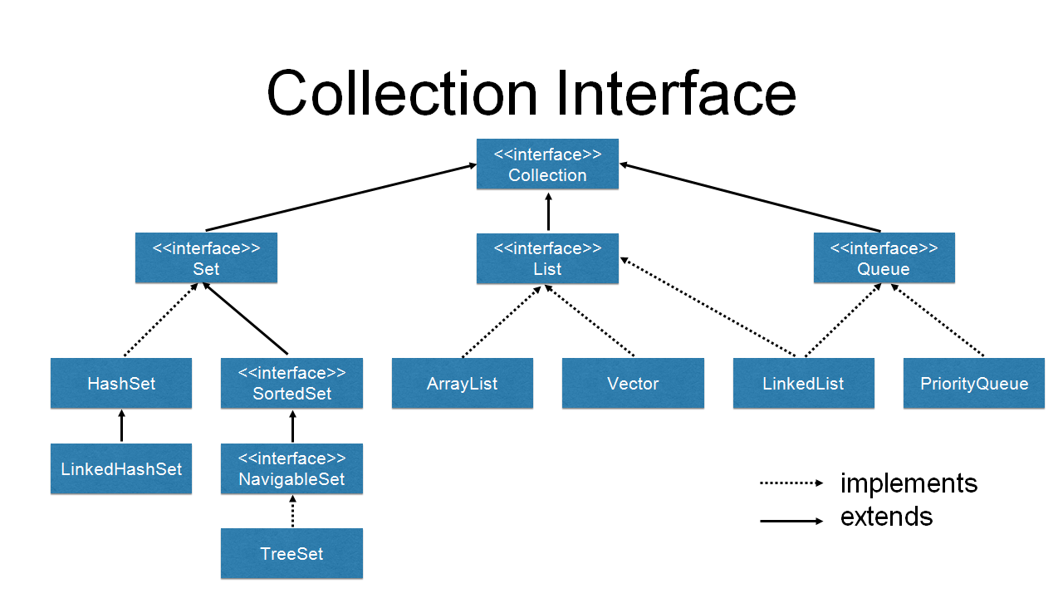
Java Library and Apple Library Hierarchies

Slide 14
Python vs Java
Python utilizes MODULES
Java utilizes CLASSES
But, wait. They operate similarly, isn’t Python Object-Oriented?
https://stackoverflow.com/questions/18034683/what-is-the-big-difference-between-modular-and-object-oriented-programming
A fun read :)
Note: Python practices Polymorphism, Inheritance, and Abstraction. The only aspect missing is Encapsulation (data hiding)!

Slide 15
Person.java from Person.py
Your task is to translate the Python module into a Java Class
The module can be found at: https://github.com/threefinbdd/comp250/blob/main/inclass_demonstration/Python/HelloWorldClass.py
or on Moodle

