Slide 1
COMP-250
Computer Programming II
Instructor: Brandon Dave

Slide 2
Thus far…
What we’ve discussed so far:
ArrayLists, Collections
Class Objects
OOP Technique: Encapsulation
Data Hiding
Inheritance: Parent-Child Relationship
Today’s agenda:
Understanding Algorithms Complexity with Sorting Algorithms

Slide 3
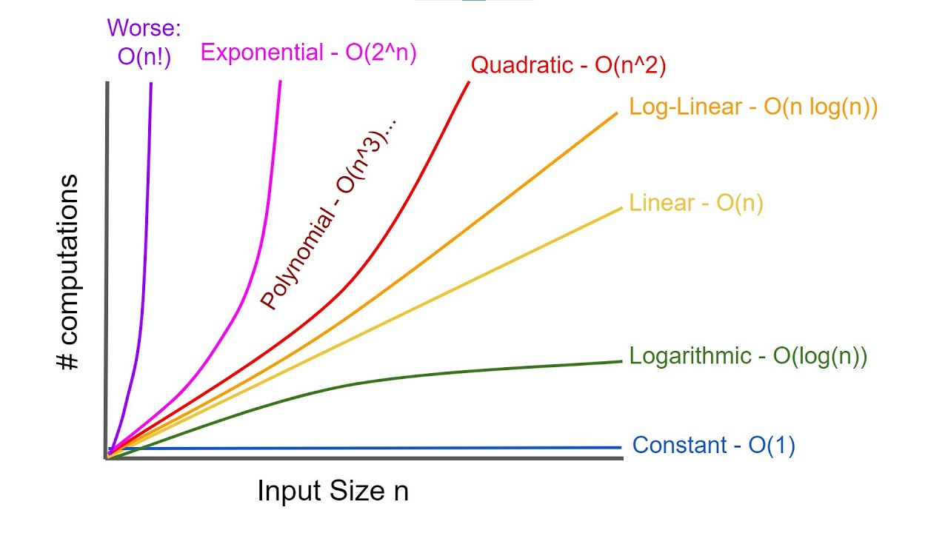
Algorithmic Complexities
Cost of running programs can be evaluated in two areas:
How long does the algorithm take to run?
How much memory does the algorithm need to run?
As the size of our input size increases, how bad does our computational complexity grow?

Slide 4
Basic Overview of Different Analyses
Big Oh notation: Examines Algorithm Computation at the worst-case scenario O(n)
Big Omega notation: Examines Algorithm Computation at the best-case scenario Ω(n)
Big Theta notation: Examines Algorithm Computation at the best-case scenario given all worst cases Θ(n)
We only care about Big Oh notation (worst cases)

Slide 5
How would you sort this?
Given the list of numbers:
[10, 3, 2, 4, 8, 5, 6, 7, 1, 9]

Slide 6
Two Approaches
[10, 3, 2, 4, 8, 7, 5, 6, 1, 9]
[3, 10, 2, 4, 8, 7, 5, 6, 1, 9]
[10, 3, 2, 4, 8] [7, 5, 6, 1, 9]
[3, 10, 2, 4, 8] [5, 7, 6, 1, 9]

Slide 7
How would you sort this?
Given the list of letters:
[G, L, A, X, Z, F, I, G, O, N]
Given the list of words:
[dog, instructor, computer, television, cat, student, coffee, soda, first, last]

Slide 8
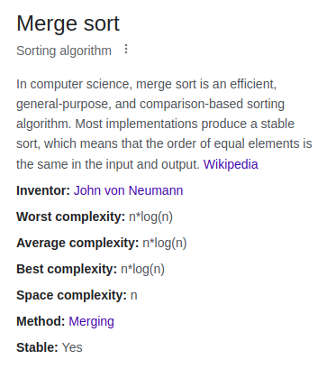
List of Common Sorting Algorithms
Bubble Sort
Selection Sort
Insertion Sort
Merge Sort
Quick Sort
Heap Sort
List provided by freecodecamp: https://www.freecodecamp.org/news/sorting-algorithms-explained/

Slide 9
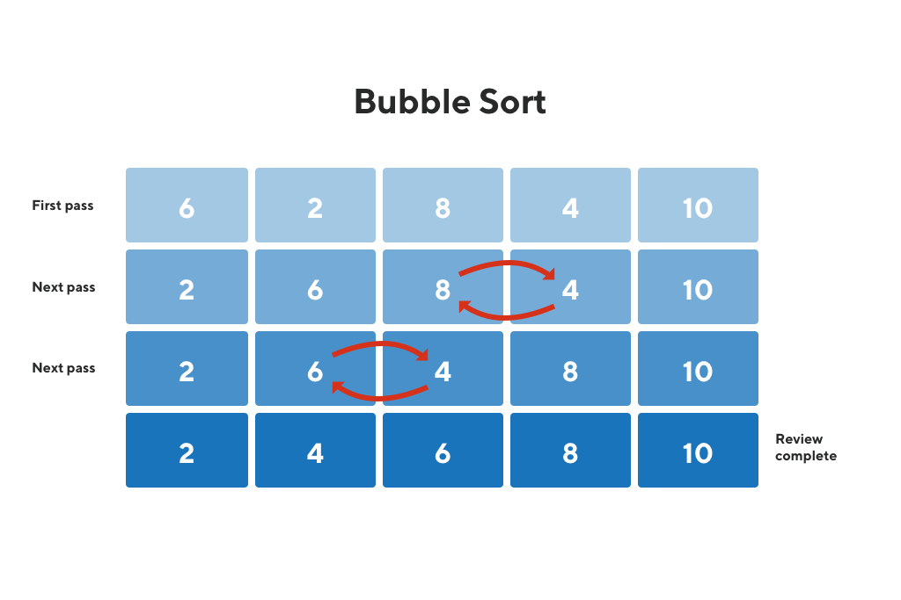
Bubble Sort worst case: (n²)
Imagine the Bubble Sort as a Swap function. The simplest and most naive form of sorting.
Compares 2-adjacent indices for greater/less than comparison.
If [current] is greater than [current+1], swap the nodes.
Requires n-pass throughs n-times, as you must traverse through every node by every node to check if [current] and [current+1] are in order.

Slide 10
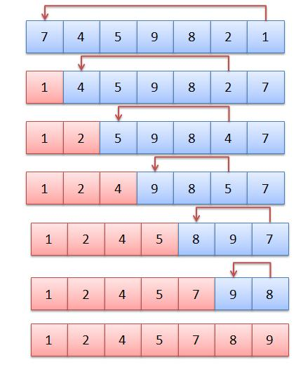
Selection Sort worst case: (n²)
Go through every node to find the lowest value and move the found node to the start.
Requires n-passes n-amount of times.

Slide 11
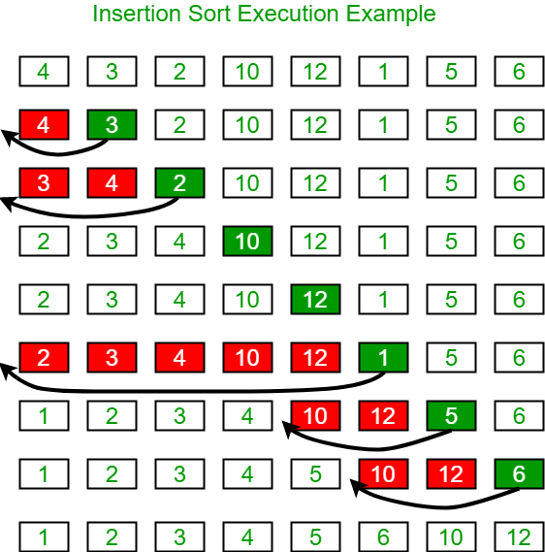
Insertion Sort worst case: (n²)
Similar to a Selection Sort; however, does not find the lowest value per pass. Adjusts found values respective to the current sorted list.

Slide 12
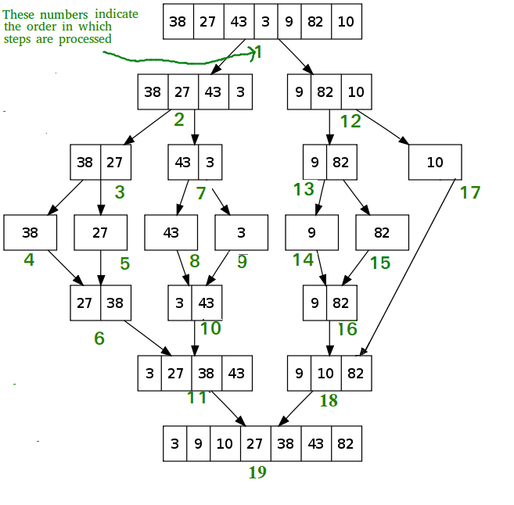
Merge Sort worst case: O(nlogn)
Our first approach of a Divide-and-Conquer problem
Because we half the problem each pass, the problem becomes logarithmic!
The sorting problem becomes log(n)
The merging of all problems back into 1 solution becomes O(n)

Slide 13
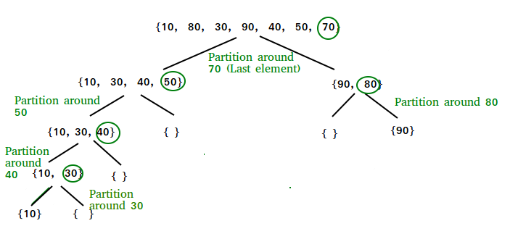
Quick Sort worst case: O(n²)
Another divide-and-conquer approach
What if the original list is in reverse order?
The poorly chosen pivot value makes the quicksort algorithm an overly complex insertion/selection sort!

Slide 14
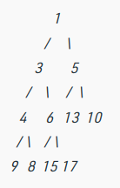
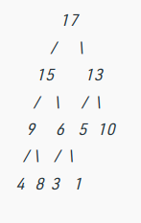
Heap Sort
worst case: O(nlogn)
Utilizing a binary tree and tree traversal algorithms to sort layers of the binary tree
Additional Reading: https://www.geeksforgeeks.org/heap-sort/
*Only included for Completion Sake! Better to research after looking into data structures

