Slide 1
COMP-250
Computer Programming II
Instructor: Brandon Dave

Slide 2
Thus far…
What we’ve discussed so far:
Understanding Algorithms Complexity with Sorting Algorithms
Today’s agenda:
Understanding Different Data Structures
Queues
Stacks
Graphs

Slide 3
Data Structures
The big data structures to conceptually understand:
Queues
Stacks
Graphs
Trees

Slide 4
Array
ArrayList
int[] myNumbers = new int[]{1, 2, 3, 4, 5}
myNumbers[3] = 10; // Re-assigns data
myNumers[4]; // retrieval of data, given an index
*Remember Arrays cannot grow or shrink!
myNumbers.length; // returns the size of the Array
add( ): Inserts data into the structure
remove( ): Deletes data from the structure
clear( ); Removes ALL data from the structure
get( ): Retrieves data from the structure, given an index
size( ): Returns the size of the ArrayList

Slide 5
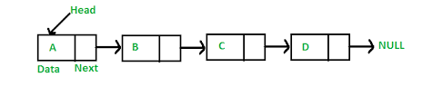
Linked List
Expands from Array and ArrayList to store 3 more “points” from the list
Head
Tail
Next
https://www.geeksforgeeks.org/data-structures/linked-list/

Slide 6
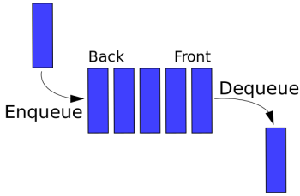
Queues
Imagine a grocery line of people
The first person in the line is able to checkout their items. The next person must wait for the first person to leave.
First In, First Out (FIFO)
Enqueue: Add Dequeue: Remove Peek/Front: “sees” the top, but does not retrieve

Slide 7
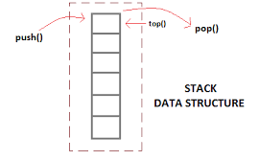
Stack
Imagine a cake from the bakery
The first layer of the cake gets pushed down as additional layers are added on top.
First In, Last Out (FILO)
Last in, First Out (LIFO)
Push: Add Pop: Retrieval and Removal Peek/Top: “sees” the top, but does not retrieve
Whether to use FILO or LIFO is based on the use-case of the program
Imagine inventory management with perishable goods

Slide 8
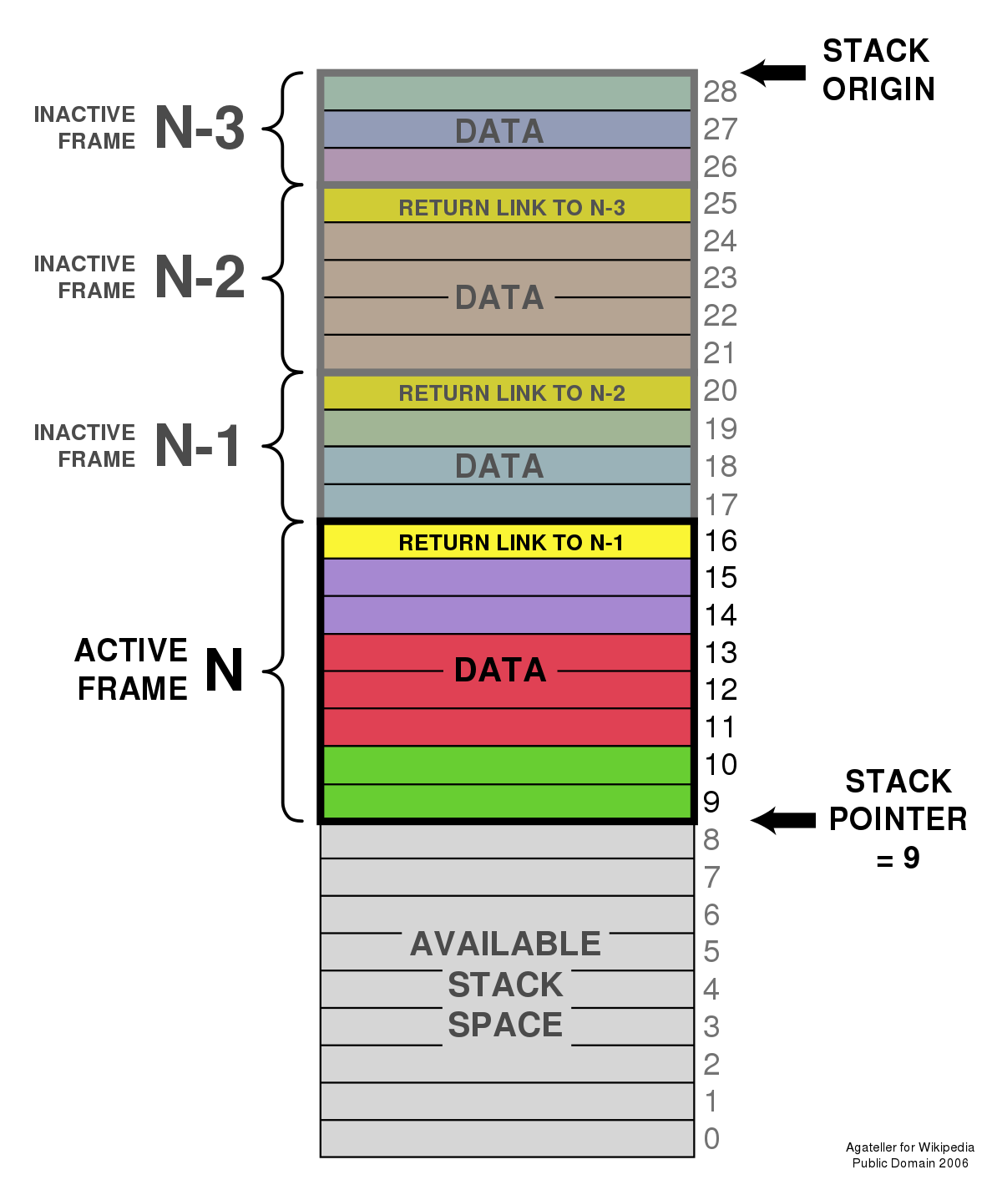
Stack
A computer’s memory is stored in a stack architecture.
The earliest data created in a program becomes more and more shrouded deeper in the memory stack.
This is the start of understanding a computer’s vulnerability in cyber security (see: Stack Buffer Overflow)
Additional reading: https://en.wikipedia.org/wiki/Stack_buffer_overflow

Slide 9
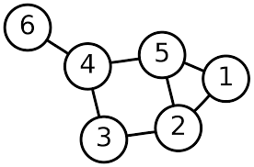
Graphs
A data structure that interlinks data and relationships.
A node is known as a graph vertex (plural: vertices)
A line that connects two vertices is known as an edge
Edges define relationships between Nodes

Slide 10
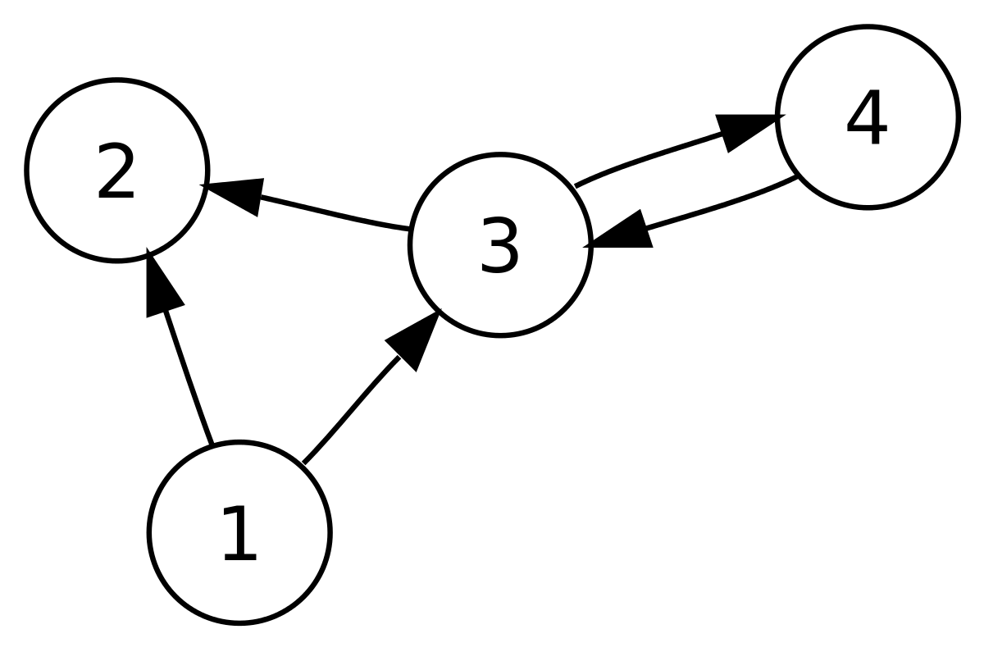
Graphs
Node-to-Node connections can be Directed or Undirected
If a Graph is directed, connection between Nodes must travel along the arrow’s pointed direction
Graph’s without arrows can be traveled in any direction

Slide 11
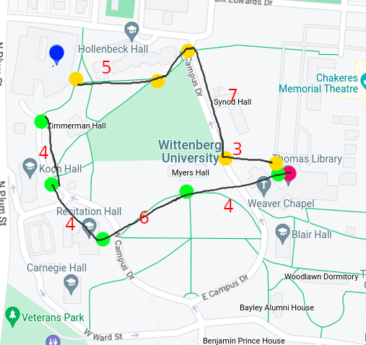
Graphs
GPS coordinates relies on Graph Theory to plot out a person’s route by varying means:
Optimality of Travel Time
Optimality of Carbon Efficiency

Slide 12
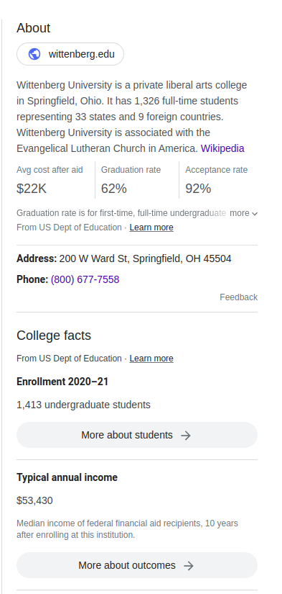
Knowledge Graph
Combining Logic with Graph Theory!
Creating these quick and useful informative “knowledge panels” from Google are generated from Knowledge Graphs
At the simplest level:
Node A hasA Relationship R to Node B
John isA Father to Joe Joe isA Child of John
Additional Reading: https://people.cs.ksu.edu/~hitzler/pub2/2020_CACM_SWsurvey-authorversion.pdf

Slide 13
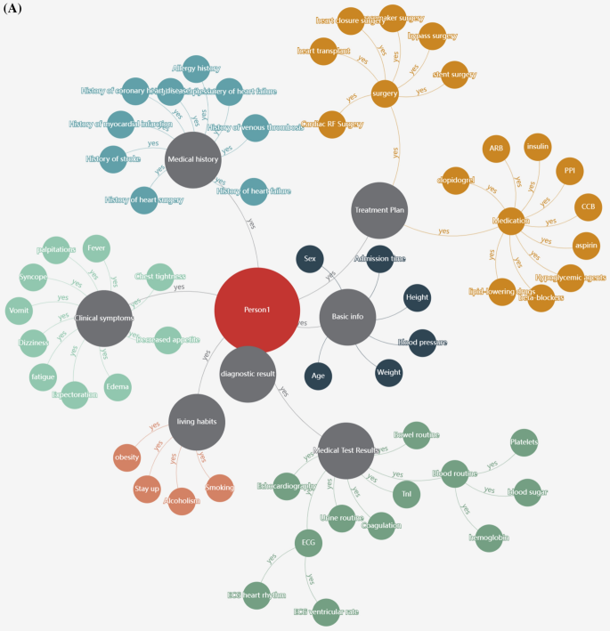
Other Applications
Google’s Knowledge Graph
Biomedical Knowledge Graph
Animal Taxonomy (Kingdom, Phylum, Class, Order, Family, Genus, Species)

Slide 14
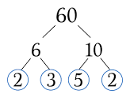
Trees
A hierarchical approach for directed graphs.

