Slide 1
COMP250: Environment SetUp

Slide 2
Development Tools
You also need a Java programming environment such as Visual Studio, Eclipse, NetBeans, or an account at https://repl.it.
I have personally used NetBeans and Visual Studio Code/Community

Slide 3

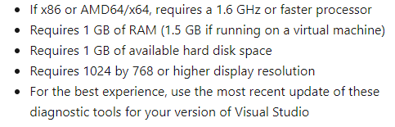
System Requirement
Lightweight systems should be fine for the course
MacBook Air, Chromebooks, etc
Most modern systems since 2008 should have the hardware support for whatever environment you choose.
Visual Studio Code
Visual Studio Community 2019

Slide 4
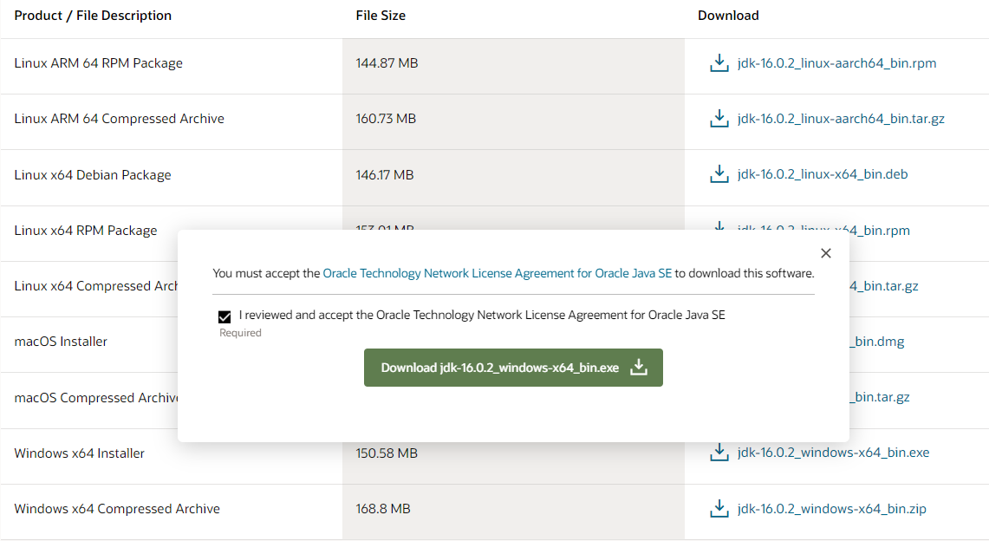


Support File Package - (Just pick one based on your 32 or 64-bit environment)
Language Support Package for development tool to interpret code
https://www.oracle.com/java/technologies/javase-jdk16-downloads.html
Download support package
Run .exe
If you downloaded the compressed version, unzip the file and then run the .exe
Run “java -version” and “javac -version” in command prompt to ensure proper download and installation

Slide 5
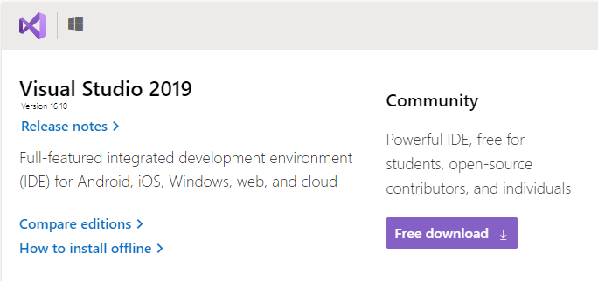
Visual Studio Community and VS Code
Visual Studio Community:
https://visualstudio.microsoft.com/downloads/
Visual Studio Code JDK Set Up:
https://code.visualstudio.com/docs/java/java-tutorial

Slide 6
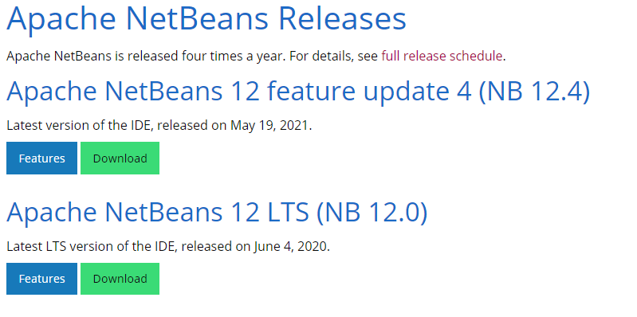
Netbeans: https://netbeans.apache.org/download/index.html
*Note: LTS stands for Long Term Support

