Slide 1
COMP-250
Computer Programming II
Instructor: Brandon Dave

Slide 2
Thus far…
What we’ve discussed so far:
Our First Java Program: Hello World
Today’s agenda:
DataTypes

Slide 3
Primitive Data Types
Numerics:
byte
short
int
long
float
double
Other:
char
boolean

Slide 4
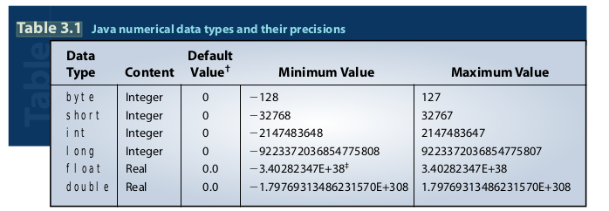
Java Numerical Data Types and Their Precisions

Slide 5
Abstract DataTypes
How do you represent:
Addresses
Geographic Coordinates (long/lat)
People
Cars
Music

Slide 6
DataTypes: Refresher Terminology
Declaration: an allocation of memory for variables
Instantiation: an instanceOf an object class; uses the “new” keyword
Initialization: Assignment of value on declaration
Assigning: Equating a value to a variable
TypeCasting: Overload a variable to a different datatype; implicit or explicit

Slide 7
Pre- vs Post -Op
Pre: Perform the arithmetic BEFORE the operation
Post: Perform the arithmetic AFTER the operation

Slide 8
Variating Arithmetic Examples
Numeric.java showcases:
Slide 4 Min/Max of DataTypes
Addition with varying data types and typecasting
Pre- vs Post- Operation

Slide 9
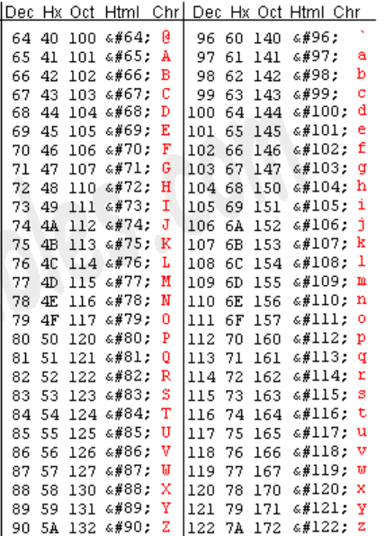
Alphabetic Representation
Character aka char: A single letter
Referenced with Decimal Values via an ASCII table, computers are Binary in nature
Words aka String: A list of characters

Slide 10
Skipping char and String for now…
Aside for what was just briefly covered, Java’s implementation of String can be further explored next week when we discuss Scanner and Console Output!

