Slide 1
COMP-250
Computer Programming II
Instructor: Brandon Dave

Slide 2
Thus far…
What we’ve discussed so far:
Expanding on char and String
Scanner Object
Print Format
Today’s agenda:
Booleans
Conditionals
Selection Statements

Slide 3
Operators
Relational
< If left side is less than
> If left side is greater than
<= If left side is less than or equal to
>= If left side is greater than or equal to
== If left side and right side are identical
!= If left side is not identical to right side
Logical
&& Left side AND Right side must be true
|| Either side can be true to pass
! is pretty common for “NOT” but you might see other symbols used such as ~

Slide 4
Conditional Statements
If, else-if, else
if(statement 1){ // perform 1 } else if(statement 2){ // perform 2 } else { // default perform }
If Statement 1 and Statement 2 match, do both cases perform?
You’ll find yourself using these more than Switch-Cases
Switch-Case
Switch(check-based on){ case [statement 1]: //perform 1 break; case [statement 2]: //perform 2 break; default: // perform default break; }
Consider what happens if the “break;” is not implemented.
Switch-Case has a top-down priority list
Popular when user is given a set of Options they can select from. Example: Bash Scripting “- options”

Slide 5
Mental Exercise: “Will it run?”
if( (5+5 == 10) && (3+3 <= 10) ){ } // Check Left, Check Right, Is L & R True?
if( 10*10 < Math.pow(10, 3) ) {
char userInput = ‘y’; if(userInput == ‘n’) { }
String sentence = “Yes, play again!”; if(sentence.charAt(0) == ‘Y’){ } // What is .indexOf()? Is there something else?
double pi = Math.PI(); string convertPi = pi.toString(); if(convertPi.contains(“3.14”) == true){ }

Slide 6
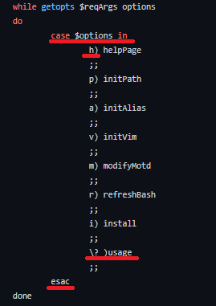
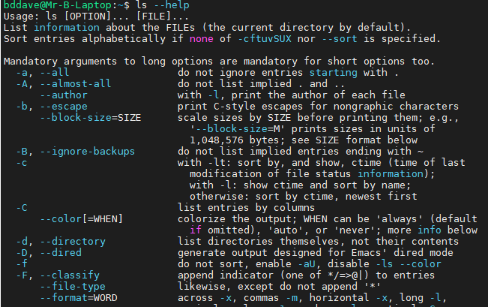
Switch Case Example Using WSU Assignments
Note the different style, but it’s still something you can read!
Command:
ls -h (ls --help)
will give us the Help Page on how to use the command “ls”
Switch-Case/Esac
h), p), a) : are the Case [statement] lines
“esac” is the closing curly brace

