Slide 1
COMP-250
Computer Programming II
Instructor: Brandon Dave

Slide 2
Thus far…
What we’ve discussed so far:
Program Structure:
Block Statements (conditionals, loops, and function declarations)
JavaDocs: Comprehension of Documentation
Build-Your-Own Documentation
Today’s agenda:
Passing Arguments/Parameters into Functions
Arrays

Slide 3
Parts of a Method/Function
public static void main(String[] args) throws Exception {
} // closing curly brace
public/private: Do other functions in different files need to see this?
static/dynamic/final: memory binding based on “at compile time” or “at runtime” - you’ll generally be using static for a majority of your university career
Deciding what to use is based on “when” enough information is sent to your program for it to run
return type: A specific data type that the function returns after running
Function Name: You decide this! This name is what you will call within other functions so the task coded here runs
Parameter: Data that gets passed through so the function can perform its task

Slide 4
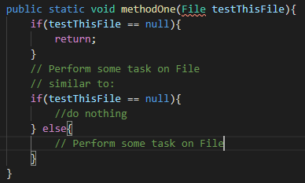
Returning “void”
Is it possible to return in a “void” type?
Yes!
Imagine you’re using a method to perform on an object being passed through as a parameter, if that object does not exist, should your method continue to run?
No! Alternatively, and what I would expect you to do, is that you would perform an if-else.
*Ignoring the fact File isn’t real and would cause a compilation error since I haven’t implemented the import to java.util.*;...

Slide 5
Parameters: Pass by Value
Java is a Pass-by Value language.
New blocks of memory need to be allocated by the system in order to use the parameter. This gets VERY heavy on memory.
Parameters passed by value do not reflect changes naturally.
Consider the scope of the variable here
public static int paramByValue(int value){
System.out.println(value);
value = value*2; // double the value
return value; // returns the doubled value
}
public static void main(String[] args) throws Exception {
int value = 6;
paramByValue(value);
int newValue = paramByValue(value);
System.out.println(value); // outputs 6
System.out.println(newValue); // outputs 12;
}

Slide 6
Parameters: Pass by Reference
A Reference uses already existing allocated blocks of memory.
Concept of “pointers” and “references” is discussed later on especially in other courses if you plan on learning more Object-Oriented Languages such as Objective C and C++.
A Parameter passed as a Reference can be modified and changed inside of the method and will reflect it’s changes outside of the method as well.
public static void paramByReference(int &value){
System.out.println(value); // value = 6
value = 10; // change the value to 10
}
public static void main(String[] args) throws Exception {
int value = 6;
paramByReference(&value);
System.out.println(value); // outputs 10
}

Slide 7
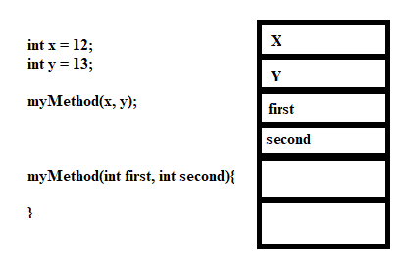
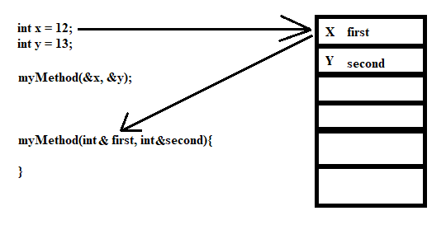
Parameters
Pass by Value: New Memory Blocks
Pass by Reference: Reuse Memory Blocks
&(ampersand) is a common symbol for languages to use with variables to utilize the variable as a “reference”.
*(asterisk) is a common symbol for languages for pointers.

Slide 8
Using Memory Addresses
Pointers and References are used together.
Variables are stored in our computer in memory addresses similar to what is seen in the previous slide.
Computer Memory Addresses operates as an abstract Data Structure “Stacks” which will be covered later.
There exists “blocks” in our computer that holds the location of the block in our computer, and also the data value saved in that block.
A Reference is a variable of a different name for something already existing. Think “

Slide 9
Parameters as Pass By Value vs Reference
PassBy.java Demonstration

Slide 10
Parameters
Pass by Value: New Memory Blocks
Pass by Reference: Reuse Memory Blocks

Slide 11
Array: Strings!
The first Array we see as intro developers are Strings.
Strings are just a collection of letters that form words and phrases.
“DOG” is made of the character ‘D’, ‘O’, and ‘G’.
Computer Scientists are weird, compared to Mathematicians! Array’s begin their indexing at [0].

Slide 12
Array: Strings!
A collection of a DataType
Must define a hard-coded size. (Can be controlled by User Input, but nonetheless, the Array Size must be defined.)
Begins at Index [0].
Last element of an Array can be discovered through the size (or length) of the array. If we begin at [0], the last element is [size-1].
String dog = “DOG”; ‘D’ = [0]; // String library will assist in String-based operations ‘O’ = [1] ‘G’ = [2]

Slide 13
Array: Strings!
Both lines perform the same operation of preparing a parameter to hold an Array of Strings.
String[] args is the recommended syntax.
String args[] is built into the Java compiler (background processing) for other language compatibility.
public static void main(String[] args);
vs
public static void main(String args[]);

Slide 14
Initializing an Array
char[] arrOfChars; char[] myArr = new char[10]; char[] wordDog = new char[3]; wordDog[0] = ‘D’; wordDog[1] = ‘O’; wordDog[2] = ‘G’; String dog = “DOG”;
// saves the variable name “arrOfChars” to be used later. Cannot be used as an array due to no memory allocation. (No Initialization) // Initialization of an Array of Characters of Size 10. // Initialization of an Array of Characters that spell the word “DOG” Arrays begin at index @ 0. Size of wordDog is 3 characters long. // Initialization of a String that contains the word “DOG”

Slide 15
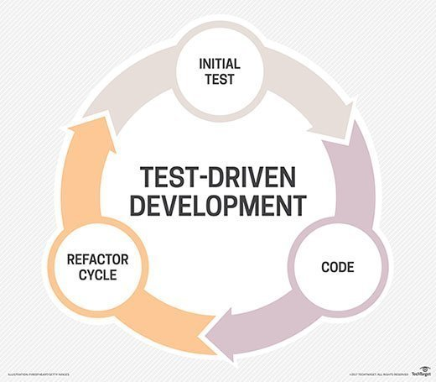
Tic Tac Toe
Conceptualizing the game of Tic-Tac-Toe may seem easy; however, we should still psuedocode out all the rules to ensure we program everything to the rules.
We will be employing Test-Driven Development as a Software Engineering technique.
List out the requirements to your application
Evaluate completeness of requirements (typically determined by the project lead)
Develop those requirements
Test if all requirements are met. (Handling errors along the way)

Slide 16
Tic Tac Toe
What are some of the basic rules to tic-tac-toe?
The board is normally a 3x3 board
Player One is assigned a symbol (O)
Player Two is assigned a different symbol from Player One (X)
Players are able to place their symbols in alternating turns
Defining “Alternating”: Players are not able to place their respective symbols in multiple positions during the same turn. Players must wait for the other player in order to place another symbol.
Players are not able to take a slot already used by a previous player’s placement.
The game ends when a Game Ending Criteria is met.
Defining “Game Ending Criteria”: More discussed on the next slide.

Slide 17
Tic Tac Toe
How to play:
Player One initializes a move with a symbol (O)
Player Two moves next with a different symbol (X)
Repeat from step 2 until a game ending criteria is met
Game Ending Criteria:
A player has met a winning criteria if their respective symbol reads 3 times in a row vertically, horizontally, or diagonally
The game has met a stalemate in that all fields of the 3x3 board is filled without any winning criteria met.

Slide 18
TicTacToe.java
TicTacToe.java
Demonstration of TDD (Test Driven Development) for the implementation of the game TicTacToe
Customized TicTacToe
Demonstration of the same game of TicTacToe but with input/output of text files to customize the game of TicTacToe

Slide 19
Flower Shop (2/6-2/20)

