Slide 1
8조
vertex(x+d*0.20, y+d*0.40);
endShape() ;
noFill();
arc(x, y+d*0.75,d*1.30,d*0.50,0,PI);
line(x, y+d*0.60, x, y+d);
fill(0,0,0);
ellipse(x-d*1.10, y, d*0.50, d*0.60);
ellipse(x+d*1.10, y, d*0.50, d*0.60);
fill(255,255,255);
ellipse(x-d*1.10, y-d*0.13, d*0.30, d*0.30);
ellipse(x+d*1.10, y-d*0.13, d*0.30, d*0.30);
fill(255,0,0);
ellipse(x+d*1.10, y+d*0.18, d*0.30, d*0.25);
ellipse(x-d*1.10, y+d*0.18, d*0.30, d*0.25);
noStroke();
fill(255,255,255);
ellipse(x-d*0.65, y-d*2.50, d*1.40, d*4);
ellipse(x+d*0.65, y-d*2.50, d*1.40, d*4);
stroke(2*d,2*d,2*d);
line(x, y-d*1.75, x-d*0.01, y-d*3.30);
noStroke();
fill(255, 220, 0);
ellipse(x+d*0.65, y-d*2.50, d*0.70, 2*d);
ellipse(x-d*0.65, y-d*2.50, d*0.70, 2*d);
}
}
class Playerble {
Playerble() { };
Playerble(float p, float q, float r) {
x = p; y = q; d = r;
}
float x, y, d;
void dr() {
fill(#000000);
circle(x, y, d);
fill(#FFFFFF);
circle(x, y, d/1.1);
fill(#FFFFFF);
circle(x-d/5, y-d/9, d/5);
circle(x+d/5, y-d/9, d/5);
fill(#000000);
circle(x-d/5, y-d/9, d/10);
circle(x+d/5, y-d/9, d/10);
circle(x, y+d/5, d/5);
fill(#FF0000);
circle(x, y+d/5, d/5.5);
noFill();
stroke(10);
}
}
class character{
character(float a, float b, float c) { x = a; y = b; s = c; };
float x, y, s;
void Mokoko() {
//모코코 오른쪽 머리 잎
strokeWeight(s*7);
fill(85,181,84);
beginShape();
vertex(s * 340 + x, s * 45 + y);
bezierVertex(s*360+x,s*100+y, s*350+x,s*170+y, s*250+x,s*180+y);
bezierVertex(s*240+x,s*140+y, s*240+x,s*100+y, s*290+x,s*80+y);
bezierVertex(s*330+x,s*65+y, s*330+x,s*50+y, s*340+x,s*45+y);
endShape();
beginShape();
vertex(s*250+x,s*180+y);
bezierVertex(s*260+x,s*150+y, s*284+x,s*131+y, s*314+x,s*106+y);
endShape();
//모코코 왼쪽 머리 잎
strokeWeight(s*7);
fill(85,181,84);
beginShape();
vertex(s*100+x,s*130+y);
bezierVertex(s*130+x,s*90+y, s*250+x,s*90+y, s*250+x,s*180+y);
bezierVertex(200*s+x,200*s+y, 155*s+x,185*s+y, 140*s+x,160*s+y);
bezierVertex(130*s+x,145*s+y, 120*s+x,135*s+y, 100*s+x,130*s+y);
endShape();
beginShape();
vertex(250*s+x,180*s+y);
bezierVertex(230*s+x,160*s+y, 190*s+x,140*s+y, 170*s+x,140*s+y);
endShape();
//모코코 얼굴
//가운데 채울 삼각형
strokeWeight(0);
fill(196,237,137);
triangle(111*s+x,379*s+y, 389*s+x,379*s+y, 250*s+x,161*s+y);
//모코코 얼굴 외곽
strokeWeight(s*7);
fill(196,237,137);
curve(25*s+x,405*s+y, 385*s+x,375*s+y, 250*s+x,165*s+y, 25*s+x,405*s+y);
/*삼각형 오른쪽 윗변
3:1 비율로 좌측 하단으로 내려갈수록 크기 up
현재 90:30만큼 크기 키움*/
strokeWeight(s*7);
curve(250*s+x,71*s+y, 115*s+x,375*s+y, 385*s+x,375*s+y, 250*s+x,71*s+y);
fill(196,237,137);
/*삼각형 아랫변
90:30 만큼 픽셀 늘림 5625 625 6250 79
수학적으로 계산해서 111만큼 크기 키움*/
strokeWeight(s*7);
curve(475*s+x,405*s+y, 115*s+x,375*s+y, 250*s+x,165*s+y, 475*s+x,405*s+y);
fill(196,237,137);
/*삼각형 왼쪽 윗변
3:1 비율로 좌측 하단으로 내려갈수록 크기 up
현재 75:25만큼 크기 키움*/
//모코코 왼쪽 눈
fill(0);
strokeWeight(0);
circle(190*s+x,316*s+y,42*s);
fill(255);
circle(195*s+x,310*s+y,14*s);
//모코코 오른쪽 눈
fill(0);
circle(310*s+x,316*s+y,42*s);
fill(255);
circle(315*s+x,310*s+y,14*s);
//모코코 왼쪽 홍조
fill(255,148,180);
circle(160*s+x,340*s+y,24*s);
//모코코 오른쪽 홍조
fill(255,148,180);
circle(340*s+x,340*s+y,24*s);
//모코코 입
fill(255,148,180);
strokeWeight(7*s);
curve(250*s+x,230*s+y, 235*s+x,352*s+y, 265*s+x,352*s+y, 250*s+x,230*s+y);
//모코코 왼쪽윗입술
fill(196,237,137);
strokeWeight(7*s);
curve(240*s+x,330*s+y, 250*s+x,347*s+y, 230*s+x,352*s+y, 240*s+x,330*s+y);
//모코코 오른쪽윗입술
fill(196,237,137);
strokeWeight(7*s);
curve(260*s+x,330*s+y, 250*s+x,347*s+y, 270*s+x,352*s+y, 260*s+x,330*s+y);
//모코코 혀 선
strokeWeight(7*s);
line(250*s+x,347*s+y, 250*s+x,356*s+y);
}
}
소스코드
character p = new character(100, 100, 0.5);
character q = new character(600, 200, 0.7);
character r = new character(200, 500, 1);
Playerble a = new Playerble(50, 150, 180);
Playerble b = new Playerble(500, 210, 80);
Playerble c = new Playerble(300, 100, 210);
move m = new move(100, 100, 20);
move n = new move(400, 150, 10);
void setup() {
size(1000, 1000);
p.Mokoko();
q.Mokoko();
r.Mokoko();
a.dr(); b.dr(); c.dr();
m.bunny(); n.bunny();
}
class move {
move() { };
move(float p, float q, float r) {
x = p; y = q; d = r;
}
float x, y, d;
void bunny() {
noStroke();
fill(255,255,255);
ellipse(x, y, d*4.5, d*3.5);
stroke(255, 200, 0);
strokeWeight(d*0.05);
fill(255, 220, 0);
rect(x-d*0.50, y-d*0.30, d, d*0.67);
stroke(0,0,0);
strokeWeight(d*0.01);
fill(255,160,0);
beginShape() ;
vertex(x+d*0.20, y+d*0.40);
vertex(x, y+d*0.60);
vertex(x-d*0.20, y+d*0.40);

Slide 2
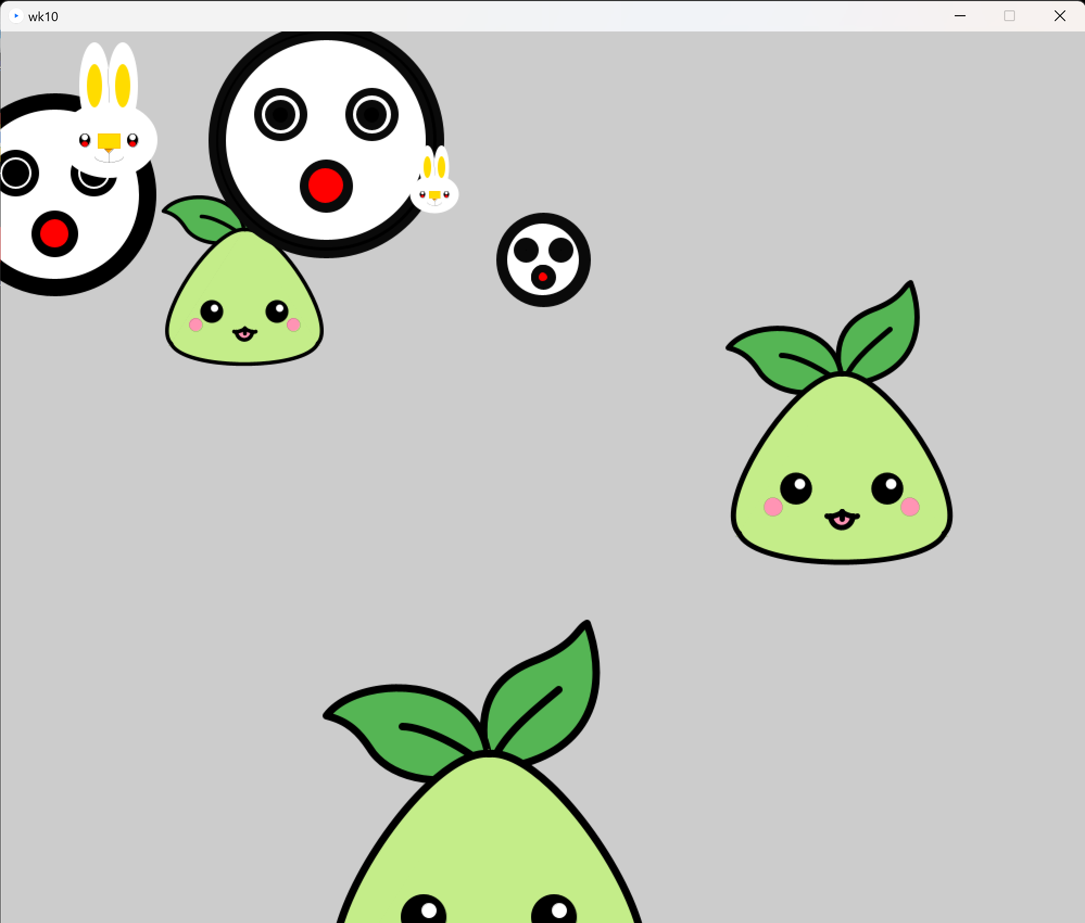
8조
실행화면

