Slide 1
소스 코드
class mix {
mix() {
x = random(750);
y = random(750);
s = 0.8;
vx = random(-3,3);
vy = random(-2,2);
aa = new character[2];
for(int i = 0; i<2;i++){
aa[i] = new character(x+i*250-125,y);
}
}
float x, y, s, vx, vy;
character [] aa;
void update(){
x += vx;
y += vy;
if(x<0 || x>750) vx = -vx;
if(y<0 || y>750) vy = -vy;
for(int i = 0;i<2;i++){
aa[i].x = x + i*250 -125;
aa[i].y = y;
}
}
void Mokoko() {
for(int i=0;i<2;i++) aa[i].smile();
//모코코 오른쪽 머리 잎
strokeWeight(s*7);
fill(85,181,84);
beginShape();
vertex(s * 340 + x, s * 45 + y);
bezierVertex(s*360+x,s*100+y, s*350+x,s*170+y, s*250+x,s*180+y);
bezierVertex(s*240+x,s*140+y, s*240+x,s*100+y, s*290+x,s*80+y);
bezierVertex(s*330+x,s*65+y, s*330+x,s*50+y, s*340+x,s*45+y);
endShape();
beginShape();
vertex(s*250+x,s*180+y);
bezierVertex(s*260+x,s*150+y, s*284+x,s*131+y, s*314+x,s*106+y);
endShape();
//모코코 왼쪽 머리 잎
strokeWeight(s*7);
fill(85,181,84);
beginShape();
vertex(s*100+x,s*130+y);
bezierVertex(s*130+x,s*90+y, s*250+x,s*90+y, s*250+x,s*180+y);
bezierVertex(200*s+x,200*s+y, 155*s+x,185*s+y, 140*s+x,160*s+y);
bezierVertex(130*s+x,145*s+y, 120*s+x,135*s+y, 100*s+x,130*s+y);
endShape();
beginShape();
vertex(250*s+x,180*s+y);
bezierVertex(230*s+x,160*s+y, 190*s+x,140*s+y, 170*s+x,140*s+y);
endShape();
//모코코 얼굴
//가운데 채울 삼각형
strokeWeight(0);
fill(196,237,137);
triangle(111*s+x,379*s+y, 389*s+x,379*s+y, 250*s+x,161*s+y);
//모코코 얼굴 외곽
strokeWeight(s*7);
fill(196,237,137);
curve(25*s+x,405*s+y, 385*s+x,375*s+y, 250*s+x,165*s+y, 25*s+x,405*s+y);
/*삼각형 오른쪽 윗변
3:1 비율로 좌측 하단으로 내려갈수록 크기 up
현재 90:30만큼 크기 키움*/
strokeWeight(s*7);
curve(250*s+x,71*s+y, 115*s+x,375*s+y, 385*s+x,375*s+y, 250*s+x,71*s+y);
fill(196,237,137);
/*삼각형 아랫변
90:30 만큼 픽셀 늘림 5625 625 6250 79
수학적으로 계산해서 111만큼 크기 키움*/
strokeWeight(s*7);
curve(475*s+x,405*s+y, 115*s+x,375*s+y, 250*s+x,165*s+y, 475*s+x,405*s+y);
fill(196,237,137);
/*삼각형 왼쪽 윗변
3:1 비율로 좌측 하단으로 내려갈수록 크기 up
현재 75:25만큼 크기 키움*/
//모코코 왼쪽 눈
fill(0);
strokeWeight(0);
circle(190*s+x,316*s+y,42*s);
fill(255);
circle(195*s+x,310*s+y,14*s);
//모코코 오른쪽 눈
fill(0);
circle(310*s+x,316*s+y,42*s);
fill(255);
circle(315*s+x,310*s+y,14*s);
//모코코 왼쪽 홍조
fill(255,148,180);
circle(160*s+x,340*s+y,24*s);
//모코코 오른쪽 홍조
fill(255,148,180);
circle(340*s+x,340*s+y,24*s);
//모코코 입
fill(255,148,180);
strokeWeight(7*s);
curve(250*s+x,230*s+y, 235*s+x,352*s+y, 265*s+x,352*s+y, 250*s+x,230*s+y);
//모코코 왼쪽윗입술
fill(196,237,137);
strokeWeight(7*s);
curve(240*s+x,330*s+y, 250*s+x,347*s+y, 230*s+x,352*s+y, 240*s+x,330*s+y);
//모코코 오른쪽윗입술
fill(196,237,137);
strokeWeight(7*s);
curve(260*s+x,330*s+y, 250*s+x,347*s+y, 270*s+x,352*s+y, 260*s+x,330*s+y);
//모코코 혀 선
strokeWeight(7*s);
line(250*s+x,347*s+y, 250*s+x,356*s+y);
}
}
class character{
character(){
x = random(750);
y = random(750);
vx = random(-3,3); vy = random(-2,2);
}
character(float a, float b) { x = a; y = b; s = 0.5;};
float x,y,s, vx, vy;
void act(){
x += vx; y += vy;
if(x>750) x *= -1;
if(x<0) x *= -1;
if(y>750) y *= -1;
if(y<0) y *= -1;
}
void smile(){
fill(255);
ellipse(x+200, y+200, s*250, s*250/3*2);
circle(x - s*250/5 +200, y +200 - s*250/6, s*250/5);
arc(x + 200 + s*250/5, y + 200 - s*250/6, s*250/5, s*250/5, PI, 2*PI);
arc(x+200, y+200, s*250*2/3, s*250/5, 0, PI);
}
}
mix [] aa;
void setup() {
size(1000, 1000);
aa = new mix[3];
for (int i = 0; i < 3; i ++){
aa[i] = new mix();
}
}
void draw() {
background(255);
for (int i=0; i<3; i++){
aa[i].update();
aa[i].Mokoko();
}
}
class character{
character() {
x = random(0,750);
y = random(0,750);
vx = random(-3,3); vy = random(-2,2);
s = random(0.3, 0.7);
}
float x, y, s, vx, vy, t;
void collide(character b){
float dd;
dd = sqrt((x-b.x)*(x-b.x) + (y-b.y)*(y-b.y));
if(dd < (s*250+b.s*250)/2){
t = vx; vx = b.vx; b.vx = t;
t = vy; vy = b.vy; b.vy = t;
}
}
void act(){
x += vx; y += vy;
if (x > 750) vx *= -1;
if (x < 0) vx *= -1;
if (y > 750) vy *= -1;
if (y < 0) vy *= -1;
}
void Mokoko() {
//모코코 오른쪽 머리 잎
strokeWeight(s*7);
fill(85,181,84);
beginShape();
vertex(s * 340 + x, s * 45 + y);
bezierVertex(s*360+x,s*100+y, s*350+x,s*170+y, s*250+x,s*180+y);
bezierVertex(s*240+x,s*140+y, s*240+x,s*100+y, s*290+x,s*80+y);
bezierVertex(s*330+x,s*65+y, s*330+x,s*50+y, s*340+x,s*45+y);
endShape();
beginShape();
vertex(s*250+x,s*180+y);
bezierVertex(s*260+x,s*150+y, s*284+x,s*131+y, s*314+x,s*106+y);
endShape();
//모코코 왼쪽 머리 잎
strokeWeight(s*7);
fill(85,181,84);
beginShape();
vertex(s*100+x,s*130+y);
bezierVertex(s*130+x,s*90+y, s*250+x,s*90+y, s*250+x,s*180+y);
bezierVertex(200*s+x,200*s+y, 155*s+x,185*s+y, 140*s+x,160*s+y);
bezierVertex(130*s+x,145*s+y, 120*s+x,135*s+y, 100*s+x,130*s+y);
endShape();
beginShape();
vertex(250*s+x,180*s+y);
bezierVertex(230*s+x,160*s+y, 190*s+x,140*s+y, 170*s+x,140*s+y);
endShape();
//모코코 얼굴
//가운데 채울 삼각형
strokeWeight(0);
fill(196,237,137);
triangle(111*s+x,379*s+y, 389*s+x,379*s+y, 250*s+x,161*s+y);
//모코코 얼굴 외곽
strokeWeight(s*7);
fill(196,237,137);
curve(25*s+x,405*s+y, 385*s+x,375*s+y, 250*s+x,165*s+y, 25*s+x,405*s+y);
/*삼각형 오른쪽 윗변
3:1 비율로 좌측 하단으로 내려갈수록 크기 up
현재 90:30만큼 크기 키움*/
strokeWeight(s*7);
curve(250*s+x,71*s+y, 115*s+x,375*s+y, 385*s+x,375*s+y, 250*s+x,71*s+y);
fill(196,237,137);
/*삼각형 아랫변
90:30 만큼 픽셀 늘림 5625 625 6250 79
수학적으로 계산해서 111만큼 크기 키움*/
strokeWeight(s*7);
curve(475*s+x,405*s+y, 115*s+x,375*s+y, 250*s+x,165*s+y, 475*s+x,405*s+y);
fill(196,237,137);
/*삼각형 왼쪽 윗변
3:1 비율로 좌측 하단으로 내려갈수록 크기 up
현재 75:25만큼 크기 키움*/
//모코코 왼쪽 눈
fill(0);
strokeWeight(0);
circle(190*s+x,316*s+y,42*s);
fill(255);
circle(195*s+x,310*s+y,14*s);
//모코코 오른쪽 눈
fill(0);
circle(310*s+x,316*s+y,42*s);
fill(255);
circle(315*s+x,310*s+y,14*s);
//모코코 왼쪽 홍조
fill(255,148,180);
circle(160*s+x,340*s+y,24*s);
//모코코 오른쪽 홍조
fill(255,148,180);
circle(340*s+x,340*s+y,24*s);
//모코코 입
fill(255,148,180);
strokeWeight(7*s);
curve(250*s+x,230*s+y, 235*s+x,352*s+y, 265*s+x,352*s+y, 250*s+x,230*s+y);
//모코코 왼쪽윗입술
fill(196,237,137);
strokeWeight(7*s);
curve(240*s+x,330*s+y, 250*s+x,347*s+y, 230*s+x,352*s+y, 240*s+x,330*s+y);
//모코코 오른쪽윗입술
fill(196,237,137);
strokeWeight(7*s);
curve(260*s+x,330*s+y, 250*s+x,347*s+y, 270*s+x,352*s+y, 260*s+x,330*s+y);
//모코코 혀 선
strokeWeight(7*s);
line(250*s+x,347*s+y, 250*s+x,356*s+y);
}
}
character [] aa;
void setup() {
size(1000, 1000);
aa = new character[3];
for (int i=0; i<3; i++) {
aa[i] = new character();
}
}
void draw(){
background(0,255,255);
for (int i=0; i<3; i++) {
if(i != 2){
for(int j=i+1;j<3;j++){
aa[i].collide(aa[j]);
}
}
aa[i].act();
aa[i].Mokoko();
}
}
8조
punleu [] aa;
void setup() {
size(800, 600);
aa = new punleu[5];
for (int i=0; i<5; i++) {
aa[i] = new punleu();
}
}
void draw(){
background(0,255,255);
for (int i=0; i<5; i++) {
aa[i].update();
aa[i].punleuShow();
}
}
class punleu {
// constructor
punleu() {
x = random(width);
y = random(height);
d = 25;
vx = random(-3,3);
vy = random(-2,2);
aa = new Siha[2];
for(int i=0;i<2;i++){
aa[i] = new Siha(x+i*200-100,y);
}
}
// member data
float x, y, d, vx, vy;
Siha [] aa;
// member function
void update(){
x += vx;
y += vy;
if(x<0 || x>width) vx = - vx;
if(y<0 || y>height) vy = - vy;
for(int i=0;i<2;i++){
aa[i].x =x+i*240-120;
aa[i].y = y;
}
}
void punleuShow() {
for(int i=0;i<2;i++) aa[i].Life();
stroke(0,0,0);
fill(125,125,200);
ellipse(x, y, d*3.5, d*3);
fill(255,255,255);
ellipse(x, y - d*1.0, d*1.4, d*1.0);
ellipse(x, y - d*1.0, d*1.4*0.7, d*1.0*0.7);
}
}
class Siha {
Siha() {
x = random(0,width);
y = random(0,height);
d = random(50,100);
vx = random(-3,3); vy = random(-2,2);
};
Siha(float a, float b) {
x = a; y = b;
d = 50;
vx = vy = 0;
};
float x, y, d, vx, vy;
void act(){
x += vx; y += vy;
if(x>width) x=0;
if(x<0) x=width;
if(y>height) y=0;
if(y<0) y = height;
}
void Life() {
noStroke();
fill(255,255,255);
ellipse(x, y, d*4.5, d*3.5);
stroke(255, 200, 0);
strokeWeight(d*0.05);
fill(255, 220, 0);
rect(x-d*0.50, y-d*0.30, d, d*0.67);
stroke(0,0,0);
strokeWeight(d*0.01);
fill(255,160,0);
beginShape() ;
vertex(x+d*0.20, y+d*0.40);
vertex(x, y+d*0.60);
vertex(x-d*0.20, y+d*0.40);
vertex(x+d*0.20, y+d*0.40);
endShape() ;
noFill();
arc(x, y+d*0.75,d*1.30,d*0.50,0,PI);
line(x, y+d*0.60, x, y+d);
fill(0,0,0);
ellipse(x-d*1.10, y, d*0.50, d*0.60);
ellipse(x+d*1.10, y, d*0.50, d*0.60);
fill(255,255,255);
ellipse(x-d*1.10, y-d*0.13, d*0.30, d*0.30);
ellipse(x+d*1.10, y-d*0.13, d*0.30, d*0.30);
fill(255,0,0);
ellipse(x+d*1.10, y+d*0.18, d*0.30, d*0.25);
ellipse(x-d*1.10, y+d*0.18, d*0.30, d*0.25);
noStroke();
fill(255,255,255);
ellipse(x-d*0.65, y-d*2.50, d*1.40, d*4);
ellipse(x+d*0.65, y-d*2.50, d*1.40, d*4);
stroke(2*d,2*d,2*d);
line(x, y-d*1.75, x-d*0.01, y-d*3.30);
noStroke();
fill(255, 220, 0);
ellipse(x+d*0.65, y-d*2.50, d*0.70, 2*d);
ellipse(x-d*0.65, y-d*2.50, d*0.70, 2*d);
}
}
plorer [] aa;
void setup() {
size(800, 600);
aa = new plorer[5];
for (int i=0; i<5; i++) {
aa[i] = new plorer();
}
}
void draw(){
background(0,255,255);
for (int i=0; i<5; i++) {
aa[i].update();
aa[i].plorerShow();
}
}
class Playerble {
Playerble(float a,float b){
x = a;
y = b;
d = 50;
vx = random(-3,3); vy = random(-2,2); s = random(0.3, 0.7);
}
Playerble(){
x = random(0,width);
y = random(0,height);
d = 50;
vx = random(-3,3); vy = random(-2,2); s = random(0.3, 0.7);
};
float x,y,d,vx,vy,s;
void dr() {
fill(#000000);
circle(x, y, d);
fill(#FFFFFF);
circle(x, y, d/1.1);
fill(#FFFFFF);
circle(x-d/5, y-d/9, d/5);
circle(x+d/5, y-d/9, d/5);
fill(#000000);
circle(x-d/5, y-d/9, d/10);
circle(x+d/5, y-d/9, d/10);
circle(x, y+d/5, d/5);
fill(#FF0000);
circle(x, y+d/5, d/5.5);
noFill();
stroke(10);
}
void collide(Playerble b){
float dd;
dd = sqrt((x-b.x)*(x-b.x)+(y-b.y)*(y-b.y));
if(dd < (s*250+b.s*250)/2){
vx = b.vx; b.vx = vx;
vy = b.vy; b.vy = vy;
}
}
void moving(){
x +=vx; y += vy;
if (x > width) vx *= -1;
if (x < 0) vx *= -1;
if (y > height) vy *= -1;
if (y < 0) vy *= -1;
}
}
class plorer {
// constructor
plorer() {
x = random(width);
y = random(height);
vx = random(-3,3);
vy = random(-2,2);
aa = new Playerble[2];
for(int i=0;i<2;i++){
aa[i] = new Playerble(x+i*200-100,y);
}
}
// member data
float x, y, vx, vy;
Playerble [] aa;
// member function
void update(){
x += vx;
y += vy;
if(x<0 || x>width) vx = - vx;
if(y<0 || y>height) vy = - vy;
for(int i=0;i<2;i++){
aa[i].x =x+i*240-120;
aa[i].y = y;
}
}
void plorerShow() {
float d = 70;
for(int i=0;i<1;i++) aa[i].dr();
fill(#000000);
square(x, y, d);
fill(#FFFFFF);
square(x, y, d/1.1);
fill(#FFFFFF);
square(x-d/5, y-d/9, d/5);
square(x+d/5, y-d/9, d/5);
fill(#000000);
square(x-d/5, y-d/9, d/10);
square(x+d/5, y-d/9, d/10);
square(x, y+d/5, d/5);
fill(#FF0000);
square(x, y+d/5, d/5.5);
noFill();
stroke(10);
}
}
Playerble [] a;
void setup() {
size(1000, 1000);
a = new Playerble[3];
for(int i = 0 ; i < 3 ; i++){
a[i] = new Playerble();
}
}
void draw(){
background(#FFFFFF);
for(int i = 0 ; i < 3 ; i++){
if(i != 2){
for(int j=i+1;j<3;j++){
a[i].collide(a[j]);
}
}
a[i].moving();
a[i].dr();
}
}
class Playerble {
Playerble(){
x = random(0,width);
y = random(0,height);
d = 50;
vx = random(-3,3); vy = random(-2,2); s = random(0.3, 0.7);
};
float x,y,d,vx,vy,s;
void dr() {
fill(#000000);
circle(x, y, d);
fill(#FFFFFF);
circle(x, y, d/1.1);
fill(#FFFFFF);
circle(x-d/5, y-d/9, d/5);
circle(x+d/5, y-d/9, d/5);
fill(#000000);
circle(x-d/5, y-d/9, d/10);
circle(x+d/5, y-d/9, d/10);
circle(x, y+d/5, d/5);
fill(#FF0000);
circle(x, y+d/5, d/5.5);
noFill();
stroke(10);
}
void collide(Playerble b){
float dd;
dd = sqrt((x-b.x)*(x-b.x)+(y-b.y)*(y-b.y));
if(dd < (s*250+b.s*250)/2){
vx = b.vx; b.vx = vx;
vy = b.vy; b.vy = vy;
}
}
void moving(){
x +=vx; y += vy;
if (x > width) vx *= -1;
if (x < 0) vx *= -1;
if (y > height) vy *= -1;
if (y < 0) vy *= -1;
}
}
um [] aa;
void setup() {
size(800, 600);
aa = new um[5];
for (int i=0; i<5; i++) {
aa[i] = new um();
}
}
void draw(){
background(0,255,255);
for (int i=0; i<5; i++) {
if(i != 4){
for(int j=i+1;j<5;j++){
aa[i].collide(aa[j]);
}
}
aa[i].act();
aa[i].fruit();
}
}
class um {
um() {
x = random(0,width);
y = random(0,height);
d = random(100,200);
vx = random(-3,3); vy = random(-2,2);
};
um(float p, float q, float r) {
x = p; y = q; d = r;
vx = random(-3,3); vy = random(-2,2);
}
float x, y, d, vx, vy;
void collide(um b){
float dd;
dd = sqrt((x-b.x)*(x-b.x) + (y-b.y)*(y-b.y));
if(dd < (d+b.d)/4){
vx = -vx;
vy = - vy;
b.vx = -b.vx;
b.vy = -b.vy;
}
}
void act(){
x += vx; y += vy;
if(x>width) x=0;
if(x<0) x=width;
if(y>height) y=0;
if(y<0) y = height;
}
void fruit() {
stroke(0,0,0);
fill(125,125,200);
ellipse(x, y, d*1.75, d*1.5);
fill(255,255,255);
ellipse(x, y - d*0.5, d*0.7, d*0.5);
ellipse(x, y - d*0.5, d*0.7*0.7, d*0.5*0.7);
}
}

Slide 2
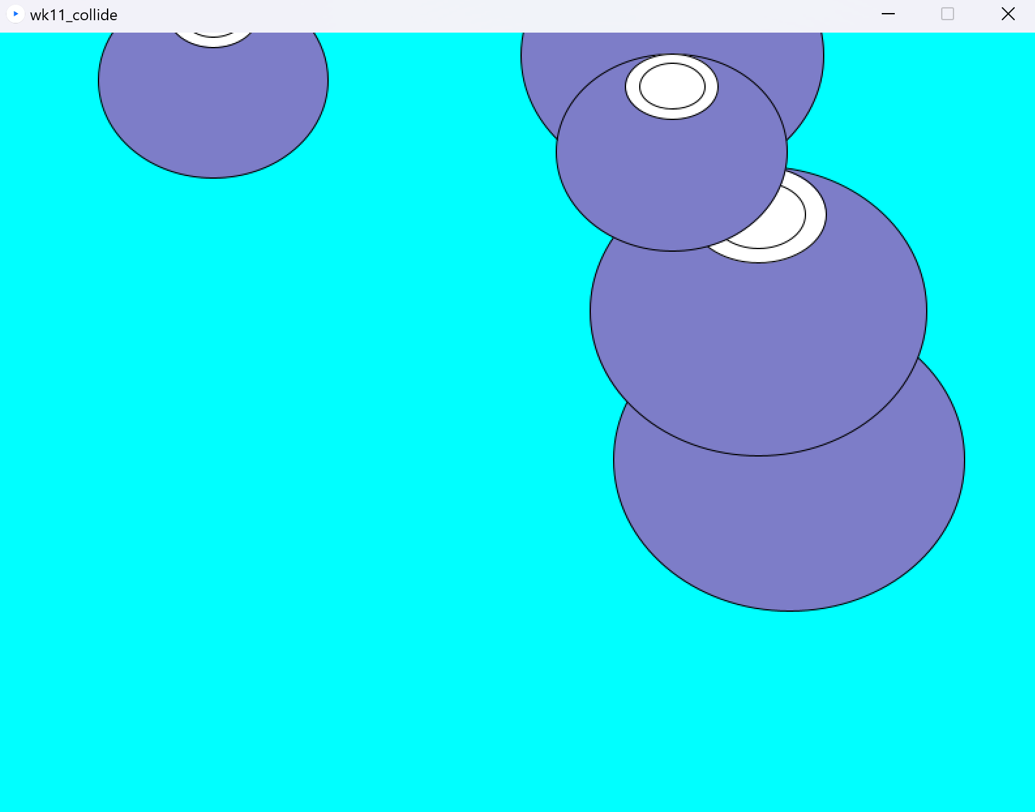
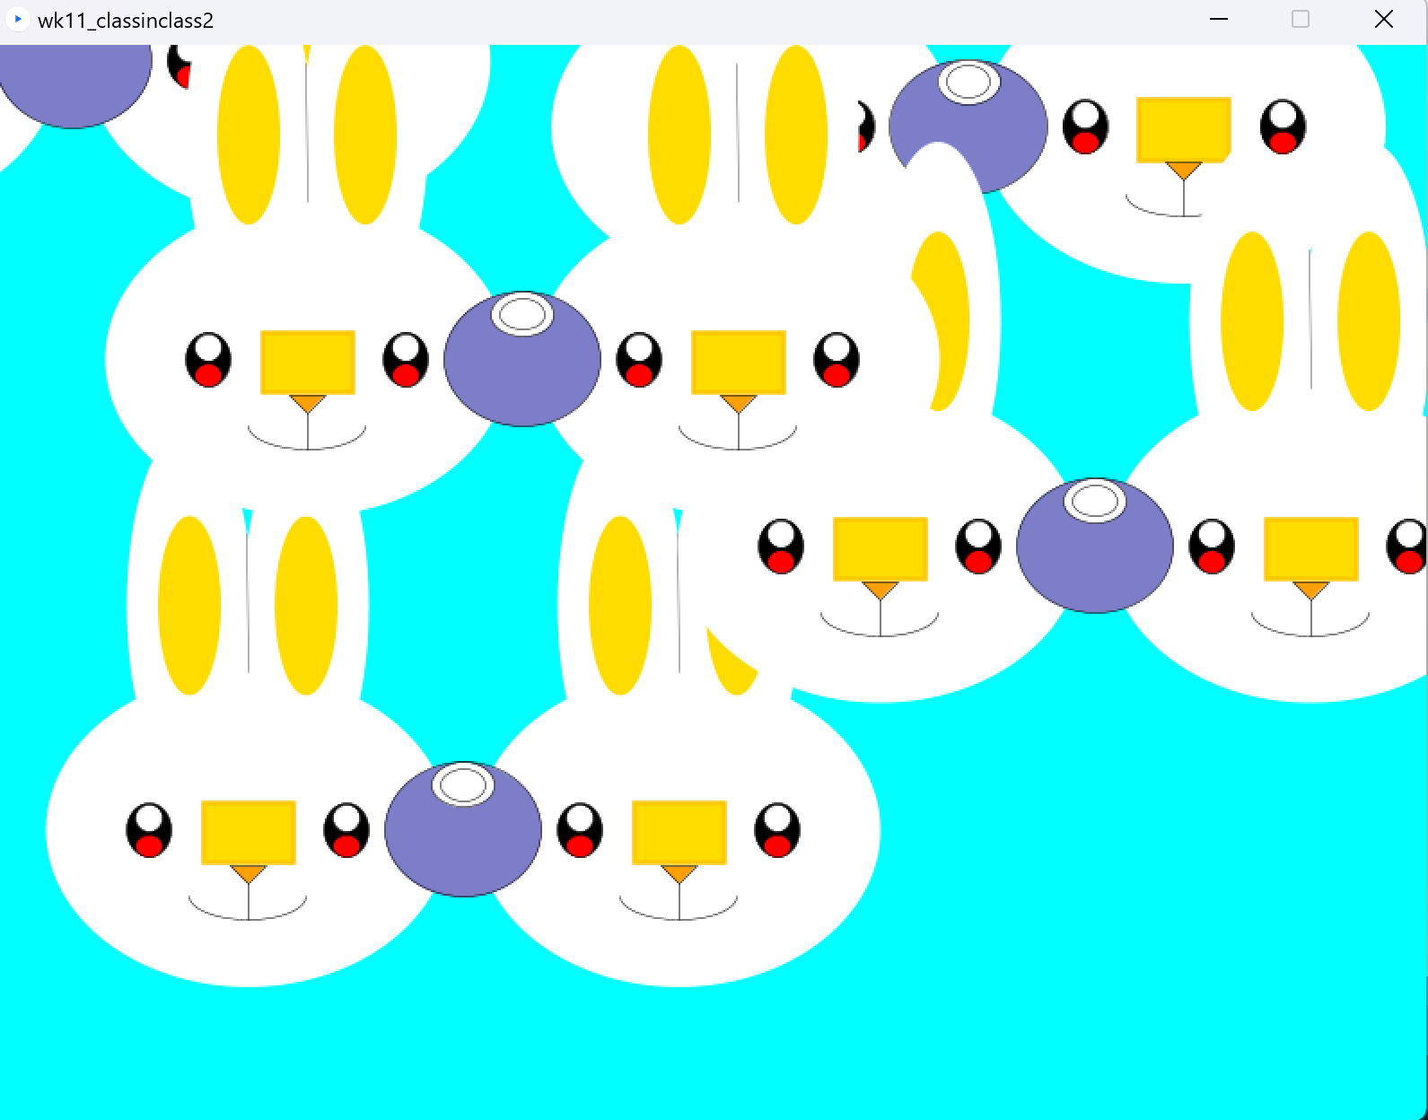
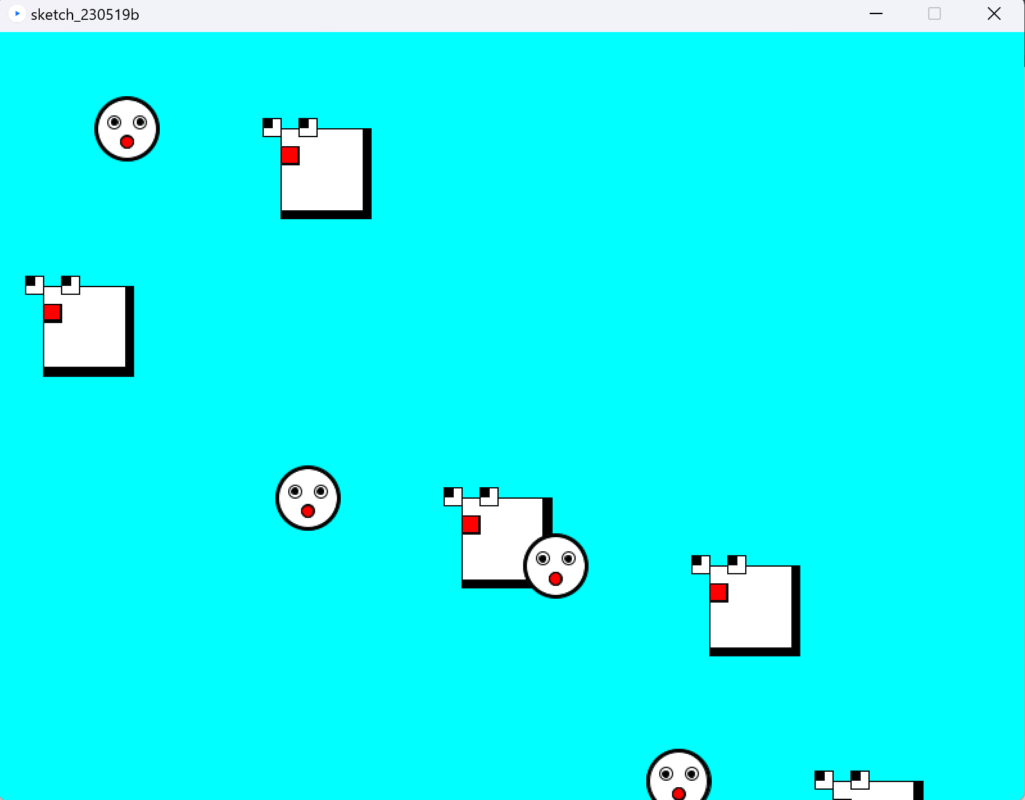
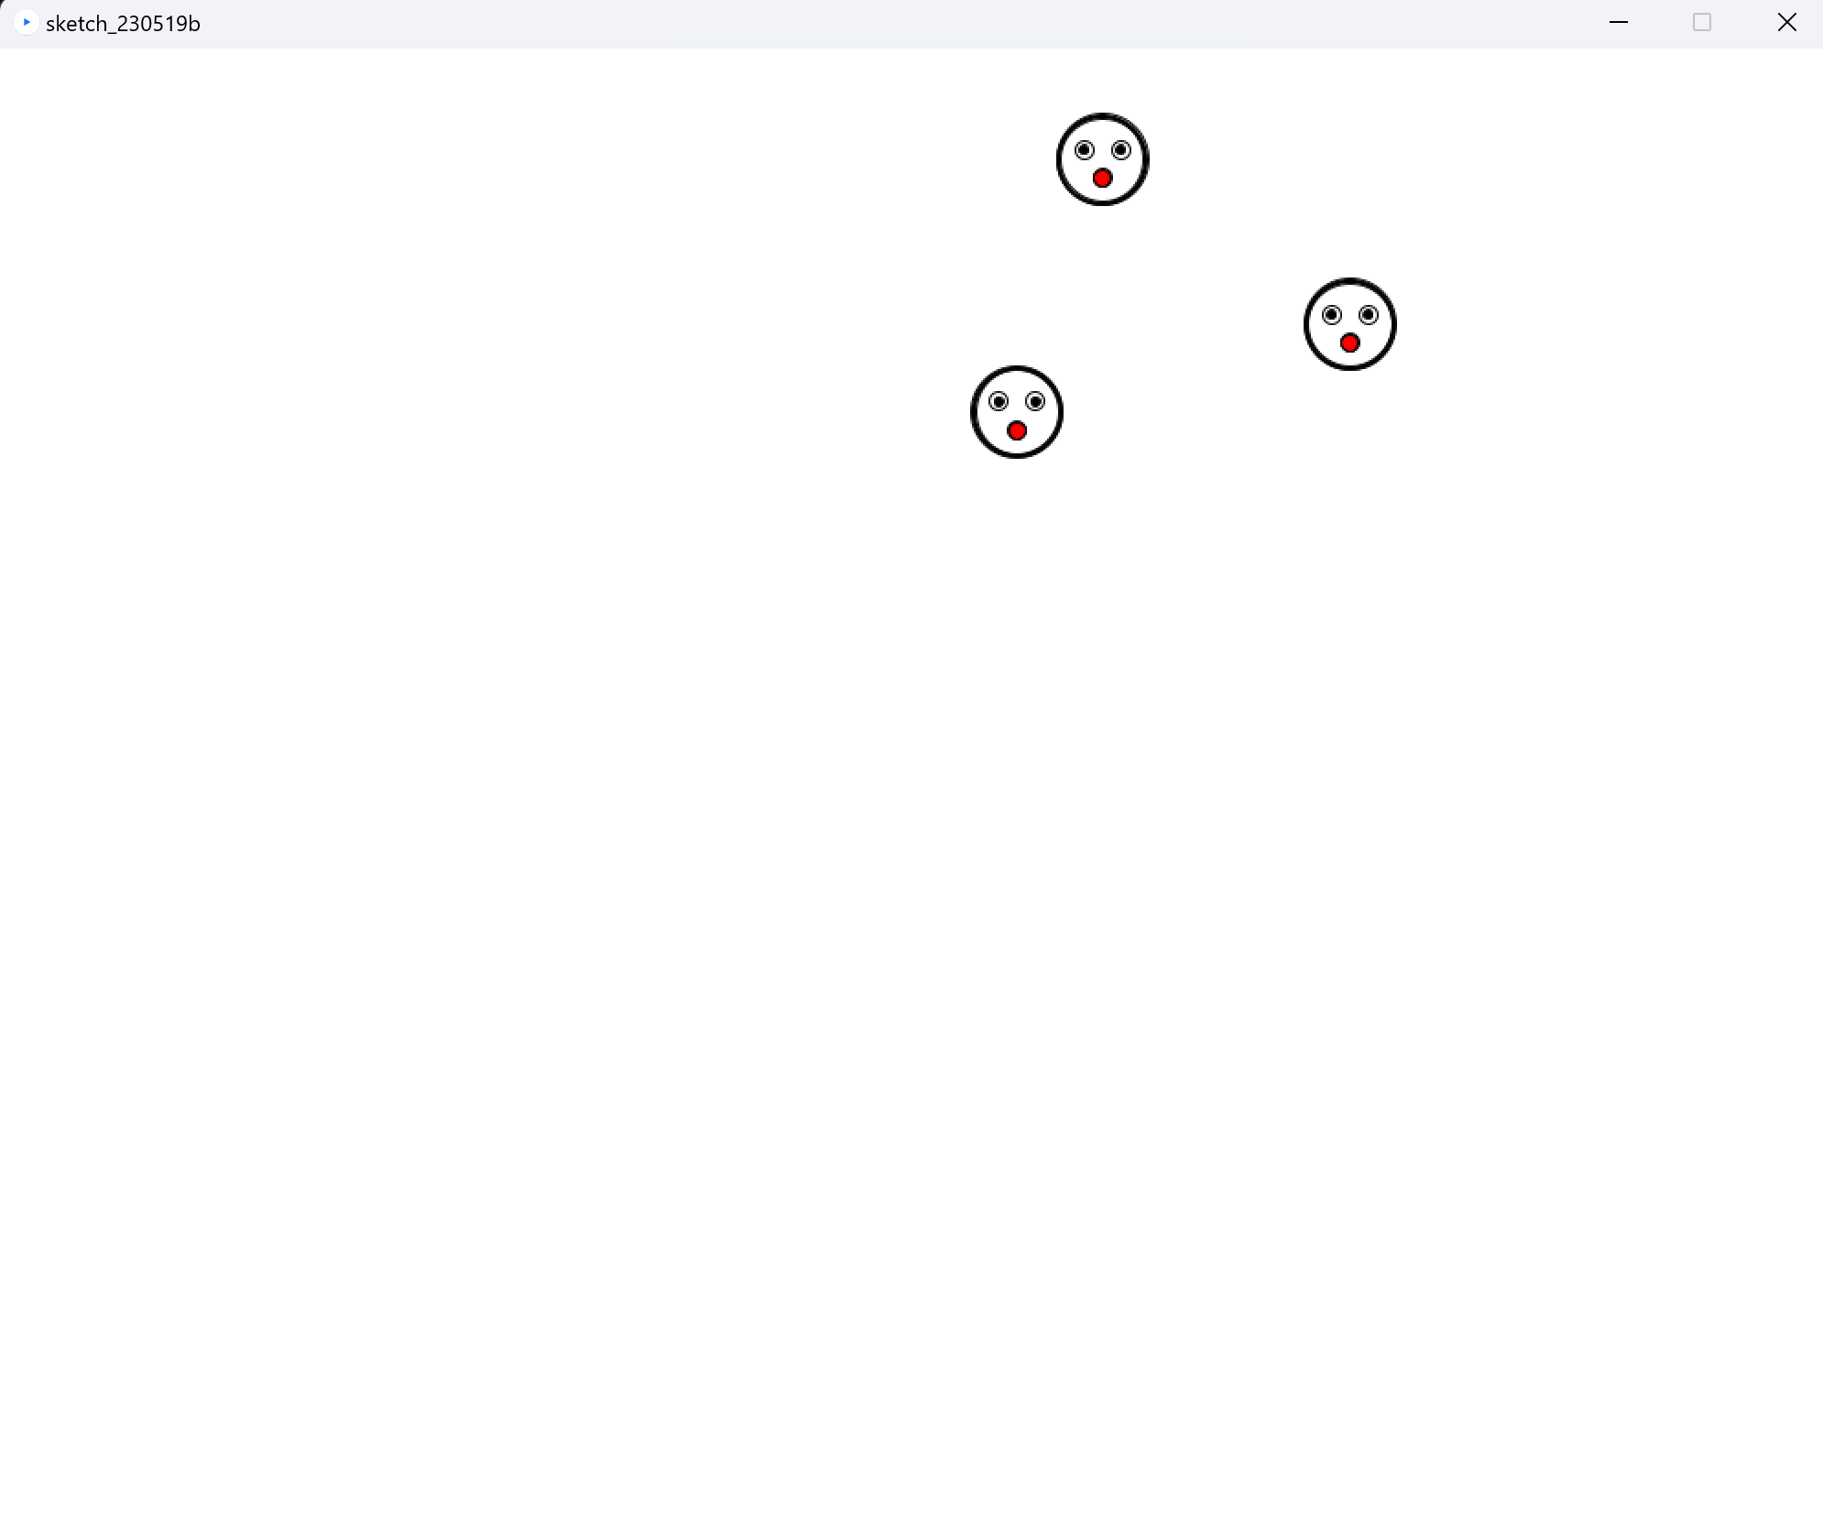
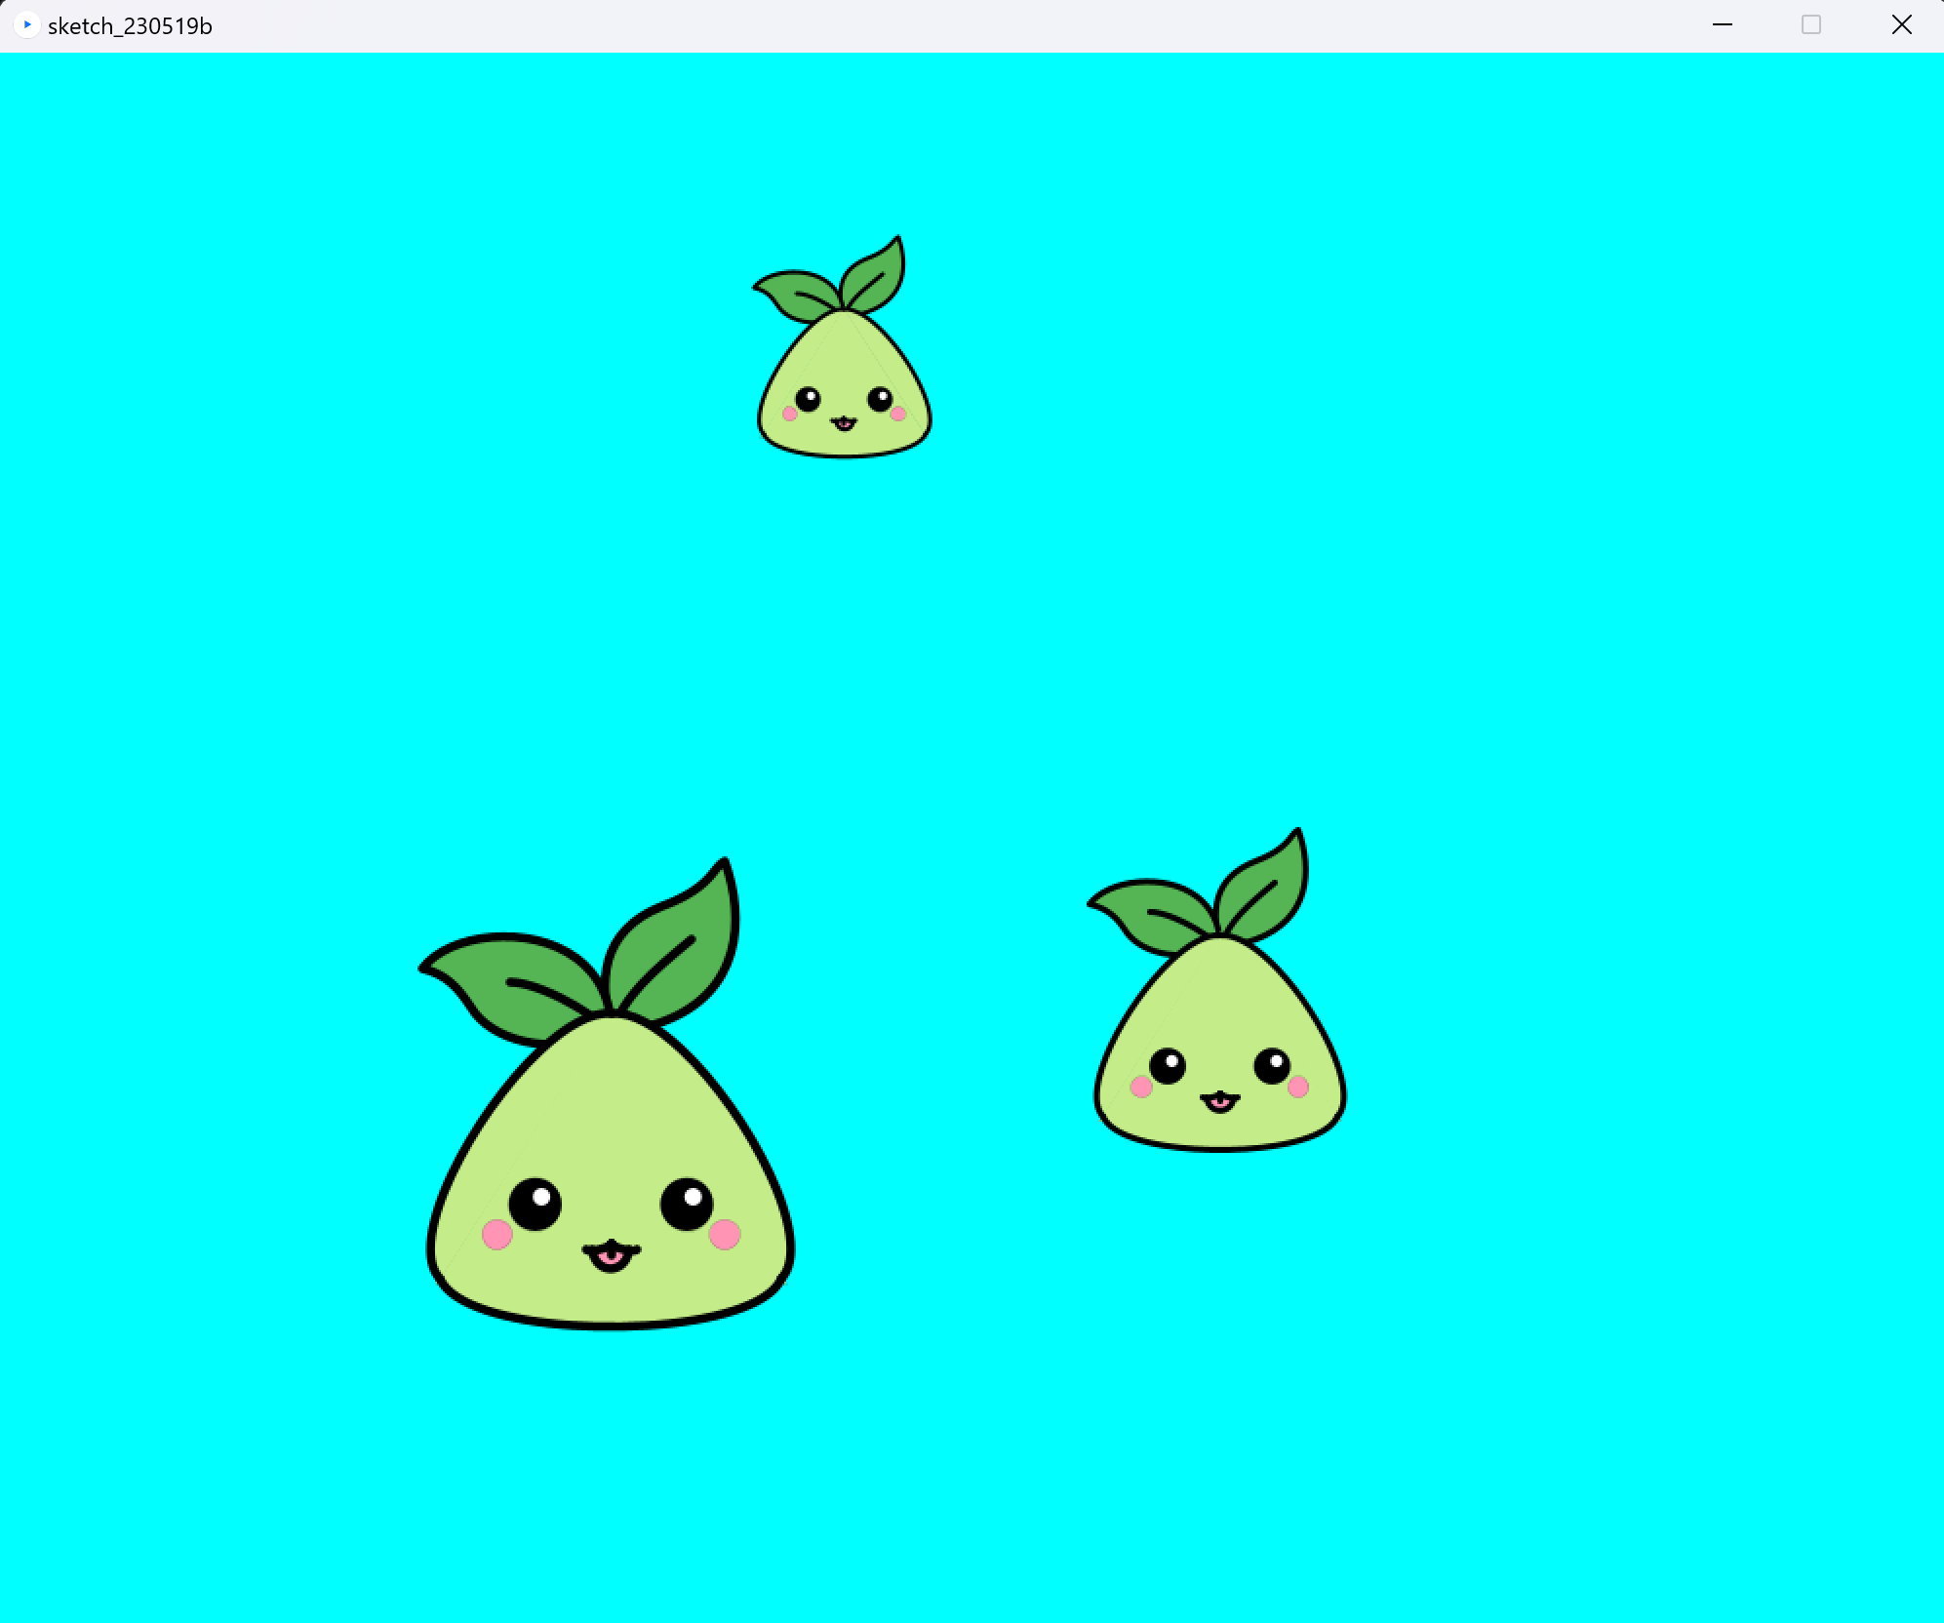
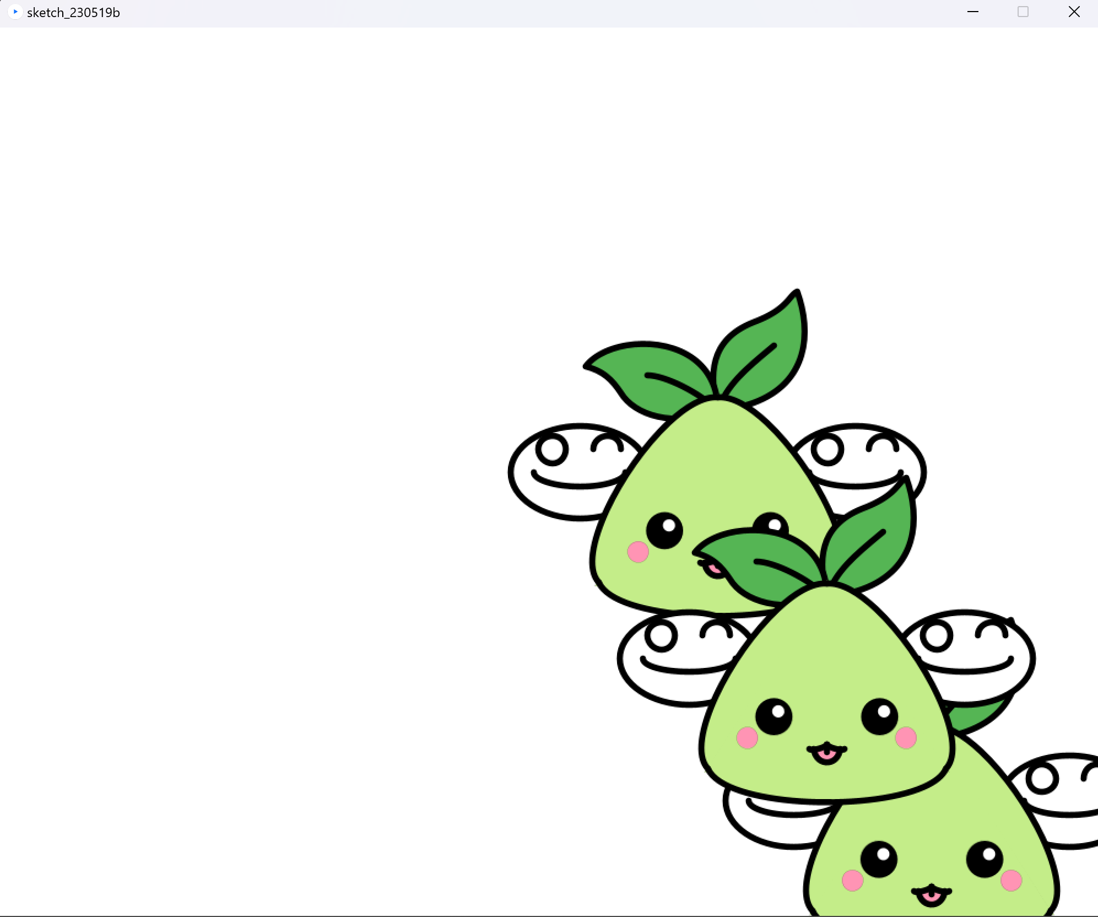
실행 화면

