Slide 1


Example PowerPoint

Slide 2
Definition
A cliché has two meanings:
An overused expression
An idea that has a special meaning different than its literal meaning

Slide 3
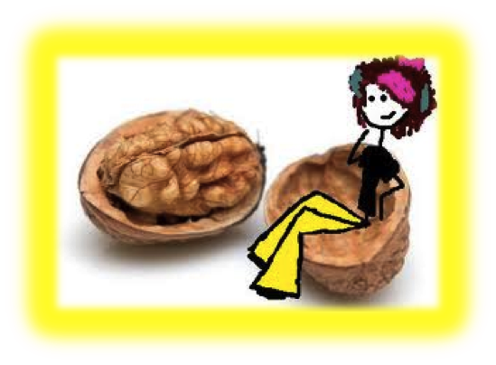
Examples
These clichés are examples overused expression.
All in a day’s work
Don’t count your chickens before they hatch
I beg to differ
In a nutshell

Slide 4
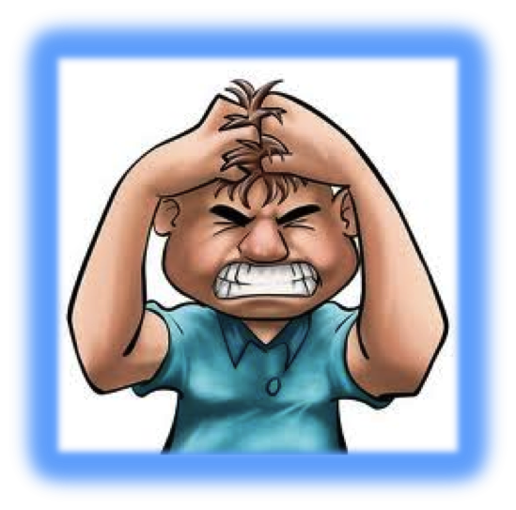
Examples
These clichés are examples an idea that has a special meanings different than its literal meaning.
“sweaty palms”
(This really means that someone is nervous.)
Clear as mud
(This really mean I’m still confused or I have questions.)
You’re driving me up the wall!
(This really means that you are driving me crazy!)

