Slide 1
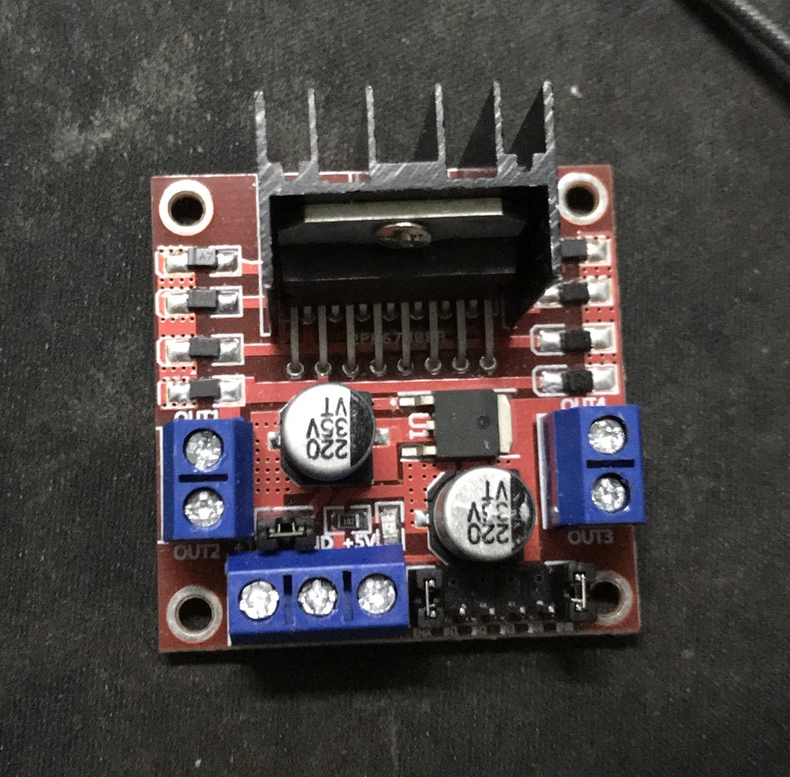
Motor 2
Motor 1
12V
5V
GND

