Slide 1
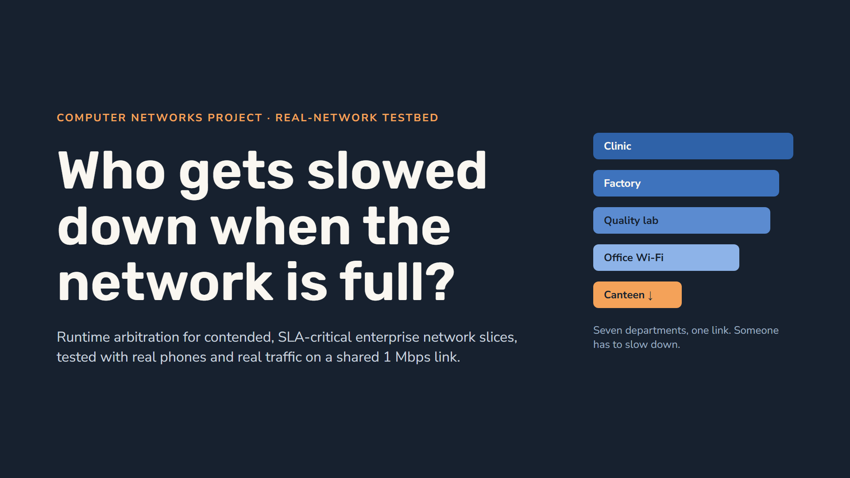
Notes:
Good morning. Our project answers one question: when a company network is full, who should be slowed down, and can the system explain why? This time we did not simulate the network. Phones and laptops join department slices over a Wi-Fi hotspot, and every byte they download goes through a real shaped link. The bars on the right are departments sharing that link. The canteen bar is shorter: by the end you will see why the canteen, and not the clinic, gives way, and you will see it on measured traffic.

Slide 2
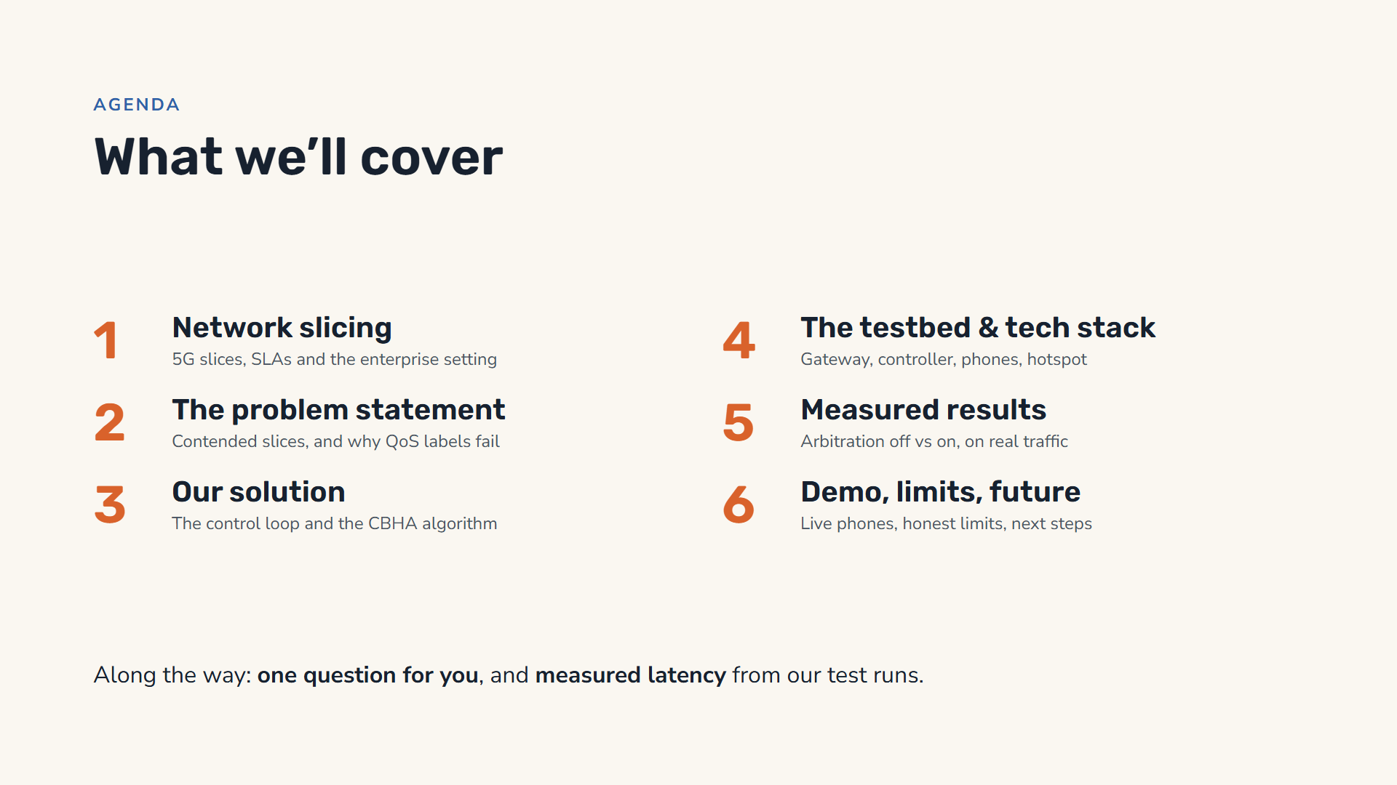
Notes:
Here is the plan. First some background: what network slicing is and how an enterprise uses it. Then the problem statement: what happens when slices compete for a full link, and why the usual label-based approach makes bad decisions. Then our solution, the control loop and the CBHA algorithm. Then the testbed we built: a gateway that every byte passes through, a controller, and phones on a hotspot. Then the measured results with arbitration off and on. Finally the live demo, the honest limits and what comes next.

Slide 3
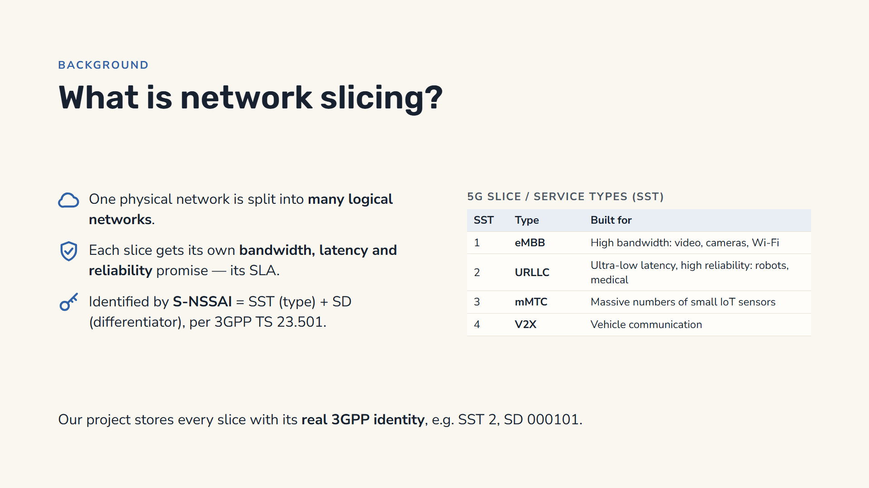
Notes:
Network slicing is one of the core ideas of 5G. Instead of one network that treats all traffic the same, the operator carves the physical network into several logical, end-to-end networks called slices. Each slice gets its own guarantees — bandwidth, latency, reliability — written down as a service-level agreement. 3GPP identifies a slice with an S-NSSAI: the Slice/Service Type, or SST, plus an optional Slice Differentiator, SD. The standard types are eMBB for high bandwidth, URLLC for ultra-reliable low latency, mMTC for massive IoT, and V2X for vehicles. Our project models slices natively with S-NSSAI, so connecting to a real 5G core later needs no data migration.

Slide 4
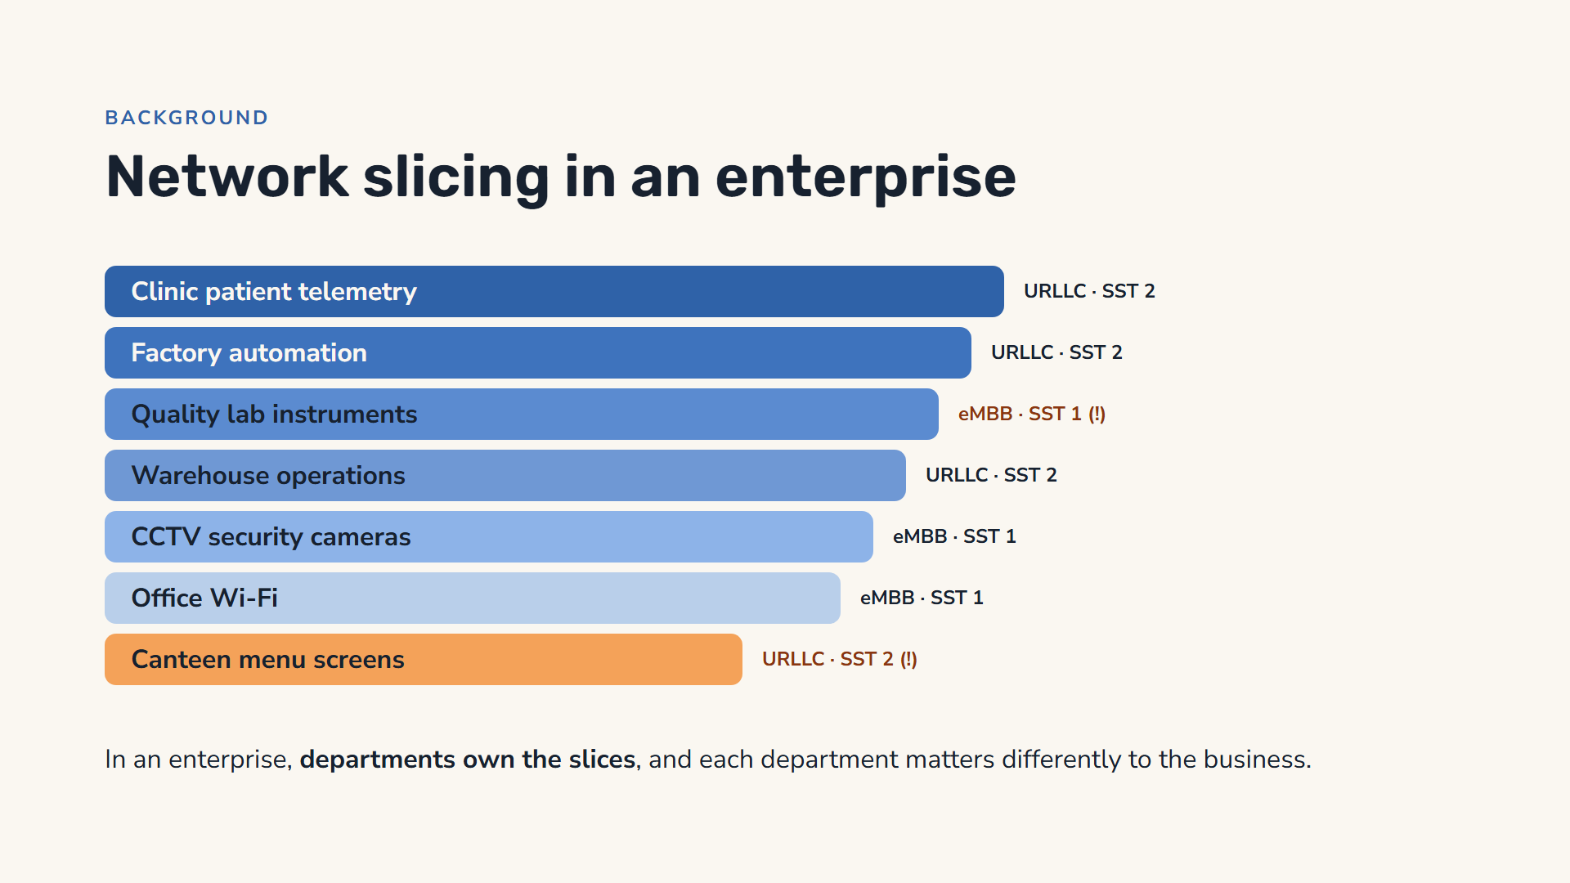
Notes:
In a company network, slicing gives each department’s systems its own reserved lane. Our testbed has seven: the clinic’s patient telemetry, factory automation, the quality lab’s instruments, warehouse operations, security cameras, office Wi-Fi and the canteen menu screens. Next to each lane is its 5G slice type. Notice two things. The canteen screens were set up as URLLC, the same premium type as the clinic, simply because of the template someone chose. And the regulated quality lab was set up as plain eMBB. Remember both; they are the root of the problem.

Slide 5
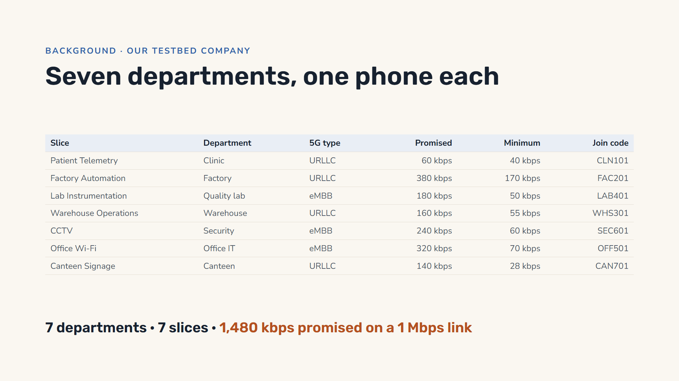
Notes:
Our testbed company has seven departments, each with one slice: the clinic, the factory, the quality lab, the warehouse, security, office IT and the canteen. Each slice is promised a normal share and a guaranteed minimum, and each has a six-character join code; a phone types the code, or scans a QR code from the dashboard, to join that department’s slice. Why kilobits and a 1 Mbps link? So that seven phones on one laptop hotspot can really overload the link without the Wi-Fi itself becoming the bottleneck. The total promised is 1,480 kbps.

Slide 6
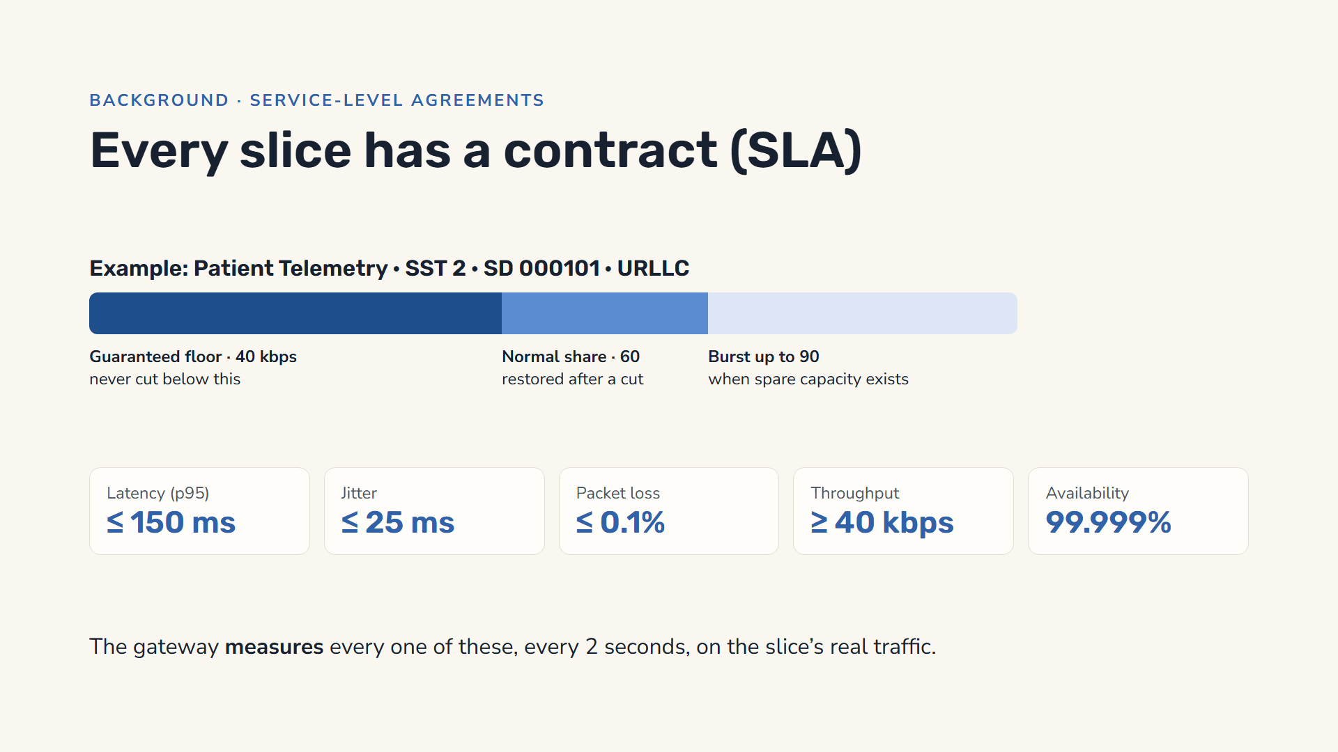
Notes:
Each slice comes with a contract. Bandwidth has three levels: a guaranteed floor the system may never cut below, a normal share it is restored to after any cut, and a burst ceiling. For the clinic: a 40 kbps floor, 60 normal, 90 burst. Then there are quality targets: latency at most 150 milliseconds at the 95th percentile, jitter at most 25, packet loss at most 0.1 percent, at least 40 kbps, and five-nines availability. In this project these are not modelled numbers: the gateway measures each of them every two seconds from the slice’s own traffic and probes, and the dashboard compares them with the targets.

Slide 7
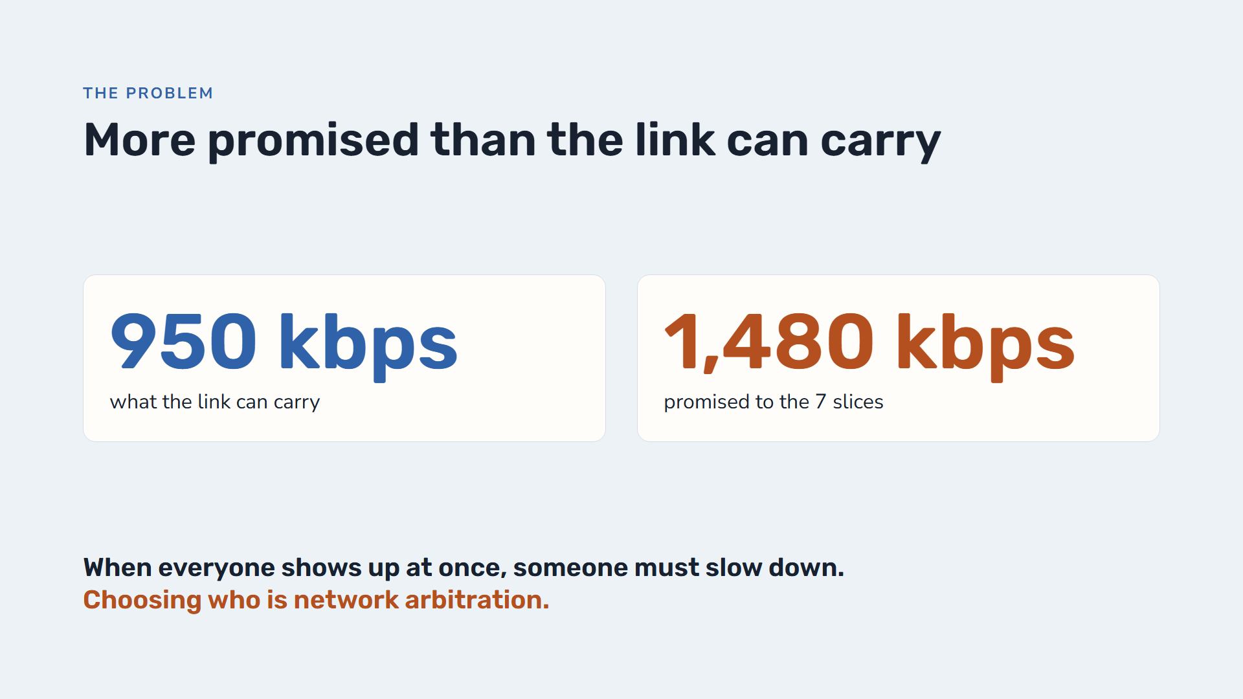
Notes:
The testbed link is 1 Mbps, of which 950 kbps is offered to slices; 50 is kept back. But the slices were promised 1,480 kbps in total, 156 percent. That is normal, like a gym selling more memberships than it has machines, because not everyone comes at once. The problem appears when real demand goes above 950 kbps. Then the link’s queue fills up, and something must be slowed down. Deciding who, and by how much, is network arbitration.

Slide 8
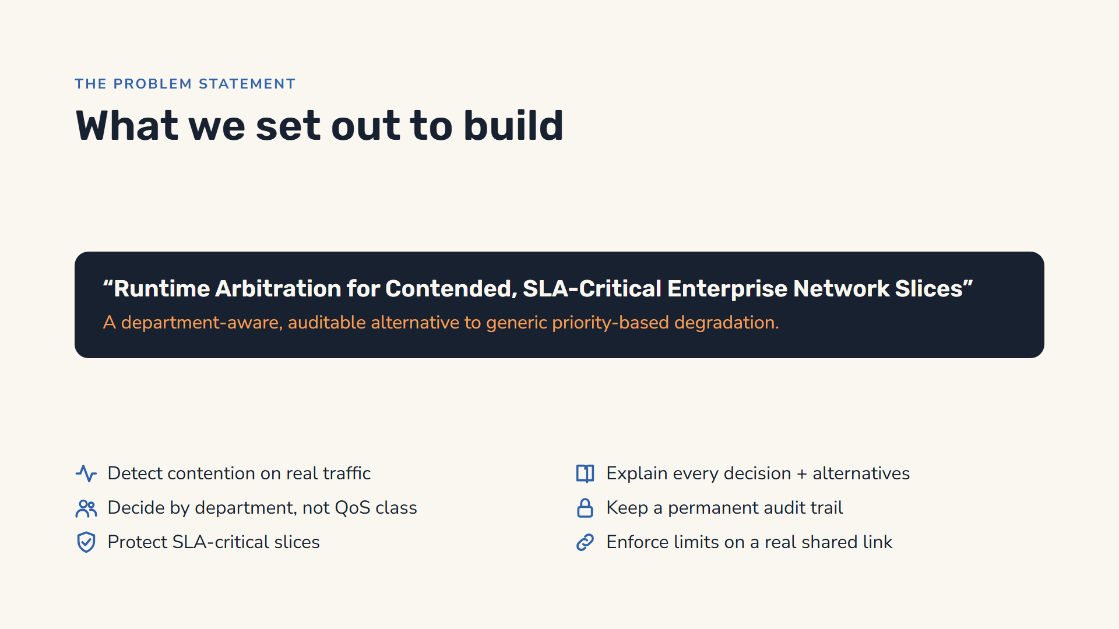
Notes:
This is our problem statement: runtime arbitration for contended, SLA-critical enterprise network slices, a department-aware, auditable alternative to generic priority-based degradation. In practice the system must detect contention while traffic is flowing; decide which slices give up bandwidth using department and business context rather than QoS class; protect slices whose SLAs are critical; explain every decision, including the alternatives it considered; keep a permanent audit trail; and, in this project, actually enforce the new limits on a real shared link that real devices use, and measure the effect.

Slide 9
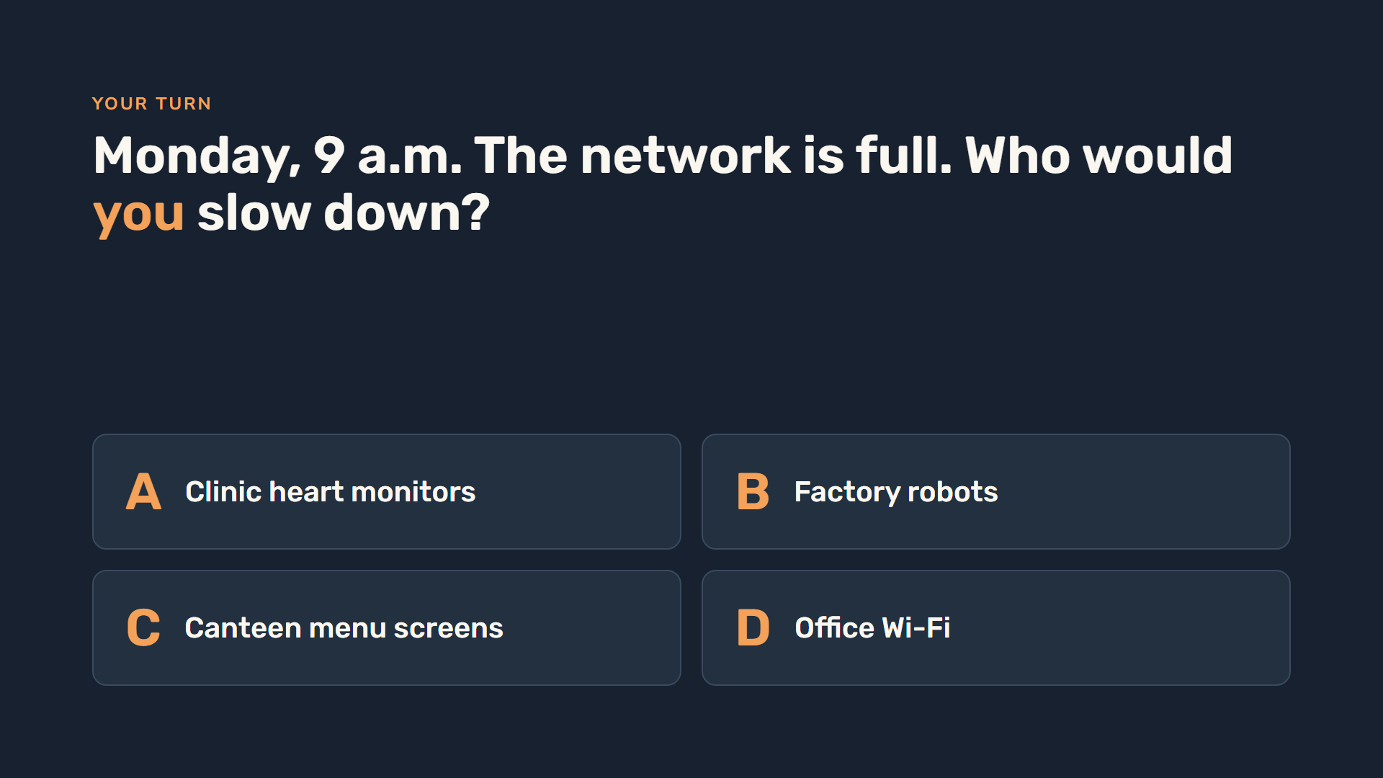
Notes:
Ask the room to vote: A, B, C or D. Almost everyone picks C, the canteen menu screens — maybe a little from office Wi-Fi — and nobody picks the clinic. Hold on to that answer, because the next slide shows what a normal network actually does.

Slide 10
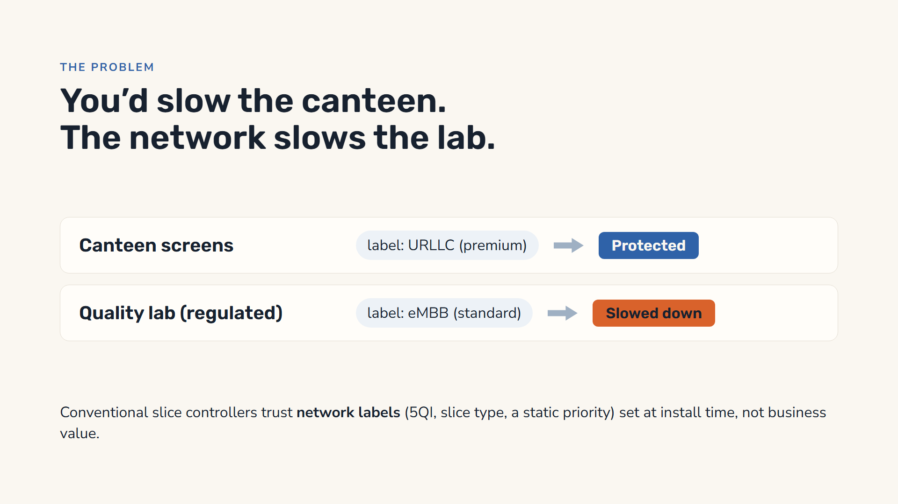
Notes:
Here is the twist. Network equipment decides using the technical label given to each system when it was set up, often from a template, by whoever installed it. The canteen screens happened to be set up as URLLC, the premium type. The quality lab, which is regulated and cannot lose data, was set up as eMBB, the standard type. So when capacity runs short, a label-based controller protects the lunch menu and slows the lab. And without any controller at all it is worse: everyone waits in the same full queue, the clinic included. We will measure that later.

Slide 11
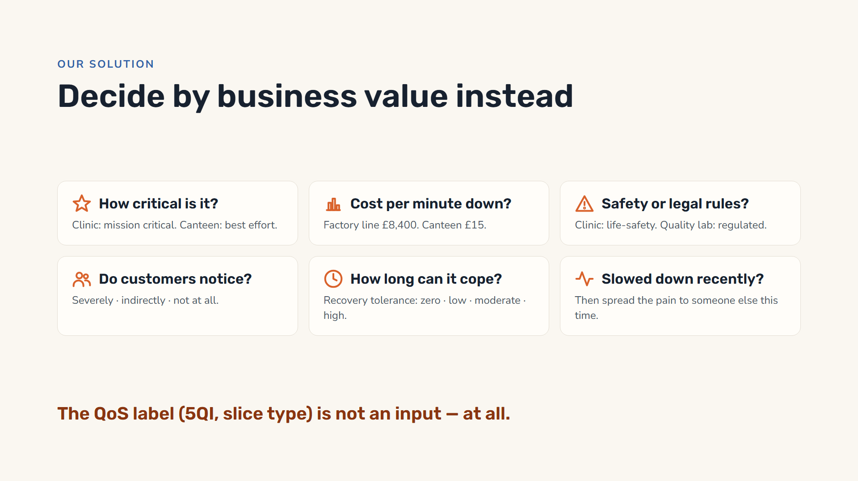
Notes:
Our system ignores network labels entirely and asks six business questions about each department. How critical is it — the clinic is mission critical, the canteen best effort. What does an outage cost per minute — the factory line about 8,400 pounds, the canteen screens 15. Are there safety or legal obligations — the clinic is life-safety, the quality lab regulated. Do customers notice? How long can it cope with being slowed — its recovery tolerance. And was it slowed down recently, so the burden can rotate. The QoS class literally isn’t a field in the engine’s input, so it cannot influence the outcome.

Slide 12
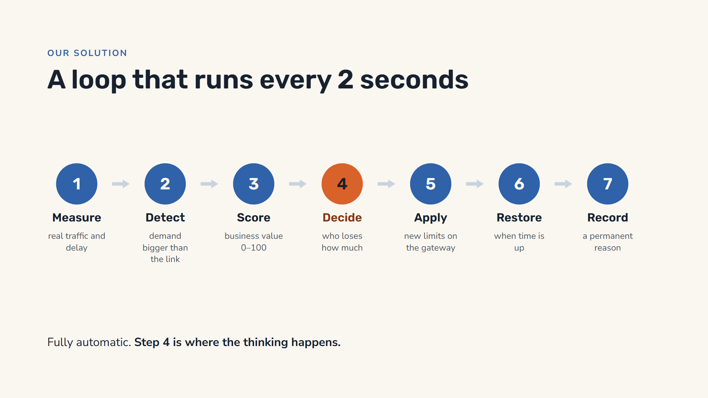
Notes:
The whole system is one loop, repeated every two seconds. Measure: the gateway reports each slice’s demand, carried traffic, drops and probe latency from the last two seconds of real traffic. Detect a shortage, calmly: demand must be above 102 percent of the link on two readings in a row, and it needs three calm readings to call it over. Score each slice by business value. Decide how much to take from each, the clever part. Apply: push the new speed limits to the gateway, which enforces them on the next 20-millisecond tick. Restore them when the department’s recovery time is up, from 30 seconds to 30 minutes. And record a permanent explanation.

Slide 13
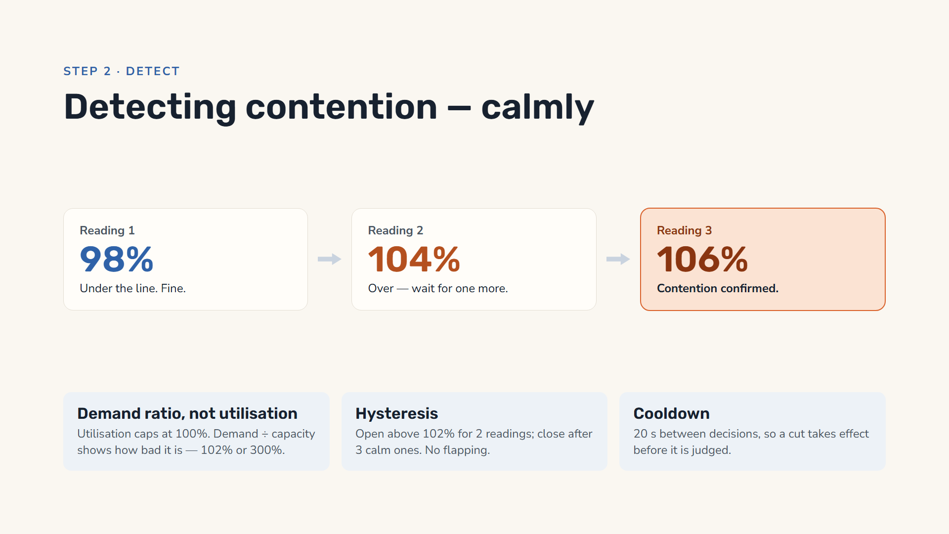
Notes:
Detecting contention sounds easy — if demand is above capacity, act — but that fires dozens of times a minute because demand jitters around the line. Three mechanisms from control engineering fix it. First, it measures the demand ratio, demand divided by capacity, not utilisation: utilisation can never exceed 100 percent, so it can’t tell 102 percent from 300 percent, or how much bandwidth to free. Second, hysteresis: it needs demand above 102 percent for two readings in a row to open an event, and three calm readings to close it — slow to declare victory, so it doesn’t flap. Third, a 20-second cooldown between decisions, so an applied cut has time to take effect before the loop judges it. In control-theory terms: the setpoint is capacity minus headroom, the actuator is bandwidth allocation, and the 102 percent band is the dead band.

Slide 14
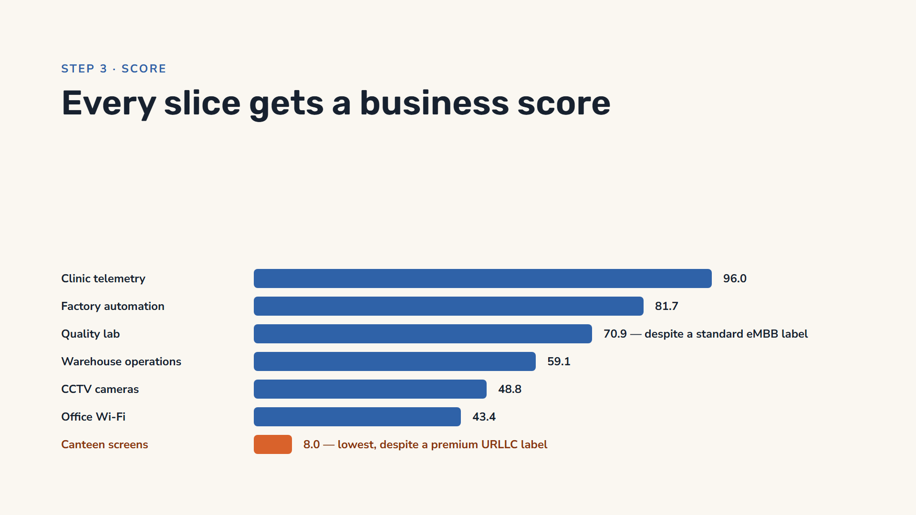
Notes:
These are the real scores the system computes for the testbed company, from the business answers. The clinic scores 96, the factory 82, the quality lab 71, and the canteen screens just 8, even though the canteen slice carries a premium URLLC label and the lab only a standard eMBB one. The scoring engine has no field for the label at all, so it cannot be fooled by it. Cost per minute is compressed on a log scale, so one department cannot win just by declaring a huge number.

Slide 15
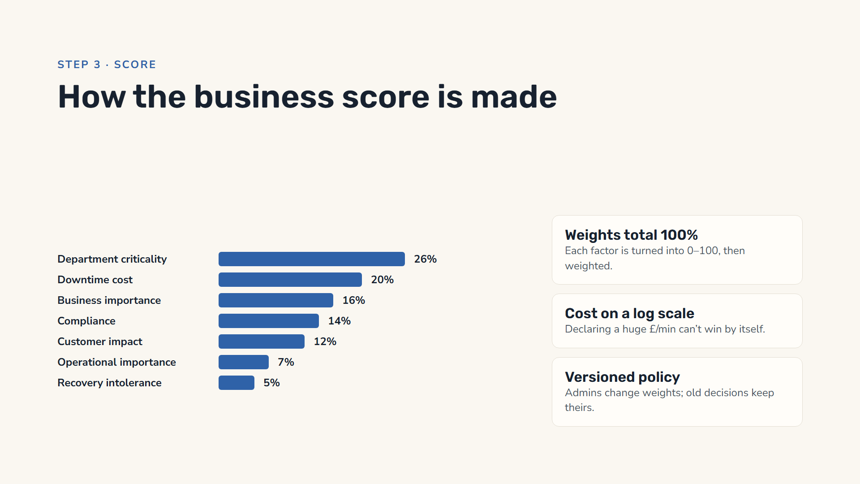
Notes:
The business score is a weighted sum of seven factors, each first normalised to a 0 to 100 scale. In the default policy, department criticality counts 26 percent, downtime cost 20, business importance 16, compliance 14, customer impact 12, operational importance 7 and recovery intolerance 5; the weights must total exactly 100 percent. Downtime cost is log-normalised: the reference cost maps to 50 and each tenfold increase adds only about 25 points, so a department cannot win simply by declaring an enormous number. The policy is versioned and immutable once active — editing creates a new draft — and every decision stores a snapshot of the policy it used, so it stays explainable after the rules change.

Slide 16
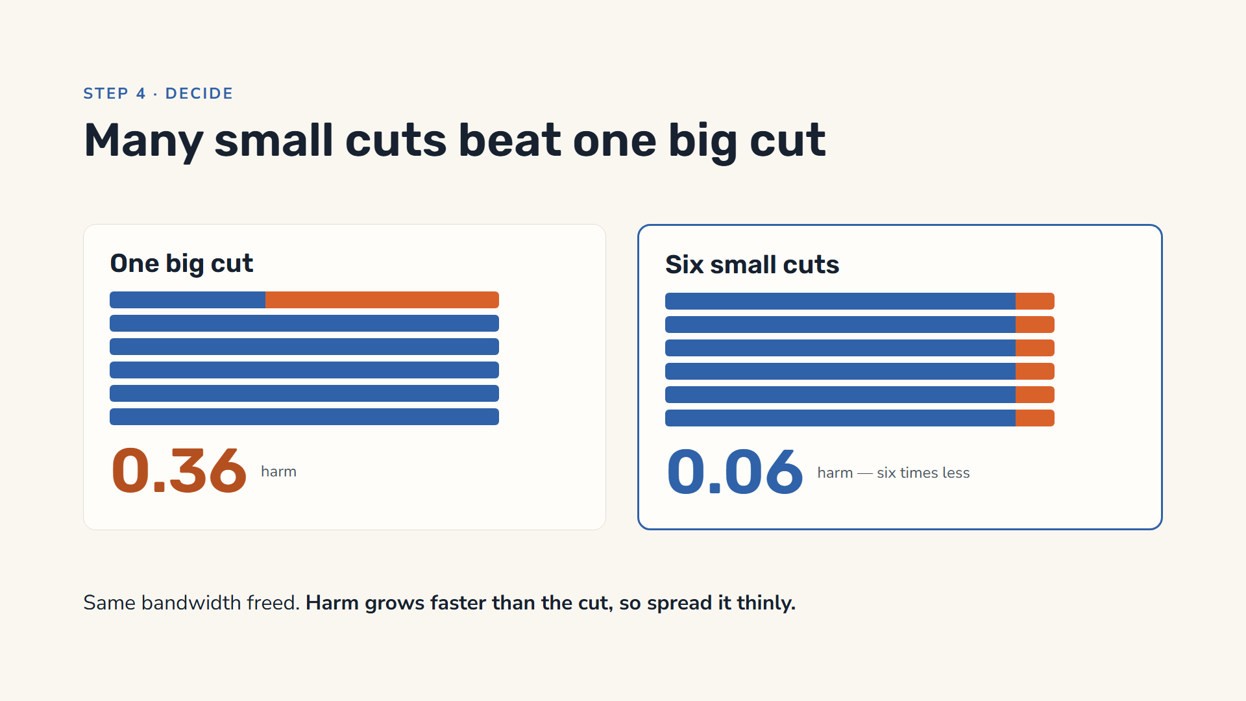
Notes:
Orange is bandwidth taken, blue is what remains. Both plans free exactly the same amount. But harm grows faster than the size of the cut — think of it as the cut squared. One slice cut by 60 percent: 0.6 times 0.6 is 0.36. Six slices cut by 10 percent each: six times 0.01 is 0.06 — six times less harm. So the engine keeps handing the next small piece of the cut to whichever slice it hurts least right now. In the real engine the steepness of each curve comes from the department’s recovery tolerance. Mathematically this is a convex optimisation solved by water-filling; the docs call our algorithm CBHA, Convex Business-Harm Arbitration.

Slide 17
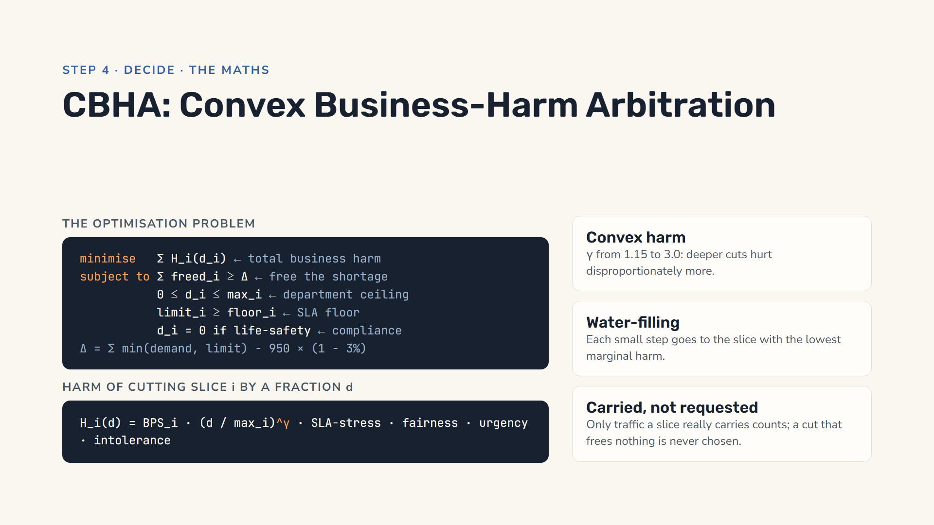
Notes:
Formally, choose a degradation fraction d for each slice to minimise total business harm, subject to freeing the shortage, never exceeding each department’s ceiling, never crossing a slice’s floor, and never touching life-safety slices. One change matters on a real link: a slice can never carry more than its limit, and the rest of what it asks for is dropped in its own queue anyway. So the shortage is computed from what the slices can actually carry, the minimum of demand and limit, minus the link with a 3 percent headroom. Cutting a slice that already sends less than its new limit frees nothing, so the engine never picks it. Harm is the business score times the normalised cut raised to a power gamma, between 1.15 and 3, from recovery tolerance, which makes harm convex. The solver is water-filling: repeatedly give the next small step to the slice whose marginal harm per kbps freed is lowest. For a convex problem with one budget constraint, that is optimal up to the step size. A decision takes milliseconds.

Slide 18
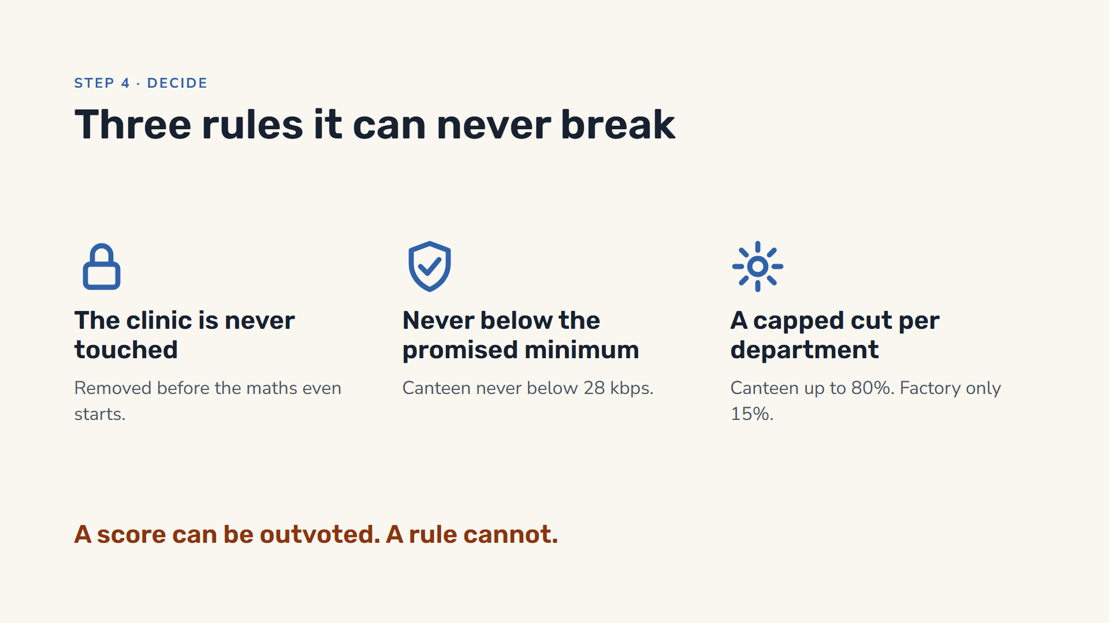
Notes:
Three hard limits. First, life-safety slices like the clinic are taken out of the calculation before it begins, so no combination of numbers can ever cut them. Many systems instead give safety a large weight, but a weight can be outvoted when enough other factors line up; a constraint cannot. Second, every slice has a contractual minimum it never goes below; the canteen screens, for example, never drop below 28 kbps. Third, each department has a maximum cut: 80 percent for the canteen, 20 for the quality lab, 15 for the factory. When those rules leave too little to free, the engine does not break them: it reports a partial plan and alerts the operator.

Slide 19
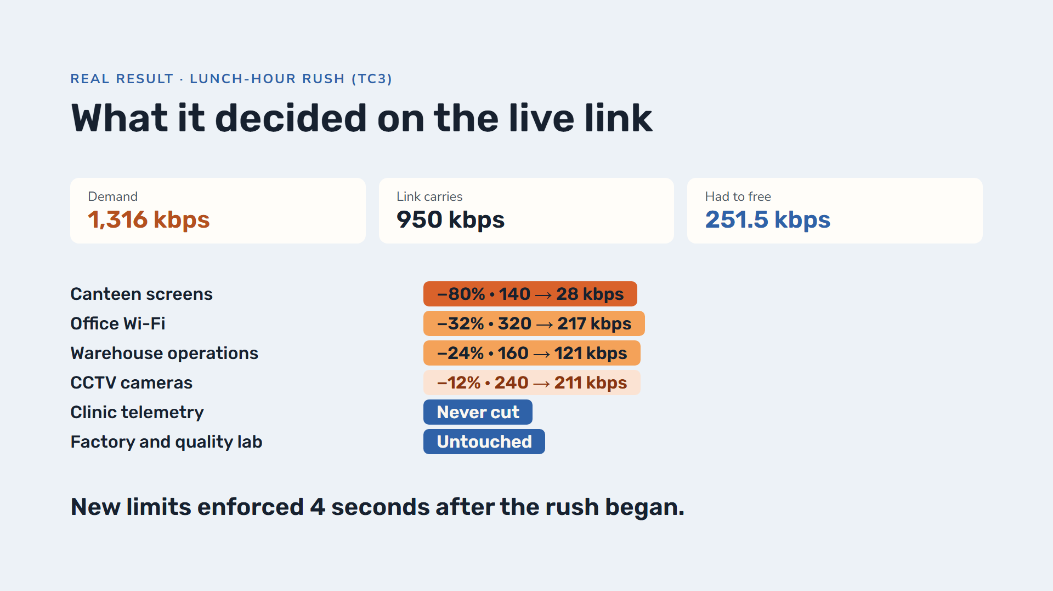
Notes:
This is a real decision from our test run of the lunch-hour rush: the canteen asks for double its share, office and cameras run flat out, the warehouse is busy. Demand reached 1,316 kbps on a 950 kbps link. Under the current limits the slices could carry 1,173 kbps, so 251.5 kbps had to be freed, including the 3 percent safety margin. The canteen gave up 80 percent, down to its 28 kbps minimum. Office Wi-Fi was cut to 217, the warehouse to 121, the cameras to 211. The clinic was never cut, and the factory and quality lab were untouched. Notice: the canteen’s premium URLLC label did not protect it, and the lab’s standard eMBB label did not expose it. The gateway was enforcing the new limits four seconds after the load changed.

Slide 20
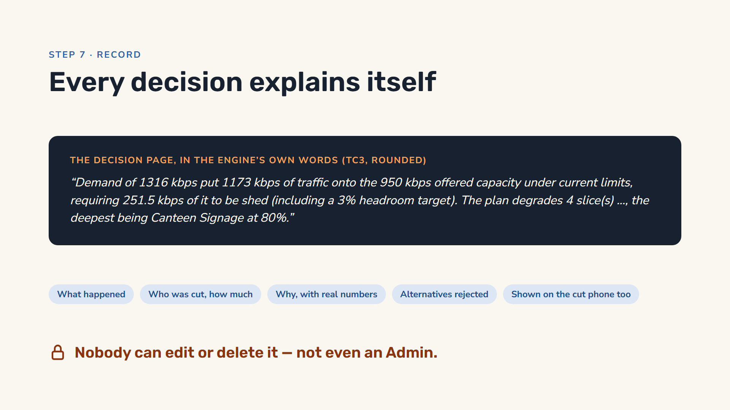
Notes:
If a department head asks why their system was slowed at lunch, the answer is a page in the app, not a guess. The text here follows the engine’s own summary template, with the numbers from our lunch-rush run rounded. Each decision records what was happening, who was cut and by how much, why in plain sentences with real numbers, the alternative plans it priced and rejected, and the rules in force at that moment. And in this testbed the department sees it too: the phone of a slice that was cut shows the explanation on its own page. The record is append-only: there is no edit or delete button anywhere, even for administrators.

Slide 21
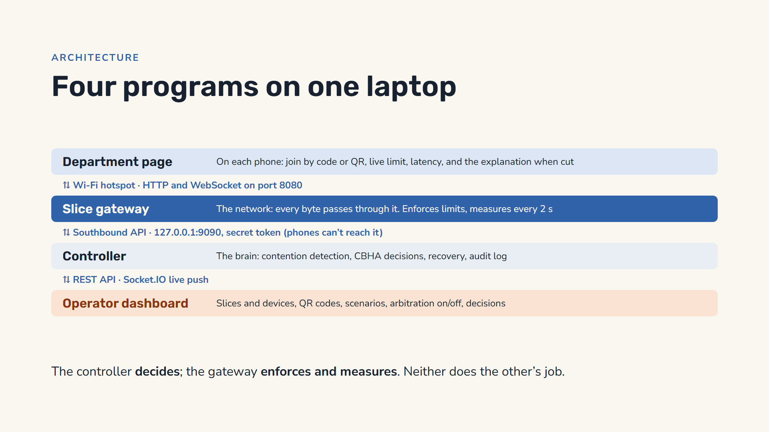
Notes:
The testbed is four programs on one laptop. Each phone opens the department page, served by the gateway over the hotspot on port 8080; it joins a slice, starts a download at the rate it chooses, and sends small probes to measure latency. The slice gateway is the network: every byte the phones download passes through it, it enforces each slice’s limit and the shared 1 Mbps link, and it measures every two seconds. The controller is the brain: it reads those measurements over a private API on the laptop’s loopback address, protected by a secret token, so phones cannot reach it; it detects contention, runs the CBHA engine, pushes new limits back and records everything. The operator dashboard is where we watch it, show QR codes, run scenarios and read decisions.

Slide 22
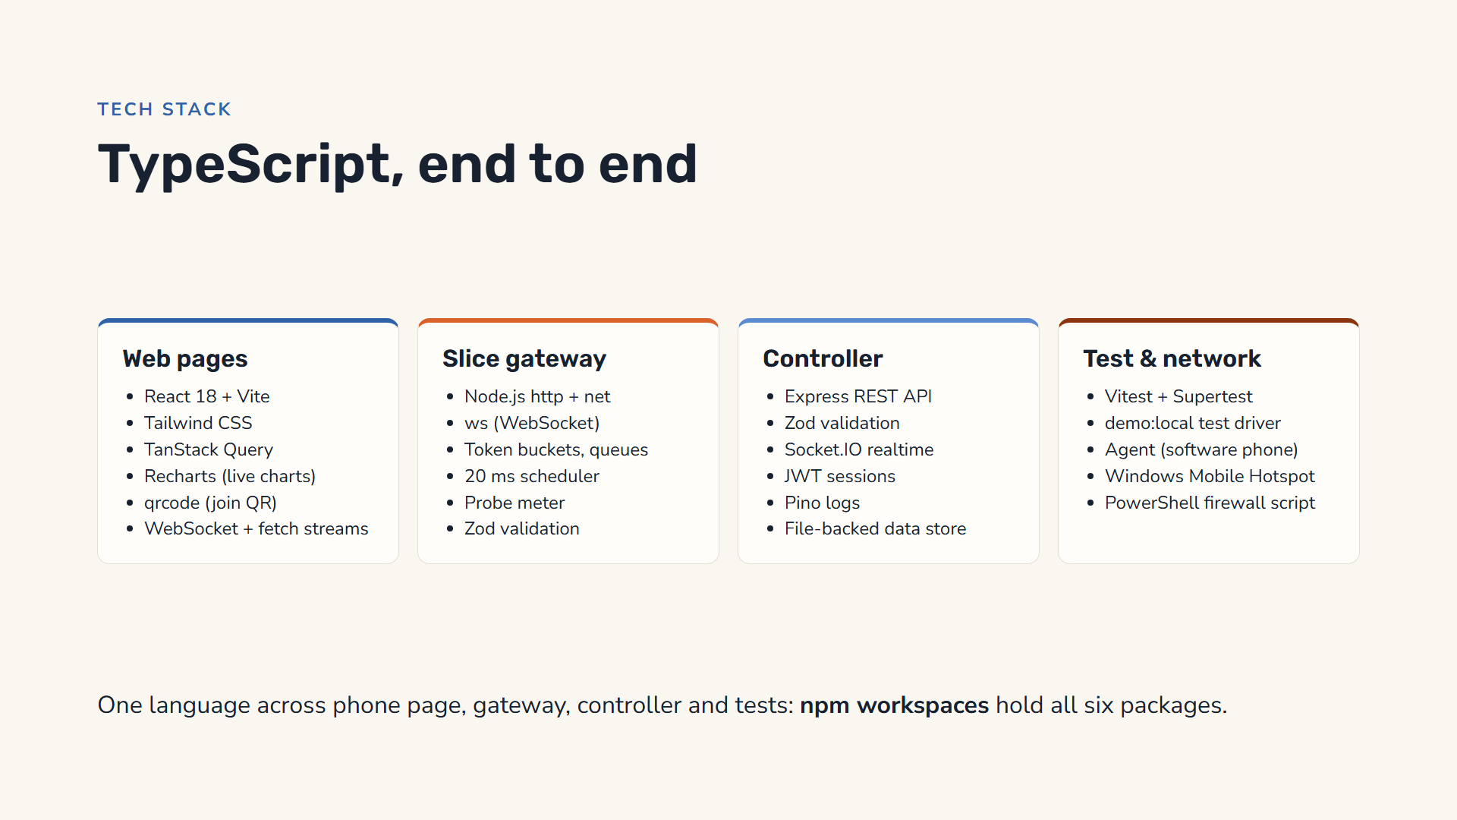
Notes:
Everything is TypeScript. The two web pages, the operator dashboard and the department page on the phones, are React 18 built with Vite, styled with Tailwind, with TanStack Query for server data, Recharts for live charts and the qrcode library for join codes; the phone page talks to the gateway with a WebSocket and a streaming download. The slice gateway is plain Node.js, using its built-in HTTP and network modules and the ws WebSocket library; it contains our token buckets, queues, a 20 millisecond scheduler and the probe meter. The controller is Express with Zod validation, Socket.IO, JWT sessions, Pino logging and a data store saved to a file. Tests use Vitest and Supertest; a test driver runs six test cases end to end, and a small agent program acts as a phone when we do not have seven real ones. On the network side we use Windows Mobile Hotspot and a PowerShell script that opens the firewall for the local network only.

Slide 23
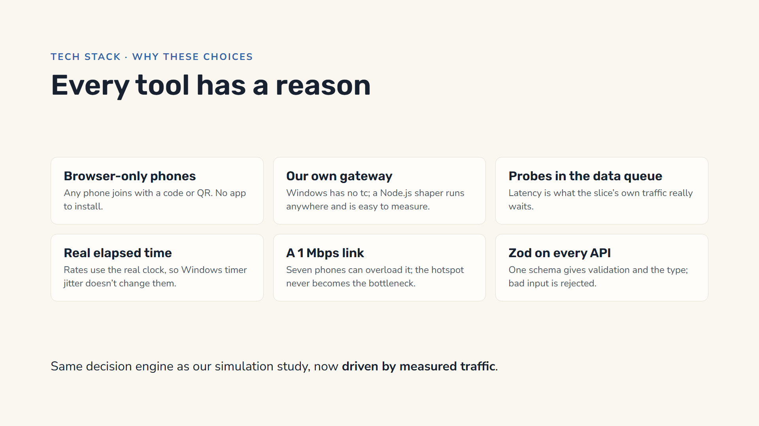
Notes:
Each choice was made for a reason. Phones only need a browser: any phone can join by typing a code or scanning a QR, with nothing to install. We wrote our own gateway because Windows has no Linux-style traffic control, and a Node.js shaper runs on any laptop and is easy to instrument. Latency probes go through the same queue as the slice’s data, so the latency we report is exactly what that slice’s traffic waits. Rates are computed from real elapsed time, so the uneven Windows timers do not change them; we measured the shaper within a quarter of a percent of its limit. The link is scaled to 1 Mbps so seven phones can overload it while the Wi-Fi itself stays far from full. And every API input is checked with Zod.

Slide 24
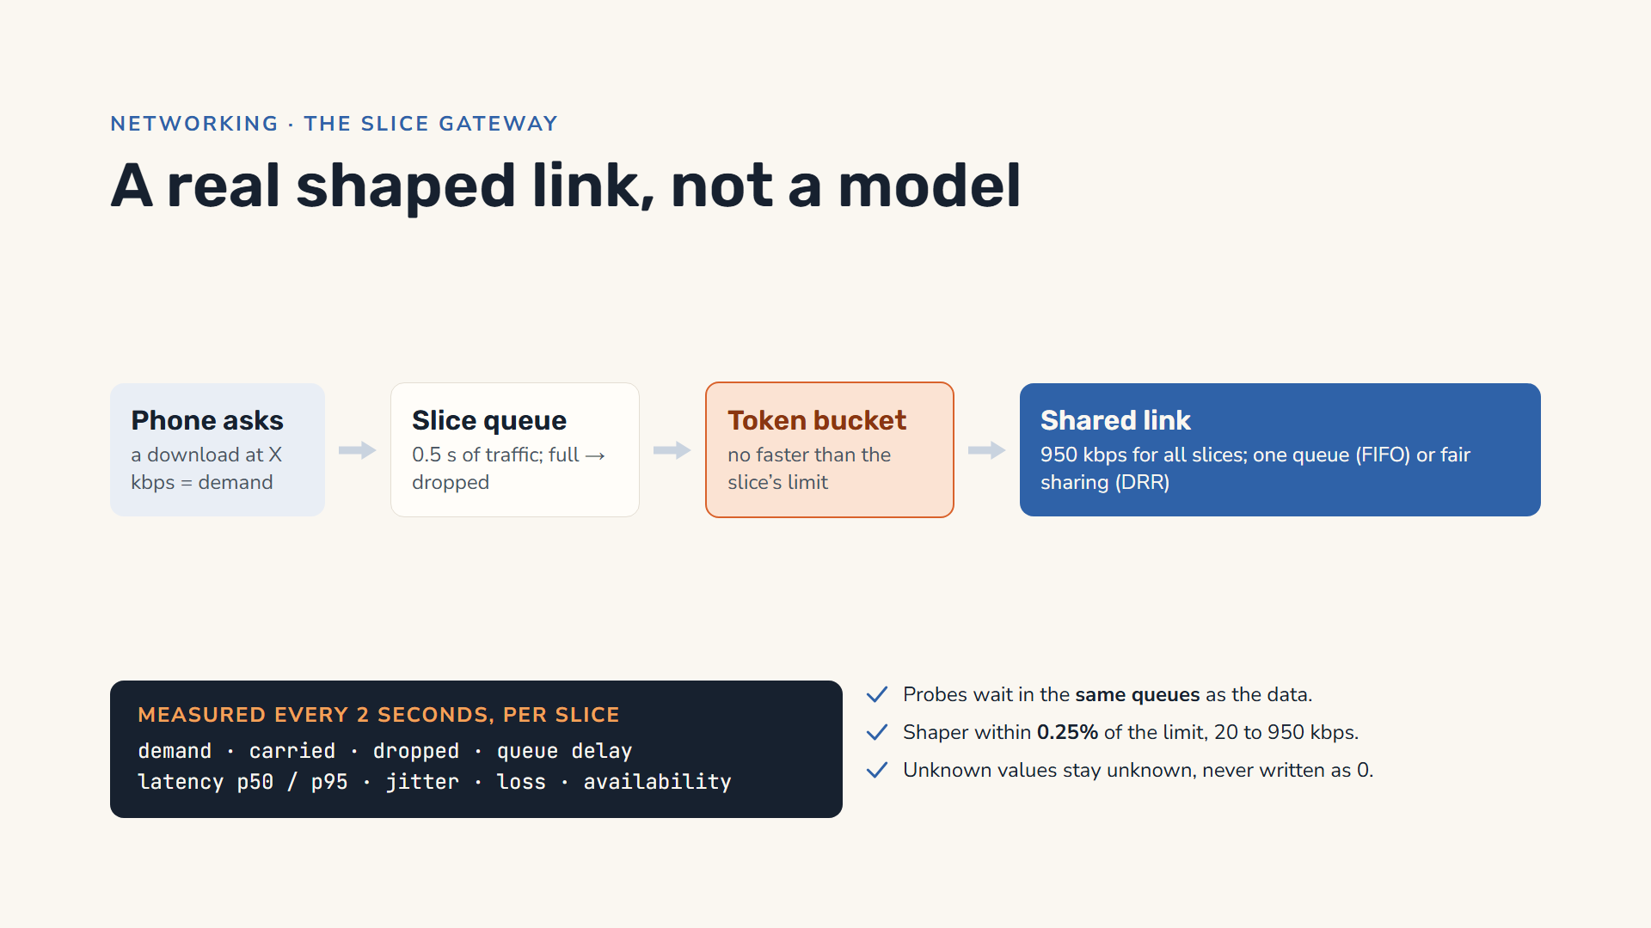
Notes:
This is the heart of the testbed, and the big difference from a simulation. When a phone asks for a download at some rate, that rate is the slice’s demand, and the bytes really flow. Every 20 milliseconds the gateway runs three steps. The bytes go into the slice’s own queue, which holds half a second of traffic; if it is full, bytes are dropped. A token bucket lets them out no faster than the slice’s limit. Then all slices share one link of 950 kbps. With the default setting that is one shared queue, like a plain switch port; we also built fair sharing, deficit round robin, as an option. Every two seconds the gateway records each slice’s demand, carried rate, drops, queueing delay, latency, jitter, loss and availability. The latency comes from small probes that wait in the same queues as the data, so it is what the slice’s traffic really experiences. We measured the shaper: within a quarter of a percent of its limit at every speed we tested.

Slide 25
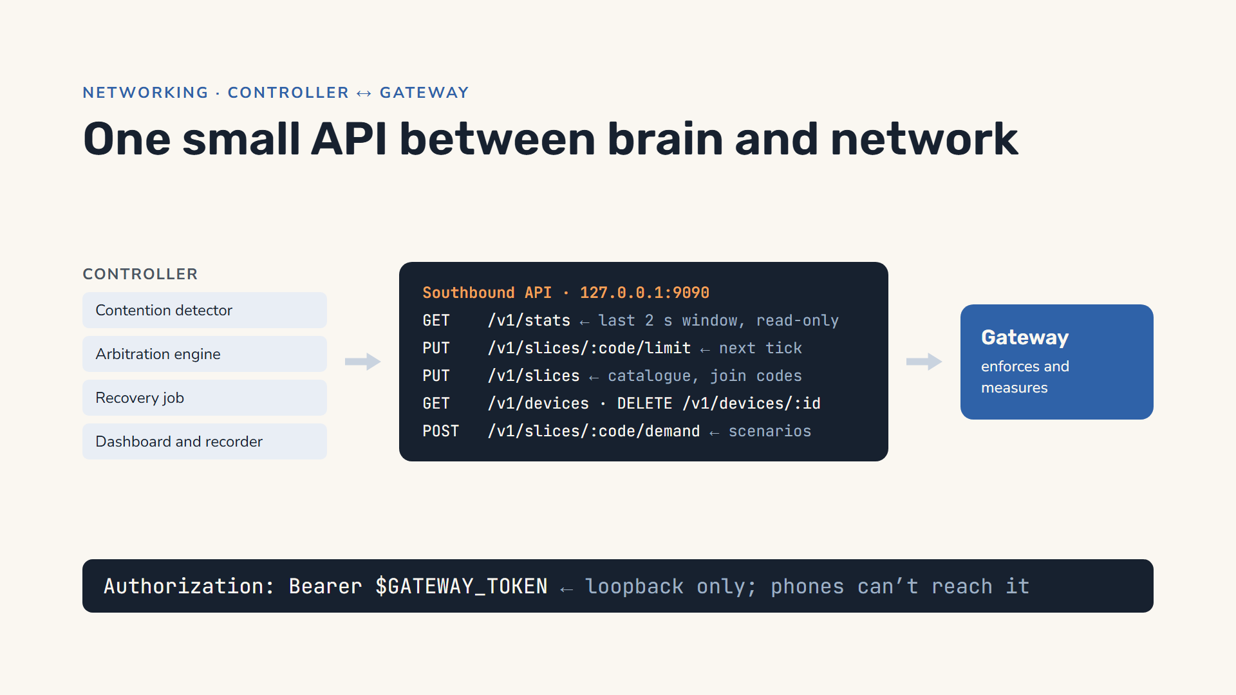
Notes:
The controller and the gateway talk through one small API, the southbound API. The controller reads the last completed two-second window with GET stats; it is read-only, so the controller, the dashboard and the recorder all see exactly the same numbers. It sets a new limit with one PUT per slice, which the gateway applies on its next 20 millisecond tick. It sends the slice catalogue with the join codes, lists and removes devices, and the dashboard’s scenario buttons set every device’s demand through it. The API listens only on the laptop’s loopback address and needs a secret token, so a phone on the hotspot cannot change any limit. If the gateway restarts, the controller notices within three seconds and sends the catalogue again with the current limits.

Slide 26
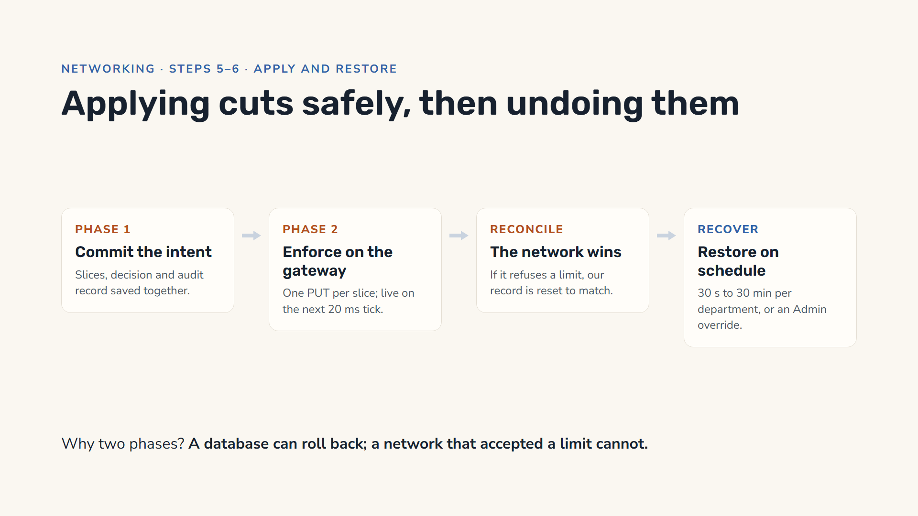
Notes:
Applying a decision touches two systems: our data store, which can roll back, and the network, which cannot; you cannot un-send a limit the gateway has already applied. So it happens in two phases. Phase one commits the intent: the slice changes, the decision and its audit record are saved together. Phase two pushes the new limits to the gateway, one request per slice, and they take effect on the next 20 millisecond tick. If the gateway refuses one, we reconcile: the gateway’s value wins and our record is corrected, otherwise every later decision would be computed against a fiction. Recovery runs on its own schedule, restoring each slice when its department’s recovery window ends, from 30 seconds for zero-tolerance departments to 30 minutes for the canteen; an administrator can also override a decision at once, giving a reason, and that is audited too.

Slide 27
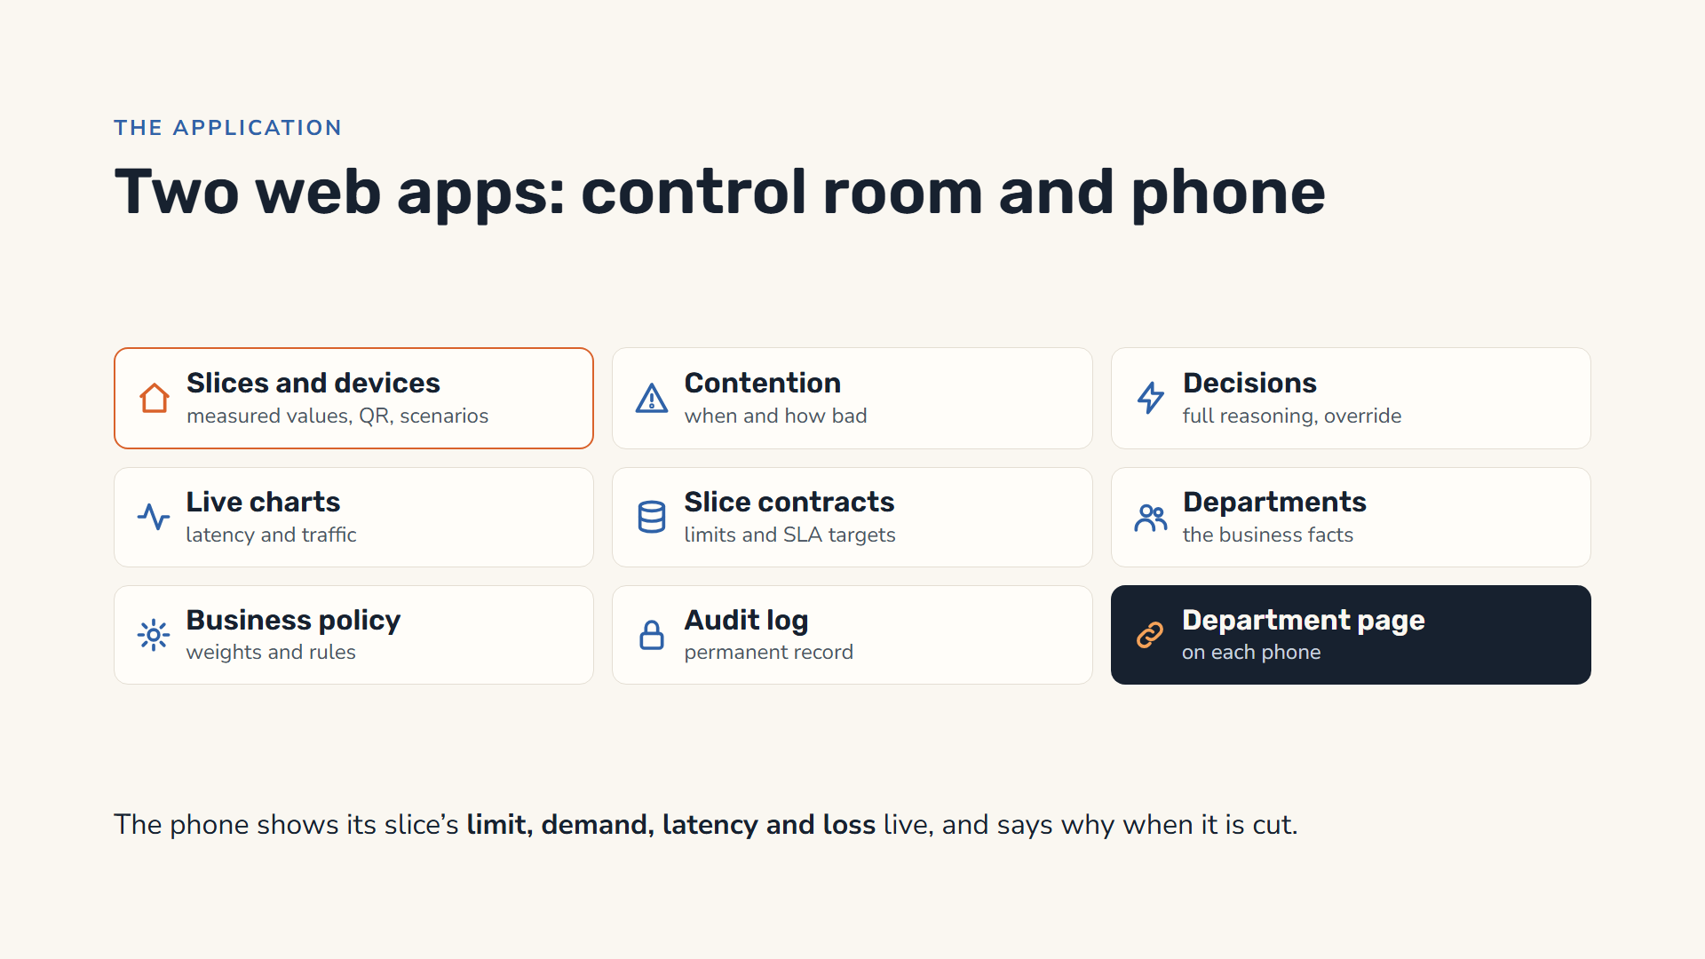
Notes:
There are two web apps. The operator dashboard is the control room. Its home page, Slices and devices, shows every slice with its measured demand, carried traffic, latency and loss, a QR code for each department, the scenario buttons, the switch for automatic arbitration, the list of joined devices and the recording download. Contention and Decisions show when shortages happened and the full reasoning for each decision, with an override for administrators. Live charts plot latency and traffic. Slice contracts, Departments, Business policy and the Audit log hold the rules. The second app is the department page on each phone: it joins with a code, chooses how much to download, and shows its slice’s limit, demand, latency and loss every second, plus the controller’s explanation when its slice is cut.

Slide 28
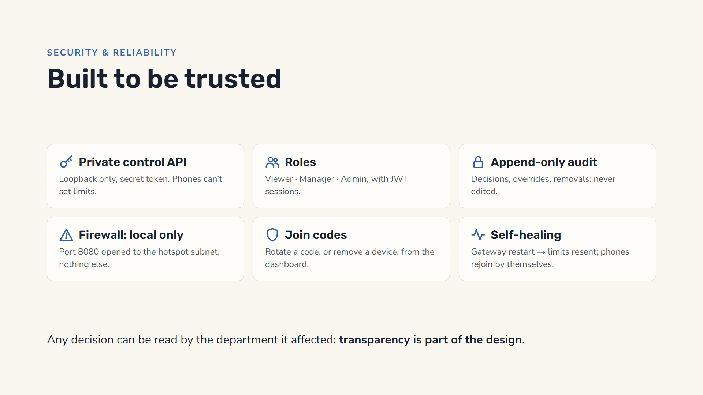
Notes:
Because this system cuts bandwidth for real departments, it has to be trustworthy. The control API that sets limits listens only on the laptop itself and needs a secret token, so a phone on the hotspot cannot change anything. Operators sign in with roles, viewer, manager or admin, and JWT sessions. The audit trail is append-only: decisions, overrides and device removals are recorded and never edited. Our firewall script opens only port 8080, and only to the local network. Join codes can be rotated, and any device can be removed, from the dashboard. And it heals itself: if the gateway restarts, the controller notices and resends the current limits, and each phone page joins its slice again on its own.

Slide 29
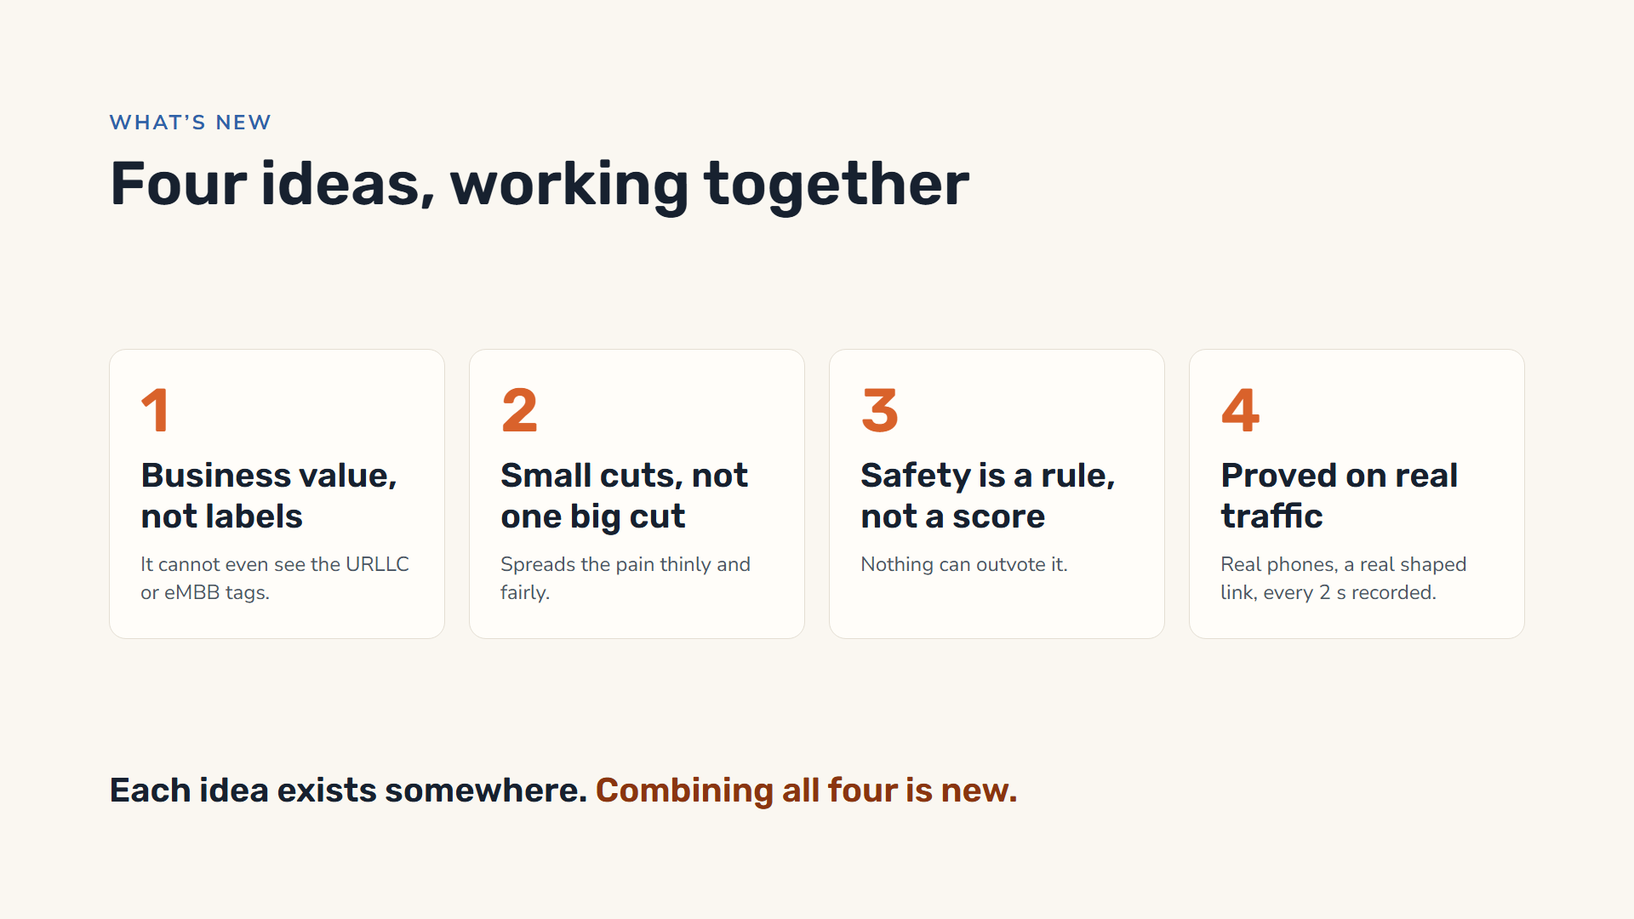
Notes:
Here is what is new. One: it decides by business value, and structurally cannot read network labels; the input has no field for them. Two: a convex harm curve, shaped by each department’s recovery tolerance, spreads small cuts instead of one deep cut, which a priority sort cannot do. Three: life-safety is a hard constraint, removed before optimisation, not a large weight. Four: we did not stop at a simulation. The decisions drive a real shaped link that real devices use, and every two-second window is recorded, so the effect of each decision is measured, not assumed.

Slide 30
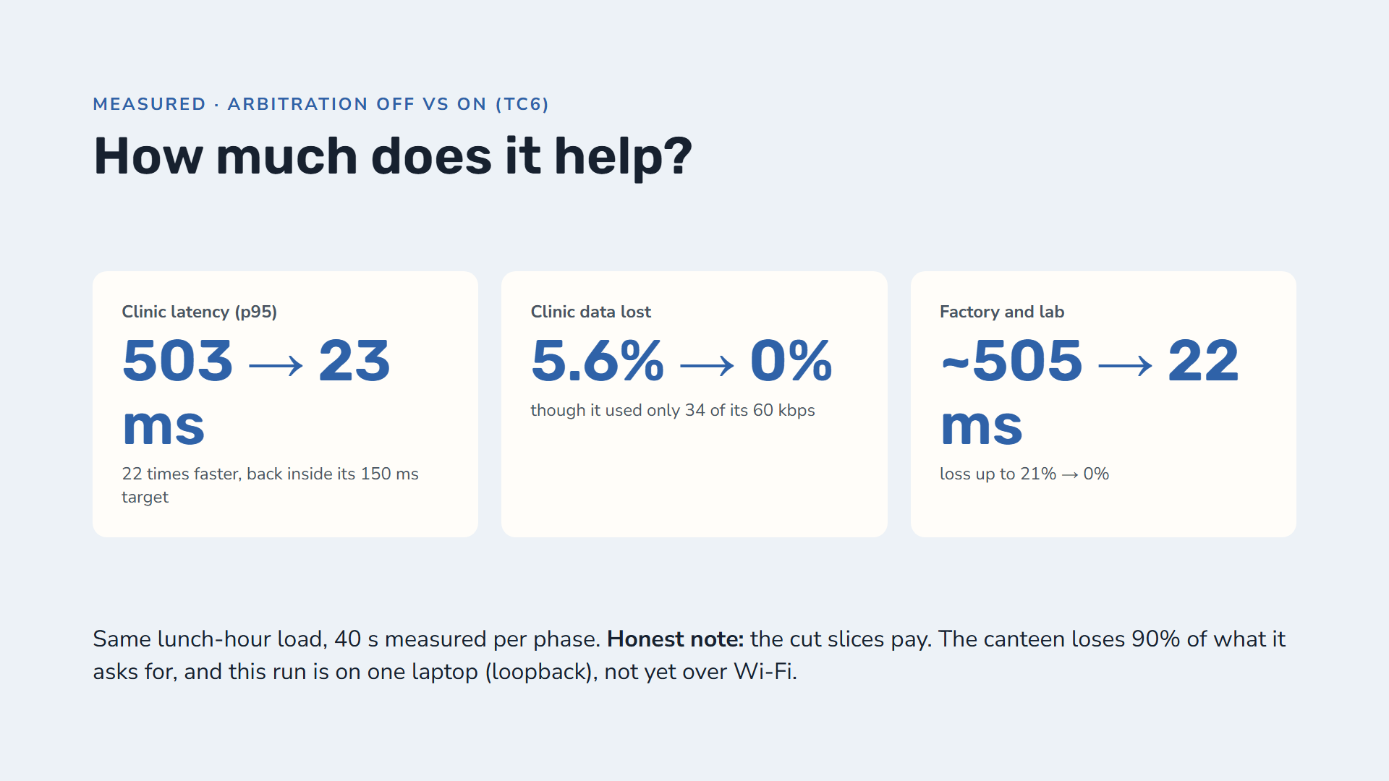
Notes:
This is the proof. We ran the lunch-hour load twice: first with automatic arbitration off, then on, measuring 20 windows of two seconds each time. With arbitration off, the shared link is overloaded and its queue is full, so every slice waits about half a second, even the clinic, which is using only 34 of its 60 kbps, and the clinic loses 5.6 percent of its data. With arbitration on, the engine cuts the cheap slices, the shared queue drains, and the clinic’s latency falls from 503 to 23 milliseconds with zero loss. The factory and the lab recover the same way. Be honest about two things. The slices that were cut pay for it: the canteen asks for ten times its 28 kbps minimum, so 90 percent of its traffic is dropped. And this measurement runs on one laptop over loopback; the phone run over the hotspot is the next measurement.

Slide 31
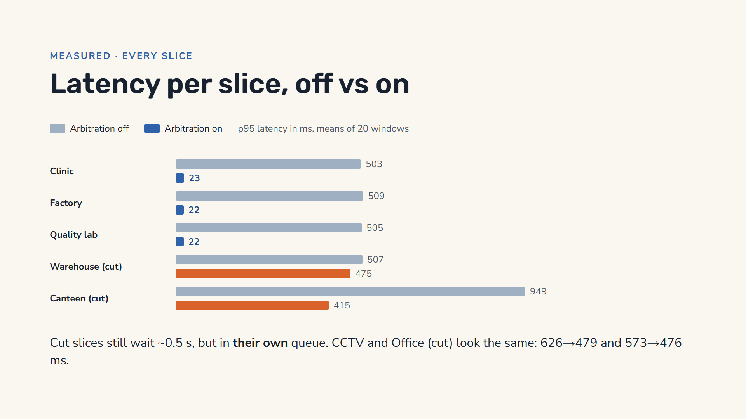
Notes:
Here is every slice from the same run, grey with arbitration off and blue or orange with it on. Off, everyone sits near half a second, and the canteen near a full second. On, the protected slices, clinic, factory and lab, drop to about 22 milliseconds. The slices that were cut, shown in orange, still wait about half a second. That is not the shared queue any more: each now waits in its own slice queue, which holds half a second at its new, lower limit and stays full because it asks for more than its limit. That is exactly where we want the waiting to happen: in the slices the business chose to slow, not in the clinic.

Slide 32
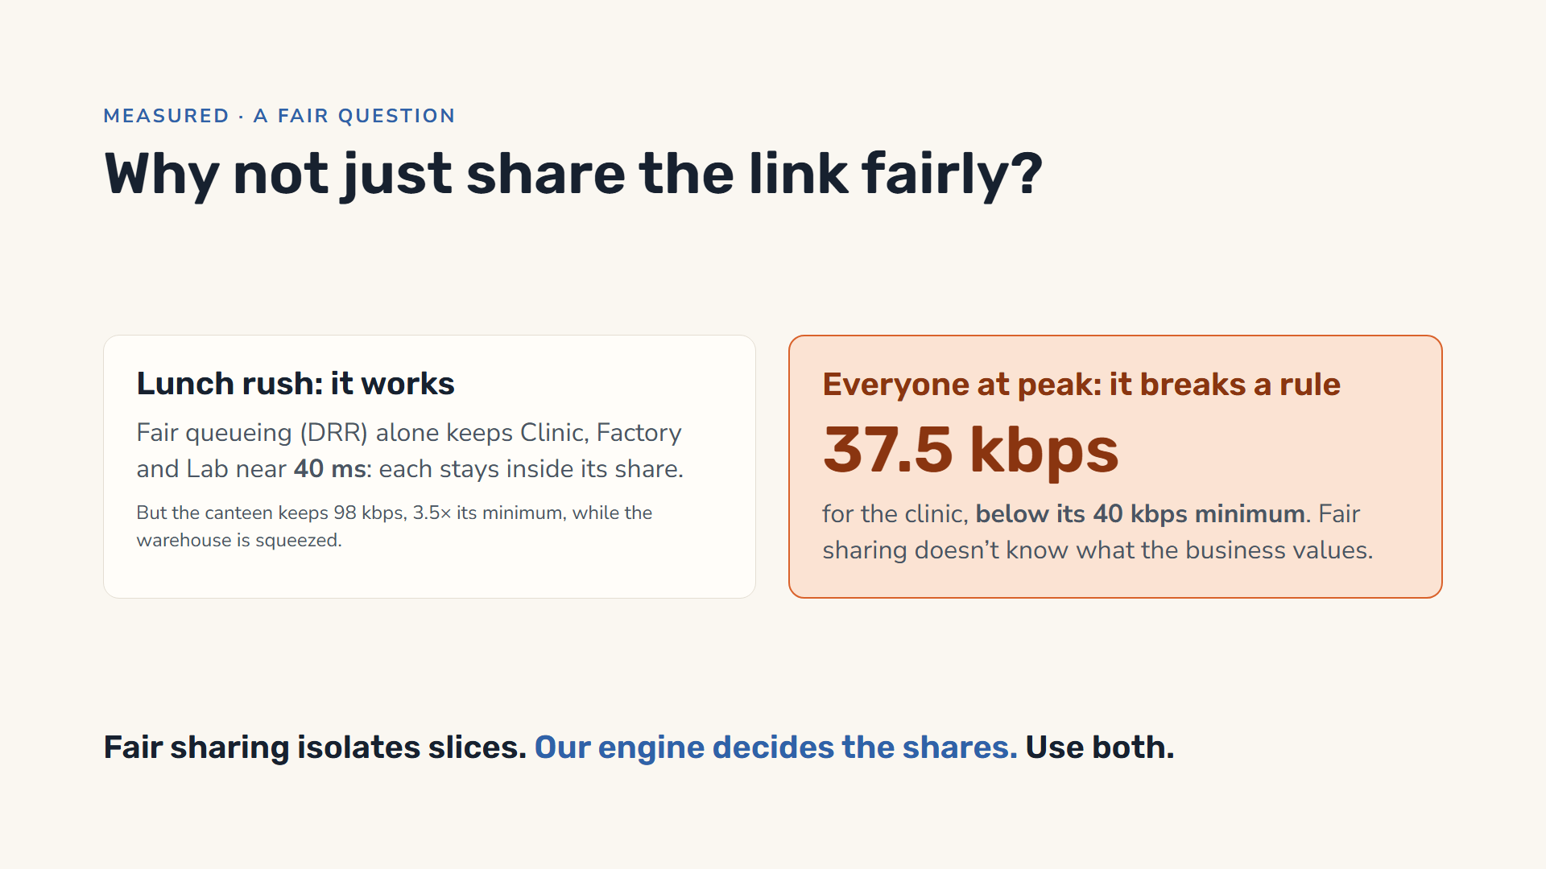
Notes:
A good question from any networking person: why not simply share the link fairly between slices? We built that too, weighted deficit round robin, and measured it with no controller at all. In the lunch rush it works well: the clinic, factory and lab each send less than their fair share, so they never wait behind anyone, and stay near 40 milliseconds. But it is business-blind: the canteen keeps 98 kbps, three and a half times its minimum, while the warehouse, which matters far more, is squeezed. And when everyone is at peak, fair sharing gives each slice a share proportional to its size, which leaves the life-safety clinic at 37.5 kbps, below its 40 kbps contractual minimum. So the two are complementary: fair queueing isolates slices, and our engine decides what the shares should be. We ran the full test cases with both switched on: the protected slices were already fast with fair sharing alone, and arbitration then decided who pays, cutting the canteen to its minimum and reducing loss for the warehouse and cameras.

Slide 33
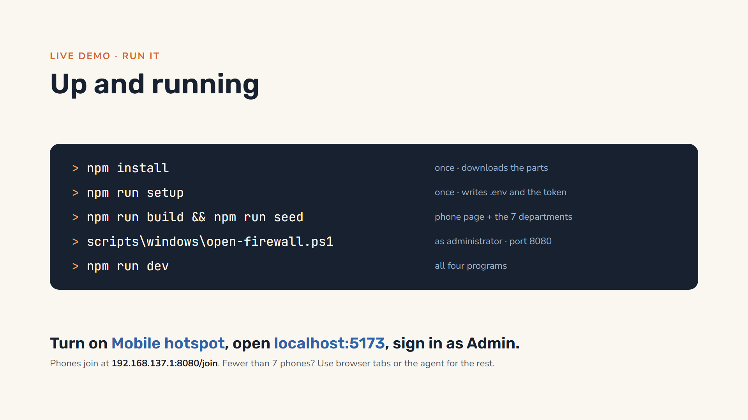
Notes:
Running it needs only Node.js and a Windows laptop. Once: npm install, then npm run setup, which writes the settings file and a secret token, then npm run build so the gateway can serve the phone page, and npm run seed to create the seven departments. Open PowerShell as administrator and run the firewall script, which opens port 8080 for the local network only. Then npm run dev starts all four programs. Turn on the Windows Mobile Hotspot, open localhost 5173 on the laptop and sign in as Admin. Phones connect to the hotspot and open 192.168.137.1 port 8080 slash join, or scan the QR code. If we have fewer than seven phones, browser tabs on the laptop or the agent program fill in the other departments.

Slide 34
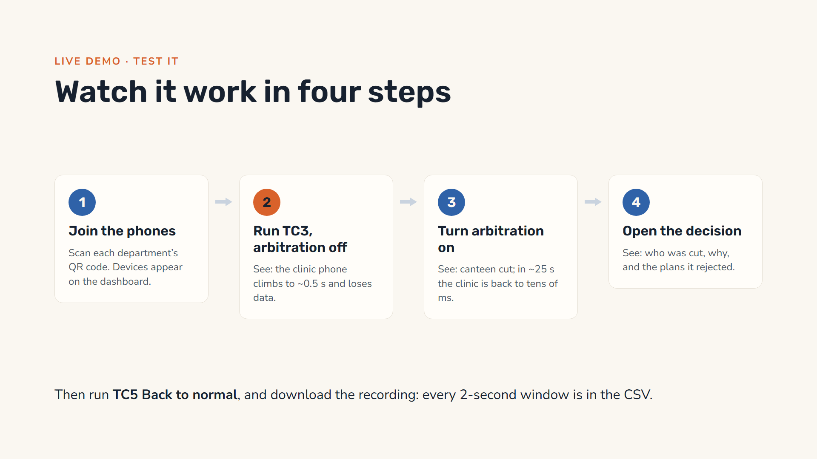
Notes:
This is the live demo. One: each department’s phone scans its QR code from the dashboard and appears in the devices list. Two: press Run on TC3, the lunch-hour rush, and switch automatic arbitration off. Within a minute the clinic phone’s latency climbs to about half a second and it starts losing data, although its own limit has not changed: everyone is stuck in the same full queue. Three: switch arbitration on. Within a few seconds the engine cuts the canteen and the other cheap slices; after about 25 seconds the shared queue has drained and the clinic is back to tens of milliseconds with no loss. Four: open the newest decision and read the explanation and the alternatives it rejected; the canteen phone shows its own explanation too. Finally run TC5 to return to normal, and download the CSV recording of the whole demo.

Slide 35
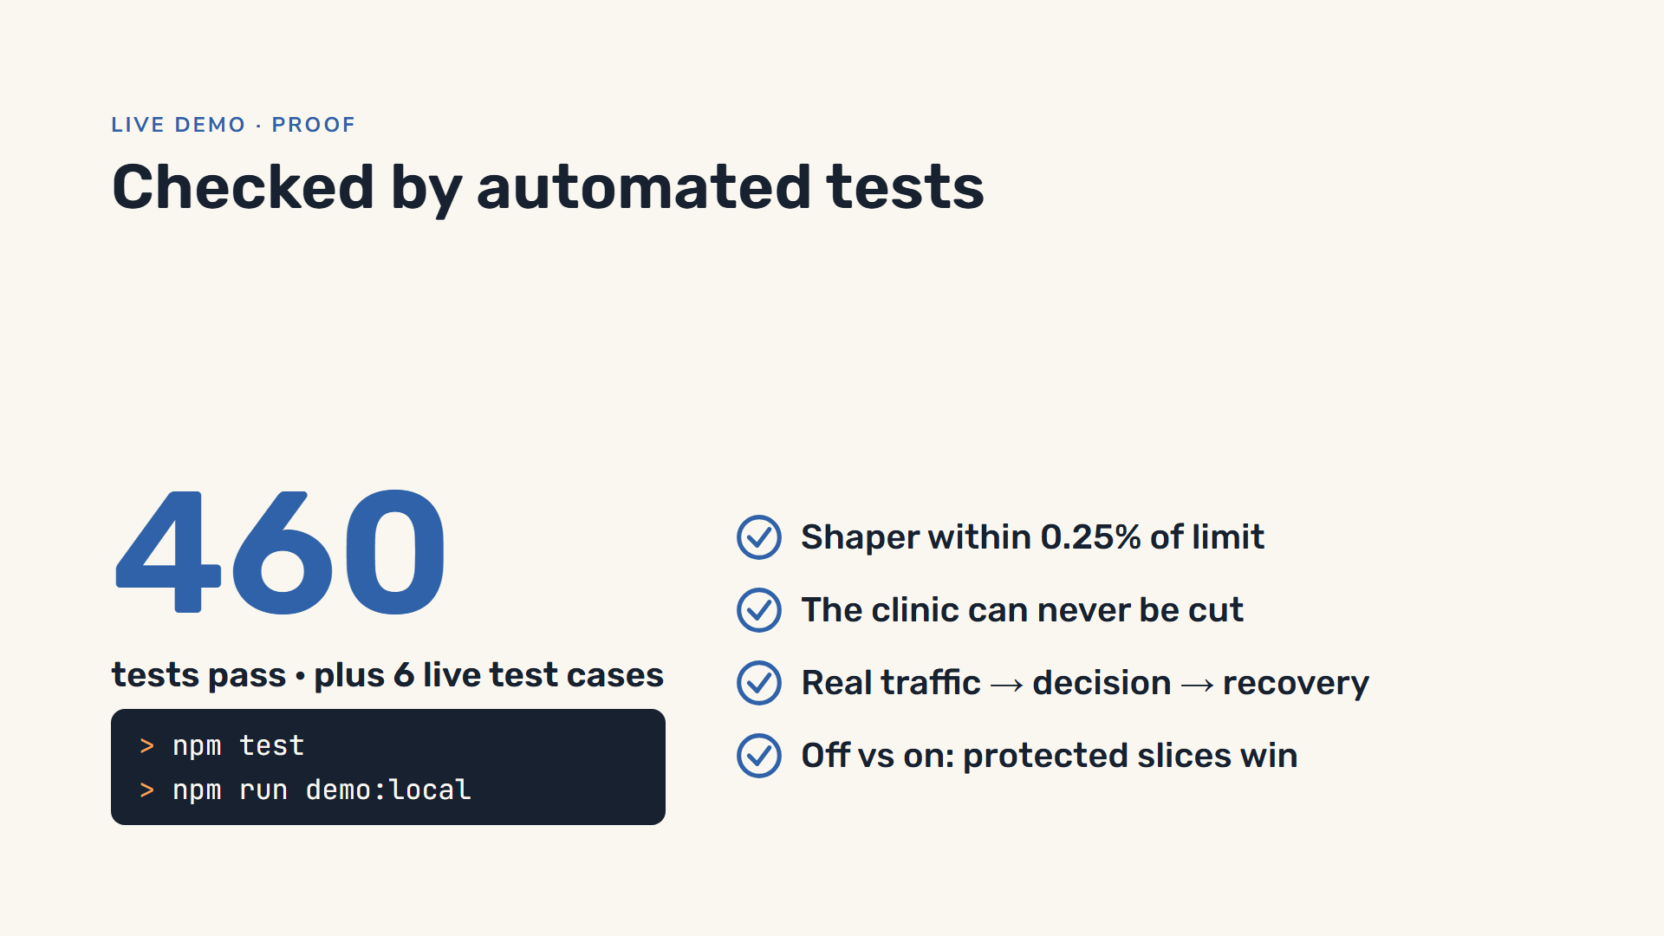
Notes:
The strongest evidence is the tests. npm test runs 460 automated tests, 443 for the controller and 17 for the gateway, with 50 cloud-database tests skipped. The gateway tests check that the shaper holds its rate within three percent, that the shared link is never exceeded, that a full shared queue hurts every slice, that fair sharing isolates and weights slices correctly, and that the control API needs its token. Then npm run demo:local runs the six test cases end to end on real traffic: normal day, canteen flood, lunch rush, everyone at peak, recovery, and arbitration off versus on. All six pass with the default link. While building it we found and fixed real bugs, for example a fair-sharing mode that did not actually isolate slices, and added a test for each.

Slide 36
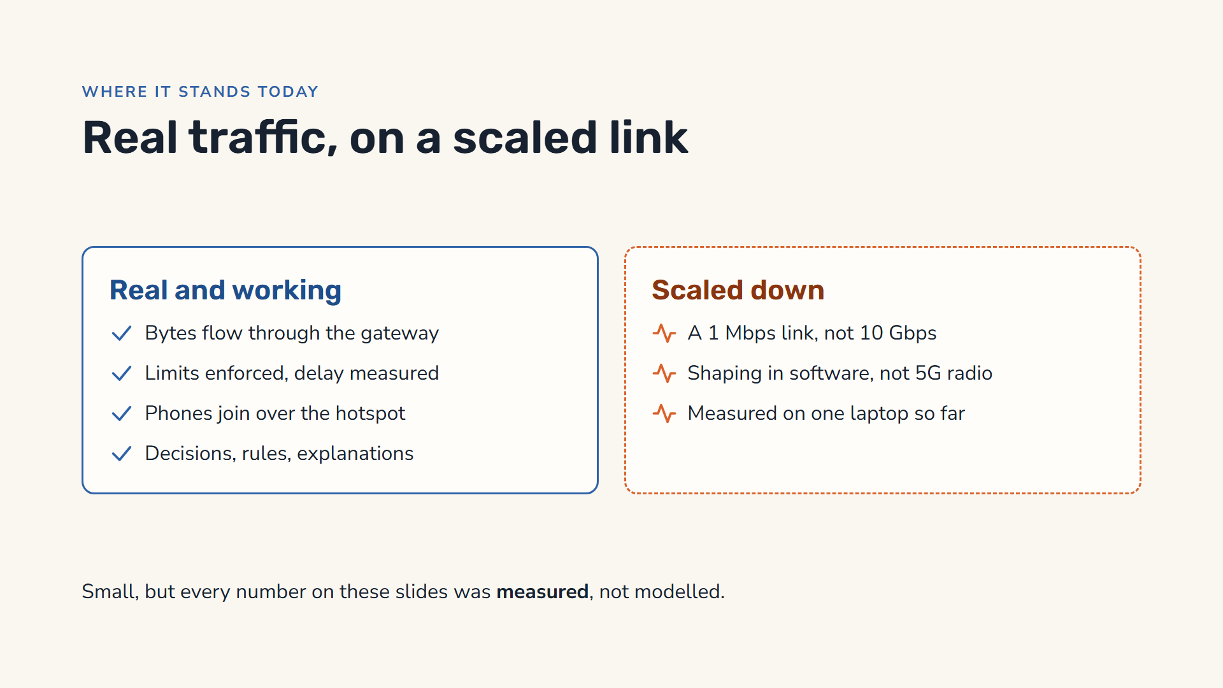
Notes:
Let’s be honest about where it stands. What is real: bytes really flow through our gateway, the limits are really enforced, the delay and loss are really measured, phones really join over the laptop’s hotspot, and the decisions, rules and explanations are the full working system. What is scaled down: the link is 1 megabit per second, not 10 gigabits, so seven phones can fill it; the shaping is done in our own software, not in a 5G radio or a kernel; and the measured results so far come from software agents on one laptop, over loopback. The phone run is supported and ready; it is the next measurement.

Slide 37
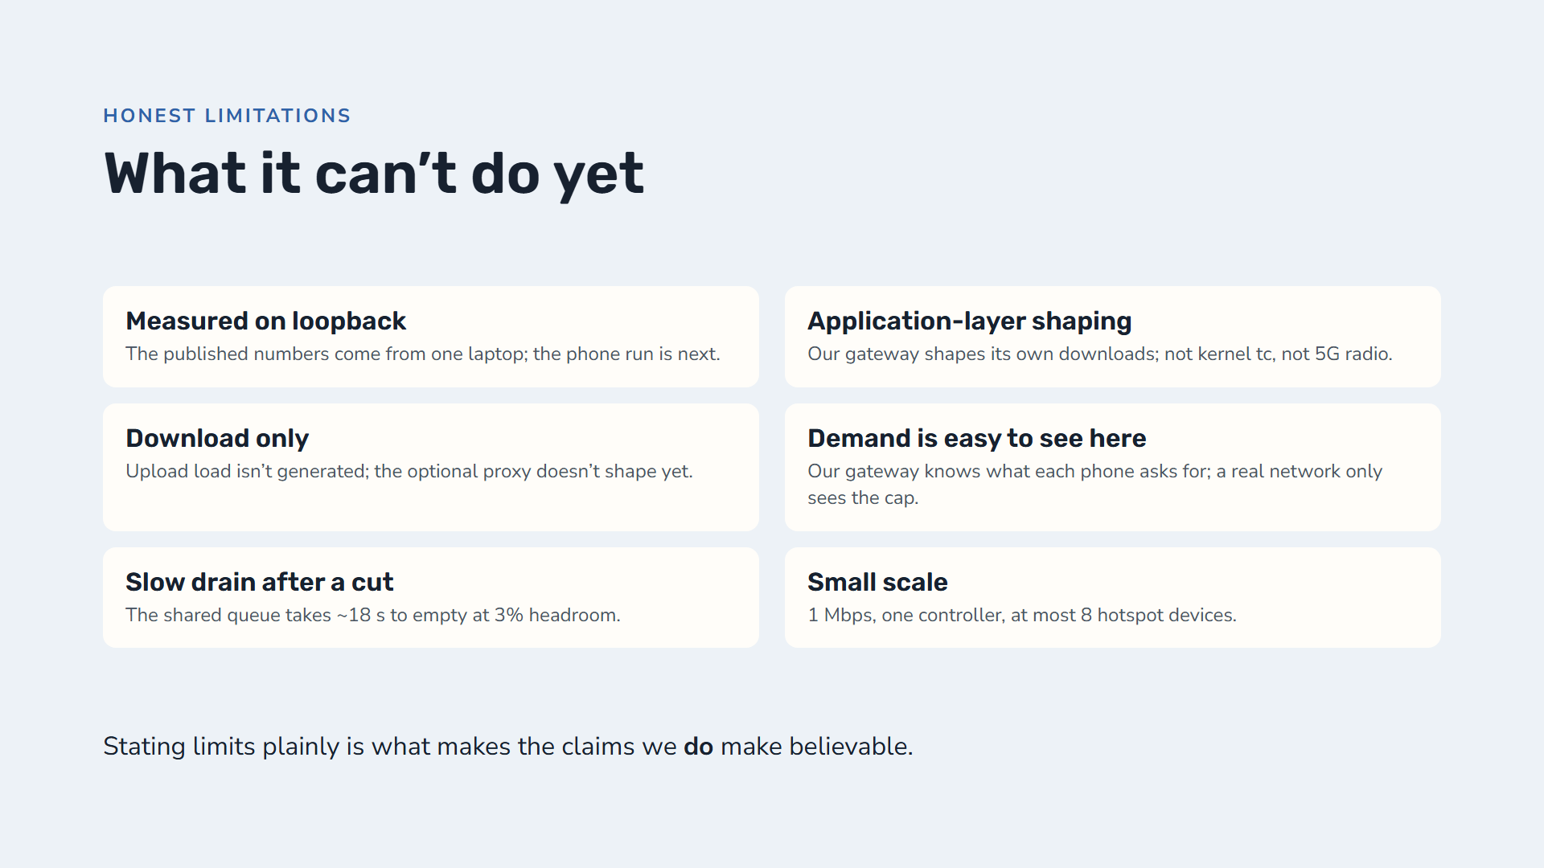
Notes:
We want to be upfront about the limits. The numbers we showed come from software agents on one laptop over loopback; they test the real gateway and control loop but not the Wi-Fi hop, and the phone run over the hotspot is the next measurement. The shaping happens in our own application, on the downloads it generates; it is not Linux kernel traffic control and not 5G radio slicing. Only download load is generated, and the optional proxy for phones’ own apps checks that a device has joined but does not shape its traffic yet. Our gateway can see exactly what each phone asks for, which a real network cannot once a slice is capped. After a cut, the shared queue drains slowly, about 18 seconds, because it only has the 3 percent headroom to drain with; a smaller buffer or active queue management would fix that. And it is small: a 1 Mbps link, one controller, and at most eight devices on a Windows hotspot.

Slide 38
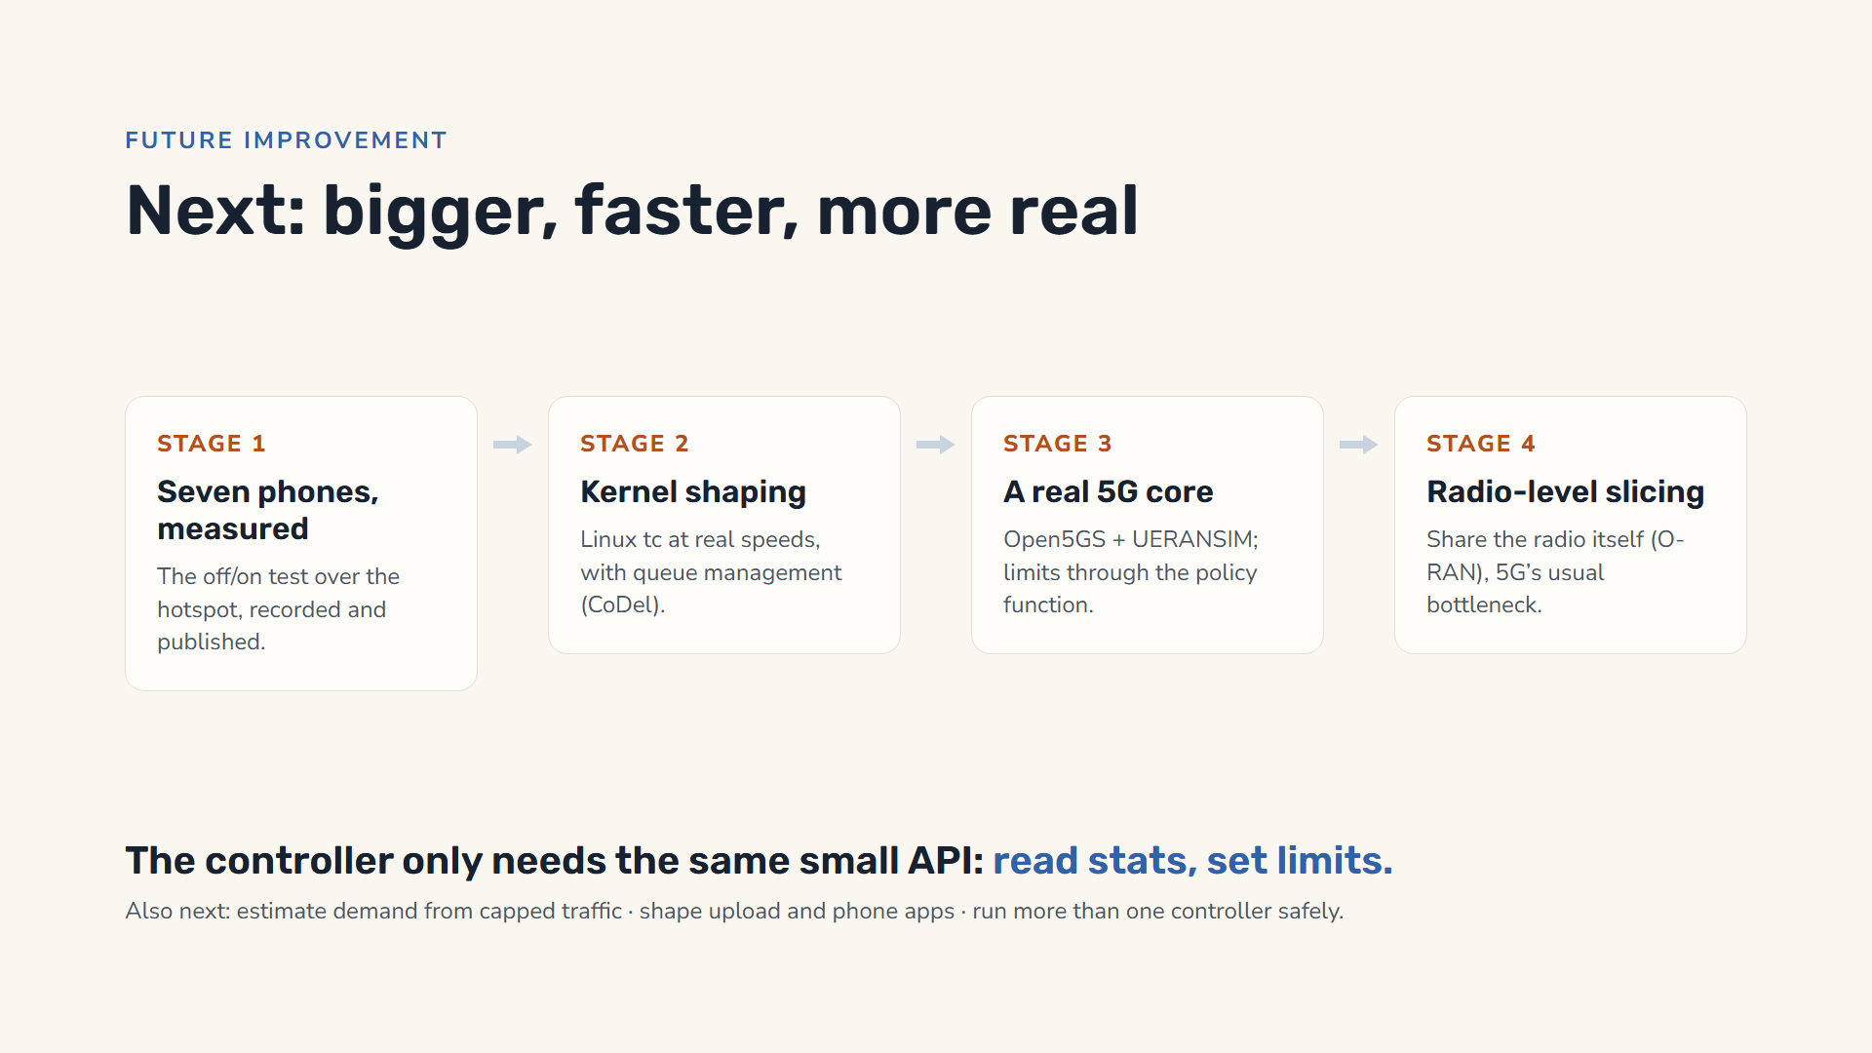
Notes:
Our next steps make it bigger, faster and more real, in four stages. Stage one: run the arbitration off-and-on test with seven real phones over the hotspot and publish those numbers. Stage two: move the shaping into the Linux kernel with traffic control, at real speeds, and add active queue management such as CoDel so the shared queue drains in milliseconds instead of seconds. Stage three: a real 5G core, Open5GS with UERANSIM simulating the phones and radio, with our limits applied through its policy function. Stage four: radio-level slicing through O-RAN. The controller does not need to change much for any of these: it only needs the same two things, read the measurements and set the limits. We also want to estimate demand from capped traffic, shape upload and phones’ own apps, and run more than one controller safely.

Slide 39
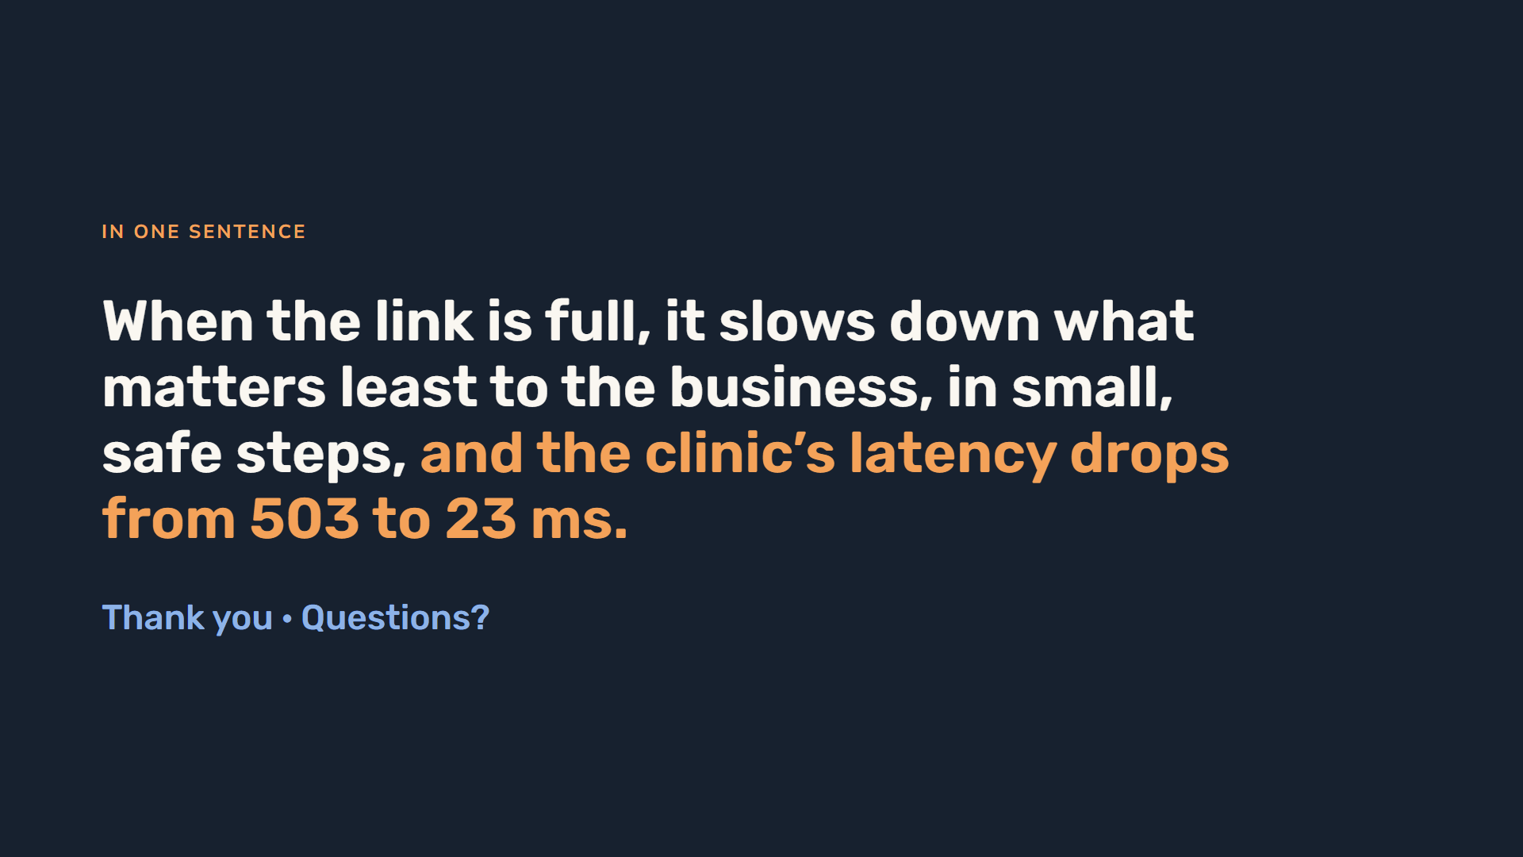
Notes:
To sum up: when a company link is full, our system decides who slows down using business value instead of stale technical labels, spreads the cut across several slices in small steps, never touches life-safety services, and records a permanent explanation of every decision. And this time we measured it on real traffic: with arbitration on, the clinic’s latency dropped from about half a second to 23 milliseconds, with no loss. Thank you; we are happy to take questions, or to show the phones live.

