Slide 1
OpenAI PDF Compiler
Thriambak Giriprakash​

Slide 2
The Purpose
Many documents are full of jargon that is hard to understand and read, having AI summarize what is written will make these documents easier to read and comprehend

Slide 3
Base Components
On-Device PDF Search/Display
Search With ChatGPT API (In progress)

Slide 4
Main Challenges
Getting the API Key to work properly

Slide 5
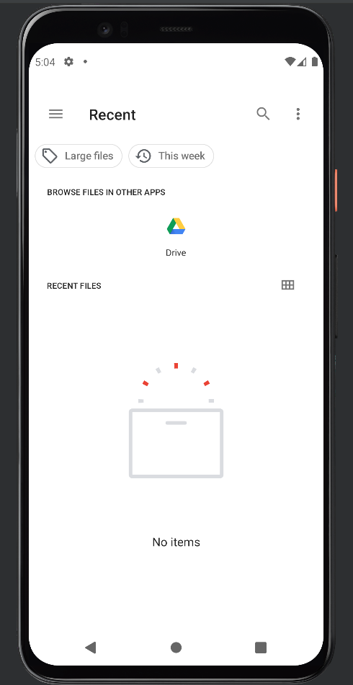
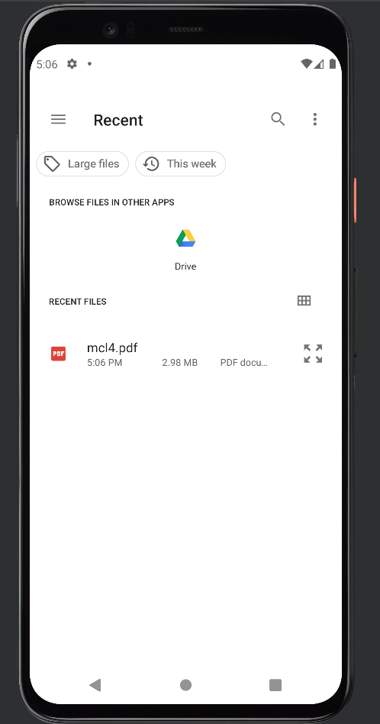
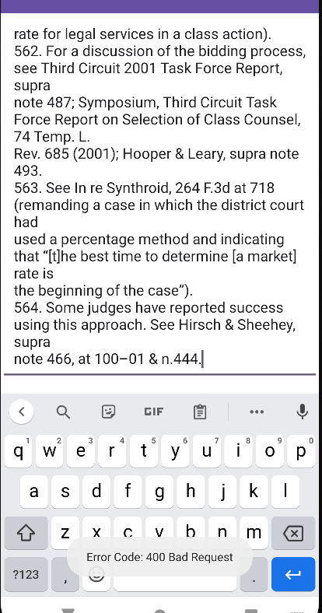
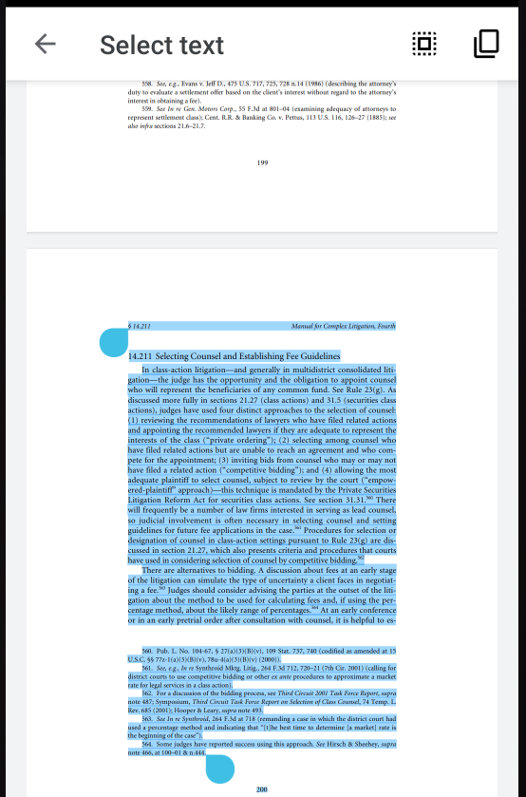
ScreenShots of Progress

