Slide 1
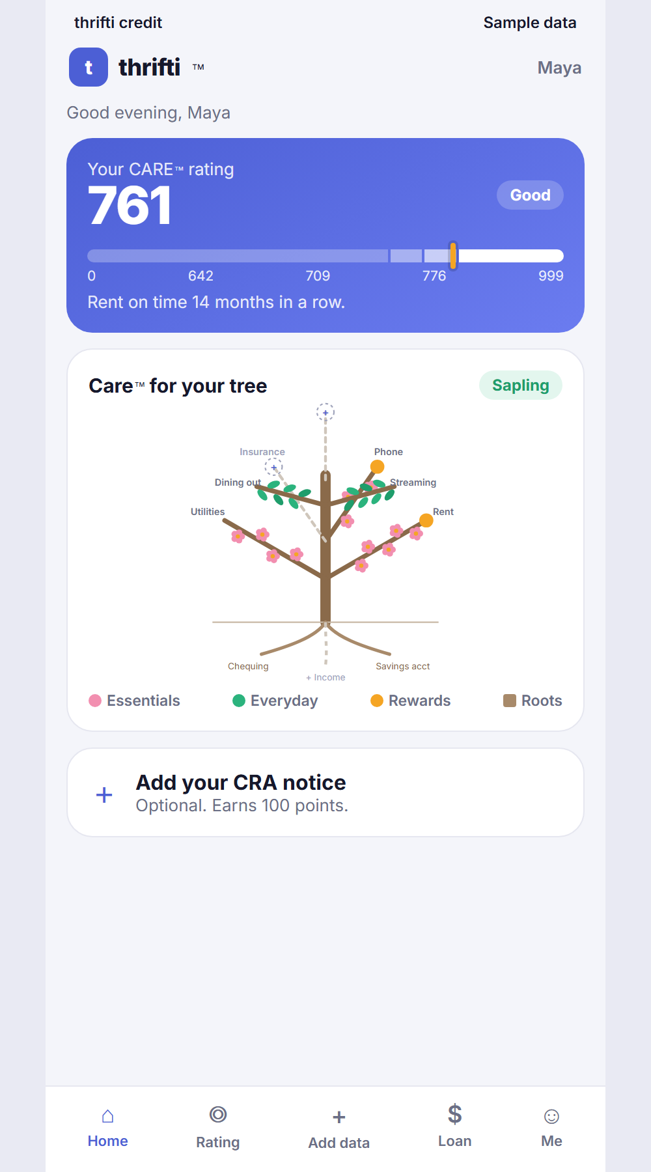
thrifti credit
Your reliability should lower your rate
A credit rating built on rent and bills, and a partner-funded loan that pays off expensive cards
Investor discussion draft | November 2026

Slide 2
For investors: a low-cost way into a large, underserved credit market
1
A market that is under stress
2
A wedge with a clear saving
1.45 million Canadians missed a credit payment in one quarter.
Moving card debt to a lower-rate loan saves the customer real money, which drives sign-ups.
3
Capital-light by design
4
Built already
A partner credit union funds the loans. thrifti owns the customer and the rating.
A working app prototype exists today, made in one week.
Source: Equifax Canada Market Pulse, Q3 2025 (released 26 November 2025).

Slide 3
Canadians are falling behind on credit, and the strain is growing
Public figures today; our survey adds the borrower view
1.45M
$2.62T
1.63%
consumers missed a credit payment in Q3 2025, about 46,000 more than in Q2
total consumer debt, up 3.4% year over year
of non-mortgage balances 90+ days late, up 14% year over year
Stress is sharpest for people aged 26 to 35: their 90+ day rate was 2.45%, up 20.5% in a year.
OUR SURVEY WILL ADD how many people in our audience had their credit fall during the affordability crisis, and why.
Source: Equifax Canada Market Pulse, Q3 2025, equifax.ca newsroom.

Slide 4
Card debt costs about 20% a year, roughly double a good personal loan
On $6,000 of card debt
$195
a month over 3 years at 10.50%
About $1,890 less interest than the same payment on a 21.99% card
OUR SURVEY WILL ADD how much card debt our audience carries and what rate they pay today.
Source: Bank of Canada data cited by FCAC (INDU committee, 25 Nov 2024): card rates 18.86% to 19.35% in 2019, 20.28% to 20.74% in 2024. Loan figures: thrifti sample, standard amortization.

Slide 5
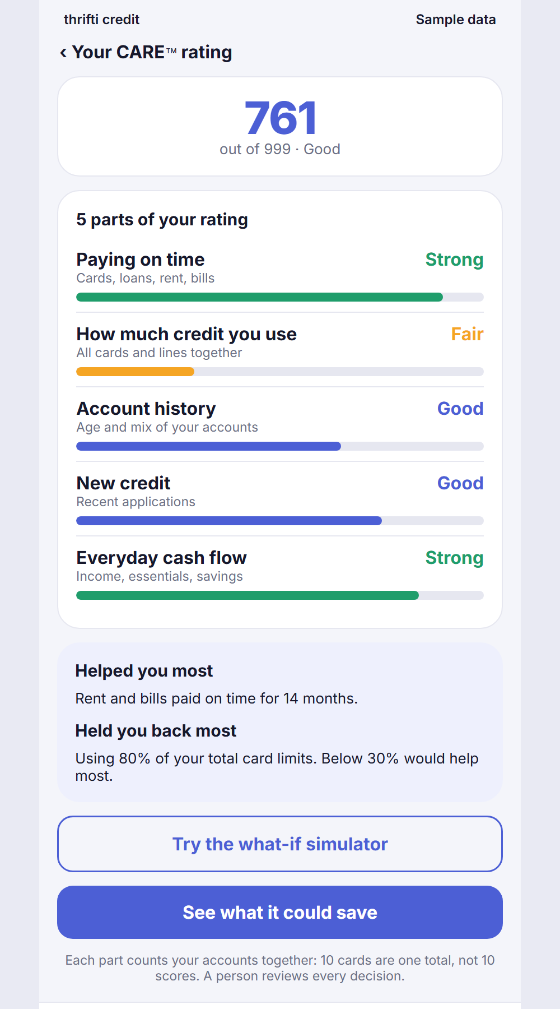
Bureau scores miss how people actually pay; cash-flow data fills the gap
✓
Cash-flow data predicts repayment
FinRegLab found cash-flow measures generally performed as well as traditional credit scores, and often improved risk prediction.
✓
Biggest gains for thin or low-score files
In its 2025 study of 38,000+ loans, gains were largest for low-score borrowers: AUC up 0.015, and 0.023 for the youngest files.
✓
Best used alongside the bureau
Models that combined cash-flow and credit data performed best, so thrifti adds to the core score rather than replacing it.
Source: FinRegLab, The Use of Cash-Flow Data in Underwriting Credit (2019); Sharpening the Focus (June 2025); Advancing the Credit Ecosystem (July 2025). US data.

Slide 6
Lenders that serve thin-file Canadians report high repayment
95%
13,500
historical repayment rate reported by Windmill Microlending over 20 years, lending to newcomers
clients supported by Windmill since 2005
This is Windmill's own reported figure, not an audited one, and it covers a different product. It shows that thin files are not the same as high risk. thrifti's own repayment data will come from the partner pilot.
OUR SURVEY WILL ADD how reliably our audience pays rent and bills, measured against their income.
Source: windmillmicrolending.org (help desk pages and Potential to Prosperity announcement).

Slide 7
Two growing groups need a fairer rating: people under strain, and newcomers
1.45M
380,000
$22,321
Canadians who missed a credit payment in one quarter (Q3 2025)
new permanent residents planned each year, 2026 to 2028, most with thin Canadian files
average non-mortgage debt per Canadian consumer
Launch scope: all of Canada except Quebec. Main audience: people whose credit fell in the affordability crisis. Newcomers are a second group.
OUR SURVEY WILL ADD the share of each group open to switching card debt to a thrifti loan.
Source: Equifax Canada Market Pulse Q3 2025; IRCC 2026 to 2028 Immigration Levels Plan (CIMM briefing, 4 Dec 2025).

Slide 8
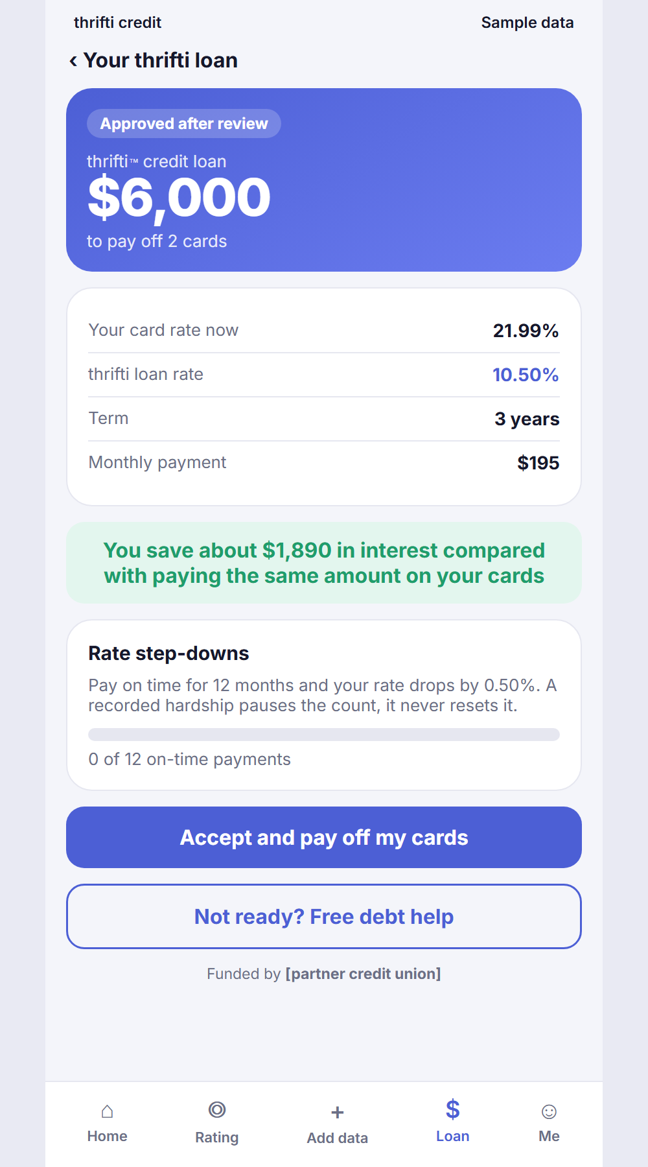
The product: a rating people understand, a tree that grows, and a cheaper loan
Care for your tree: essentials bloom, habits bear fruit
CARE rating in 5 plain parts, with reasons
Loan offer: we apply for you, a person reviews

Slide 9
How it works: thrifti applies, a person decides, a credit union funds
1
2
3
4
Customer shares
CARE rating
Human review
Partner funds
Credit report, cards, and optional rent, bills, CRA notice
Core of 12 standard criteria plus thrifti add-ons
AI prepares the file. A person decides. Never AI alone.
Credit union pays off the cards. Customer repays thrifti loan.
Built to the EU standard for credit scoring: a plain explanation, human review of every decision, no social media or health data.

Slide 10
Why now: open banking is becoming law, and borrowers are under pressure
2026
Consumer-Driven Banking Act enacted (S.C. 2026, c. 3). Key sections start on a date still to be set.
2025
Budget 2025 moved oversight of consumer-driven banking to the Bank of Canada.
Today
thrifti works with uploaded statements now and can connect to banks directly once open banking is live.
Source: Justice Laws Website, Consumer-Driven Banking Act; FCAC Annual Report 2025 to 2026.

Slide 11
Lean to run: the technology costs about $530 a month at launch
Item | Per month (USD)
Cloudflare Workers (app and API) | $5
Supabase Pro (database, sign-in, files) | $25
Flinks Starter (bank links, later) | $500
Technology floor | $530
Bank linking can wait: customers upload statements for now, so the real launch floor is about $30 a month. The main costs are people: reviewers, legal review and a security test, which are being quoted.
Source: Vendor pricing pages checked 12 November 2026: developers.cloudflare.com, supabase.com/pricing, flinks.com/pricing.

Slide 12
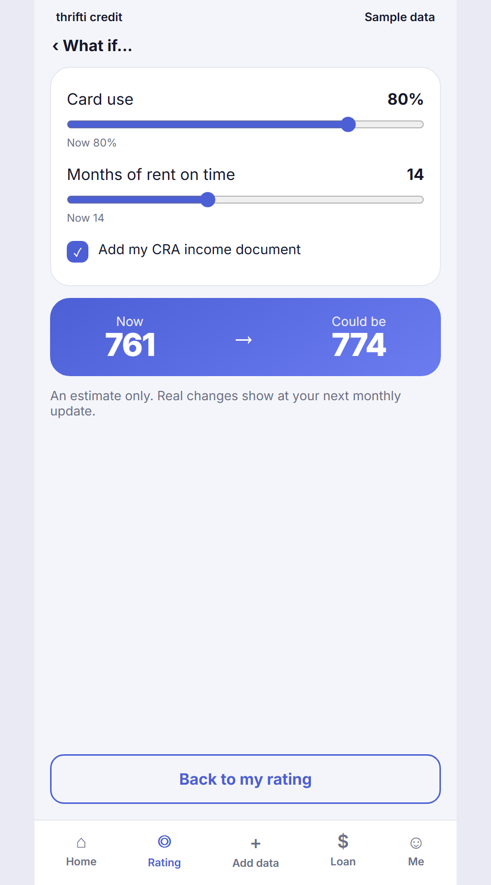
What we are asking for
Amount: [to be set by AD]
Use: pilot with one credit union partner, legal review, security test, first reviewers
Next 90 days: borrower survey, partner pilot agreement, closed test with real users
contact@thrifti.app

