Slide 1


ProjC Jenkins Architecture
Pull Docker image from Jfrog
Run container
Checkout project repo
Developer
Build
Test
Sonar Analysis
Deploy
Delete container & image

Slide 2




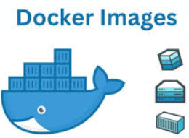



Devops Architecture
Developer
State files
Dev Resource
Pull Docker image
Terraform Repo
Terraform Host
Jenkins Node
Run container
Devops Eng
Checkout project repo
Build, Test, Analysis
Docker Host
Ansible Repo
Ansible Host
Deploy
Delete Container
Monitoring

