Slide 1
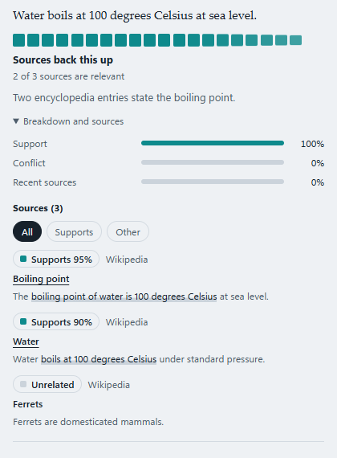
RESEARCH IMPLEMENTATION REVIEW 1
Synthetic Silence 2.0
Auditing language-model answers against sources: deterministic verdict rules, provable properties, and a validation on FEVER
supported
refuted
mixed
insufficient
Piush Kole | Thrilok M
Department of Computer Science, Christ University
Real Chrome run, demo data
Notes:
About 30 seconds. Introduce the team and the one-line idea: we turn an LLM answer into per-claim verdicts, and every true or false verdict points to a quoted sentence in a source. The screenshot is the working Chrome extension. Today: problem, literature, method, statistics, implementation, results, comparison.

Slide 2



People read LLM answers with no way to check them
Fluent and specific
No marker
Silence on failure
Names, dates and figures make an invented fact look like a recalled one.
A reader cannot tell recall from invention. Larger models can repeat common misconceptions more often (Lin et al., 2022).
A failed search, a missing source and a disagreeing source must not look like the same outcome.
Problem statement
Given an answer written by a language model, return one verdict per claim that a reader can trace to a quoted sentence in a source, and keep “no evidence” apart from “the check failed”.
Notes:
About 1 minute. Three points. One: fluent specifics look true. Two: the reader has no marker. Three: when a checker fails silently, silence looks like 'no problem found'. Our problem statement is the dark box: per-claim verdict, traceable to a quote, with failure kept separate from absence.

Slide 3
Five objectives, each tied to something we can test
1
Verdict procedure
Per-source stances with a verbatim quote; five outcomes.
Research questions
RQ1 Does the retrieval source or the aggregation rule matter more for decisive claims?
RQ2 Can a pooled entailment score abstain when sources do not mention a claim?
RQ3 Does a density or entropy score track whether evidence supports a claim?
2
Provable properties
Prove them for the rules and two earlier scores; check against the code.
3
Validation on FEVER
Confusion matrices, Wilson intervals, paired exact tests.
4
Explicit failure
An outage is an error for that claim, never “no sources”.
5
Working tool
Chrome extension on a FastAPI backend, plus a cross-model audit protocol.
Notes:
About 1 minute. Five objectives map to the five contributions in the paper. The three research questions on the right are answered later by the FEVER validation and by the propositions: RQ1 and RQ2 empirically, RQ3 by proof plus the earlier study.

Slide 4
Literature: no quote-backed audit at reading time
Work | What it does | Gap for a reader-side audit
Guo et al., 2022 | Survey: claim detection, retrieval, verdict, justification | Pipeline view; no deployed audit
Thorne et al., 2018 (FEVER) | Wikipedia claims labelled SUPPORTS, REFUTES, NEI | Fixed corpus; claims given, not extracted
Schlichtkrull et al., 2023 (AVeriTeC) | Real-world claims with open-web evidence | A dataset, not a reader-facing verdict
Manakul et al., 2023 (SelfCheckGPT) | Flags hallucination by sampling consistency, no evidence | No source sentence to show the reader
Min et al., 2023 (FActScore) | Share of atomic facts a knowledge source supports | A score, not a quote-backed verdict
Ji et al., 2023; Lin et al., 2022 | Hallucination survey; TruthfulQA misconceptions | Shows the need, not a tool
Our earlier study | Density signal: AUROC 0.546 on FEVER, 0.275 on AVeriTeC | Does not track support, hence this work
Notes:
About 1.5 minutes. Walk down the table. The survey gives the pipeline. FEVER and AVeriTeC give labelled data. SelfCheckGPT and FActScore are the closest work on LLM factuality: one uses no evidence, the other returns a score. None returns a verdict with a quote the reader can find. The last row is our own earlier study, which motivates the change of approach on the next slide. LLM-as-judge bias (Zheng et al., 2023) is why we hold the checker fixed.

Slide 5
Earlier density signal did not generalise
Reading the chart
Below 0.5 means the signal points the wrong way. Cross-manifold tests fell to chance.
What we do instead
Read what each source says about the claim
Require a verbatim quote for every counted source
Decide with deterministic rules we can prove things about
Keep density and entropy as research-mode signals only
Notes:
About 1 minute. This is the research gap, from our own earlier work. The density signal had AUROC 0.546 on FEVER, which is weak, then 0.275 on AVeriTeC, which is inverted, and 0.335 even with matched controls. Cross-manifold tests collapsed to chance. So a density score is not a safe basis for telling a reader whether a claim is supported. We keep it in research mode and build the verdict from source stance.

Slide 6





Method: six steps from answer to traceable verdict
1
2
3
4
5
6
Extract
Retrieve
Rank
Stance
Verdict
Show
LLM splits the answer into self-contained claims
Wikipedia and OpenAlex, merged and deduplicated
Cosine similarity to the claim; keep the top 6
Per source: supports, refutes, neutral, irrelevant, plus a quote
Rules R1 to R5 over counted sources
Side panel: sources, quotes, page highlights
Research mode only
Density ρ (kNN plus Mahalanobis) and entropy U are computed beside the verdict, marked NOT CALIBRATED, and never decide it.
Failure semantics
If every retriever fails, or the stream drops, that claim is an error with a retry. It is never shown as “no sources”.
Notes:
About 1.5 minutes. Walk left to right. Extraction keeps names, numbers and dates as written. Two retrievers run together. Ranking uses sentence-embedding cosine similarity and keeps six. The stance call returns one stance, a confidence and a quote per source; a stance without a verbatim quote is downgraded to neutral. Then five deterministic rules. The dashed box is the earlier research signal, shown only in research mode. The red box is the failure rule: outage is an error, not silence.

Slide 7
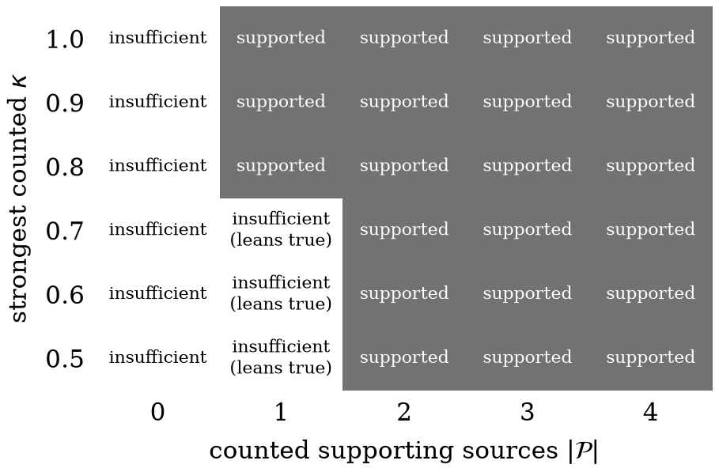
Verdict rules: five outcomes, decided by counted sources
P: sources that support, confidence ≥ 0.5, quote verified in the source
N: sources that refute, same tests
Q(T): |T| ≥ 2, or |T| = 1 with confidence ≥ 0.8
Rule | Condition (first that applies) | Verdict
R1 | no sources retrieved (n = 0) | no sources
R2 | P and N both non-empty, and Q(P) or Q(N) | mixed
R3 | Q(P) | supported
R4 | Q(N) | refuted
R5 | otherwise | insufficient
Verdict by number of counted supporting sources and strongest confidence, no counted refutation. One source qualifies only at confidence 0.8 or more.
Why: one weak source cannot say “backed up”
Notes:
About 1 minute. Counted sets P and N need confidence at least 0.5 and a verified quote. Q says when a side qualifies: two counted sources, or one with confidence 0.8. The five rules are tried in order. The figure shows the regions. The practical point: a single weak source can never produce 'supported'.

Slide 8








Statistical and data-science concepts applied
Cosine similarity
kNN + Mahalanobis
Ledoit–Wolf shrinkage
Softmax entropy U
Ranks sources by closeness to the claim; keeps the top 6.
Distance of a claim from 10,000 FEVER claim embeddings (research mode).
Stabilises the covariance; condition number ≤ 1 + (1−δ)p/δ.
Evenness of source matches (τ = 0.1); high when many match alike.
Confusion, macro-F1
Wilson 95% interval
Exact McNemar test
Paired bootstrap
Per-class precision and recall; abstention shown as NEI recall.
Honest error bars for proportions at n = 100 (about ±10 points).
Paired test on discordant claims; every variant sees the same 100 claims.
4,000 resamples for each difference; Bonferroni across six tests.
Notes:
About 1 minute. Eight tools, two groups. First four are the modelling side: cosine ranking, kNN plus Mahalanobis density with Ledoit-Wolf shrinkage, and softmax entropy. The last four are the evaluation side: confusion matrix with macro-F1, Wilson intervals, exact McNemar test on paired claims, and a paired bootstrap, with a Bonferroni threshold of 0.0083 because we ran six comparisons.

Slide 9
Five properties, proved and then checked against the code
Theorem 1
Verdict rules Exhaustive, exclusive, order-invariant, symmetric, monotone. Every true, false or mixed verdict has a verified quote.
27,930
source configurations tested exhaustively for Theorem 1
Prop. 2
Entropy U Non-decreasing in τ, and U ≥ 1 − δ/(τ ln N): many sources matching alike give high U, agree or not.
15,000
Prop. 3
Single-query density With one query, ρ ≈ (kNN distance + 1)/2, so the Mahalanobis term cannot change an AUROC.
random configurations of 4 to 7 sources
Prop. 4
Shrinkage Shrunk covariance is positive definite, with condition number ≤ 1 + (1−δ)p/δ.
34
Prop. 5
Wilson interval The Wilson limits form one interval inside [0, 1] that contains the estimate.
paper tests pass; no counterexample found
Notes:
About 1 minute. Each property is proved in the paper. Theorem 1 is the audit property: the system cannot assert true, false or disputed without a quote in a source. Props 2 to 4 explain why the earlier scores behave as they do: entropy rewards redundancy, and the single-query density collapses to a nearest-neighbour distance. We also test every statement against the deployed code, so the proofs and the code cannot drift apart. These checks are not proofs; they are drift alarms.

Slide 10
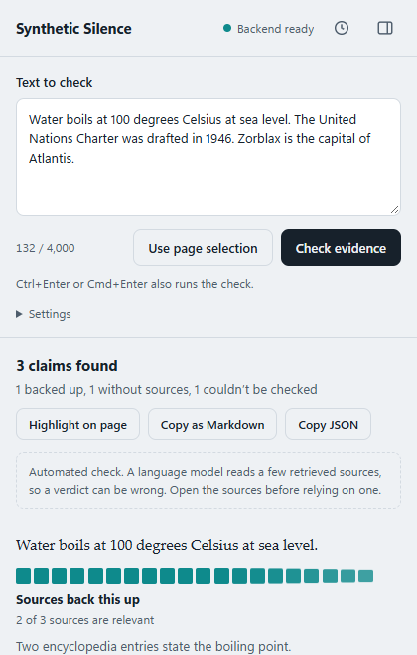
Working Chrome extension on a FastAPI backend
Extension
Backend
Popup and side panel
Right-click or Alt+Shift+S on any text
Claims stream in as each one finishes
Highlight claims on the page, no DOM changes
History, Markdown and JSON export
FastAPI, NDJSON streaming
Wikipedia and OpenAlex retrieval
gpt-4o-mini at temperature 0, JSON repair and retry
Result cache; typed API from OpenAPI
Budget errors reported, not hidden
117
44
35
backend tests pass
extension unit tests pass
real-Chrome end-to-end checks pass
Real Chrome 155 run with a stub backend (fixed demo data)
Notes:
About 1.5 minutes. Show the extension live if the review allows: paste text, press Ctrl+Enter, watch claims stream in. Left: real screenshot from our end-to-end run in real Chrome, with a stub backend so the output is deterministic. The demo claims show all three states: backed up, could not be checked because the search budget was used up, and no sources found. The last two are different states on purpose. Tests: backend 117, extension unit 44, and the real-Chrome end-to-end run. Live verdicts with the real model need OpenRouter credit.

Slide 11
Confusion matrices on 100 balanced FEVER claims
100
33 / 36 / 31
3
seed 42
claims scored
SUPPORTS / REFUTES / NEI
variants, same claims
gpt-4o-mini, temp 0
Pooled + OpenAlex (baseline)
Pooled + Wikipedia
Stance + Wikipedia (first prompt)
gold \ pred | S | R | N | M
SUPPORTS | 15 | 9 | 9 | 0
REFUTES | 3 | 31 | 2 | 0
NEI | 2 | 24 | 5 | 0
gold \ pred | S | R | N | M
SUPPORTS | 24 | 8 | 1 | 0
REFUTES | 4 | 31 | 1 | 0
NEI | 6 | 25 | 0 | 0
gold \ pred | S | R | N | M
SUPPORTS | 22 | 2 | 8 | 1
REFUTES | 13 | 12 | 10 | 1
NEI | 9 | 3 | 19 | 0
Teal: correct cells. Red: wrong cells. Shade is the share of the gold row. S, R, N, M = SUPPORTS, REFUTES, NEI, MIXED. Rows sum to 33, 36, 31.
Notes:
About 1 minute. Same 100 claims for every variant; they come from the FEVER development split, balanced, seed 42. The baseline OpenAlex run scored 100 of 150 sampled claims because the anonymous OpenAlex budget ran out, so all variants are reported on those 100. Read the matrices by row. Pooled with Wikipedia gets the SUPPORTS and REFUTES rows mostly right but puts 25 of 31 NEI claims in REFUTES. The stance variant spreads NEI correctly but loses REFUTES: 13 of 36 called SUPPORTS.

Slide 12
Results: retrieval helped, pooled never abstained
Variant | Accuracy (95% CI) | Macro-F1 | Decisive (95% CI) | NEI recall
Pooled + OpenAlex | 51.0 (41.3–60.6) | 0.466 | 66.7 (54.9–76.6) | 16.1%
Pooled + Wikipedia | 55.0 (45.2–64.4) | 0.445 | 79.7 (68.8–87.5) | 0.0%
Stance + Wikipedia | 53.0 (43.3–62.5) | 0.528 | 49.3 (37.8–60.8) | 61.3%
Percent except macro-F1. Decisive = the 69 SUPPORTS and REFUTES claims.
66.7 → 79.7%
decisive accuracy with Wikipedia (suggestive, p = 0.064)
0% vs 61.3%
NEI recall: pooled score vs stance variant
Notes:
About 1.5 minutes. Overall accuracy is flat, between 51 and 55 percent, and the intervals overlap heavily; with 100 claims that is about plus or minus 10 points. The interesting differences are in the decisive claims and in abstention. Wikipedia retrieval lifts decisive accuracy from 66.7 to 79.7, but the paired test gives p = 0.064, so we call it suggestive, and FEVER is built from Wikipedia so a Wikipedia retriever is expected to help. The pooled score never says not enough info; the per-source variant does 61 percent of the time.

Slide 13
Comparison: retrieval mattered more than the rule
Paired tests on the same claims (exact McNemar)
Design comparison with related audits
A vs B | Claims | A only / B only | Diff, points (95% CI) | p
PW vs PO | decisive 69 | 14 / 5 | +13.0 (+1.4, +24.6) | 0.064
SW vs PW | decisive 69 | 5 / 26 | −30.4 (−44.9, −15.9) | 0.0002
SW vs PO | decisive 69 | 11 / 23 | −17.4 (−33.3, 0.0) | 0.058
SW vs PW | all 100 | 24 / 26 | −2.0 (−16.0, +12.0) | 0.888
 | SelfCheckGPT | FActScore | This work
External evidence | No | Yes | Yes
Unit checked | Sentence | Atomic fact | Claim
Output | Consistency score | Share supported | Verdict plus quote
Not compared numerically: the methods use different data and tasks. We claim a difference in design, not in accuracy.
PO pooled + OpenAlex; PW pooled + Wikipedia; SW stance + Wikipedia. Six tests were run; the Bonferroni threshold is 0.0083, which only the shaded row meets.
Against our earlier density signal
AUROC 0.546 (FEVER) and 0.275 (AVeriTeC) there; here, verdicts that carry quotes.
The aggregation rule changed decisive accuracy significantly only for the first stance prompt, and for the worse.
Notes:
About 1.5 minutes. Left: the paired comparisons, which are the fair way to compare variants on the same claims. Only one passes the Bonferroni threshold: the first stance prompt is worse than the pooled score on decisive claims. Wikipedia against OpenAlex is suggestive but not significant. Right: a design comparison with the two closest related methods. We do not claim better accuracy than them; we did not run them on the same data. The claim is about design: external evidence, claim-level unit, verdict with a quote.

Slide 14
Analysis: what we found, and what we got wrong
+13.0 pts
0% recall
p = 0.0002
Retrieval source
Pooled score cannot abstain
First stance prompt
Wikipedia over OpenAlex on decisive claims. Suggestive (p = 0.064); FEVER is Wikipedia-derived.
It called 25 of 31 NEI claims refuted. One score cannot split “not mentioned” from “contradicted”.
Abstains (61.3% NEI recall) but is much worse on decisive claims than the pooled score.
Failure analysis: 13 of 36 REFUTES claims were called supported
Cause 1: the stance call judged the normalised claim, which had dropped the detail that made it false.
Cause 2: the prompt accepted near misses (1945 for 1946; a TV series for a radio station).
Both fixed with a regression test. The corrected variant is not yet shown to beat pooled, so the default stays pooled.
Notes:
About 1 minute. Three findings, one admission. Retrieval source mattered; the pooled score cannot abstain; the first per-source prompt abstains but is worse on decisive claims. We inspected the 13 refuted claims called supported and found two causes that were ours: the stance call saw the normalised claim, and the prompt was too lenient. We fixed both and added a regression test, but a re-run on a fresh sample was cut off when the API account ran out of credit, so we draw no conclusion about the corrected prompt and keep pooled as the default.

Slide 15
Conclusion, limits and next steps
Every verdict traces to a quoted sentence, and absence is kept apart from failure.
Limits
Next steps
100 claims: intervals about ±10 points
FEVER is Wikipedia-derived: compare variants, not absolutes
Corrected stance prompt not yet evaluated
Cross-model audit specified, not run (API credit)
Evaluate the corrected prompt on a 150-claim fresh sample
Run the 40-prompt audit on seven commercial models (about US$1.6)
Compare verdicts with human judgements
Fit the conformal calibration interface (not fitted today)
Thank you. Questions?
Notes:
About 30 seconds. One-sentence conclusion first. Then be direct about the limits: small sample, Wikipedia-derived benchmark, corrected prompt not evaluated, cross-model audit built and tested but not run because of API credit. Next steps are concrete. Invite questions. Likely questions: why FEVER, why not a bigger sample, why keep the density score, how are quotes verified. Answers are in the paper: Sections 4, 5 and 6 and the Limitations section.

