Slide 1

SMART INDIA HACKATHON 2026
TITLE PAGE
• Problem Statement ID – SIH-26138
• Problem Statement Title-
Dynamic Maritime Decarbonization,
Voyage Speed and Dual-Fuel Optimization
Engine
• Theme - Clean and Green Technology
• PS Category- Software
• Team ID- 145834
• Team Name – TeamBuilders

Slide 2
IDEA: GREENFLEET QUANTUM
TeamBuilders
Problem Statement:
Fuel takes up over 50% of the entire cost of running a cargo ship.
Ships sail along fixed paths at constant engine speed, fighting against rough waves and water currents.
High carbon smoke leads to heavy government fines under new IMO environmental rules.
Our Idea (GreenFleet Quantum):
A simple software that uses live satellite maps to find the easiest sea path with minimum water resistance.
Suggests the best engine speed for every part of the trip so the ship burns less fuel.
Works directly on existing ship computers with zero new hardware and 1-click route loading.
Cuts fuel burn by 16.8% and saves over $230,000 on a single trip.
Proposed Solution:
Autonomous Routing: Dynamic real-time speed and heading optimization across oceanic corridors using live Copernicus metocean vectors.
Naval Physics Twin: Holtrop-Mennen hull drag, ISO 15016 wave resistance, and non-linear engine SFOC power curves.
156-Qubit Hybrid HQOA: QPSO quantum tunneling + QGA rotation gates evaluating 10^14 speed
• Zero-Hardware ECDIS: NMEA 0183 ($ECWPL) route
export into Furuno, Transas, and Wärtsilä bridge consoles.
Satellite & Vessel Telemetry
Copernicus Currents + Ship AIS GPS
Innovation & Uniqueness:
Dynamic routes: The route can change according to real-time ocean and weather conditions.
Quantum-powered optimization: Uses quantum computing to explore a large number of possible routes efficiently.
Complete solution: Combines route planning, fuel reduction, CO₂ reduction, and regulatory compliance in one system.
Green fuels : Ammonia, methane , LPG, etc
GreenFleet Core
Quantum Engine
IBM Qiskit + Physics
(Offline SQLite)
Bridge ECDIS
Furuno / Transas
(1-Click .nmea)

Slide 3

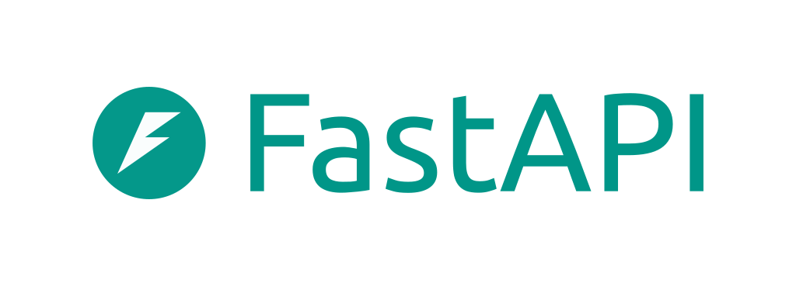






TECHNICAL APPROACH
TeamBuilders
TECHSTACK:
Frontend and visualisation:
React 19,Typescript ,Vite,Leaflet Nautical GIS, Lucide UI
Backend and Physics Engine:
FastAPI (Python 3.12),Numpy,SciPy,Uvicorn,Pydantic v2
QUANTUM & OPTIMIZATION:
IBM Qiskit 1.3, QPSO Quantum Tunneling,QGA,PyTorch FNO
METOCEAN AND AIS FEED
Copernicus CMEMS (1/12),Open-Meteo Maine,AISStream
DATABASES AND SECURITY
SHA-256 Crypto,SQLite WAL,Other
Flowchart (Methodology & Implementation Process):
Bridge Navigation & Satellite Feeds
Live Environmental & Ship Positioning Inputs
Copernicus Satellite Metocean
Live ocean currents, wave height & wind
Ship AIS Telemetry Stream
GPS position, speed over ground & draft
Local SQLite DB
7-Day Offline Cache
Shipboard Edge Gateway (Docker Container)
Combines weather grid with ship GPS; works 100% offline
If Offline / Signal Drop:
Use Cached Forecast & Dead-Reckoning
Data Validation
Check
Tech Stack Symbols:
YES
FastAPI
Naval Hydrodynamic Physics Engine (Holtrop & ISO 15016)
Calculates calm water drag, wave resistance & exact engine power needed
Python
React 19
TypeScript
AIS Loop
(every 3s)
Quantum Route Optimizer (IBM Qiskit)
Tests thousands of speed schedules to find lowest fuel & carbon cost
IBM Qiskit
SQLite WAL
Docker
Leaflet GIS
Bridge ECDIS Radar
1-Click .nmea route load
(Furuno / Transas)
5 Route Presets
Lowest Fuel / Storm Safe
Fast Arrival / Bio-Fuel
IMO Compliance
Auto-generated XML report
(IMO DCS & EU MRV)
Git Repo:
https://github.com/thrinadh2005/SIH

Slide 4
FEASIBILITY AND VIABILITY
TeamBuilders
Feasibility Analysis:
Technical Feasibility:
• Constructed on standard open-source libraries (Python 3.12, FastAPI, React 19, IBM Qiskit), preventing vendor lock-in.
• Hydrodynamic math embeds Holtrop-Mennen calm water regression alongside ISO 15016 wave drag coefficients.
• Direct pipeline ingests free Copernicus Marine (CMEMS) satellite data, eliminating external commercial weather API fees.
[TRL-7 Validated System]
Operational Feasibility:
• Operates as pure containerized software on bridge workstations; requires zero drydocking, hull cuts, or sensor installs.
• Exports standard NMEA 0183 route plans (.nmea) that deck officers load directly onto Furuno, Transas, and Wärtsilä ECDIS.
• Master and watchkeeping officers retain complete navigational discretion, preserving standard bridge operating procedures.
[Zero Capex • Plug-and-Play]
Economic Viability:
• Delivers roughly $237,800 in net fuel savings on a single Pacific transit for a typical 15,000 TEU container carrier.
• Achieves positive operational cash return on the maiden crossing with zero upfront capital expenditure.
• Lightweight Docker image deploys via vessel IT in under 15 minutes, avoiding shipyard technician callout expenses.
[Breakeven: 1st Voyage]
Potential Challenges & Risks:
Mid-ocean satellite communication blackouts disrupt links to shorebased cloud servers for hours at a time.
Sudden gale squalls and high ocean swells drastically increase hull resistance, forcing main engines to burn excess fuel.
Software or communication failures could stop the system from providing route updates.
Engineering Mitigations & Safeguards:
A working version can simulate a full journey from Singapore to Rotterdam using real ocean current data and the Holtrop method to calculate ship resistance.
Helps save fuel and reduce operating costs.
Can work with existing ship and weather data

Slide 5
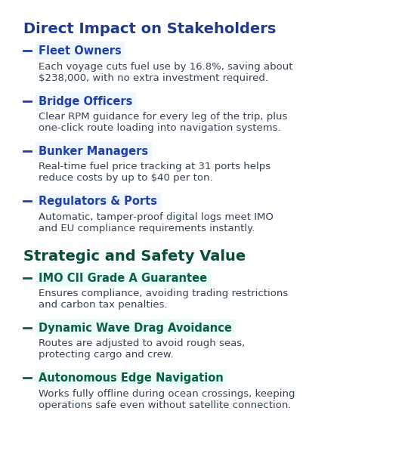
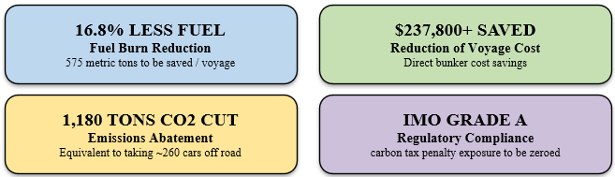
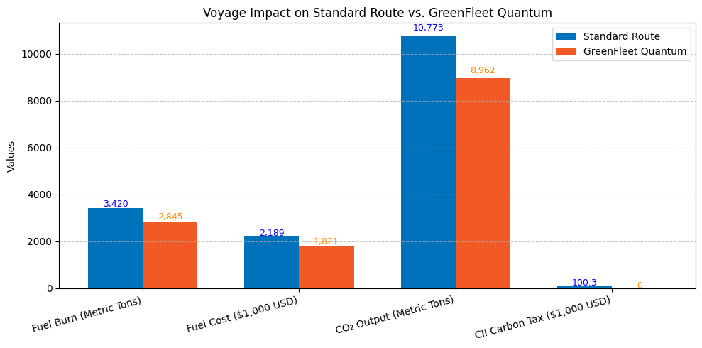
IMPACT AND BENEFITS
TeamBuilders
KEY PERFORMANCE METRICS (VERIFIED SAVINGS):

Slide 6
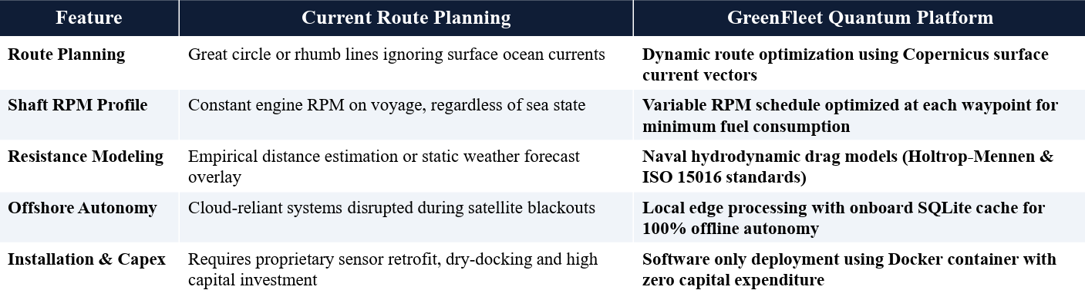
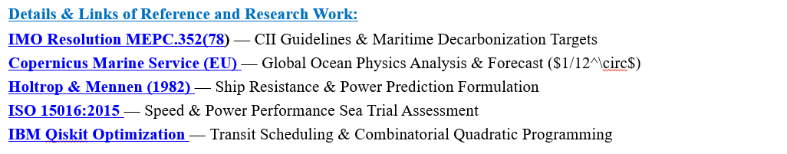
RESEARCH AND REFERENCES
TeamBuilders

