Slide 1


NAME: Preeti Singh
SECTION: KOC08 REGISTRATION NO.: 12218823
ROLL NO.: RKOC08A26

Slide 2

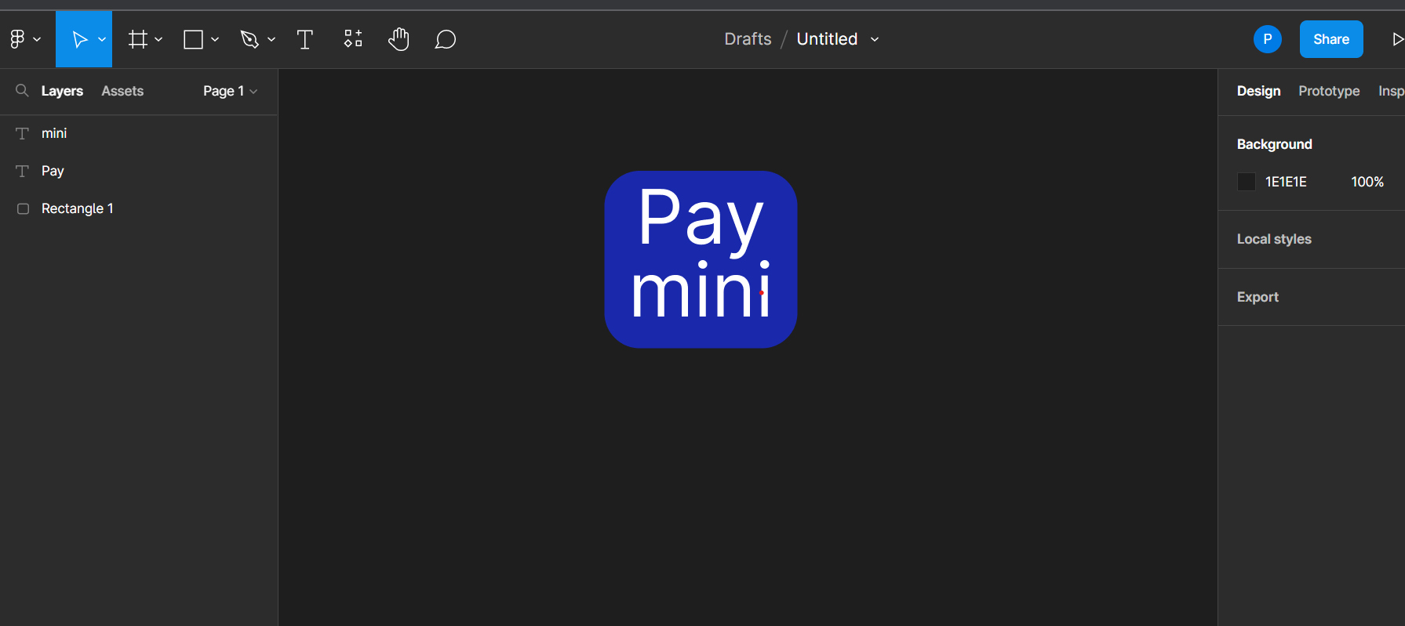
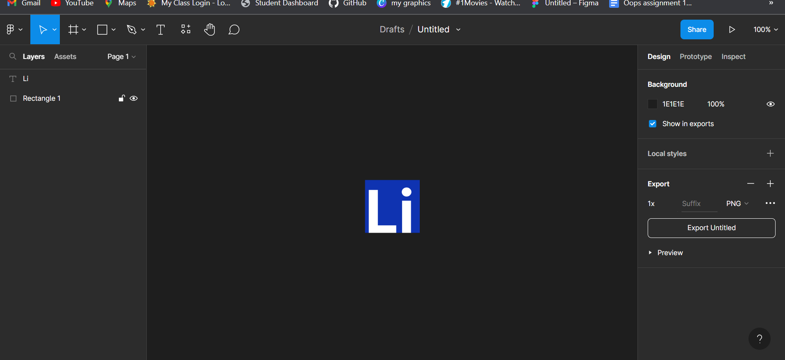
SCREENSHOT
LINK https://www.figma.com/files/team/1181650276111593179/Preeti-Singh's-team?fuid=1181650267430786350 https://www.figma.com/file/6shXfxqoMoz6OtFOZ1pVNK/Untitled?t=1XUanhwf7nqPOC8h-0
ACCOMPLISHMENT Create 2 logos using Figma.

Slide 3

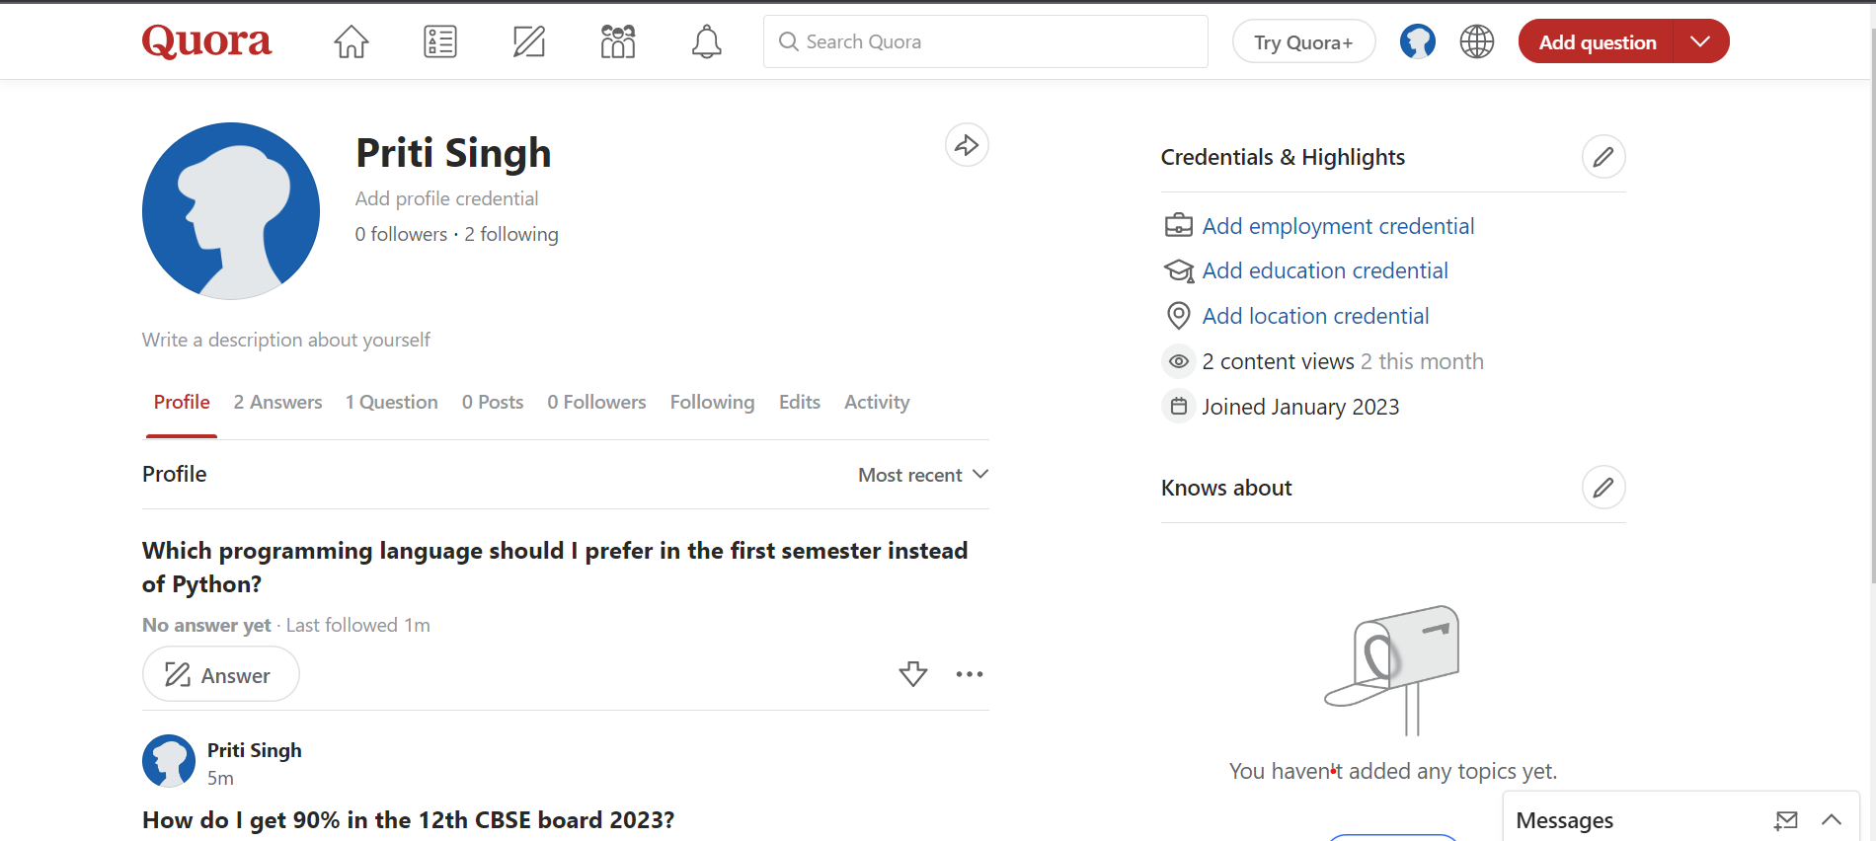
SCREENSHOT
LINK https://www.quora.com/profile/Priti-Singh-2329
ACCOMPLISHMENT Answered More than 3 question till date.

Slide 4

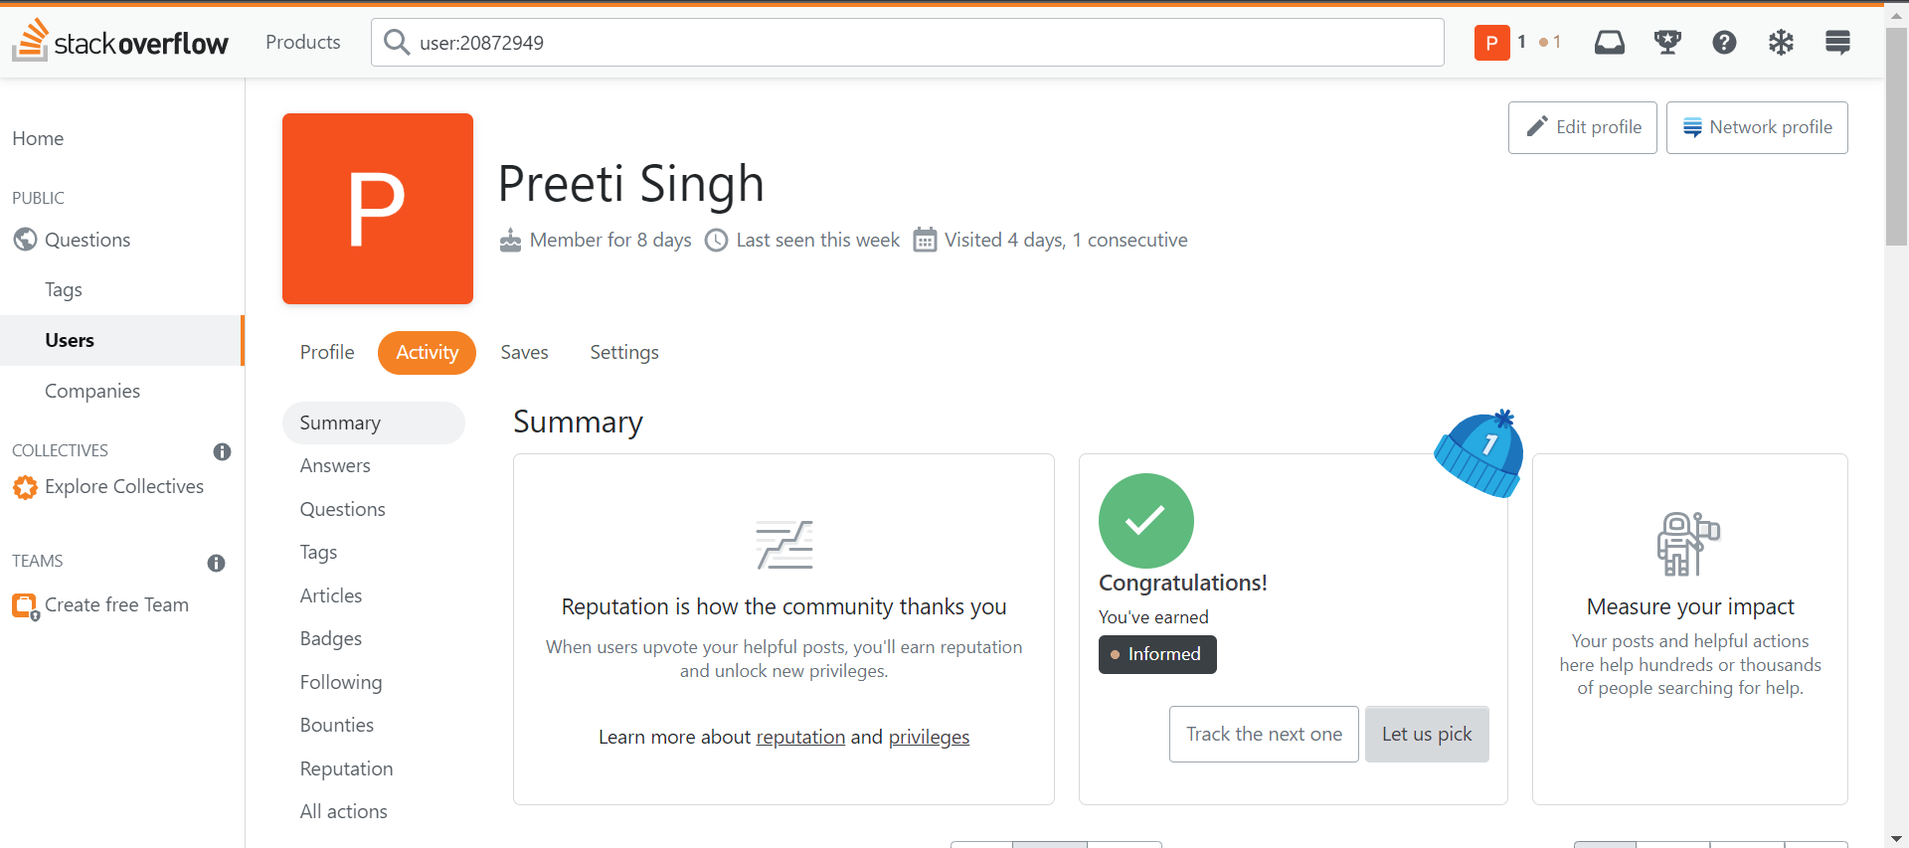
 | SCREENSHOT
 | LINK https://stackoverflow.com/users/20872949/preeti-singh
 | ACCOMPLISHMENT
 | Asked few Questions

Slide 5

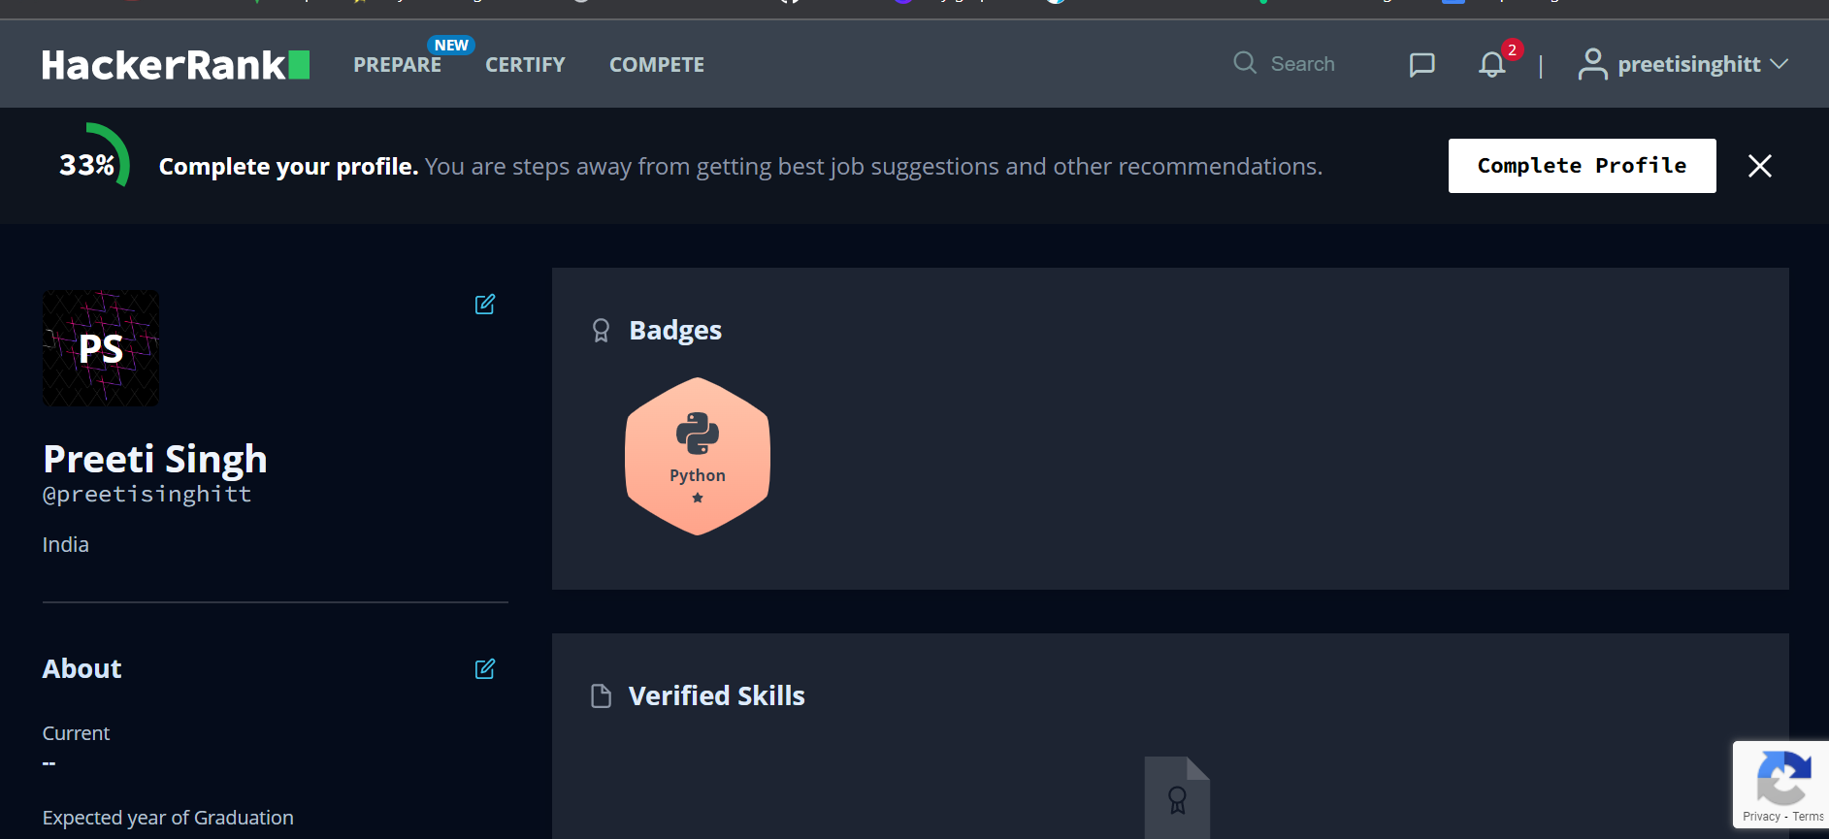
 | SCREENSHOT
 | LINK https://www.hackerrank.com/preetisinghitt
 | ACCOMPLISHMENT
 | Got a badge in python.

Slide 6


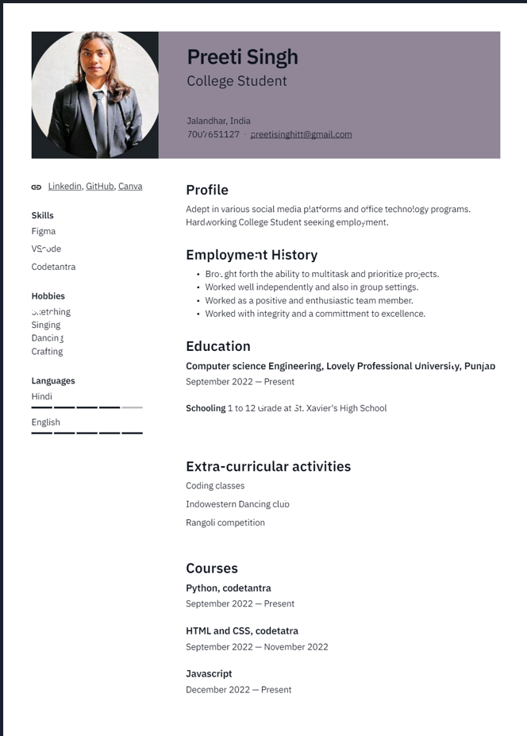

Slide 7

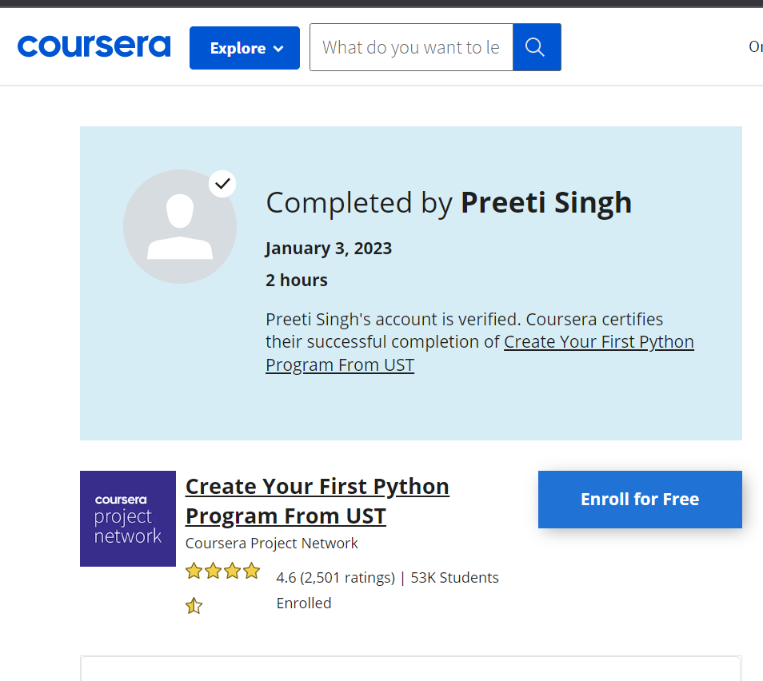
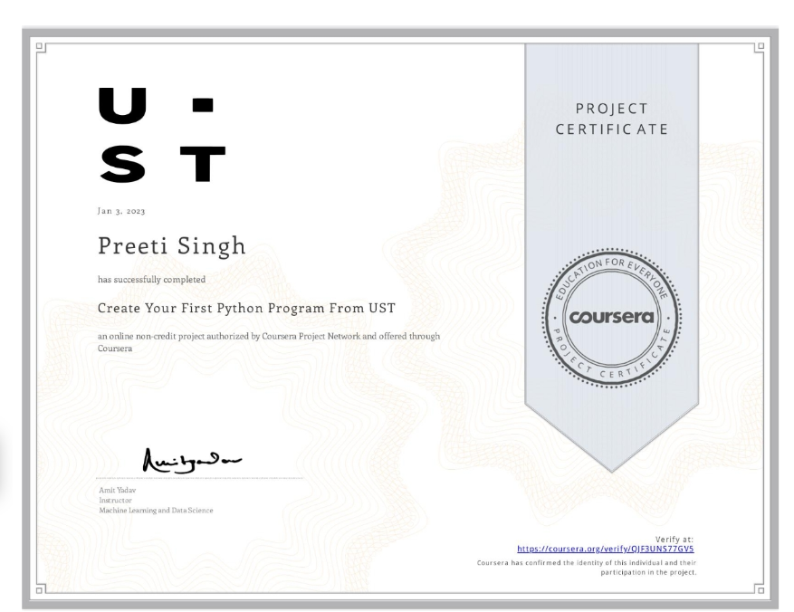
 | SCREENSHOT
 | LINK https://coursera.org/share/07ba3c246854a2039f392737572611b9
 | ACCOMPLISHMENT
 | MOOCS Course and got certificate .

Slide 8

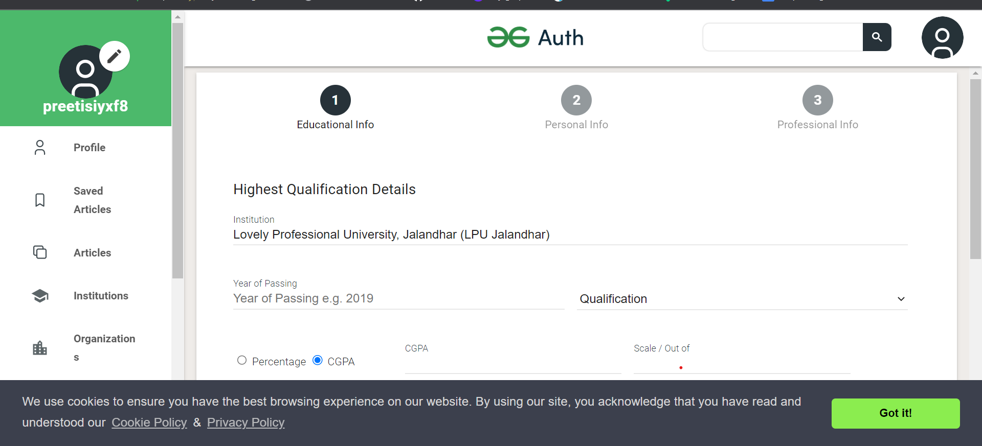
 | SCREENSHOT
 | LINK https://auth.geeksforgeeks.org/edit-profile.php
 | ACCOMPLISHMENT
 | Solving Few Questions.

Slide 9

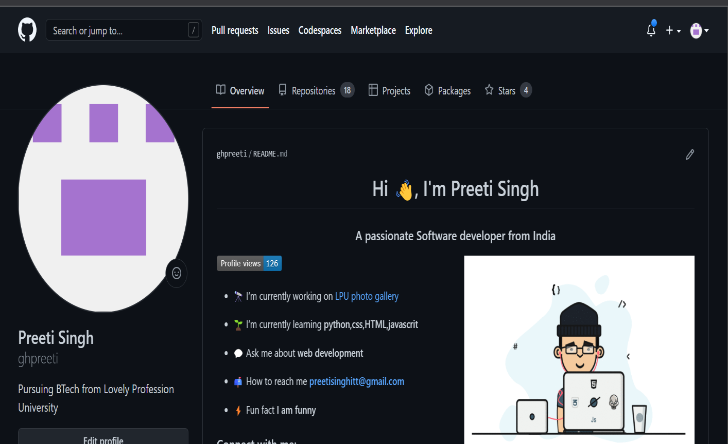
 | SCREENSHOT
 | LINK https://github.com/ghpreeti
 | ACCOMPLISHMENT
 | Created and Uploaded a Repository of Python Project. In that python project, also has uploaded html projects

Slide 10

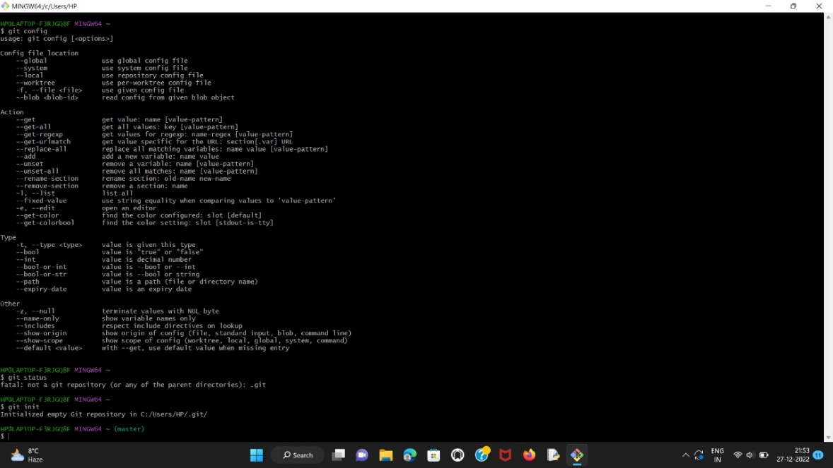
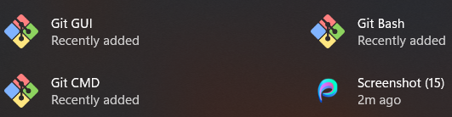
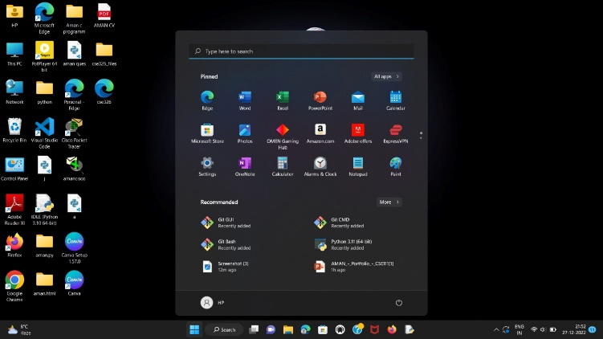
 | SCREENSHOT
 | ACCOMPLISHMENT Use of command like (git config –global user.name; git add .; git status; git commit; git init; git config –global email etc) Created a repository using Git name (git.txt)

