Slide 1
Python – упр.3

Slide 2
Lists(списъци)
list1 = ['physics', 'chemistry', 1997, 2000];
list2 = [1, 2, 3, 4, 5, 6, 7 ];
print( "list1[0]: ", list1[0])
print("list2[1:5]: ", list2[1:5])
print ( "Value available at index 2 : “,list1[2])
list1[2] = 2001;
print ( “New value available at index 2 : “,list1[2])
del list1[2];
print ( " After deleting value at index 2 : “,list1)

Slide 3
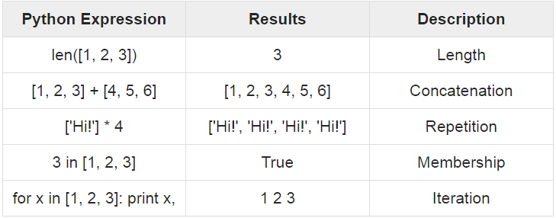
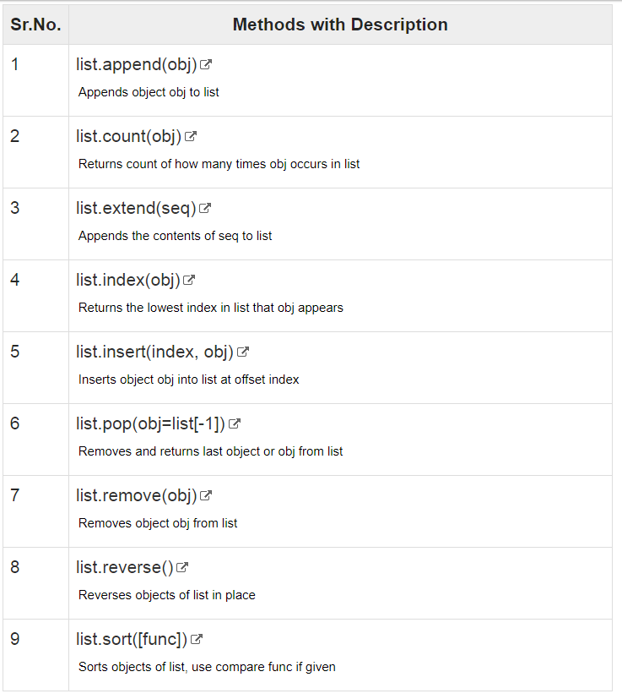
Lists(списъци) 2

Slide 4
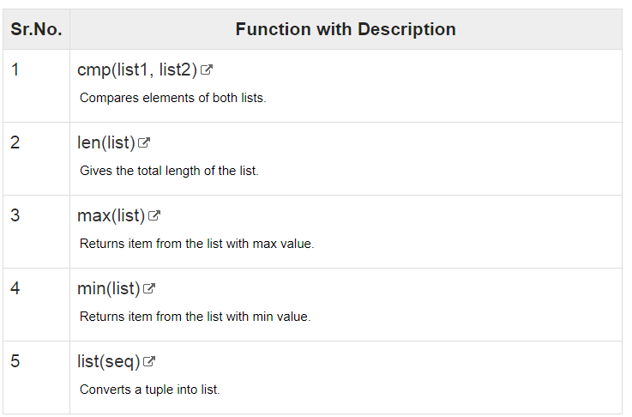
Lists(списъци) 3

