Slide 1
Python – упр.2

Slide 2
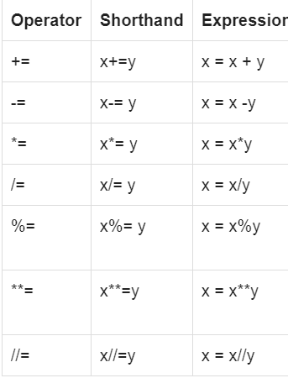
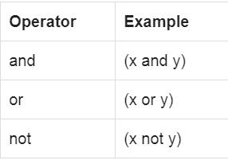
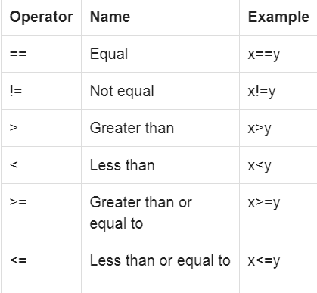
Оператори - продължение
Присвояване
Логически
Сравнение

Slide 3
Python if elif else
if expression1 :
statement_1
statement_2
....
elif expression3 :
statement_3
statement_4
....
else :
statement_5
statement_6
a=10
if(a>10):
print("a is not 10")
else :
print("a is 10")

Slide 4
Python for loop
for var_name in sequence:
statement_1
statement_2
....
for var_name in sequence:
statement_1
statement_2
....
#The list has 4 elements,
#indices start at 0 and end at 3
color_list = ["Red", "Blue", "Green", "Black"]
for c in color_list:
print(c)

Slide 5
Функция range()
range(a)
range(a,b)
range(a,b,c)
for a in range(2,19,5):
print(a)
2
7
12
17

Slide 6
print() function
str1 = 'Python' print("Welcome %s" % str1)
print("Actual Number = %d" %15)
print("Float number = %f" %15)
print(”no new line”, end="")
str1 = 'World'
str2 = ':'
print("Python%s %s" %(str1,str2))
%s -> String
%d -> Integer
%e -> exponential
%f -> Float
%o -> Octal
%x -> Hexadecimal

