Slide 1
Digital Portfolio
STUDENT NAME: THRISHA K
REGISTER NO : 2428C0123
NMID: C7E364CF2242727B7F041FEA8F2E07EC
DEPARTMENT: B.SC ARTIFICAL INTELLIGENCE AND MACHINE LEARNING
COLLEGE: SRI KRISHNA ADITHYA COLLEGE OF ARTS AND SCIENCE
UNIVERSITY:BHARATHIYAR UNIVERSITY

Slide 2
PROJECT TITLE
MY PORTFOLIO

Slide 3


AGENDA
Problem Statement
Project Overview
End Users
Tools and Technologies
Portfolio design and Layout
Features and Functionality
Results and Screenshots
Conclusion
Github Link
3/21/2024 Annual Review

Slide 4

PROBLEM STATEMENT
In today's digital age, students lack a centralized, personalized, and professional online presence to showcase their academic and personal achievements, skills, and contact information."

Slide 5

PROJECT OVERVIEW
Developed a personal portfolio website using HTML, CSS, and JavaScript
Presents personal details, education, and contact information
Displays photo and an interactive greeting button
Responsive and visually appealing design.

Slide 6

WHO ARE THE END USERS?
Students – For creating academic/project portfolios.
Recruiters/Employers – To review candidate profile & projects quickly.
Faculty/Guides – To evaluate student’s technical skills and project work.
Self – As a digital resume for internships & job opportunities.

Slide 7

TOOLS AND TECHNIQUES
Frontend:
HTML5CSS3 (Responsive Design, Flexbox)
JavaScript (Basic Interactivity)
Resources:
Font Awesome (Icons)
Online image hosting
Editor:
VS Code
Hosting (Optional):
GitHub Pages / Netlify

Slide 8
POTFOLIO DESIGN AND LAYOUT
Structure:
Header with name and title
Profile photo section
Information card:
name, roll no, college, email, phone
Footer with copyright
Design:
Gradient background
Card-based layout
Responsive design for mobile screens
8

Slide 9
FEATURES AND FUNCTIONALITY
Responsive layout
Personal photo and profile
Clean, user-friendly interface
Interactive button with JavaScript greeting
Direct links to email and phone
Organized and modular code

Slide 10
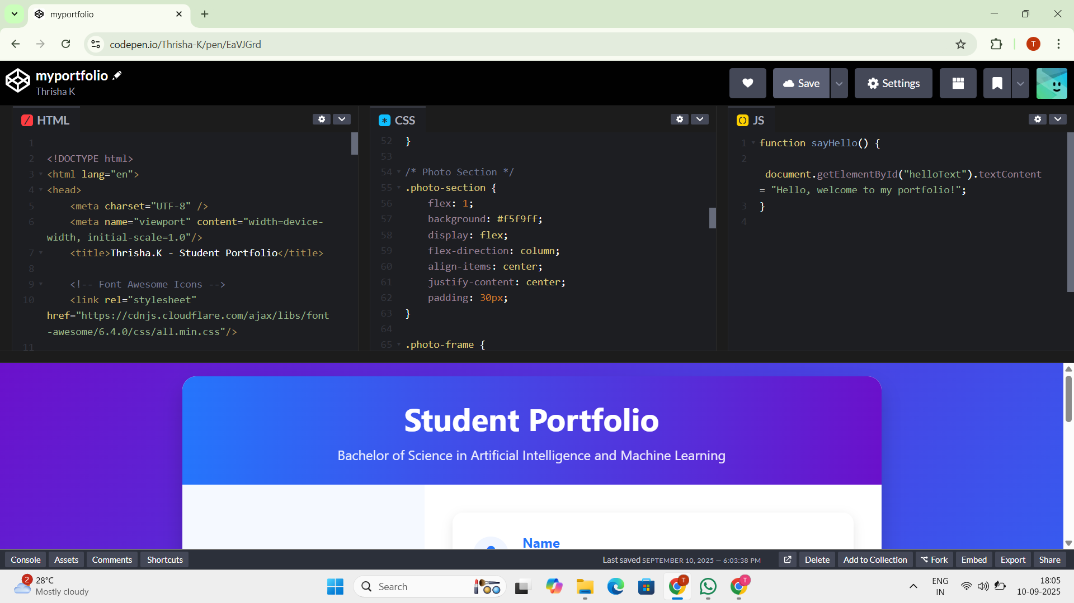

RESULTS AND SCREENSHOTS
3/21/2024 Annual Review
10

Slide 11
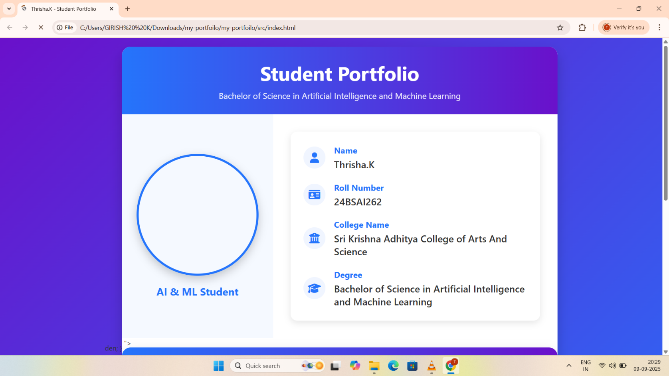
RESULTS AND SCREENSHOTS
3/21/2024 Annual Review
11

Slide 12
CONCLUSION
Successfully created a personal, responsive, and professional portfolio
Demonstrated proficiency in HTML, CSS, and JS
Improved understanding of frontend development and design best practices
Can be extended with projects, blog, or resume
12

