Slide 1
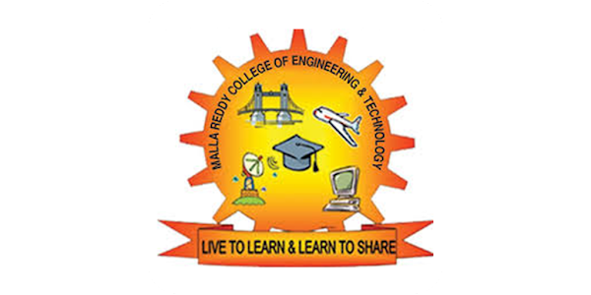
MALLA REDDY COLLEGE OF ENGINEERING & TECHNOLOGY DEPARTMENT OF INFORMATION TECHNOLOGY
GENEALOGY PREDICTION USING CONVOLUTIONAL NEURAL NETWORKS
Year / Section : IV B.Tech / I Sem & ” C”
mini-project
Presented by:
21N31A12J7 – V. Thriveni
21N31A12G3– G. Tharuni
Guided by:
Dr.K.Suresh
Assoc.professor
Batch: 08

Slide 2
AGENDA
ABSTRACT
1.INTRODUCTION
2.FUNCTIONAL AND NON-FUNCTIONAL REQUIREMENTS
3.SYSTEM ANALYSIS
4.SYSTEM ARCHITECTURE
5.UML DIAGRAMS
6.IMPLEMENTATION
7.CONCLUSION
8. REFERENCES

Slide 3
ABSTRACT
This project introduces a novel approach to genealogy by leveraging deep learning techniques to predict genealogical features from images. Traditionally, genealogy relies on historical records and genetic analysis; however, our study utilizes convolutional neural networks (CNNs) to infer physical characteristics and traits of an individual’s parents and grandparents through photographs.
Our methodology involves training CNNs on a comprehensive ancestral dataset with labeled images spanning multiple generations. This dataset allows the model to learn intricate patterns and relationships between facial features across generations. The system processes input images to extract key facial features, which are then compared to the learned patterns in the ancestral dataset.
This comparison facilitates the prediction of ancestral traits based on visual inputs. Our approach offers a cutting-edge tool for enhancing genealogical research, providing new insights into familial inheritance and the intersection of artificial intelligence with family history analysis.

Slide 4
INTRODUCTION
PURPOSE OF PROJECT:
The purpose of this project is to develop a deep learning-based system that predicts genealogical traits and familial characteristics by analyzing photographs of individuals. By leveraging convolutional neural networks (CNNs) trained on a comprehensive ancestral dataset, the system aims to identify patterns in facial features across generations. This approach provides a novel method for exploring family history and relationships, complementing traditional genealogical research methods such as historical records and genetic analysis.
The main aim of project is deep learning approach for predicting ancestral traits from images, deviating from traditional historical records and genetic analysis.
Convolutional Neural Networks (CNNs) are utilized to analyze photographs and identify facial feature patterns across generations. The model then predicts physical traits of parents and grandparents, offering a new perspective on exploring genealogy through image analysis.

Slide 5
SCOPE OF THE PROJECT:
The scope of this project involves the development and application of deep learning techniques, specifically convolutional neural networks (CNNs), to predict genealogical traits from image inputs. It includes the collection and preprocessing of a comprehensive ancestral dataset containing labeled images of individuals across multiple generations.
The project aims to design and train CNN models to recognize patterns in facial features inherited through generations, allowing for the prediction of physical traits of parents and grandparents. This project has potential applications in genealogical research, forensic science, and historical studies, providing a novel image-based approach to exploring family lineage and ancestry
EXISTING SYSTEM:
Genealogical research traditionally relies on historical records and genetic analysis to trace family lineage and relationships. Methods include examining birth and marriage certificates, census data, and DNA testing. These approaches primarily focus on documenting relationships and genetic origins, but do not address the prediction of physical traits across generations.
PROPOSED SYSTEM:
The proposed system uses convolutional neural networks (CNNs) to analyze photographs and predict genealogical traits across generations. By training the model on a dataset of labeled ancestral images, it learns to identify inherited facial features and predict physical traits of ancestors from individual photographs. This approach introduces a new dimension to genealogical research, complementing traditional methods with visual data analysis.

Slide 6
Functional Requirements:
Image Upload: Users can upload photographs for analysis.
Facial Feature Extraction: The system identifies facial features using CNNs.
Ancestral Trait Prediction: Predict physical traits of parents and grandparents.
Pattern Recognition: Compare facial features with learned generational patterns.
Display Results: Show predicted ancestral traits in a user-friendly format.
Non-Functional Requirements:
Performance: Predictions should be returned in under 5 seconds.
Scalability: Support multiple users and large datasets.
Security: Ensure secure storage and handling of user data.
Usability: Simple, intuitive interface for easy use.
Accuracy: Aim for high prediction accuracy (90%+).
Compatibility: Support common image formats (JPEG, PNG).
Maintainability: Modular design for easy updates.
Reliability: Ensure consistent results and high system uptime.

Slide 7
SYSTEM ANALYSIS
HARDWARE REQUIREMENTS:
Processor: AMD Ryzen
Hard Disk: 1 TB SSD
RAM: 16 GB
SOFTWARE REQUIREMENTS:
Operating System: Windows 11
Coding Language: Python 3.x
Deep Learning Frameworks: TensorFlow,Keras
Image Processing Libraries: OpenCV

Slide 8
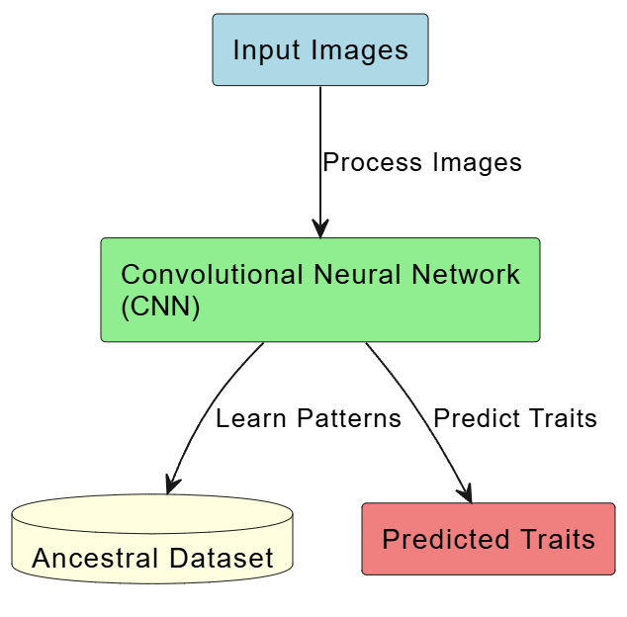
SYSTEM ARCHITECTURE

Slide 9
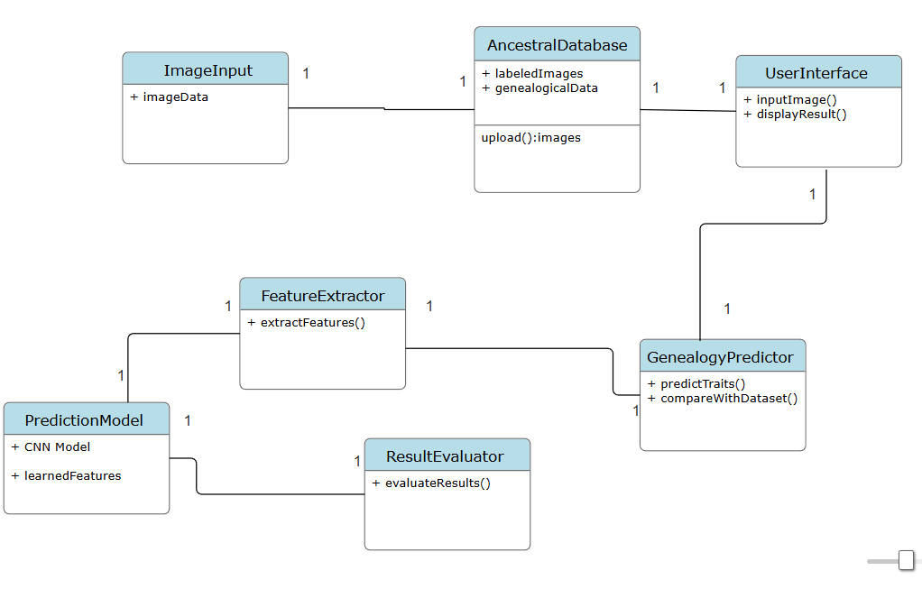
UML DIAGRAMS:
Class Diagram:
+ datasetPath
+ featureVectors
+ filename
+ path
+ __init__(imageData)
loadDataset(path)
+ inputShape
+ featureDimensions
+ scalingFactor

Slide 10
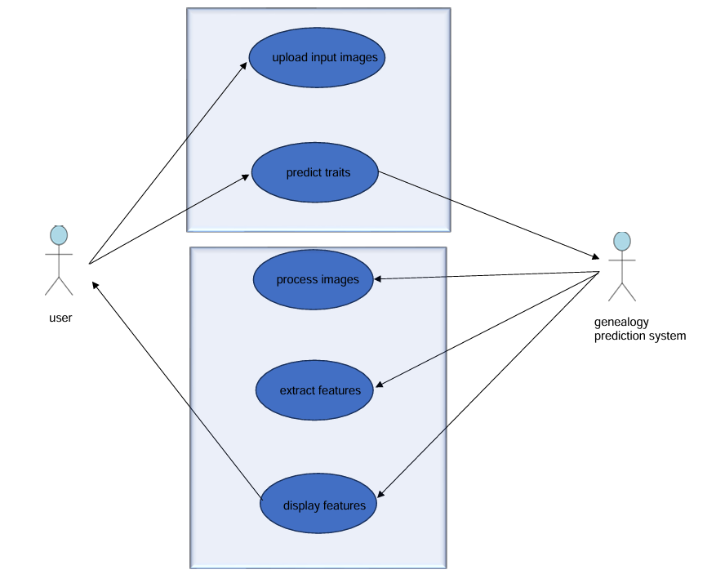
Use Case Diagram:

Slide 11
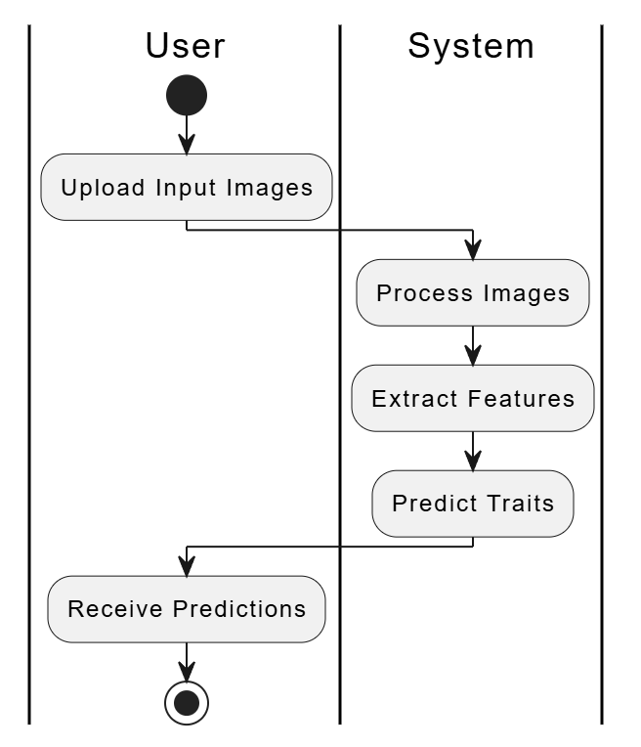
Activity Diagram:

Slide 12
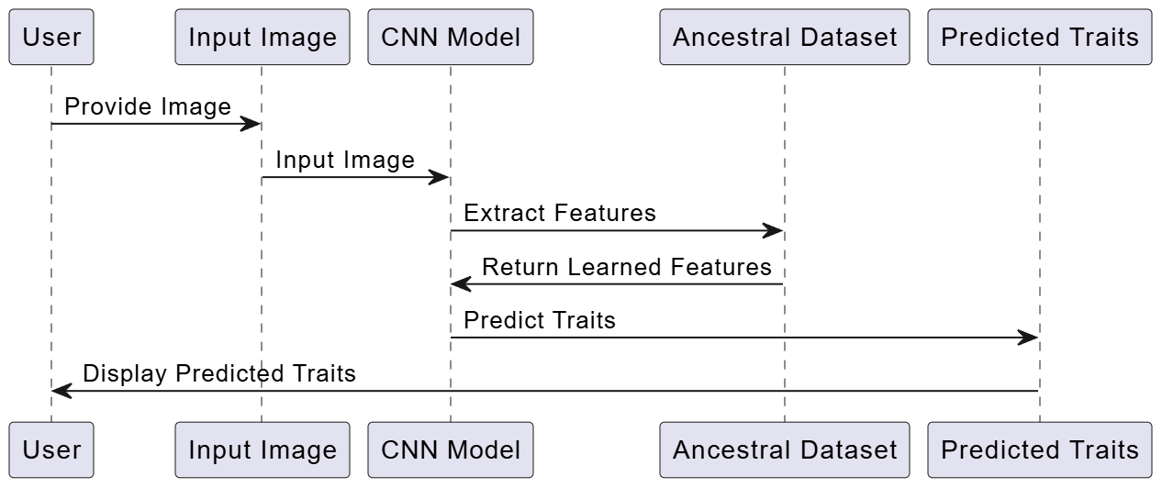
Sequence Diagram:

Slide 13
FUNCTIONALITY:
Image Upload: Users upload images of family members (parents and grandparents) and a child.
Feature Extraction: Each image is resized, normalized, and passed through the VGG16 model to generate feature vectors.
Similarity Calculation: Euclidean distance measures the similarity between the child’s feature vector and each family member’s.
Trait Prediction: Based on similarity thresholds, inherited traits (like "Eye Shape" or "Jawline") are identified and assigned to respective family members.
Display Results: The system shows similarity scores and matching traits for each family member on a results page.
TECHNICAL DETAILS:
Language/Frameworks: Python, TensorFlow/Keras for CNN model (VGG16), Flask for the web interface, and NumPy for handling image data.
Pre-trained Model: VGG16 is used for extracting facial features from images.
Dataset: Ancestral images labeled with generational metadata for training.

Slide 14
IMPLEMENTATION:
sample code:
import os
import numpy as np
from flask import Flask, request, render_template, url_for
from tensorflow.keras.preprocessing import image
from werkzeug.utils import secure_filename
from model import create_model
app = Flask(__name__)
# Path where uploaded images will be stored
UPLOAD_FOLDER = 'static/uploaded'
app.config['UPLOAD_FOLDER'] = UPLOAD_FOLDER
# Ensure the upload folder exists
os.makedirs(app.config['UPLOAD_FOLDER'], exist_ok=True)
# Load the pre-trained CNN model
model = create_model()
# Function to preprocess the image and extract features
def extract_features(img_path):

Slide 15
img = image.load_img(img_path, target_size=(224, 224))
img_array = image.img_to_array(img)
img_array = np.expand_dims(img_array, axis=0)
img_array = img_array / 255.0 # Normalize to [0, 1]
features = model.predict(img_array)
return features.flatten(
# Function to find matching characteristics based on feature vectors
# Function to find matching characteristics based on feature vectors
def find_matching_characteristics(child_features, mother_features, father_features, grandmother_features, grandfather_features):
matching_characteristics = {
"mother": [],
"father": [],
"grandmother": [],
"grandfather": [] }
# Example criteria for matching characteristics (customized for your use case)
if np.linalg.norm(child_features - mother_features) < 0.5:
matching_characteristics["mother"].append("Eye Shape")
if np.linalg.norm(child_features - father_features) < 0.5:
matching_characteristics["father"].append("Nose Shape")
if np.linalg.norm(child_features - grandmother_features) < 0.5:
matching_characteristics["grandmother"].append("Hair Color")
if np.linalg.norm(child_features - grandfather_features) < 0.5:
matching_characteristics["grandfather"].append("Facial Structure")

Slide 16
# Additional matching characteristics
if np.linalg.norm(child_features - mother_features) < 0.5:
matching_characteristics["mother"].append("Skin Tone")
if np.linalg.norm(child_features - father_features) < 0.5:
matching_characteristics["father"].append("Chin Shape")
if np.linalg.norm(child_features - grandmother_features) < 0.5:
matching_characteristics["grandmother"].append("Eyebrow Shape")
if np.linalg.norm(child_features - grandfather_features) < 0.5:
matching_characteristics["grandfather"].append("Jawline Shape")
# Check for no matching characteristics and replace empty lists with a message
for key in matching_characteristics:
if not matching_characteristics[key]:
matching_characteristics[key] = ["No matching facial features"]
return matching_characteristics
@app.route('/', methods=['GET'])
def home():
return render_template('index.html')
@app.route('/predict', methods=['POST'])
def predict():
# Save uploaded images
grandmother_image = request.files['grandmother']
grandfather_image = request.files['grandfather']
mother_image = request.files['mother']
father_image = request.files['father']
child_image = request.files['child']

Slide 17
# Save images with secure filenames
grandmother_filename = secure_filename(grandmother_image.filename)
grandfather_filename = secure_filename(grandfather_image.filename)
mother_filename = secure_filename(mother_image.filename)
father_filename = secure_filename(father_image.filename)
child_filename = secure_filename(child_image.filename)
# Save the images to static/uploaded directory
grandmother_path = os.path.join(app.config['UPLOAD_FOLDER'], grandmother_filename)
grandfather_path = os.path.join(app.config['UPLOAD_FOLDER'], grandfather_filename)
mother_path = os.path.join(app.config['UPLOAD_FOLDER'], mother_filename)
father_path = os.path.join(app.config['UPLOAD_FOLDER'], father_filename)
child_path = os.path.join(app.config['UPLOAD_FOLDER'], child_filename)
grandmother_image.save(grandmother_path)
grandfather_image.save(grandfather_path)
mother_image.save(mother_path)
father_image.save(father_path)
child_image.save(child_path)
# Extract features
grandmother_features = extract_features(grandmother_path)
grandfather_features = extract_features(grandfather_path)
mother_features = extract_features(mother_path)
father_features = extract_features(father_path)
child_features = extract_features(child_path)
# Analyze similarities (simplified example)

Slide 18
mother_similarity = np.linalg.norm(mother_features - child_features)
father_similarity = np.linalg.norm(father_features - child_features)
grandmother_similarity = np.linalg.norm(grandmother_features - child_features)
grandfather_similarity = np.linalg.norm(grandfather_features - child_features)
matching_characteristics = find_matching_characteristics(
child_features, # Find matching characteristics
mother_features,
father_features,
grandmother_features,
grandfather_features)
return render_template('results.html',grandmother_image=grandmother_filename, # Render the results in a new page (results.html)grandfather_image=grandfather_filename,
mother_image=mother_filename,
father_image=father_filename,
child_image=child_filename,
mother_similarity=mother_similarity,
father_similarity=father_similarity,
grandmother_similarity=grandmother_similarity,
grandfather_similarity=grandfather_similarity,
mother_characteristics=', '.join(matching_characteristics["mother"]),
father_characteristics=', '.join(matching_characteristics["father"]),
grandmother_characteristics=', '.join(matching_characteristics["grandmother"]),
grandfather_characteristics=', '.join(matching_characteristics["grandfather"]))
if __name__ == '__main__':
app.run(debug=True)

Slide 19
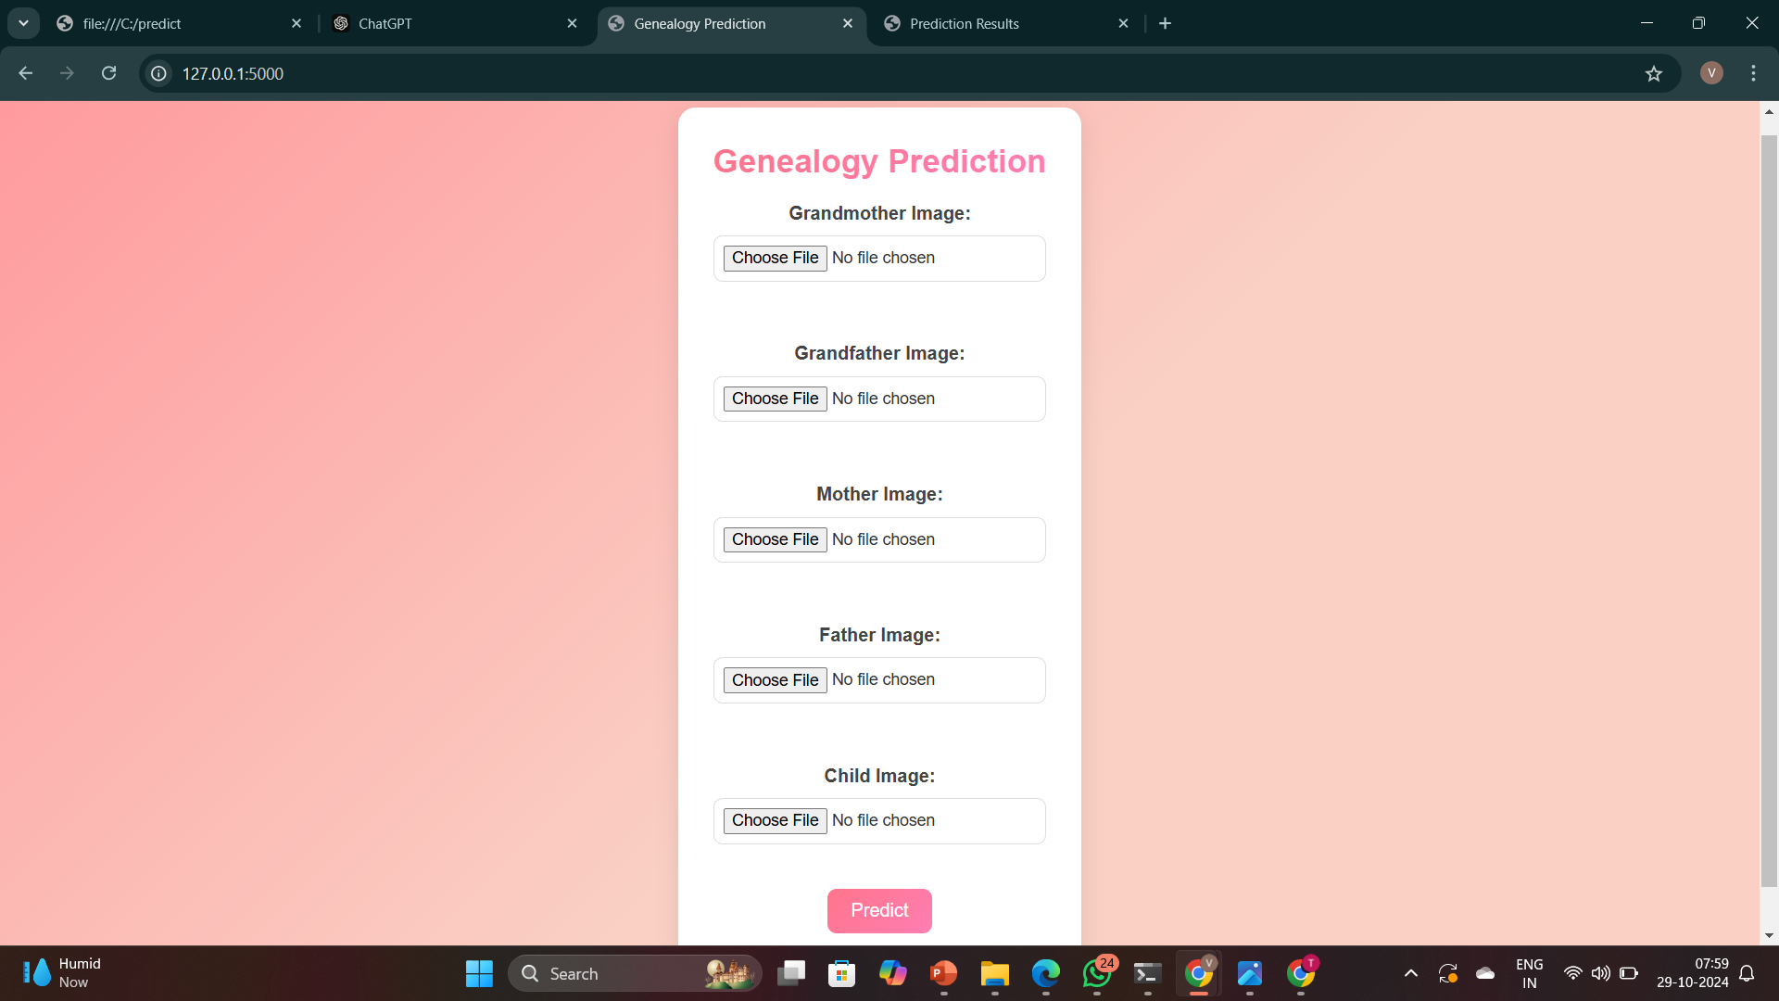
OUTPUT:

Slide 20
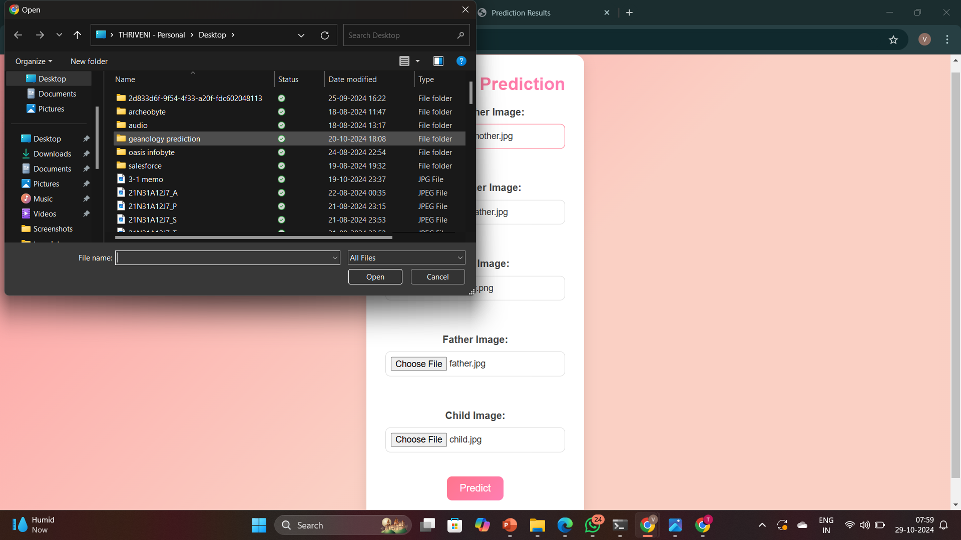

Slide 21
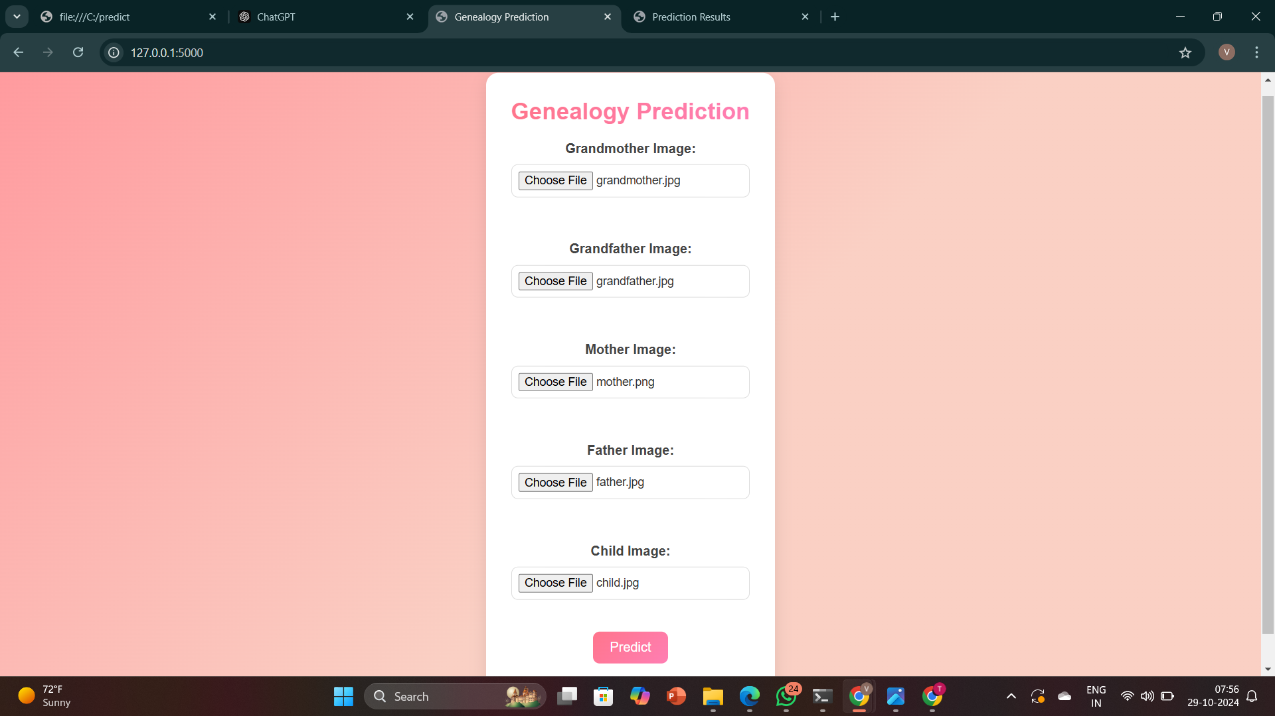

Slide 22
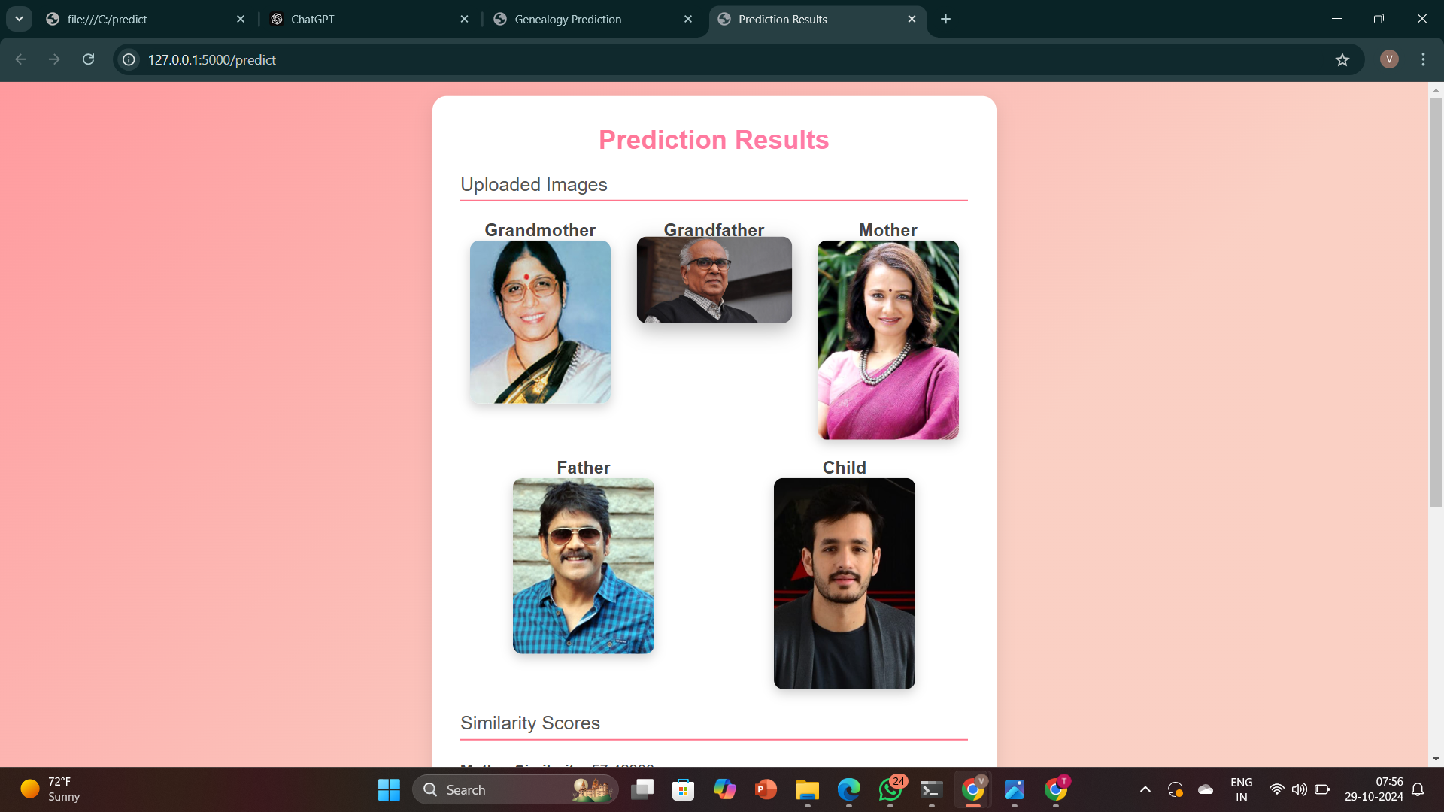

Slide 23
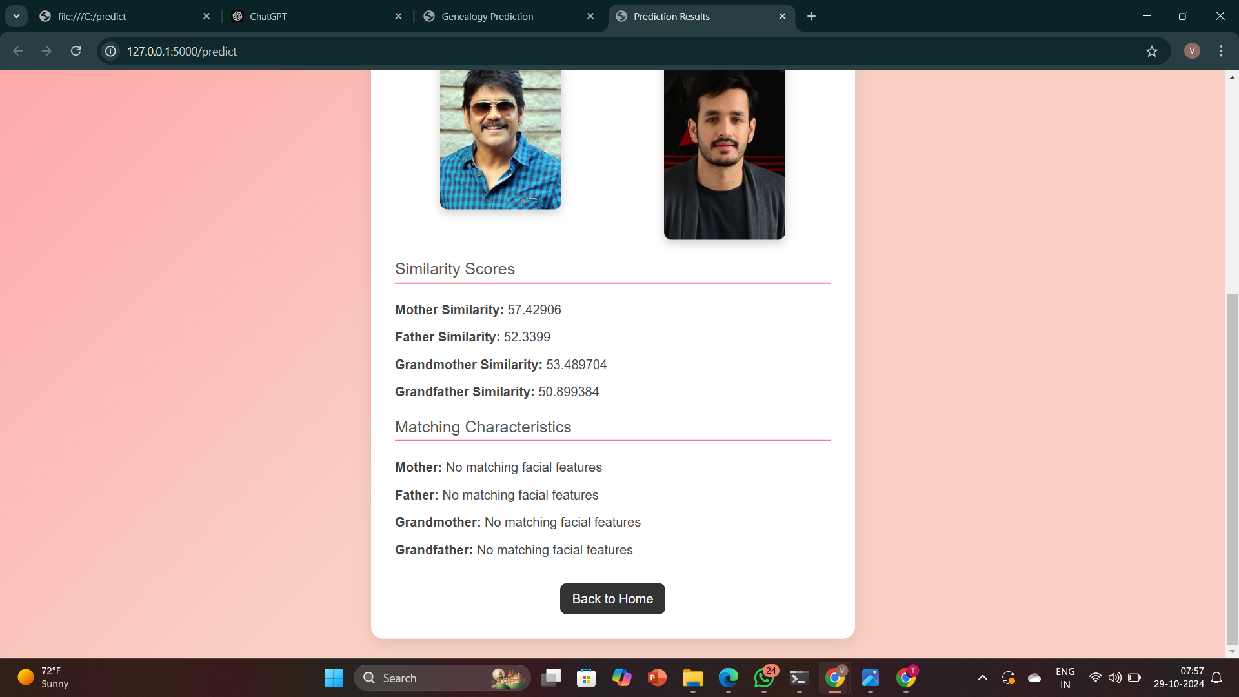

Slide 24
CONCLUSION:
Successfully implemented a CNN-based model to analyze and predict inherited facial traits from images.
The prediction of matching percentages.
Identified key inherited features (e.g.,eyeshape,jawline) between a child and ancestors with high accuracy.
Leveraged VGG16 for efficient feature extraction, enhancing prediction reliability.
Applications:
Genealogical Research: Assists genealogists in tracing inherited traits visually.
Personal Insight: Helps individuals explore their physical inheritance from family.
AI in Genealogy: Demonstrates the potential of AI to enrich genealogy studies.
Achievements:

Slide 25
LeCun, Y., Bengio, Y., & Hinton, G. (2015). Deep learning. Nature, 521(7553), 436-444. Link
Zhang, K., Zhang, Z., Li, Z., & Qiao, Y. (2016). Joint Face Detection and Alignment Using Multitask Cascaded Convolutional Networks. IEEE Signal Processing Letters, 23(10), 1499-1503. Link
Goodfellow, I., Bengio, Y., & Courville, A. (2016). Deep Learning. MIT Press. Link
TensorFlow. (2023). TensorFlow Documentation. Link
PyTorch. (2023). PyTorch Documentation. Link
REFERENCES

Slide 26
THANK YOU

