Slide 1

Project Progress Review (PPR) # nn
<Project Name/Project Id>
Presented By
Date

Slide 2
Agenda
Action items from previous PPR
Executive summary
Size of the project
Schedule and effort
Projections
Metrics
Risk management
Process compliance
Learning's/escalations/issues/concerns
Metrics – Revenue
Integra Proprietary and Confidential

Slide 3
Executive Summary
Project Title
Customer
Shared Vision
Start Date
End Date
Effort
Current Team Size
Project on schedule
Integra Proprietary and Confidential

Slide 4
Action items from previous PPR's
PPR Date | Action Item | Closure Responsibility | Closure Date |  | Remarks
 |  |  | Target | Actual
Integra Proprietary and Confidential

Slide 5
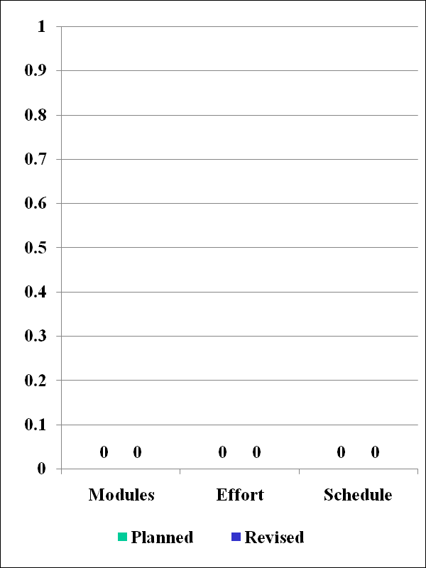
Project Details
Basis of measurement (Unit)‏ KLOC/FP)‏
Planned Modules
Planned Schedule
Planned Effort
Revised Modules
Revised Schedule
Effort based on revised size
Date of Revision
Reason for revision
Approved change controls (No., effort, amount)‏
Integra Proprietary and Confidential

Slide 6
Schedule
Milestone | Start Date |  |  | End Date |  |  | Status | Variance (%)‏ | Reason for Variance
 | P | R | A | P | R | A
Integra Proprietary and Confidential
Notes:
Schedule variance =100 * (Actual end date – Initial planned end date) / (Initial planned end date – Initial planned start date).

Slide 7
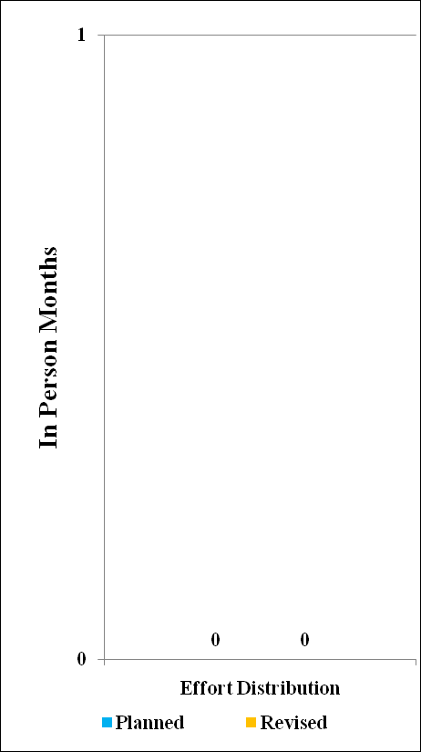
Effort Distribution
Milestone/ Deliverable | Planned Effort in pm | Actual Effort in pm | Reason for Variance
Total
Integra Proprietary and Confidential

Slide 8
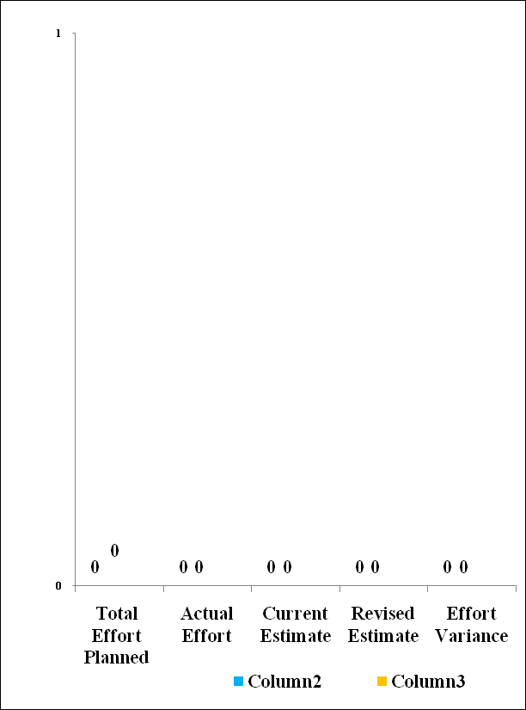
Effort Usage Summary
Variables | Current | Prev1 | Prev2 | Prev3
Total effort planned for the project completion (p)‏
Actual Effort spent till-date (a)‏
Current estimate of effort to complete remaining work (c)‏
Revised estimate (d) = (c) + (a)‏
Effort Variance (%)‏ EV = ((d) – (p))/(p)‏
Integra Proprietary and Confidential

Slide 9
Projections for the next 3 months
Resource | Month 1 | Month 2 | Month 3 | Reason
People
Hardware
Software
Integra Proprietary and Confidential

Slide 10
Metrics – Goals vs. Actual
Metrics | Organizational goal | Project goal | Actual
Effort variance % | ± 15% | ± 15%
Schedule variance % | ± 10% | ± 10%
Defect density (for documents)‏ | <0.4 def/ page | <0.4 def/ page
Defect density (Code review) & UT | < 3 defects/KLOC | < 3 defects/KLOC
Defect density ST | < 1.5 defects/KLOC | < 1.5 defects/KLOC
Defect slippage to customer | < 0.3 defects/KLOC | 95% success on STS < 0.2 defects /page on Docs
Integra Proprietary and Confidential

Slide 11
Metrics – Defect Log
Deliverable | No. of reviews / Testing | Number of Defects
 |  | Severity 1 | Severity 2 | Severity 3 | Severity 4
Initial / Internally Reported
Total |  | (a) | (b) | (c) | (d)
Customer Reported
Total |  | (e) | (f) | (g) | (h)
Grand Total |  | (a)+(e) = S1 | (b) + (f) = S2 | (c) + (g) = S3 | (d) + (h )= S4
% Distribution |  | S1 * 100 / (S1+S2+S3+S4)‏ | S2 * 100 / (S1+S2+S3+S4 | S3 * 100 / (S1+S2+S3+S4)‏ | S4 * 100 / (S1+S2+S3+S4)‏
Integra Proprietary and Confidential

Slide 12
Metrics – Defect Log
Deliverable | Total Defects (Review/Bugs) | Defect Category-wise |  |  | Size (loc /page/ screens) | Metrics (per page, kloc) | Goal (per page, kloc)
 |  | Minor | Major | Critical
Internal
Proposal
SRS
HLD (PPT - Temp)
STS
Application Sprint 1
Customer
Proposal
SRS
HLD
STS
Application Sprint 1
Integra Proprietary and Confidential

Slide 13
Risk Management Plan
Total Number of risks : <Identified +Unforeseen>
Number of unforeseen risks:
Open: < >
Risk Description | Prob (1-100) | Impact (1-10) | Risk Exposure | Mitigation Plan | Contingency Plan
Integra Proprietary and Confidential

Slide 14
Risk Handling
Sl. No | Risk Description | I/UF | How was risk handled?
Integra Proprietary and Confidential

Slide 15
Process Compliance
Process | Date
PMP Approved
Last PPR
Last risk revisit
Data Collection regular
Process Area (s) of concern
-
Integra Proprietary and Confidential

Slide 16
Health Check (month)
Process | Date
Schedule Variance
Effort Variance
Escape Defects
Invoice
-
Integra Proprietary and Confidential

Slide 17
Learnings / Improvements
Lessons learnt
Reusable components developed/ IP developed
Continuous improvement requests raised
Contributions to Organizational Process Assets
-
Integra Proprietary and Confidential
Integra Proprietary and Confidential

Slide 18
Issues / Concerns of Project Team
 | ISSUE | Responsibility | Target Date | Actions Taken | Actions to be taken | Status (Open / Closed)‏
CUST
Sys Admin
Gen Admin
HR
QA
TMG
Others
-
Integra Proprietary and Confidential
Integra Proprietary and Confidential

Slide 19
Escalations done in Project
Sl. No. | Issue Description | Raised date | Raised by | Escalated to | Assigned to | Closure Date
 |  |  |  |  |  | Planned | Actual
-
Integra Proprietary and Confidential
Integra Proprietary and Confidential

Slide 20
Milestones
Sl. No. | Milestone | Date | Amount | Invoice Status | Payment Status
Integra Proprietary and Confidential
Integra Proprietary and Confidential

Slide 21
Customer Feedback
Concerns Raised by Customer | Actions Taken
<>
<>
<>
Appreciations | How did we achieve it ?
<>
<>
Customer satisfaction rating | <Rating> as on <date>
Integra Proprietary and Confidential
Integra Proprietary and Confidential

Slide 22


