Slide 1
알고리즘 설계 및 분석
Foundations of Algorithm
유관우

Slide 2
Chap 3. Dynamic Programming(D.P)
Mergesort, quicksort, binary SRCH, Matrix mult.
  No subproblem overlapping
  D & C is good!!
However, if subproblem overlapping, D.P.
Strategy
  Establish a recursive property
  Solve in a bottom-up fashion - programming
    (Solving smaller instances first →
    save them in an array →
    use them later)
(Eq) Fibonacci seq.

Slide 3
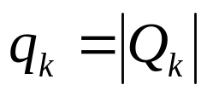
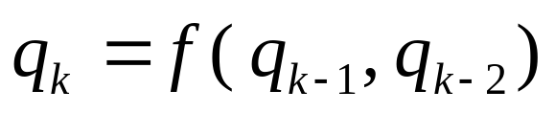


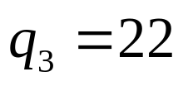

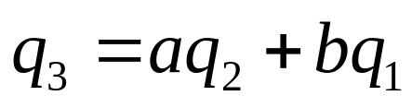

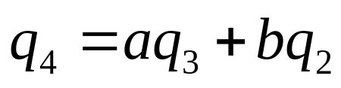
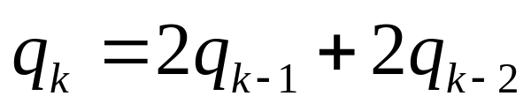
연립방정식 :
2. Recursive Property :

Slide 4
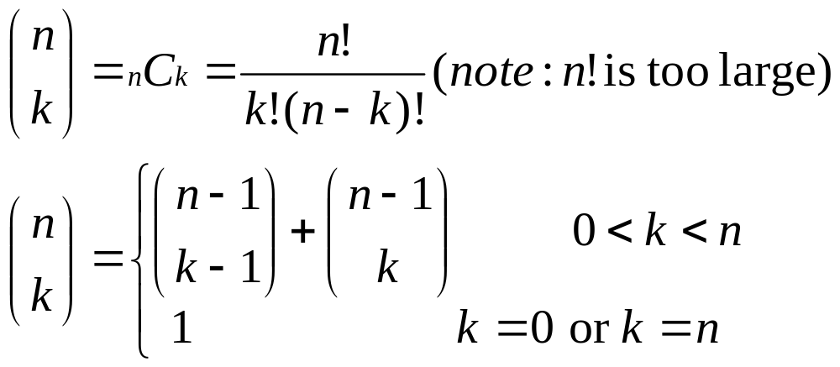
Binomial coefficient
Function bin(n,k:integer):integer;
{
if k=0 or k=n then bin=1;
else bin = bin(n-1,k-1) + bin(n-1,k);
}

Slide 5
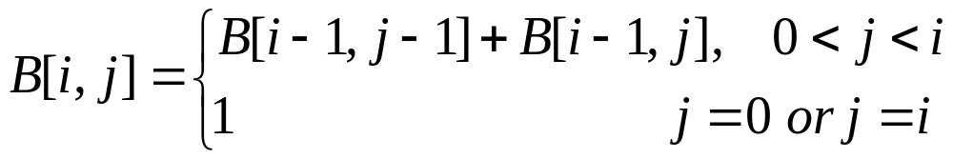
Too much overlapping -> exponential alg.
  Dynamic Programming(D.P.)
  1.Establish a recursive property
  2.Solve in a bottom-up fashion
0 1 2 3 4 j k
0
1
2
3
4
i
n
1
1
1
1
1
…
1
1
1
2
3
4
1
3
6
1
4
1
B[i-1,j-1] B[i-1,j]
B[I,j]

Slide 6
Function bin2(n,k:integer):integer;
var i,j : index
B : array[0..n,0..n] of integer;
{
for i=0 to n do
for j=0 to min(i,k) do
if j=0 or j=i then B[i,j]=1;
else B[i,j]=B[i-1,j-1]+B[i-1,j];
bin2=B[n,k];
}

Slide 7
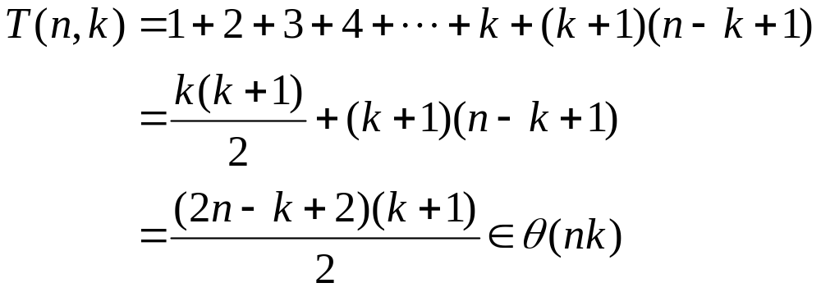
Time complexity Analysis(every-case)
Memory space : (nk) entries
Better way? Yes!
1-D array is enough! Why?
i
0 1 2 3 … k k+1 … n
# passes
1 2 3 4 … k+1 k+1 … k+1
(n-k+1) times

Slide 8
Floyd’s Algorithm for shortest paths
Weighted, directed graph(digraph)
G=(V,E)
Vertex, edge, path
[v₁,v₂,v₃,v₄]
Simple path
Cycle
Cyclic, acyclic
Length[v₁,v₂,v₃]=1+3=4
Length[v₁,v₂,v₄,v₃]=1+2+2=5
Shortest path from v to u
  [v₁,v₄,v₃]: S.P.
1
v₁
v₂
3
9
v₅
5
1
2
3
3
v₄
2
v₃
4

Slide 9
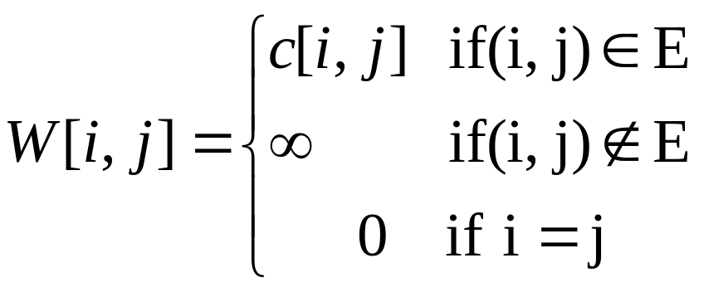
All pairs shortest problem
  “Given any pair (u,v), find a S.P. from u to v”
Naïve Algorithm
  Compute all paths and determine a S.P.
  Worse than exponential time
  ∃(n-2)! Paths from a vertex
More efficient algorithm?
  Yes. Use D.P.
Graph representation!
Adjacency list
Adjacency matrix :W

Slide 10
1
2
1
4
1
5
5
2
1
9
3
3
4
2
3
4
4
4
3
2
5
3
5
1
3
Adjacency list : memory space : O(n+e)

Slide 11
1
2
3
4
5
1
2
3
4
5
1
0
1
∞
1
5
1
0
1
3
1
4
2
9
0
3
2
∞
2
8
0
3
2
5
3
∞
∞
0
4
∞
3
10
11
0
4
7
4
∞
∞
2
0
3
4
6
7
2
0
3
5
3
∞
∞
∞
0
5
3
4
6
4
0
Adjacency matrix W
Distance matrix D
D[i,j]=length of S.P. from i to j
Goal : D[1…n,1..n], P[1..n,1..n]
Assumption : no negative weight cycle!
S.P.

Slide 12
  D^{(k)}[I,j]=length of S.P.
  Only {v₁, v₂, … , v_{k}}
IDEA
  D⁽⁰⁾ = W → D⁽¹⁾ → D⁽²⁾ → ··· → D^{(n)} = D
  (Eg) D⁽⁰⁾ [2,5]=∞
  D⁽¹⁾ [2,5]=min(length[v₂,v₅], length[v₂,v₁,v₅]
  = min(∞, 14)=14
  D⁽²⁾ [2,5]=14 D⁽³⁾ [2,5]=14
  D⁽⁴⁾ [2,5]=min(14,5,13,10)=5 D⁽⁵⁾ [2,5]= 5 = D[2,5]
  D⁽⁰⁾ [i,j]=W[i,j] D^{(n)} [i,j]=W[i,j]
v_{i}
v_{j}
Strategy (Approach)
  1. Establish a recursive property : D^{(k-1)}→D^{(k)}
  2. Solve bottom-up for k=1,2,…,n
    W = D⁽⁰⁾ → D⁽¹⁾ → D⁽² ⁾→ ··· → D^{(n )} = D

Slide 13
  An S.P
  Only {v₁, v₂, … , v_{k}} = I
  Case1: v_{k}∉I, for an S.P.
  D^{(k)}[i,j]=D^{(k-1)}[i,j]
  Case2: v_{k}∈I, for all such S.P’s
  D^{(k)}[i,j]=D^{(k-1)}[i,k]+ D^{(k-1)}[k,j]
    An S.P. using only {v₁,v₂,…,v_{k}}
v_{i}
v_{j}
v_{i}
v_{k}
v_{j}
S.P using only
{v₁, v₂, … , v_{k} ₋₁}
S.P using only
{v₁, v₂, … , v_{k} ₋₁}

Slide 14
  D^{(k)} [i,j]=min(D^{(k-1)} [i,j], D^{(k-1)} [i,k]+D^{(k-1)} [k,j])
  (Eg) D⁽¹⁾ [2,4]= min(D⁽⁰⁾ [2,4], D⁽⁰⁾ [2,1]+D⁽⁰⁾ [1,4])
  = min(2, 9+1)=2
  D⁽¹⁾ [5,2]= min(∞, 3+1)=4
  D⁽¹⁾ [5,4]= min(∞, 3+1)=4
  D⁽²⁾ [5,4]= min(D⁽¹⁾ [5,4], D⁽¹⁾ [5,2]+D⁽¹⁾ [2,4])
  = min(4, 4+2)=4

Slide 15
  Procedure floyd (n : integer; W : array[1..n,1..n] of
  number ; var D : array[1..n,1..n] of number )
  var i,j,k : index;
  {
  D=W // D⁽⁰⁾ = W
  for k = 1 to n do
  for i = 1 to n do
  for j = 1 to n do
  D [i,j]=min(D [i,j], D [i,k]+D [k,j])
  }

Slide 16
  Q ? :Why D is enough instead of D⁽⁰⁾, D⁽¹⁾,…, D^{(n)} ?
  A: In kth iteration
  1. kth row & kth column do not change
  D [i,k]=min(D [i,k], D [i,k]+D [k,k])
  D [k,j]=min(D [k,j], D [k,k]+D [k,j])
  2. D [i,j]←min(D [i,j], D [i,k], D [k,j])
  Change in one entry⇒No effect on
  another Entry
  Time complexity : T(n) = n³∈θ(n³)

Slide 17
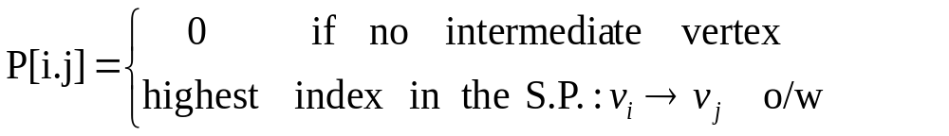
  Compute shortest path?(P)
  Procedure floyd2 (n, W, D, P )
  { P = O ; // O is 0-matrix.
  D = W;
  for k = 1 to n do
  for i = 1 to n do
  for j = 1 to n do
  if D[i,k] +D[k,j] < D[i,j] then
  { P[i,j]=k ;
  D[i,j] = D[i,k]+D[k,j] }
  }

Slide 18
  Procedure print_path (q,r : index)
  { if P[q,r] ≠ 0 then {
  print_path (q, P[q,r]);
  write (‘v’ , P[q,r]);
  print_path (P[q,r],r);}
  }
  ☺Optimization problems
  e.g. All-pairs S.P. O, binomial coef. ×
  ☺Any optimization prob. ⇒ D.P.?
  ☹ No D.P is applicable if principle of optimality
Only intermediate.
Vertices are printed

Slide 19
  Principle of optimality?
  “All subsolutions of an optimal sol. are optimal”
  e.g shortest path s.p form v_{i} to v_{j}
  ⇒ recursive property O
  ⇒ bottom-up construction 가능 (smaller → larger)
v_{i}
v_{k}
v_{j}
S.P
S.P
  e.g. principle of optimality 안 되는 최적화문제
  Longest simple paths problem
  optimal l.s.p. v₁ v₄
  [v₁,v₃,v₂,v₄]
  But, [v₁, v₃] is not optimal
1
v₁
1
3
v₂
v₃
2
4
v₄

Slide 20
Chained matrix Multiplication
Multiplying A = (a_{ij})_{p×q} B = (b_{ij})_{q×r}
Standard method : pqr multiplications
Multiplying chained matrices?
e.g. A × B × C × D
20 ×2 2 ×30 30 ×12 12 ×8
Note : Associativity
A(B(CD)) = 30 ·12 ·8 + 2 ·30 ·8 + 20 ·2 ·8 = 3680
(AB)(CD) = 20 ·2 ·30 + 30 ·12 ·8 + 20 ·30 ·8 = 8880
A((BC)D) = 2 ·30 ·12 + 2 ·12 ·8 + 20 ·2 ·8 = 1232
((AB)C)D = 20 ·2 ·30 + 20 ·30 ·12 + 20 ·12 ·8 = 10,320
(A(BC))D = 2 ·30 ·12 + 20 ·2 ·12 + 20 ·12 ·8 = 3120

Slide 21
  ☺Problem : Find an optimal order for mult. n mat
  ☹Naïve Alg : “consider all possible orders”
  t_{n} : # different orders for A₁, A₂, …, A_{n}
  t_{n} ≥ t_{n-1} + t_{n-1} =2 t_{n-1} A₁, (A₂, …, A_{n})
  t_{n} ≥2^{n-2} (A₁, A₂, …, )A_{n}

Slide 22
Principle of Optimality ? Yes
If optimal order : (A₁…A_{k} ) (A_{k+1}…A_{n} )
M[i,j] = min # mult. For A_{i} x A_{i+1}x…xA_{j}
M[i,j]=0
(E.g.) A₁ x A₂ x A₃ x A₄ x A₅ x A₆
5 x 2 x 3 x 4 x 6 x 7 x 8
d₀ x d₁ x d₂ x d₃ x d₄ x d₅ x d₆
        (A₄ A₅ ) A₆ : 4·6·7 + 4·7·8 = 392
        A₄(A₅ A₆ ) : 6·7·8 + 4·6·8 = 528
        M[4,6] = min(392, 528) = 392
optimal
optimal

Slide 23
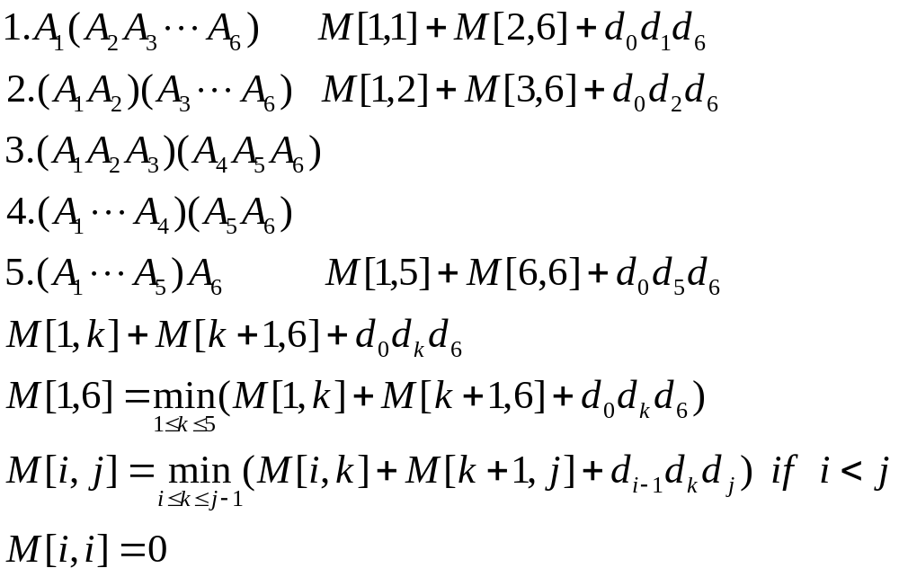
Optimal order? : one of the following’s
……..

Slide 24
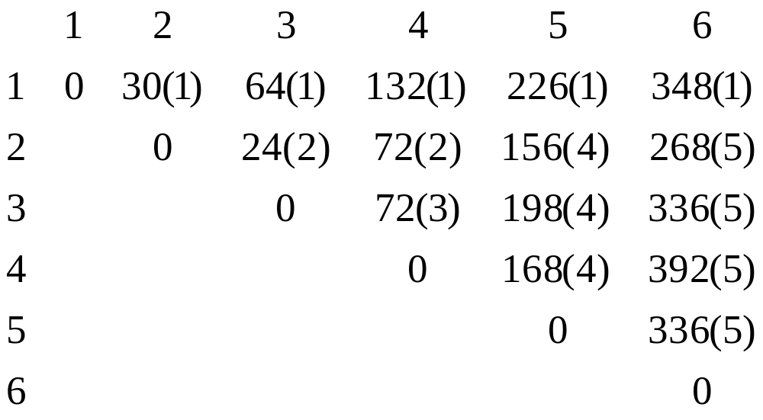
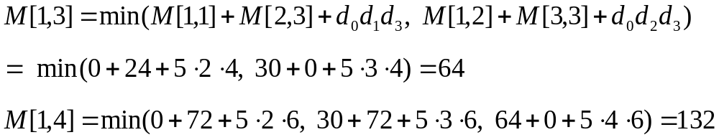
Note: too much overlapping D-&-C X
D.P: O.K
(Eg) A₁ x A₂ x A₃ x A₄ x A₅ x A₆
5 2 3 4 6 7 8
(j)
(i)

Slide 25
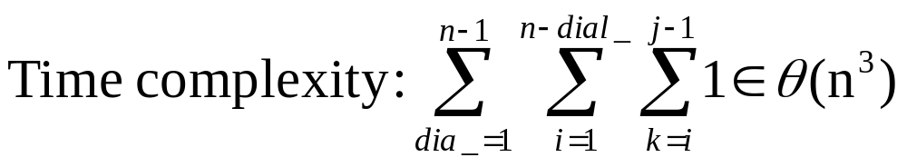
Function minmult(n:integer; d: array[0…n] of integer;
var p: array[1…n-1,1..n] of index): integer;
var i,j,k,diagonal: index;
M : array[1..n,1..n] of integer;
{ For i=1 to n do M[i,i]=0;
For diagonal =1 to n-1 do
For i=1 to n-diagonal do {
j=i+diagonal;
M[i,j]=
p[i.j]=a value of such k; }
minmult =M[1,n];
}
Procedure print_order(i,j : index);
{ if i==j then write (‘A’,i);
Else { k=p[i,j] ; write (‘(’);
print_order(i,k);
print_order(k+1,j);
write(‘)’);
}
}
print_order(1,n);
T(n)∈Θ(n)
Current best alg. Θ(nlgn) Hu&shing(’82,’84)

Slide 26
The Traveling Salesperson Problem
Euler cycle : visit each edge once.
Hamiltonian cycle: visit each node once. (tour)
The T.S.P. problem;
  Determine a shortest route(H.C.). (find an optimal tour)
Naive Alg. :”consider all possible tours” (n-1)! Tours
Principle of Optimality : v₁ → v_{k}
D.P can be used.
2
v₁
v₂
Length[1,2,3,4,1]=22
Length[1,3,2,4,1]=26
Length[1,3,4,2,1]=21
1
6
7
6
3
v₄
4
9
v₃
8
optimal
optimal

Slide 27
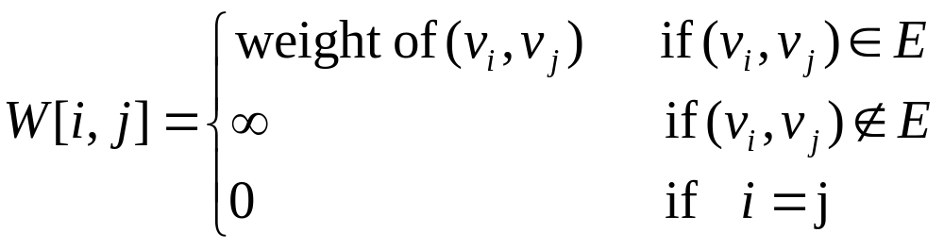

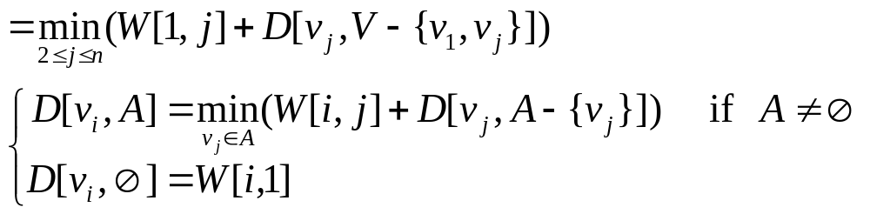
Input: Graph Adjacency Matrix W.
  V: the set of all the vertices {v₁,…v_{n}}.
  A: A V
  D[v_{i},A]= length of an S.P
  passing through each of A exactly once.
(Eg) A= {v₃}: D[v₂,A] = length [v₂,v₃,v₁] = 15
  A={v₃,v₄} :
  D[v₂,A]=min(length[2,3,4,1], length[2,4,3,1])=min(20,∞)=20
  Length of an optimal tour
v_{i}
v₁

Slide 28
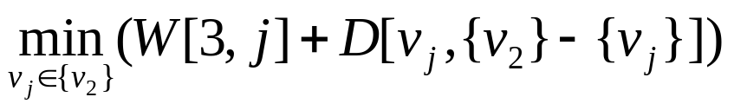
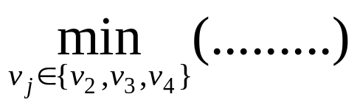
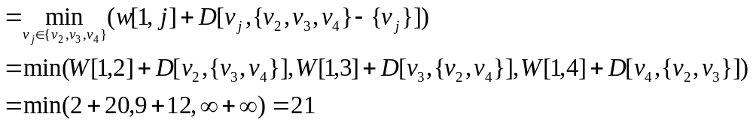
D[v₂,ø]=1, D[v₃,ø]=∞, D[v₄,ø]=6
D[v₃, {v₂} ]=
=W[3,2]+D[v₂,ø]=7+1=8
D[v₄, {v₂} ]=3+1=4
D[v₂, {v₃} ]=6+∞=∞
D[v₄, {v₃} ]= ∞ +∞=∞
D[v₂, {v₄} ]=4+6=10
D[v₃, {v₄} ]=8+6=14
D[v₄, {v₂ ,v₃} ], D[v₃, {v₂ ,v₄} ], D[v₂, {v₃ ,v₄} ]
D[v₁, {v₂ ,v₃ ,v₄} ]=

Slide 29

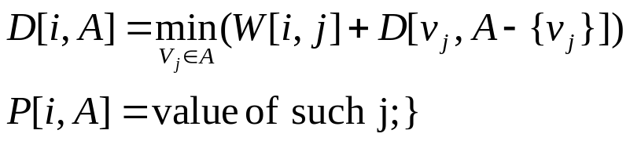
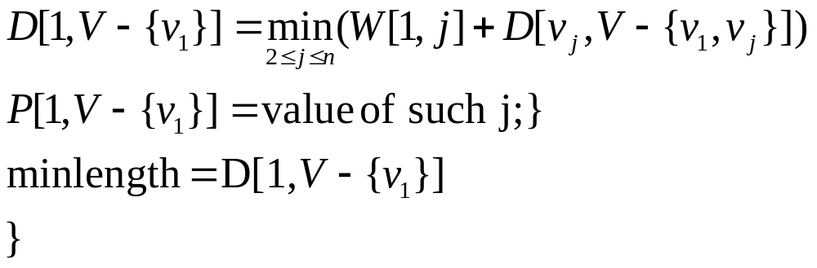
Procedure travel(n: integer;
    W: array[1..n,1…n] of number;
    var P : array[1..n,subset of V-{v₁}] of index;
    var minlength :number);
    var i,j,k : index;
    D:array[1..n, subset of V- {v₁}] of number;
  { for i=2 to n do D[i,ø]=W[i,1];
  for k=1 to n-2 do
  for all subsets A V- {v_{i}} s.t. |A|=k do
  for i s.t. i≠1 & v_{i} A do {

Slide 30
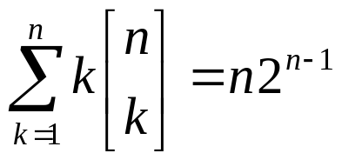
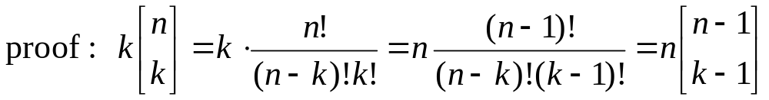
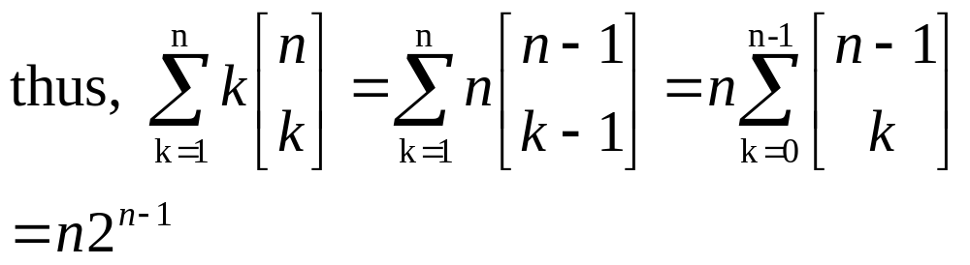
How to represent set A?
  Binary representation: n bits for a set.
Theorem:

Slide 31
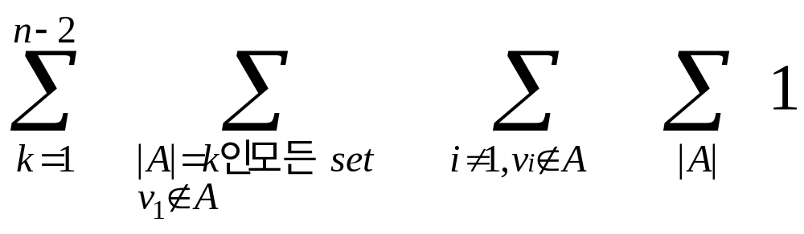
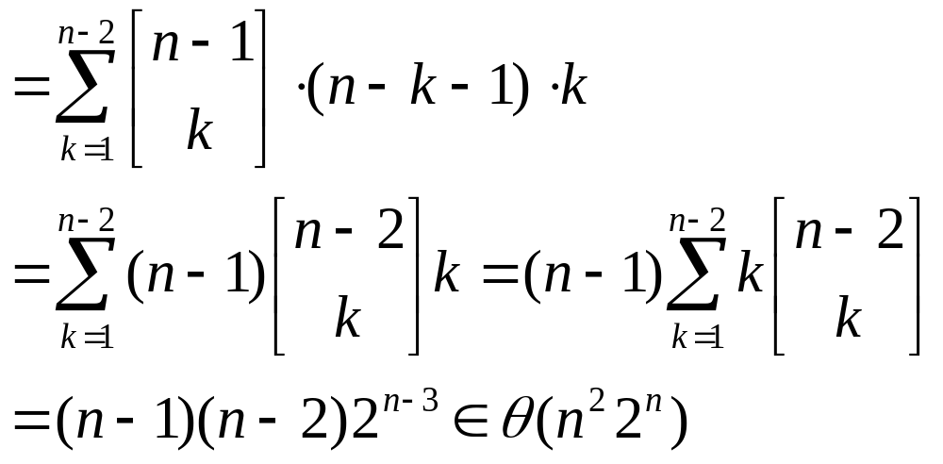
Time-complexity

Slide 32
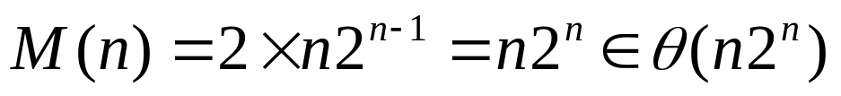




(Eg) n=20
Brute-force alg. :
D.P :
How about
    Just give up & go to chapter 9.
Optimal Tour?
(Eg)
Optimal tour :[v₁, v₃,v₄, v₂, v₁}
NP-hard problem : chapter 9
3
4
2
P[1,{v₂,v₃,v₄}]
P[3,{v₂,v₄}]
P[4,{v₂}]

Slide 33
Optimal Binary Search Trees
  Binary Search Tree (BST)
Each node : one key
p → key >= keys in Left_Subtree(p)
p → key <= keys in Right_Subtree(p)
D
R
C
R
D
U
I
U
C
I
T
W
T
W
  balanced
  Depth of a node = level of a node
  Depth of a tree

Slide 34
struct nodetype
{
keytype key;
  nodetype* left;
  nodetype* right;
};
typedef nodetype* node_pointer;

Slide 35
Algorithm 3.8 : Search Binary Trees
void search (node_pointer tree, keytype keyin, node_pointer& p)
{
bool found;
p = tree;
found = false;
while (!found && p)
if (p→key == keyin)
found = true;
else if (keyin < p→key);
p = p→left; //Advance to left child.
else
p = p→right; //Advance to right child.
}

Slide 36
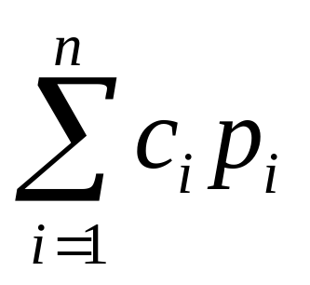
Search time for a given key:
depth (key) + 1
Optimal Binary Search Tree :
n keys,
key1 ≤ key2 ≤…. ≤key n
p_{i} : probability (key i)
c_{i} : #comparisons (key i)
Minimize the average search time

Slide 37
Eg3.7) p₁= 0.7, p₂=0.2, p₃=0.1
3(0.7)+2(0.2)+1(0.1)=2.6
2(0.7)+3(0.2)+1(0.1)=2.1
2(0.7)+1(0.2)+2(0.1)=1.8
1(0.7)+3(0.2)+2(0.1)=1.5
1(0.7)+2(0.2)+3(0.1)=1.4
1
2
3
4
5
key₃
key₃
key₂
key₁
key₁
key₂
key₁
key₁
key₃
key₃
key₂
key₁
key₂
key₂
key₃

Slide 38
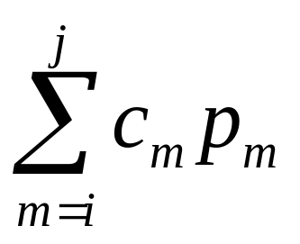
Naive Algorithm :
  Construct all BST’s and find an optimal BST.
#(n-node BST’s) : >= 2^{n-1} (Why?)
N(n) >= 2 N(n-1) if n > 1,
N(1) = 1 otherwise.
( N(n) >= 2N(n-1) >= 2² N (n-2) …. >= 2^{n-1} (N(1)) = 2^{n-1} )
Too many BST’s
Better way? Yes! D.P.
  A[i][j] : avg. search time of an optimal BST with
  Key_{i} …. Key_{j}
  minimize

Slide 39
Eg3.8 ) p₁= 0.7, p₂=0.2, and p₃=0.1
1(p₂)+2(p₃)=1(0.2)+2(0.1)=0.4
2(p₂)+1(p₃)=2(0.2)+1(0.1)=0.5
  A[2][3]=0.4
1
2
key₂
key₃
key₃
key₂

Slide 40
For each key, there is one additional comparison at the root
key_{K}
Average search time in this subtree is A[1][k-1]
Average search time in this subtree is A[k+1][n]
Key₁ ,…, key_{k-1}
Key_{k+1} ,…, key_{n}
  Optimal binary search tree given that Key_{k} is at the root

Slide 41
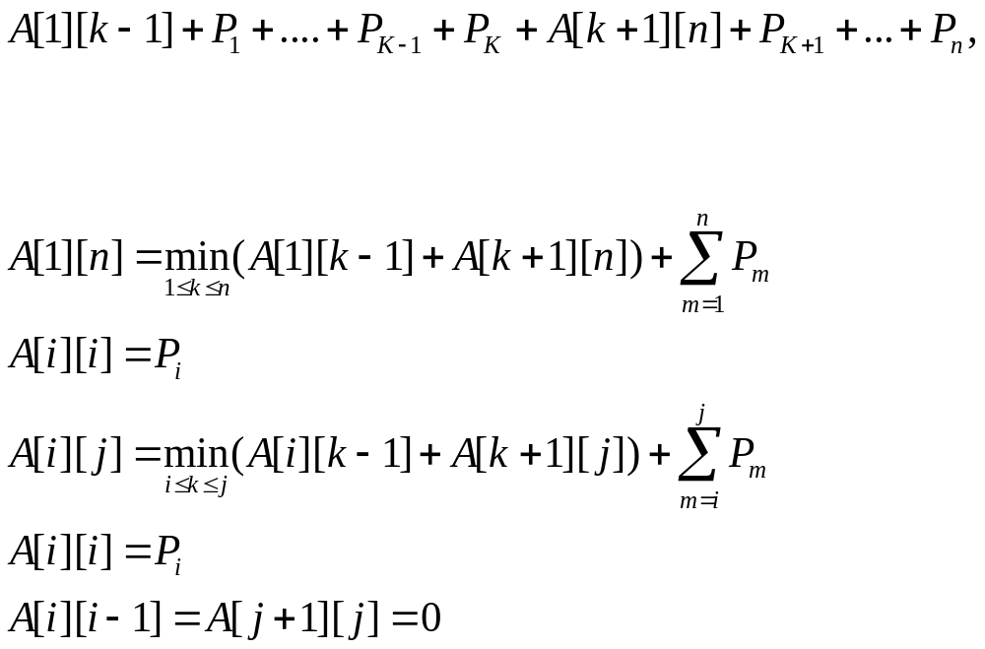
  Average time in left subtree
  Additional time comparing at root
  Average time searching for root
  Average time in right subtree
  Additional time comparing at root

Slide 42
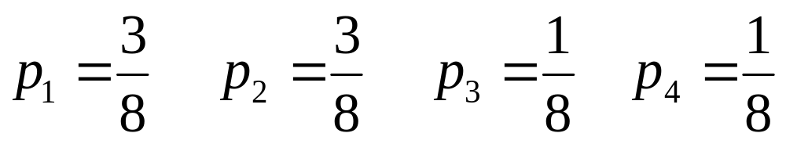






Eg3.9) Array Key :
Don
Isabelle
Ralph
Wally
Key[1]
Key[2]
Key[3]
Key[4]
0
1
2
3
4
0
1
2
3
4
I
1
0
1
0
1
1
2
2
D
R
2
0
1
2
0
2
2
2
0
3
0
3
3
W
3
4
0
4
0
4
5
0
5
0
A
R

Slide 43
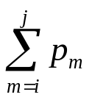

Algorithm 3.9 : Optimal Binary Search Tree
void optsearchtree (int n, const float p[ ], float& minavg, index R[ ][ ])
{
index i, j, k, diagonal;
float A[1..n+1] [0..n];
for ( i = 1; i <= n; i++ ) {
A[i][i-1] = 0;
A[i][i] = p[i];
R[i][i] = i;
R[i][i-1] = 0;
}
A[n+1][n] = 0;
R[n+1][n] = 0;
for ( diagonal =1 ; diagonal <= n-1 ; diagonal ++ )
for ( i=1 ; i <= n - diagonal ; i++ ) {
j = i + diagonal;
A[i][j] = (A[i][k-1]+A[k+1][j]) +
R[i][j] = a value of k that gave the minimum;
}
minavg = A[1][n];
}

Slide 44
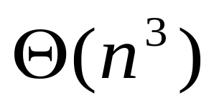
Algorithm 3.9 : Time Complexity
Build Optimal Binary Search Tree
node_pointer tree ( index i, j)
{
  index k;
  node_pointer p;
  k = R[i][j];
  if( k == 0) return NULL;
  else{
    p= new nodetype;
    p -> key = Key[k];
    p -> left = tree (i, k-1);
    p -> right = tree (k+1, j);
    return p;
    }
}
root = tree (1, n);

