Slide 1
Tournament Trees
CSE, POSTECH

Slide 2
Tournament Trees
Used when we need to break ties in a prescribed manner
  To select the element that was inserted first
  To select the element on the left
Like the heap, a tournament tree is a complete binary tree that is most efficiently stored using array-based binary tree
Used to obtain efficient implementations of two approximation algorithms for the bin packing problem (another NP-hard problem)
Types of tournament trees: winner & loser trees

Slide 3
Tournament Trees
The tournament is played in the sudden-death mode
  A player is eliminated upon losing a match
  Pairs of players play until only one remains
The tournament tree is described by a binary tree
  Each external node represents a player
  Each internal node represents a match played
  Each level of internal nodes defines a round of matches
Tournament trees are also called selection trees
See Figure 13.1 for tournament trees

Slide 4
Winner Trees
Definition
A winner tree for n players is a complete binary tree with n external nodes and n-1 internal nodes. Each internal node records the winner of the match.
To determine the winner of a match, we assume that each player has a value
In a min (max) winner tree, the player with the smaller (larger) value wins
See Figure 13.2 for winner trees

Slide 5
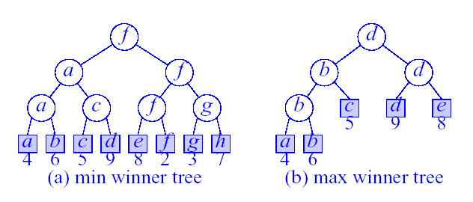
Winner Trees
The height is ⎡log₂(n+1)⎤ (excludes the player level)
What kind of games would use (a) min winner tree?
What kind of games would use (b) max winner tree?

Slide 6
Winner Tree Operations
Select winner
  O(1) time to play match at each match node.
Initialize
  n-1 match nodes
  O(n) time to initialize n-player winner tree
Remove winner and replay
  O(log n) time

Slide 7
Winner Tree Sorting Method
Read Example 13.1
Put elements to be sorted into a min winner tree.
Remove the winner and replace its value with a large value (e.g., ∞).
replay the matches.
If not done, go to step 2.

Slide 8
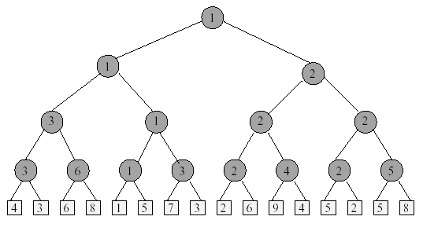
Sort 16 Numbers
1. Initialize the min winner tree

Slide 9
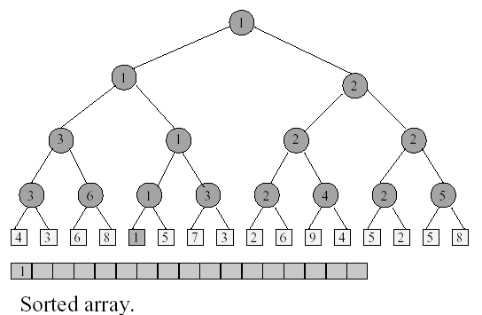
Sort 16 Numbers
2. Remove the winner and replace its value

Slide 10
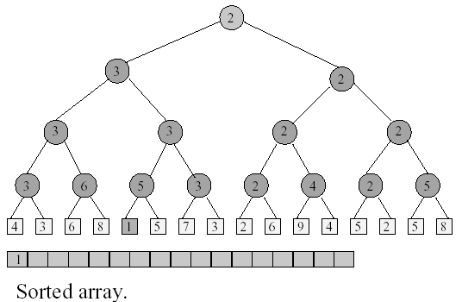
Sort 16 Numbers
3. Replay the matches

Slide 11
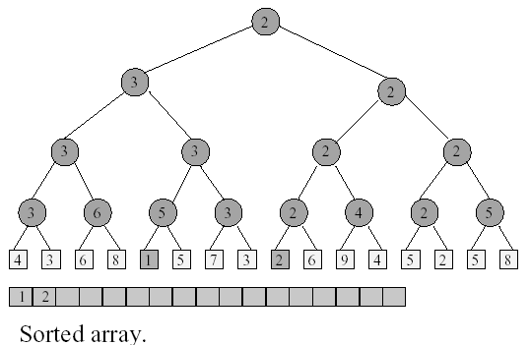
Sort 16 Numbers
Remove the winner and replace its value

Slide 12
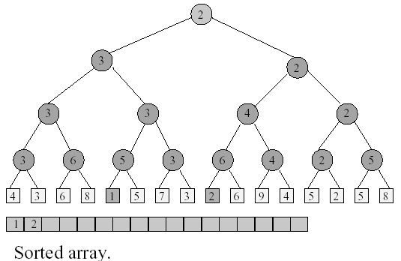
Sort 16 Numbers
Replay the matches

Slide 13
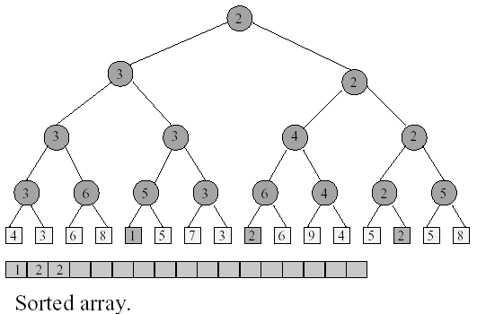
Sort 16 Numbers
Remove the winner and replace its value

Slide 14
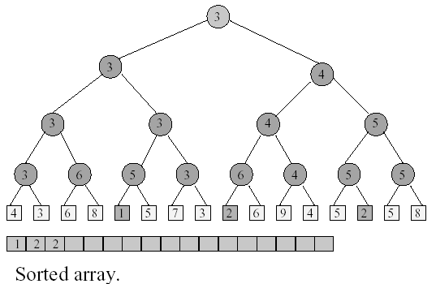
Sort 16 Numbers
Replay the matches

Slide 15
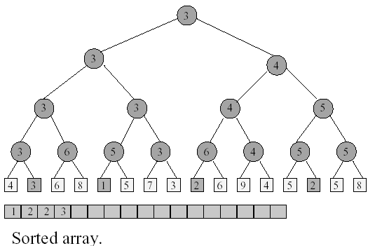
Sort 16 Numbers
Remove the winner and replace its value
Continue in this manner….

Slide 16
Time To Sort
Initialize winner tree: O(n) time
Remove winner and replay: O(logn) time
Remove winner and replay n times : O(nlogn) time
Thus, the total sort time is O(nlogn)

Slide 17
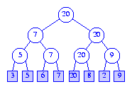
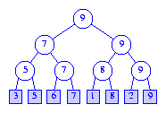
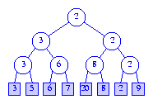
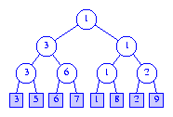
Exercise 1 – [3, 5, 6, 7, 20, 8, 2, 9]
Max Winner Tree
Min Winner Tree
After the change, the max winner tree becomes:
After the change, the min winner tree becomes:
Is this correct?

Slide 18
The ADT WinnerTree
Read ADT 13.1 for Winner Tree ADT specification
Read Program 13.1 for the abstract class winnerTree

Slide 19
The Winner Tree Representation
Using the array representation of a complete binary tree
A winner tree of n players requires n-1 internal nodes tree[1:n-1]
The players (external nodes) are represented as an array player[1:n]
tree[i] is an index into the array player and gives the winner of the match played at node i
See Figure 13.4 for tree-to-array correspondence

Slide 20
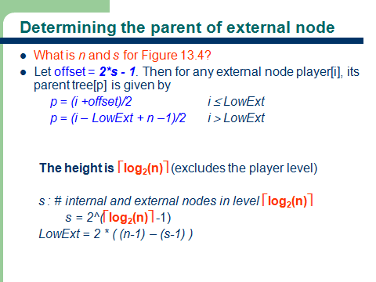
Determining the parent of external node

Slide 21
Determining the parent of external node
What is n and s for Figure 13.4?
Let offset = 2*s - 1. Then for any external node player[i], its parent tree[p] is given by
  p = (i +offset)/2 i ≤ LowExt
  p = (i – LowExt + n –1)/2 i > LowExt
  The height is ⎡log₂(n)⎤ (excludes the player level)
  s : # internal and external nodes in level ⎡log₂(n)⎤
  s = 2^(⎡log₂(n)⎤ -1)
  LowExt = 2 * ( (n-1) – (s-1) )

Slide 22
Loser Trees
Definition
A loser tree for n players is also a complete binary tree with n external nodes and n-1 internal nodes. Each internal node records the loser of the match.
The overall winner is recorded in tree[0]
See Figure 13.5 for min loser trees
Read Section 13.4

Slide 23
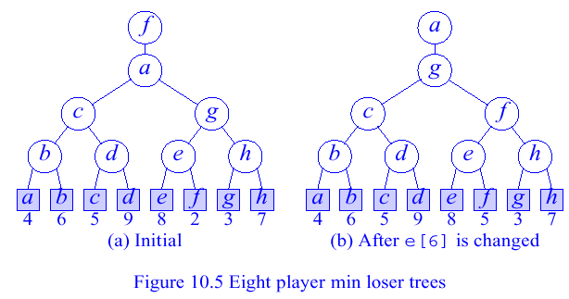
Example Min Loser Trees
Figure 13.5 Eight-player min loser trees
What is wrong with the min loser tree (b)?

Slide 24
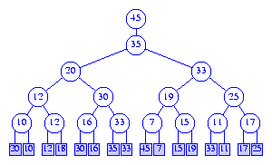

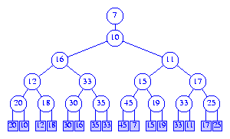
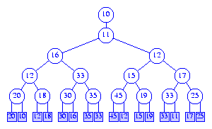
Exercise 15 – [20, 10, 12, 18, 30, 16, 35, 33, 45, 7, 15, 19, 33, 11, 17, 25]
Max Loser Tree
Min Loser Tree
After the change, the max loser tree becomes:
After the change, the min loser tree becomes:

Slide 25
Bin Packing Problem
We have bins that have a capacity binCapacity and n objects that need to be packed into these bins
Object i requires objSize[i], where 0 < objSize[i] ≤ binCapacity, units of capacity
Feasible packing - an assignment of objects to bins so that no bin’s capacity is exceeded
Optimal packing - a feasible packing that uses the fewest number of bins
Goal: pack objects with the minimum number of bins
The bin packing problem is an NP-hard problem
  → We use approximation algorithms to solve the problem

Slide 26
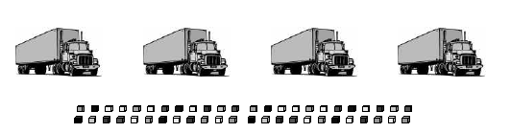
Truck Loading Problem
Have parcels to pack into trucks
Each parcel has a weight
Each truck has a load limit
Goal: Minimize the number of trucks needed
Equivalent to the bin packing problem
Read Examples 13.4 & 13.5

Slide 27
Bin Packing Approximation Algorithms
First Fit (FF)
First Fit Decreasing (FFD)
Best Fit (BF)
Best Fit Decreasing (BFD)

Slide 28
First Fit (FF) Bin Packing
Bins are arranged in left to right order.
Objects are packed one at a time in a given order.
Current object is packed into the leftmost bin
into which it fits.
If there is no bin into which current object fits,
start a new bin.

Slide 29
Best Fit (BF) Bin Packing
Let bin[j].unusedCapacity denote the capacity available in bin j
Initially, the available capacity is binCapacity for all bins
Object i is packed into the bin with the least unusedCapacity that is at least objSize[i]
If there is no bin into which current object fits,
start a new bin.

Slide 30
First Fit Decreasing (FFD) Bin Packing
This method is the same as FF except that the objects are ordered in a decreasing size so that objSize[i] ≥ objSize[i+1], 1 ≤ i < n

Slide 31
Best Fit Decreasing (BFD) Bin Packing
This method is the same as BF except that the objects are ordered as for FFD

Slide 32
Bin Packing Example
Assume four objects with objSize[1:4] = [3, 5, 2, 4]
Assuming each bin’s capacity is 7, what would the packing be if we use FF, BF, FFD, or BFD?
FF
  Bin 1: objects 1 & 3, Bin 2: object 2, Bin 3: object 4
BF
  Bin 1: objects 1 & 4, Bin 2: objects 2 & 3
FFD
  Bin 1: objects 2 & 3, Bin 2: objects 1 & 4
BFD
  Bin 1: objects 2 & 3, Bin 2: objects 1 & 4
Read Example 13.6

Slide 33
First Fit Bin Packing with Max Winner Tree
Use a max winner tree in which the players are n bins and the value of a player is the available capacity binCapacity in the bin.
Read the section on First Fit and Winner Trees on pp. 521 & See Figure 13.6 for first-fit (FF) max winner trees
See Program 13.2 for the first-fit bin packing program

Slide 34
First Fit Bin Packing with Max Winner Tree
Example: n=8, binCapacity=10, objSize[] = {8,6,5,3,6,4,2,7}
1
1
5
1
3
5
7
10
10
10
10
10
10
10
10
1
2
3
4
5
6
7
8
Initial
bin[tree[1]].unusedCapacity >= objSize[1]?

Slide 35
First Fit Bin Packing with Max Winner Tree
Example: n=8, binCapacity=10, objSize[] = {8,6,5,3,6,4,2,7}
2
2
5
2
3
5
7
2
10
10
10
10
10
10
10
1
2
3
4
5
6
7
8
After objSize[1]=8 packed
Where will objSize[2]=6 be packed into?

Slide 36
First Fit Bin Packing with Max Winner Tree
Example: n=8, binCapacity=10, objSize[] = {8,6,5,3,6,4,2,7}
3
3
5
2
3
5
7
2
4
10
10
10
10
10
10
1
2
3
4
5
6
7
8
After objSize[2]=6 packed
Where will objSize[3]=5 be packed into?

Slide 37
First Fit Bin Packing with Max Winner Tree
Example: n=8, binCapacity=10, objSize[] = {8,6,5,3,6,4,2,7}
4
4
5
2
4
5
7
2
4
5
10
10
10
10
10
1
2
3
4
5
6
7
8
After objSize[3]=5 packed
Where will objSize[4]=3 be packed into?

Slide 38
First Fit Bin Packing with Max Winner Tree
Example: n=8, binCapacity=10, objSize[] = {8,6,5,3,6,4,2,7}
4
4
5
1
4
5
7
2
1
5
10
10
10
10
10
1
2
3
4
5
6
7
8
After objSize[4]=3 packed
Where will objSize[5]=6 be packed into?

Slide 39
First Fit Bin Packing with Max Winner Tree
Example: n=8, binCapacity=10, objSize[] = {8,6,5,3,6,4,2,7}
5
3
5
1
3
5
7
2
1
5
4
10
10
10
10
1
2
3
4
5
6
7
8
After objSize[5]=6 packed
Where will objSize[6]=4, objSize[7]=2 and objSize[8]=7 be packed into?

Slide 40
More Bin Packing with Max Winner Tree
Exercise – Do the same example using BF, FFD, BFD with Max Winner Tree
Do Exercise 13.23
READ Chapter 13

