Slide 1
Week 3 Assignment
Accio Alpha
Paramater Exploration tasks

Slide 2
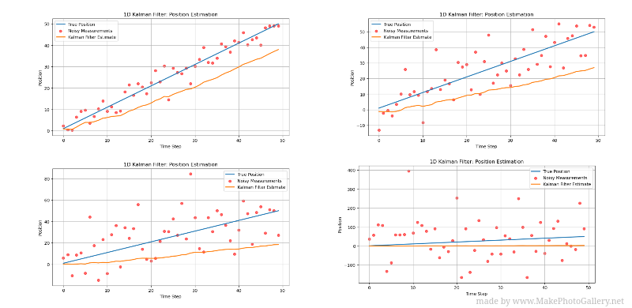
Increasing R(Measurement noise)
The following graphs show how the results evolve with increasing R values.
The measurements tend to spread out more from true values, and predictions
Dominate the estimate. Less trust is placed on the measurements and more on
the prediction model. A smaller Kalman gain is observed
Top left: R = 4
Top right: R = 8
Bottom left: R = 10
Bottom right: R = 100

Slide 3
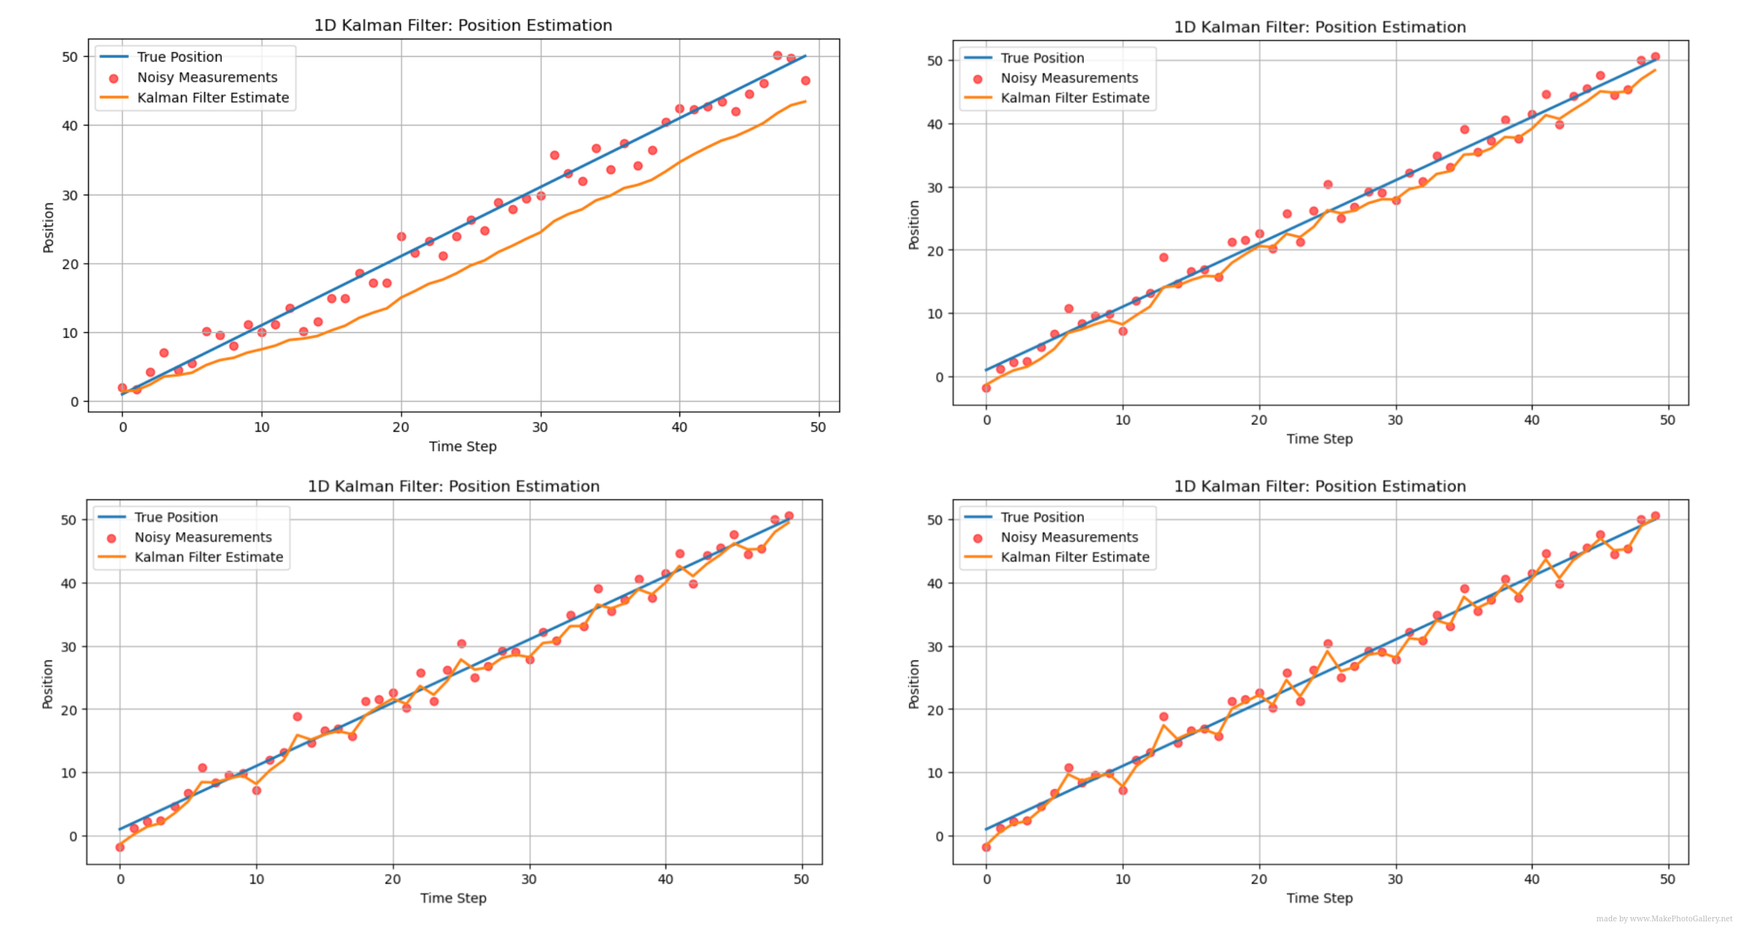
Increasing Q(Process noise)
Increasing Q(process noise) places less certainty on the Prediction
Model and more trust on the measurements. As a result the graph
is noisy but follows the measurements more closely
Top Left: Q - 0.1
Top Right: Q - 1
Bottom Left: Q - 3
Bottom Right: Q - 10

Slide 4
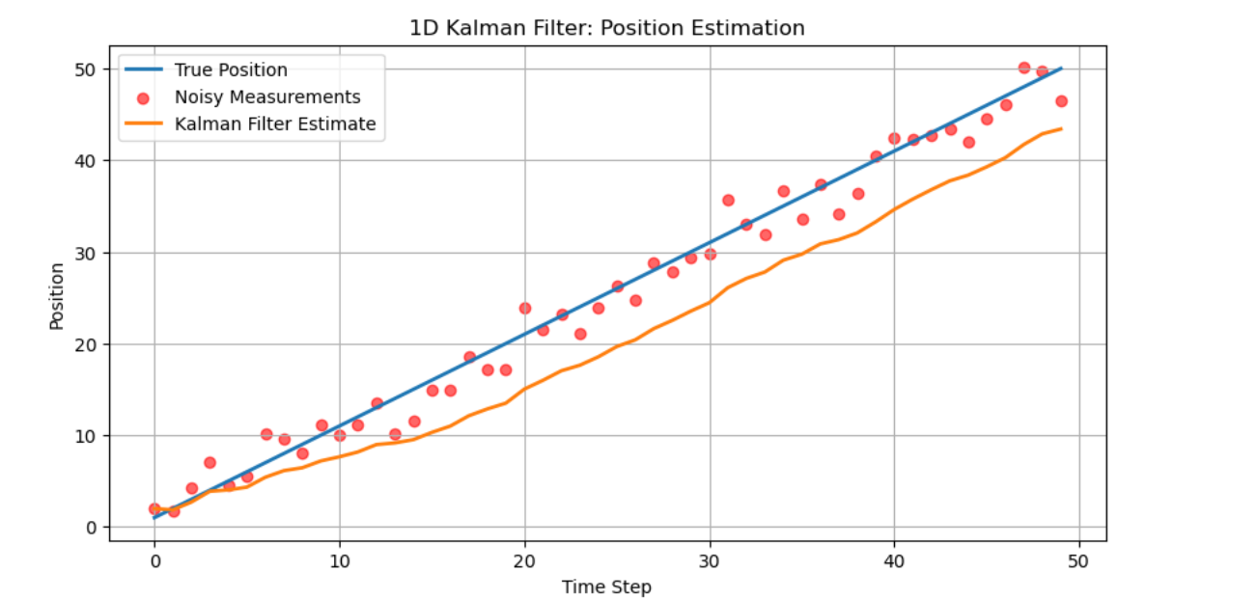
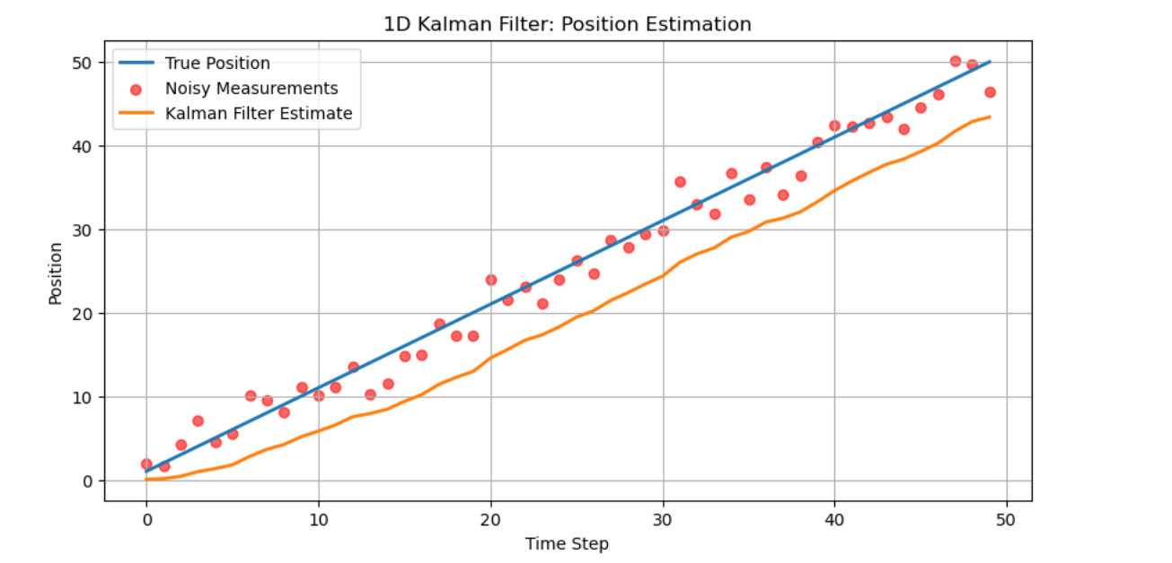
Starting with very small initial uncertainty (P)
When estimates graph is plotted with varying P values, I noticed that for large P values the model trusts the measurements more right from the early stages, however with smaller P values the filter response is slightly delayed.
Initially the Kalman gain is very low and measurements are mostly ignored. However as the filter goes, the Kalman gain increases and the filter adjusts and converges to the true state.
Large p
Small p

Slide 5
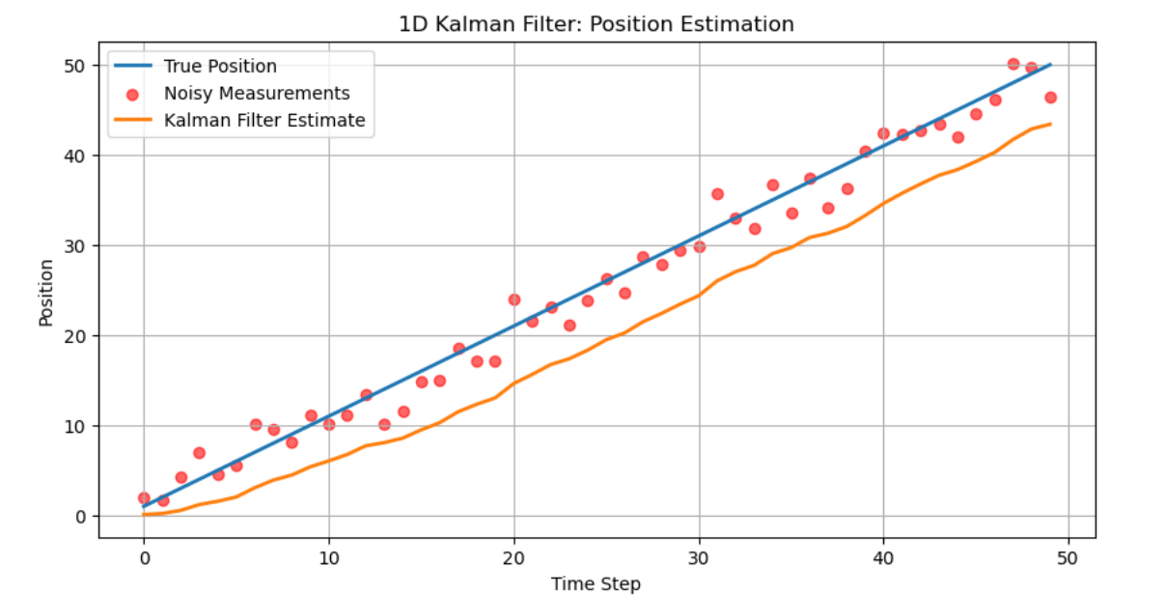
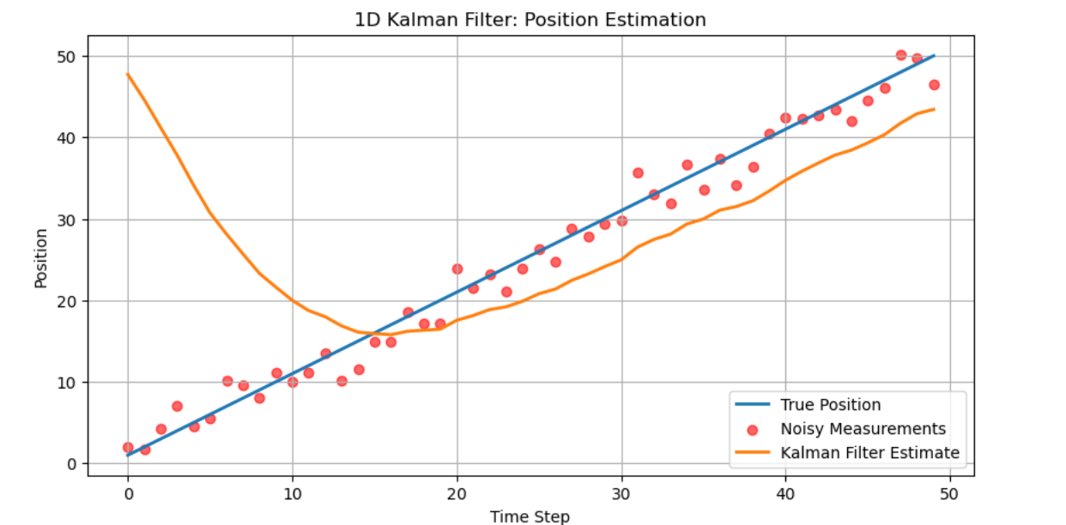
Starting with a very wrong initial state
Yes the filter does recover as long as there is non zero Process noise Q.
Original
Using a wrong guess (50 in this case)

