Slide 1

Sleepwalking Detection and Prevention System Using IoT
This presentation explores a novel IoT-based wearable system to detect and prevent sleepwalking incidents.
by
K P Bhoomika Rai
Thrisha J Shetty
Dhanya T Kunder

Slide 2



Sleepwalking: A Growing Concern
Did You Know? Up to 4% of adults and 17% of children experience sleepwalking, leading to injuries and accidents.
Sleepwalking Risks
Traditional Solutions
Need for Innovation
Sleepwalking can lead to falls, wandering, and self-harm
Medications and physical barriers are often intrusive and ineffective
A non-invasive, real-time solution is needed to ensure safety

Slide 3
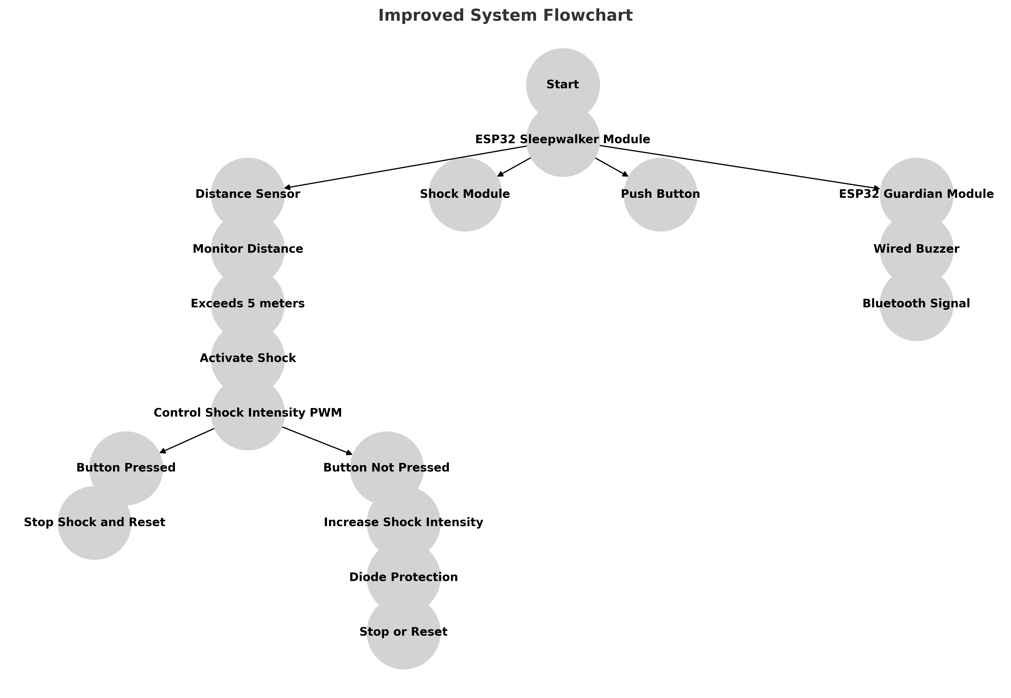
System Workflow

Slide 4
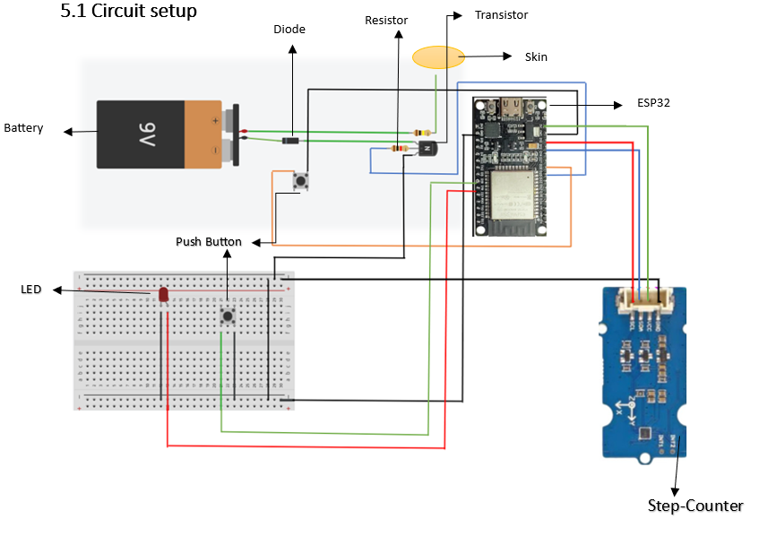
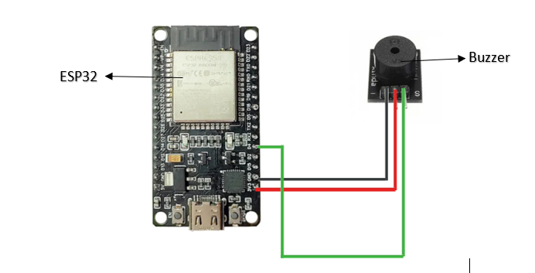

System Design and Architecture
Wearable Device
Monitoring System
Tracks movement, triggers a shock module and sends alerts.
Receives alerts and notifies the caregiver via Bluetooth.

Slide 5
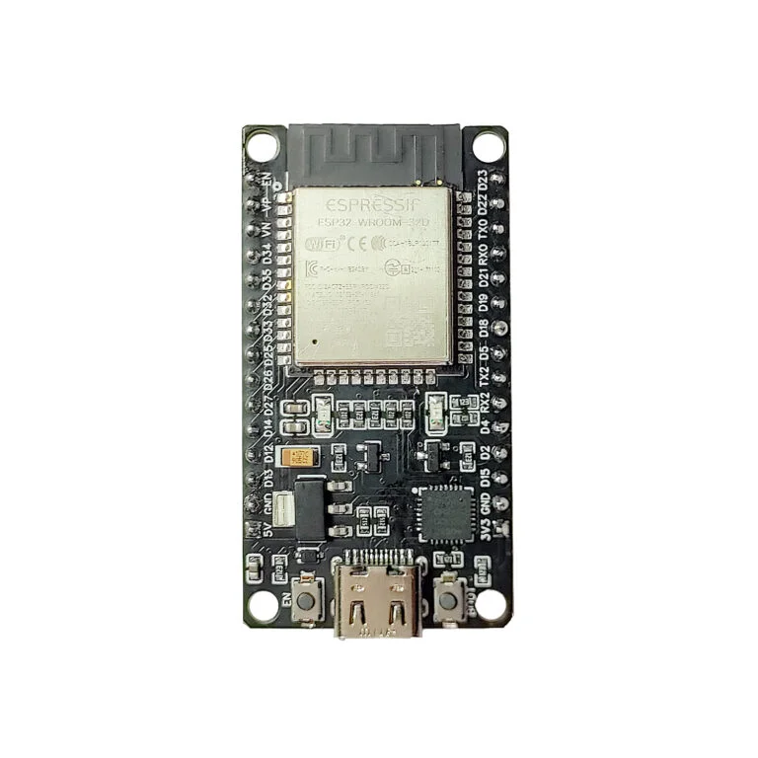
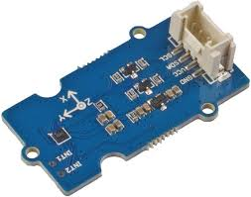
Hardware Components
ESP32 Microcontroller
Pedometer Sensor
Processes sensor data, manages Bluetooth communication and controls the shock module.
Monitors movement patterns and triggers alerts when thresholds are exceeded.
Shock Module
Delivers mild electrical stimuli to awaken the sleepwalker.

Slide 6
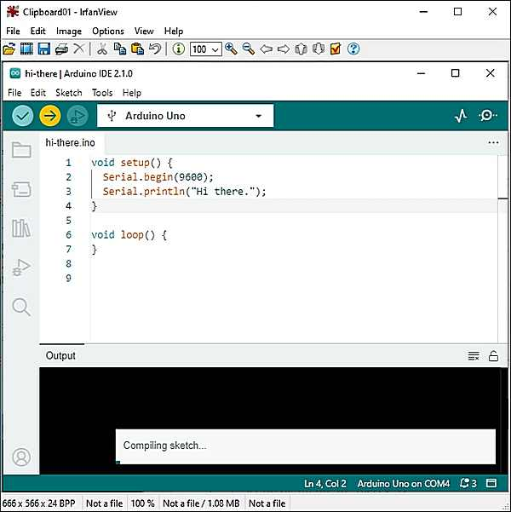



Software Implementation
Arduino IDE
Bluetooth Communication
Alarm System
The system was programmed using the Arduino IDE.
Activates the shock module and sends alerts when sleepwalking is detected.
Enables real-time alerts to the caregiver's device.

Slide 7
Benefits of the System
Enhanced Safety
Reduces the risk of injuries associated with sleepwalking.
Non-Invasive Intervention
Provides a gentle and effective way to awaken the sleepwalker.
Peace of Mind for Caregivers
Offers real-time monitoring and alerts, providing reassurance and timely intervention.

Slide 8
Experiments and Testing Plans
Detection Accuracy
The system achieved a high detection accuracy, minimising false positives
Testing with Different Motion Patterns
Rolling over vs. actual sleepwalking
Reducing false alarms
Bluetooth Communication
The Bluetooth communication stayed consistently strong and reliable.
Battery Life & Power Consumption Analysis
Checking how long the system runs continuously
Fine-Tuning Shock Intensity
Ensuring it is enough to wake the person but still safe
Long-Term Reliability Testing
Testing the system over multiple nights
Evaluating wear and tear on components

Slide 9
Market Potential & Applications
📌 Target Users
🌍 Where It Can Be Sold
💡 Commercialization Strategy
Wearable device for individuals
Subscription-based monitoring services
Mobile app integration for real-time alerts
Partnerships with hospitals & research centers
Individuals with sleepwalking disorder
Parents & guardians
Sleep clinics & hospitals
Elderly care centers
Online platforms
Pharmacies & wellness stores
Medical device suppliers
Smart home integration

Slide 10




Conclusion and Future Work
Key Findings
The system effectively detects sleepwalking and provides timely intervention.
Future Enhancements
Incorporate additional sensors, develop a mobile app, and explore advanced connection protocols.
Impact
This system has the potential to significantly improve the safety and well-being of sleepwalkers.

Slide 11
THANK YOU
Sleepwalking is unpredictable, but safety shouldn’t be.

