Slide 1

Programme B.Tech BCSE497J – Project I
Fed-PhenoGraft: Phenotype-Guided Asymmetric Cross-Modal Attention with Shared-Private Latent Decomposition for Federated Multi-Modal Parkinson's Disease Prediction
Team members:
Saurav Kumar Gupta (23BCE2336) Amit Adhikari (23BCE2327) Shreeyam Acharya (23BCE2330)
Faculty guide:
Dhivyaa CR 20701

Slide 2
29-07-2026
SCOPE
2
Aim
To develop a federated, phenotype-guided multimodal representation learning framework (Fed-PhenoGraft) that improves the prediction of Parkinson's Disease (PD) diagnosis and severity. It achieves this by asymmetrically querying imaging and genetic modalities based on clinical phenotypes, while simultaneously preserving data privacy across multiple clinical sites without centralizing raw patient data.

Slide 3
29-07-2026
SCOPE
3
Abstract
Parkinson’s Disease (PD) diagnosis benefits significantly from multimodal data (clinical, genetics, MRI, PET). However, existing methods treat modalities symmetrically and require centralized data. We propose Fed-PhenoGraft, a novel federated learning framework featuring: 1. Phenotype-Guided Asymmetric Attention: Clinical phenotypes query relevant structural and genetic features. 2. Shared-Private Latent Decomposition: Uses HSIC orthogonality to disentangle disease-relevant info from modality noise. Evaluated on the PPMI cohort, Fed-PhenoGraft aims to achieve superior prognostic accuracy and patient-specific interpretable biomarkers, all while maintaining privacy via Federated Learning.

Slide 4
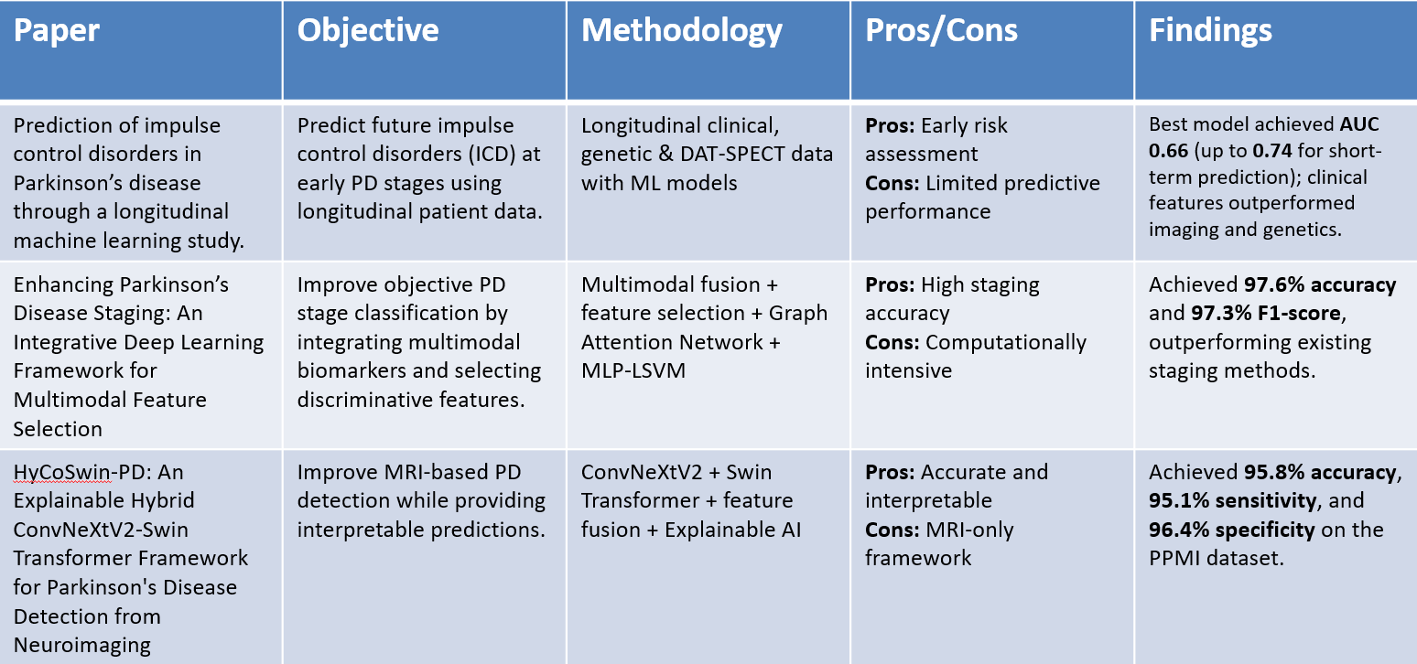
29-07-2026
SCOPE
4
Literature Review
• Modality Fusion: Combining heterogeneous data (MRI, PET, UPDRS, genetics) from the PPMI database consistently outperforms unimodal approaches for PD progression tracking [1]. • Architectural Innovations: Recent models utilize cross-attention modules to align different data modalities and dynamically weight their importance, extracting more informative features [2]. • Explainability (XAI): There is an increasing demand for explainable AI frameworks in PD diagnosis to identify affected brain regions and relevant genetic variants, moving away from "black-box" deep learning [3].

Slide 5
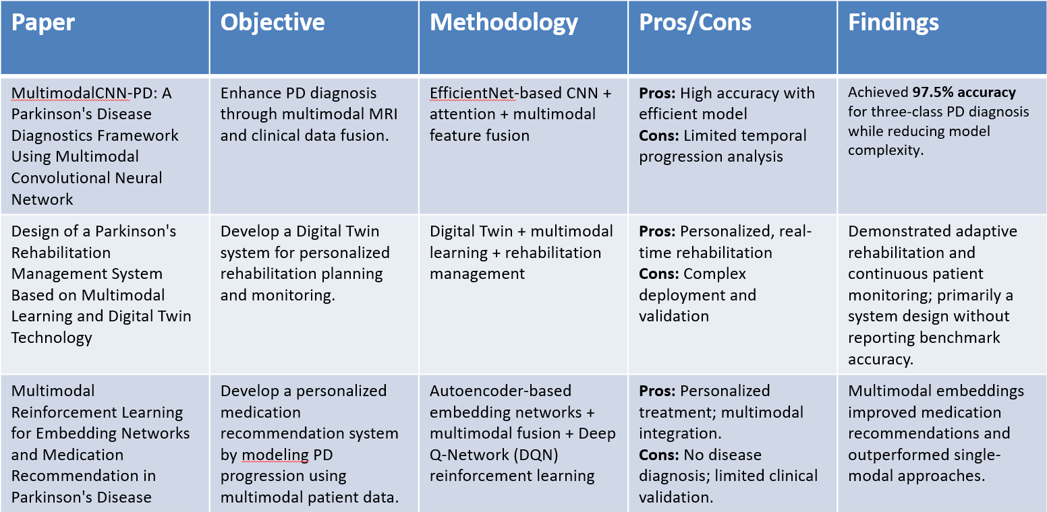
29-07-2026
SCOPE
5

Slide 6
29-07-2026
SCOPE
6
Research Gap
• Limited Integration of Multimodal Data
Most existing works utilize only one or two modalities (MRI, clinical, or imaging), failing to fully exploit complementary information from MRI, PET, clinical, and genetic data.
• Poor Handling of Incomplete Multimodal Data
Most multimodal models assume complete patient records, whereas real-world clinical datasets frequently contain missing imaging or clinical modalities, reducing model applicability.
• Lack of Longitudinal Disease Progression Modeling
Current studies primarily focus on diagnosis, staging, or medication recommendation, with limited emphasis on modeling the temporal progression of Parkinson's disease.
• Limited Use of Digital Twin Technology
Digital Twin approaches have mainly been applied to rehabilitation management, with little integration into predictive disease progression or personalized clinical decision support.

Slide 7
29-07-2026
SCOPE
7
Objectives
1. To design a Phenotype-Guided Asymmetric Attention mechanism where clinical features selectively query MRI, PET, and genetics. 2. To implement a Shared-Private Latent Decomposition using HSIC orthogonality to disentangle disease biomarkers from noise. 3. To build a federated learning pipeline (FedAvg) that trains across multiple clinical sites without centralizing raw data. 4. To incorporate robustness features (learned mask tokens for missing modalities, Monte Carlo Dropout for uncertainty). 5. To provide a multi-level explainability suite (Attention Maps, Integrated Gradients, Counterfactuals).

Slide 8
29-07-2026
SCOPE
8
Identified: Sustainable Development Goals & Outcomes
Identified: Sustainable Development Goals
• SDG 3: Good Health and Well-being (Improving diagnostic accuracy and personalized treatment for Parkinson's Disease) • SDG 9: Industry, Innovation, and Infrastructure (Developing advanced, privacy-preserving AI infrastructure for healthcare)
Outcomes
• Journal (Scopus): Target publication in high-impact Q1 journals (e.g., IEEE JBHI, Elsevier Computers in Biology and Medicine). • Product/Others: A robust, federated AI framework applicable to other multimodal neurodegenerative datasets.

Slide 9
29-07-2026
SCOPE
9
References
[1] A. Vamvakas, T. Van Balkom, G. Van Wingen, et al., "Prediction of impulse control disorders in Parkinson's disease through a longitudinal machine learning study," npj Parkinson's Disease, vol. 12, p. 38, 2026.
[2] S. W. Akram and C. K, "Enhancing Parkinson's Disease Staging: An Integrative Deep Learning Framework for Multimodal Feature Selection," Journal of Molecular Neuroscience, 2026.
[3] V. Awasthi et al., "HyCoSwin-PD: An Explainable Hybrid ConvNeXtV2-Swin Transformer Framework for Parkinson's Disease Detection from Neuroimaging," MethodsX, vol. 16, 2026.
[4] T. Zhi et al., "MultimodalCNN-PD: A Parkinson's Disease Diagnostics Framework Using Multimodal Convolutional Neural Network," Frontiers in Aging Neuroscience, vol. 18, 2026.
[5] J. Qin, Y. Cai, Z. Wang, J. Jin, X. Huang, and L. Pei, "Design of a Parkinson's Rehabilitation Management System Based on Multimodal Learning and Digital Twin Technology," in Proc. IEEE Smart World Congress (SWC), Nadi, Fiji, 2024, pp. 2073-2080.
[6] H. Kim, C. Park, J. Hoon Kim, S. Jang, and H. K. Lee, "Multimodal Reinforcement Learning for Embedding Networks and Medication Recommendation in Parkinson's Disease," IEEE Access, vol. 12, pp. 74251-74267, 2024.

