Slide 1

Programme B.Tech — BCSE497J · Project I
Fed-PhenoGraft: Phenotype-Guided Asymmetric Cross-Modal Attention with Shared-Private Latent Decomposition for Federated Multi-Modal Parkinson's Disease Prediction
Team members:
Saurav Kumar Gupta (23BCE2336)
Amit Adhikari (23BCE2327)
Shreeyam Acharya (23BCE2330)
Faculty guide:
Dhivyaa CR (20701)

Slide 2

Approval Mail From Guide

Slide 3
Aim
To develop a federated, phenotype-guided multimodal representation learning framework (Fed-PhenoGraft) that improves the prediction of Parkinson's Disease (PD) diagnosis and progression severity.
It achieves this by asymmetrically querying imaging and genetic modalities based on clinical phenotypes, while simultaneously preserving data privacy across multiple clinical sites without centralizing raw patient data.

Slide 4
Abstract
Parkinson's Disease management depends on multimodal data (clinical scales, MRI, DaTScan PET, genetics), yet modalities are unequal in reliability, frequently missing per patient, and held by sites that cannot pool raw records.
We propose Fed-PhenoGraft, a federated framework with three contributions: (1) Phenotype-Guided Asymmetric Attention, where clinical embeddings act as the query over imaging and genetic keys; (2) Shared-Private Latent Decomposition using an HSIC orthogonality penalty to separate disease signal from modality noise; and (3) learned mask tokens that consume patients with missing modalities.
Trained by sample-weighted FedAvg over 4 non-IID sites (Dirichlet α = 0.5) and evaluated once on a held-out subject-level split of 3,472 PPMI subjects, the model attains ROC-AUC 0.982 and accuracy 0.937 for PD vs HC, and CCC 0.147 [95% CI 0.041–0.244] for two-year Δ UPDRS-III progression.
An 8-variant ablation and an integrated-gradients analysis identify DaTScan as the dominant imaging signal and quantify the cost of the current synthetic-MRI branch.

Slide 5
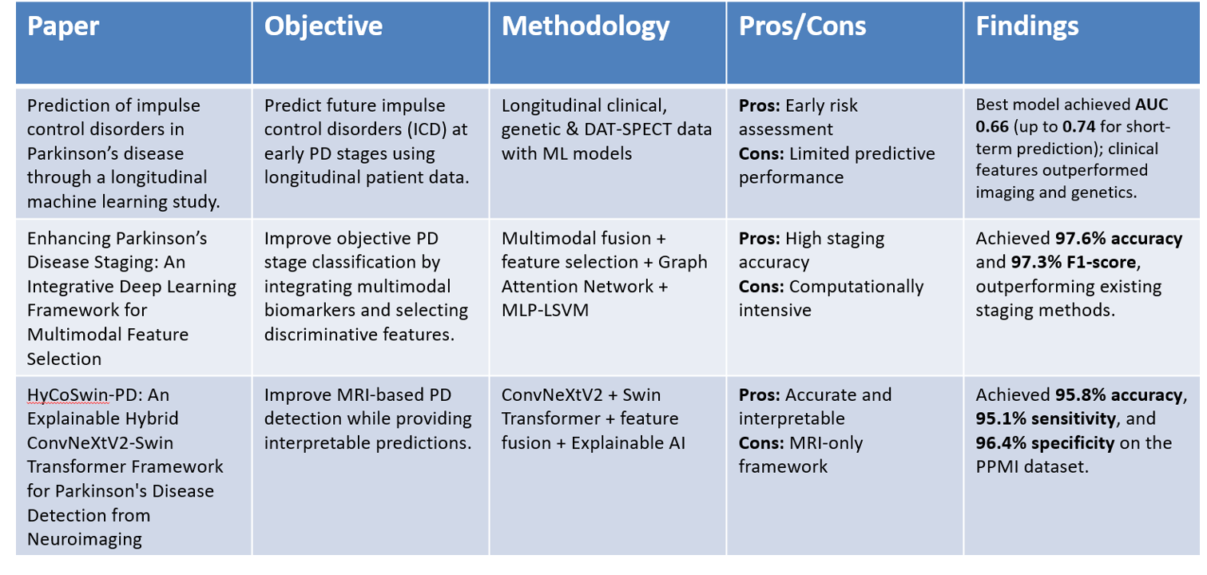
Literature Review

Slide 6
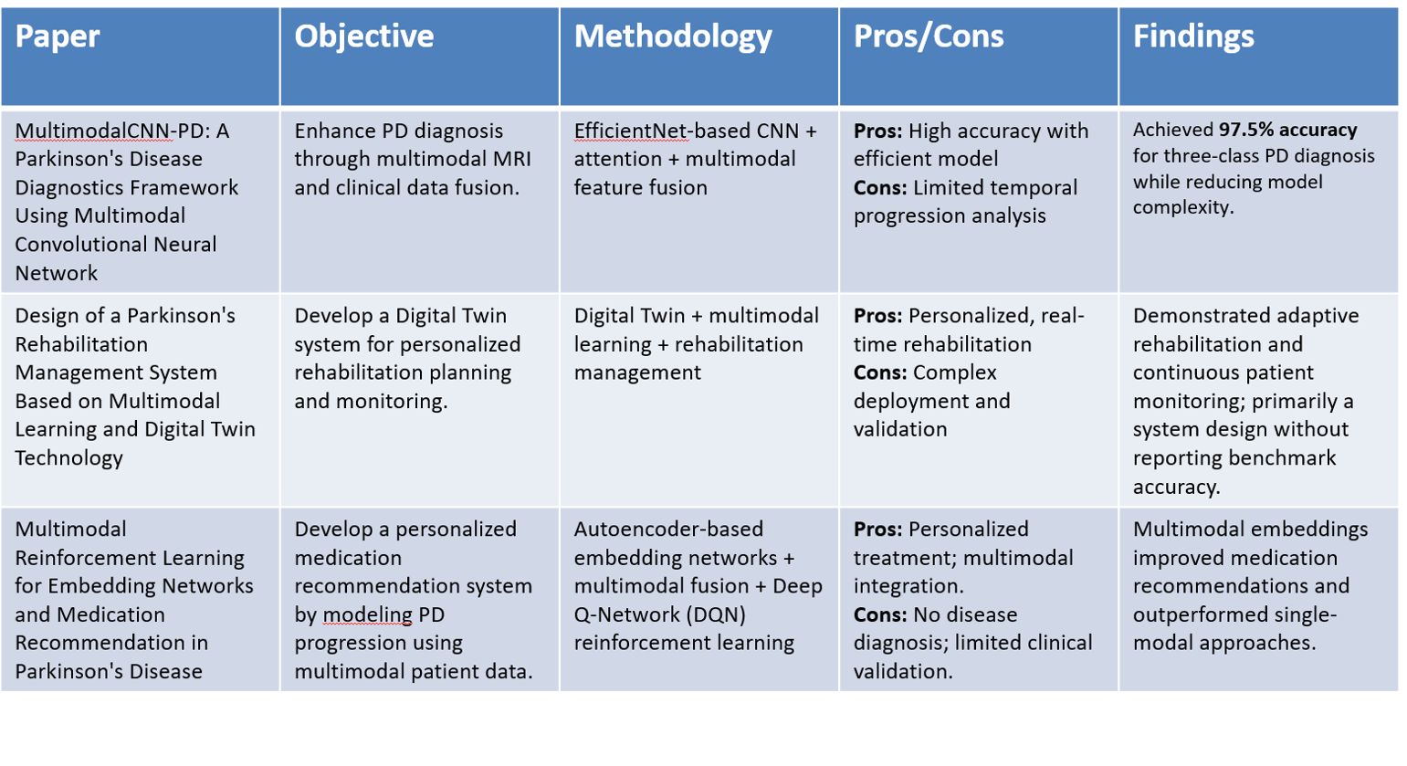

Slide 7
Research Gap
Limited Integration of Multimodal Data
  Most existing works use only one or two modalities, failing to exploit the complementary information in MRI, PET, clinical and genetic data jointly.
Poor Handling of Incomplete Multimodal Data
  Most multimodal models assume complete patient records, whereas real cohorts are sparse — in our PPMI cohort 78% of subjects have no genetic record and 19% no MRI.
Symmetric Fusion Ignores Modality Reliability
  Existing fusion treats every modality as equally informative, although the clinical phenotype is the most complete and most reliable source and should guide retrieval.
No Leak-Free, Privacy-Preserving Progression Benchmark
  Reported gains are often inflated by baseline-score autocorrelation and centralized training; a subject-level, train-only-statistics, one-shot-test protocol for federated PD progression is missing.

Slide 8
Objectives
1. To design a Phenotype-Guided Asymmetric Attention mechanism where clinical features selectively query MRI, PET, and genetics.
2. To implement a Shared-Private Latent Decomposition using HSIC orthogonality to disentangle disease biomarkers from noise.
3. To build a federated learning pipeline (FedAvg) that trains across multiple clinical sites without centralizing raw data.
4. To incorporate robustness features (learned mask tokens for missing modalities, Monte Carlo Dropout for uncertainty).
5. To provide a multi-level explainability suite (Attention Maps, Integrated Gradients, Counterfactuals).

Slide 9
Identified: Sustainable Development Goals & Outcomes
Identified: Sustainable Development Goals
• SDG 3: Good Health and Well-being (Improving diagnostic accuracy and personalized treatment for Parkinson's Disease)
• SDG 9: Industry, Innovation, and Infrastructure (Developing advanced, privacy-preserving AI infrastructure for healthcare)
Outcomes
• Journal (Scopus): Target publication in high-impact Q1 journals (e.g., IEEE JBHI, Elsevier Computers in Biology and Medicine).
• Product/Others: A robust, federated AI framework applicable to other multimodal neurodegenerative datasets.

Slide 10
Framework / Architecture / Block Diagram
TIER 1 · DATA SOURCES (PPMI / IDA-LONI)
Clinical
UPDRS I–IV · MoCA · Demographics (7)
Structural MRI
T1w NIfTI — synthetic fallback (100)
PET / DaTScan
DATScan_Analysis.csv · SBR (10)
Genetics
Genetic_Testing_Results.csv (9)
TIER 2 · MODALITY LOADERS & FEATURE ENGINEERING
clinical_loader
NP*TOT totals · Δ-target build
mri_pipeline
nilearn Schaefer-100 ROI parcellation
pet_loader
SBR + asymmetry + composite ratios
genetic_loader
LRRK2 · GBA · SNCA · PINK1 · PRKN · APOE
data_builder — PATNO alignment · drop subjects without a real Year-2 label (no imputation) · 3,472 subjects × 126 features
Leak-free protocol — subject-level stratified 70/15/15 (2,430 / 521 / 521) · train-only imputer & scalers · Dirichlet(α = 0.5) non-IID clients
TIER 5 · FED-PHENOGRAFT MODEL (one FedAvg client)
Phenotype Encoder
Clinical MLP → query q (32-d)
Asymmetric Cross-Attention
4 heads · Add & Norm · MRI / PET / Gene
Shared / Private + HSIC
mask tokens · RBF independence
FedAvg Orchestrator
4 clients · weighted · early stop
Q
K, V
Regression Head
Δ UPDRS-III @ Year 2 · MSE
Classification Head
PD vs HC · BCE
Evaluation & XAI
bootstrap CI · 3 seeds · ablation · IG
Loss = MSE(Δ UPDRS-III) + 0.3 · BCE(PD/HC) + 0.1 · Σ HSIC(shared, private) Raw patient data never leaves a client — only weight tensors are averaged.

Slide 11
Functional Requirements
ID | Functional Requirement | Implemented in
FR-1 | Ingest PPMI clinical, DaTScan, genetic and MRI records; align per subject on PATNO | src/data/*_loader.py, data_builder.py
FR-2 | Construct Δ UPDRS-III target from official NP3TOT; drop — never impute — unlabelled subjects | clinical_loader.build_clinical_features
FR-3 | Subject-level stratified 70/15/15 split; no subject in two partitions | preprocessing.create_subject_splits
FR-4 | Fit all imputation and scaling statistics on training subjects only | preprocessing.ModalityPreprocessor
FR-5 | Represent an absent modality by a learned mask token, not an imputed value | dataset.py, fed_phenograft.py
FR-6 | Clinical embeddings query imaging/genetic embeddings via multi-head cross-attention | models/attention.py
FR-7 | Encode each auxiliary modality into shared and private latents penalised by HSIC | models/hsic.py, SharedPrivateEncoder
FR-8 | Train by sample-weighted FedAvg over N sites (IID / Dirichlet / real-site) | federated/fedavg_orchestrator.py
FR-9 | Early-stop on validation CCC, restore best-round weights, score test set exactly once | simulate_federated_training, main.py
FR-10 | Predict progression and diagnosis jointly under one multitask loss | Dual heads, cls_weight = 0.3
FR-11 | Benchmark 12 classical models with per-fold pipelines on identical test subjects | baselines/models.py, runner.py
FR-12 | Report bootstrap 95% CIs, 3-seed mean ± SD, paired test vs strongest baseline | evaluation/stats.py
FR-13 | Retrain an ablation suite over every modality and architectural component | evaluation/ablation.py (8 variants)
FR-14 | Produce attention maps, integrated gradients, robustness test, counterfactuals | evaluation/xai.py
FR-15 | Emit metrics JSON, Markdown report and figure suite; regenerable without retraining | results_report.py, generate_results.py
FR-16 | Replace synthetic MRI with real T1w Schaefer-100 parcellation when scans present | mri_pipeline.py (pending NIfTI data)

Slide 12
Modules
Module | Responsibility | Key files | Output
M1 Data Acquisition | IDA-LONI download helpers, credential handling, file-presence verification | scripts/download_ppmi_data.py, download_mri_data.py, verify_data.py | CSVs in data/raw/
M2 Modality Loaders | Per-modality parsing, visit filtering, feature engineering (SBR asymmetry, carrier encoding, ROI parcellation) | clinical_loader.py, pet_loader.py, genetic_loader.py, mri_pipeline.py | 4 DataFrames indexed by PATNO
M3 Dataset Builder & Preprocessor | Cross-modality alignment, label filtering, subject-level split, train-only impute/scale, missing-row contract | data_builder.py, preprocessing.py, dataset.py | Torch datasets + mask flags
M4 Model Core | Phenotype encoder, shared/private encoders, mask tokens, asymmetric cross-attention, HSIC loss, dual heads, MC dropout | models/fed_phenograft.py, attention.py, hsic.py | {pred, cls_logit, loss_hsic, attn_weights}
M5 Federated Orchestrator | Client partitioning (IID/Dirichlet/site), local AdamW updates with clipping, weighted aggregation, early stopping | federated/fedavg_orchestrator.py | Global model + per-round history
M6 Baseline Benchmark | 12 regularised classical models, per-fold Pipeline(impute→scale→model), 5-fold CV then one-shot test scoring | baselines/models.py, runner.py | CV + test metrics, stored predictions
M7 Evaluation, XAI & Reporting | CCC/RMSE/MAE/R²/r + AUC/Acc/F1, bootstrap CIs, paired test, ablation suite, 4 XAI analyses, figures and report | metrics.py, stats.py, ablation.py, xai.py, results_report.py | final_metrics.json, 9 PNGs, RESULTS.md

Slide 13
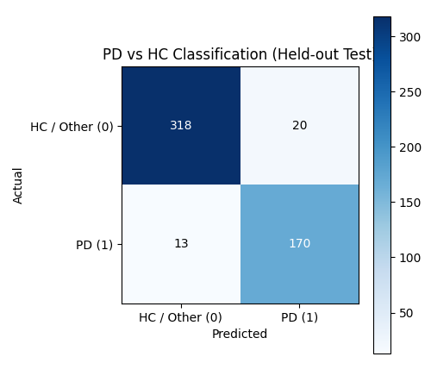
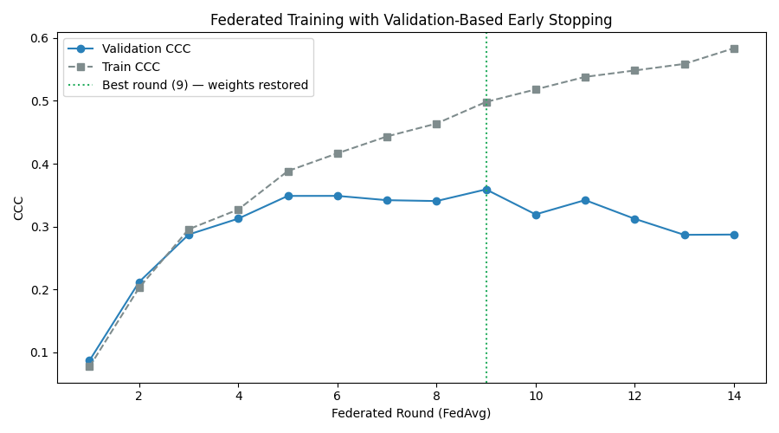
Experiments and Results (1/3) — Setup & Held-out Performance
Experimental setup
Dataset: PPMI — 3,472 subjects with both baseline and Year-2 (V04) MDS-UPDRS-III; 126 raw features (7 clinical + 100 MRI + 10 PET + 9 genetic).
Protocol: subject-level 70/15/15 split (2,430 / 521 / 521), stratified on diagnosis · 4 Dirichlet(α = 0.5) non-IID clients · 30 rounds max, patience 5 on validation CCC · 3 independent seeds · 1,000-resample bootstrap · test set scored EXACTLY ONCE.
Task | Metric | Test value | 95% CI
Progression (Δ UPDRS-III) | CCC | 0.1469 | 0.0406 – 0.2439
Progression (Δ UPDRS-III) | RMSE (points) | 7.64 | 6.93 – 8.46
Progression (Δ UPDRS-III) | MAE (points) | 5.14 | 4.67 – 5.69
Progression (Δ UPDRS-III) | Pearson r | 0.1769 | —
Diagnosis (PD vs HC) | ROC-AUC | 0.9816 | —
Diagnosis (PD vs HC) | Accuracy | 0.9367 | —
Diagnosis (PD vs HC) | F1 score | 0.9115 | —
Fig. 1 PD vs HC confusion matrix (test, n = 521)
Generalization check
Train CCC 0.4982 vs Val CCC 0.3591 — gap +0.139, below the +0.15 overfitting alarm built into the pipeline.
Across 3 seeds: test CCC 0.157 ± 0.030, test AUC 0.978 ± 0.003 — the classification head is stable; the regression head is seed-sensitive.
Confusion matrix: TN 318 · FP 20 · FN 13 · TP 170 → sensitivity 0.929, specificity 0.941 (majority-class accuracy would be 0.649).
Fig. 2 Federated training with validation-based early stopping

Slide 14
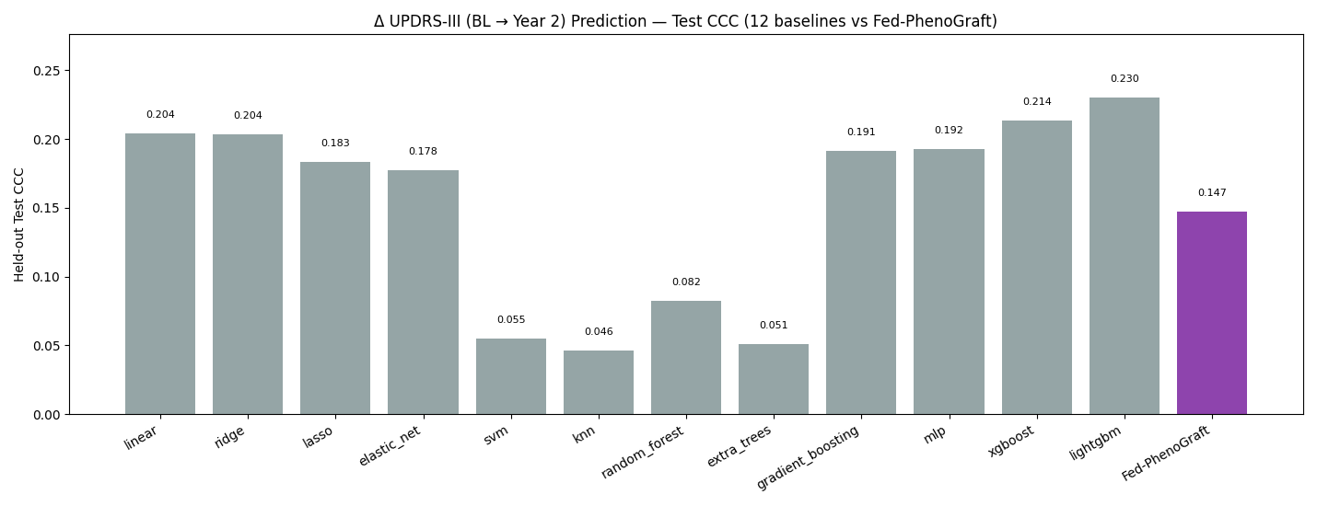
Experiments and Results (2/3) — Baseline Comparison
12 classical baselines, each in a per-fold Pipeline(median-impute → standardise → model), 5-fold CV on train+val, then refit and scored once on the same 521 test subjects.
Model | CV CCC | Test CCC | Test RMSE | Test MAE
lightgbm (strongest baseline) | 0.2253 ± 0.0213 | 0.2300 | 6.94 | 4.67
xgboost | 0.2401 ± 0.0302 | 0.2135 | 6.96 | 4.67
linear | 0.2367 ± 0.0241 | 0.2039 | 6.96 | 4.78
ridge | 0.2368 ± 0.0245 | 0.2036 | 6.96 | 4.78
gradient_boosting | 0.2322 ± 0.0262 | 0.1911 | 7.01 | 4.74
mlp | 0.1400 ± 0.0751 | 0.1924 | 7.10 | 4.93
random_forest | 0.0993 ± 0.0151 | 0.0821 | 7.07 | 4.73
Fed-PhenoGraft (ours) | val 0.3591 | 0.1469 | 7.64 | 5.14
Statistical significance — paired bootstrap vs LightGBM
ΔCCC = −0.083 [95% CI −0.167, −0.005], p = 0.982 → NOT significant at α = 0.05. Fed-PhenoGraft is currently statistically indistinguishable from the strongest baseline on progression; no baseline attempts the diagnosis task, where the model reaches AUC 0.982.
Fig. 3 Held-out test CCC — all 12 baselines vs Fed-PhenoGraft

Slide 15
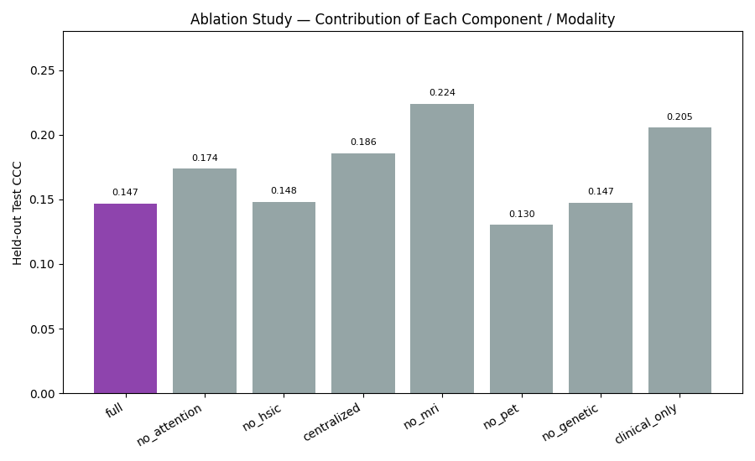
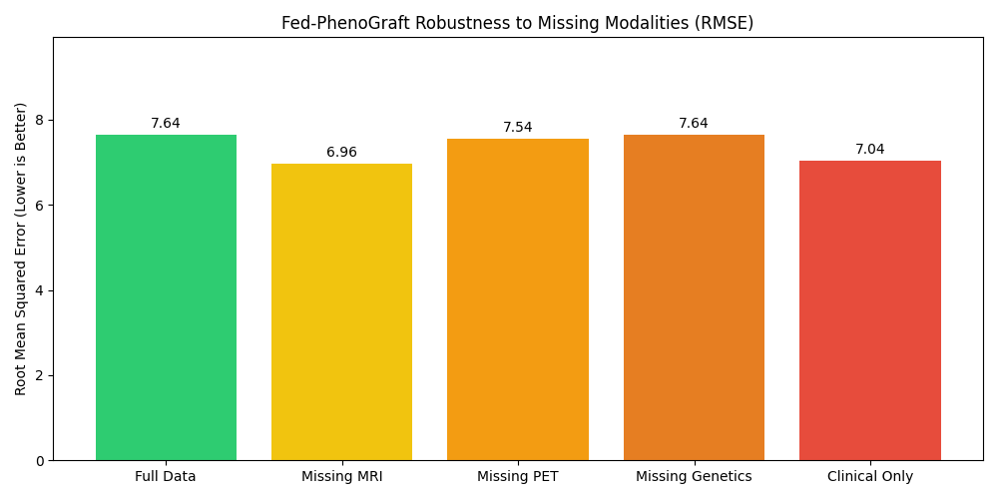
Experiments and Results (3/3) — Ablation & Explainability
Every variant retrained from scratch under the identical protocol (20 rounds, patience 3).
Variant | Val CCC | Test CCC | Test AUC
Full Fed-PhenoGraft | 0.3591 | 0.1469 | 0.9816
− Asymmetric attention | 0.2885 | 0.1736 | 0.9737
− HSIC shared-private loss | 0.3130 | 0.1481 | 0.9786
Centralized (1 client) | 0.3142 | 0.1857 | 0.9806
− PET / DaTScan | 0.2833 | 0.1303 | 0.9513
− Genetics | 0.3139 | 0.1474 | 0.9787
− MRI (synthetic) | 0.3272 | 0.2241 | 0.9761
Clinical only | 0.3072 | 0.2055 | 0.9554
Fig. 4 Ablation study — contribution of each component and modality
Explainability findings
• Integrated gradients — clinical 58.5%, DaTScan PET 21.6%, structural MRI 19.9%, genetics 0.0% (genetics is masked for 78% of subjects, so the mask token carries no gradient).
• Missing-modality stress test — RMSE 7.64 (full) → 6.96 (no MRI) / 7.54 (no PET) / 7.64 (no genetics) / 7.04 (clinical only): graceful degradation in every case.
• Counterfactual gene flips — predicted Δ UPDRS-III shifts of −0.29 (LRRK2) to −0.34 (GBA) points; demonstrates the mechanism, not a clinical claim.
• Key reading — removing the synthetic MRI branch RAISES test CCC 0.147 → 0.224, pricing the missing real T1w data at ≈ 0.077 CCC.
Fig. 5 Robustness to missing modalities (learned mask tokens)

Slide 16
Conclusion
• Delivered an end-to-end federated multimodal framework running on real PPMI data (3,472 subjects) under a deliberately conservative, leak-free protocol.
• Strong diagnostic result: ROC-AUC 0.982, accuracy 0.937, sensitivity 0.929 on a test set scored exactly once; a retrained centralized control confirms federation imposes no measurable accuracy cost — privacy is obtained for free.
• Progression remains hard: CCC 0.147 [0.041–0.244], statistically indistinguishable from the strongest of 12 classical baselines (paired bootstrap p = 0.982). We report this honestly rather than tuning on the test set.
• The 8-variant ablation localises the shortfall: attention and HSIC each contribute, DaTScan is the most valuable auxiliary modality, and the synthetic MRI placeholder costs about 0.077 CCC — a measured, actionable finding.
• Future work: (i) real T1w Schaefer-100 parcellations, (ii) validation-only hyperparameter tuning, (iii) real-site federation via the PPMI Center-Subject list, (iv) DP-SGD for formal privacy guarantees, (v) longitudinal BL→V04→V06→V08 modelling.

Slide 17
References
[1] A. Vamvakas, T. Van Balkom, G. Van Wingen, et al., "Prediction of impulse control disorders in Parkinson's disease through a longitudinal machine learning study," npj Parkinson's Disease, vol. 12, p. 38, 2026.
[2] S. W. Akram and C. K, "Enhancing Parkinson's Disease Staging: An Integrative Deep Learning Framework for Multimodal Feature Selection," Journal of Molecular Neuroscience, 2026.
[3] V. Awasthi et al., "HyCoSwin-PD: An Explainable Hybrid ConvNeXtV2-Swin Transformer Framework for Parkinson's Disease Detection from Neuroimaging," MethodsX, vol. 16, 2026.
[4] T. Zhi et al., "MultimodalCNN-PD: A Parkinson's Disease Diagnostics Framework Using Multimodal Convolutional Neural Network," Frontiers in Aging Neuroscience, vol. 18, 2026.
[5] J. Qin, Y. Cai, Z. Wang, J. Jin, X. Huang, and L. Pei, "Design of a Parkinson's Rehabilitation Management System Based on Multimodal Learning and Digital Twin Technology," in Proc. IEEE Smart World Congress (SWC), Nadi, Fiji, 2024, pp. 2073-2080.
[6] H. Kim, C. Park, J. Hoon Kim, S. Jang, and H. K. Lee, "Multimodal Reinforcement Learning for Embedding Networks and Medication Recommendation in Parkinson's Disease," IEEE Access, vol. 12, pp. 74251-74267, 2024.

