Slide 1
Basic Html 101
Prepared by
Kyaw Lin Oo
Founder of EventNook
email: k@eventnook.com

Slide 2
Html Editor Downloads
WebMatrix - http://www.microsoft.com/web/webmatrix/
Sublime - http://www.sublimetext.com/3

Slide 3
html document structure (page)
<!DOCTYPE html>
<html>
<head>
</head>
<body>
</body>
</html>

Slide 4
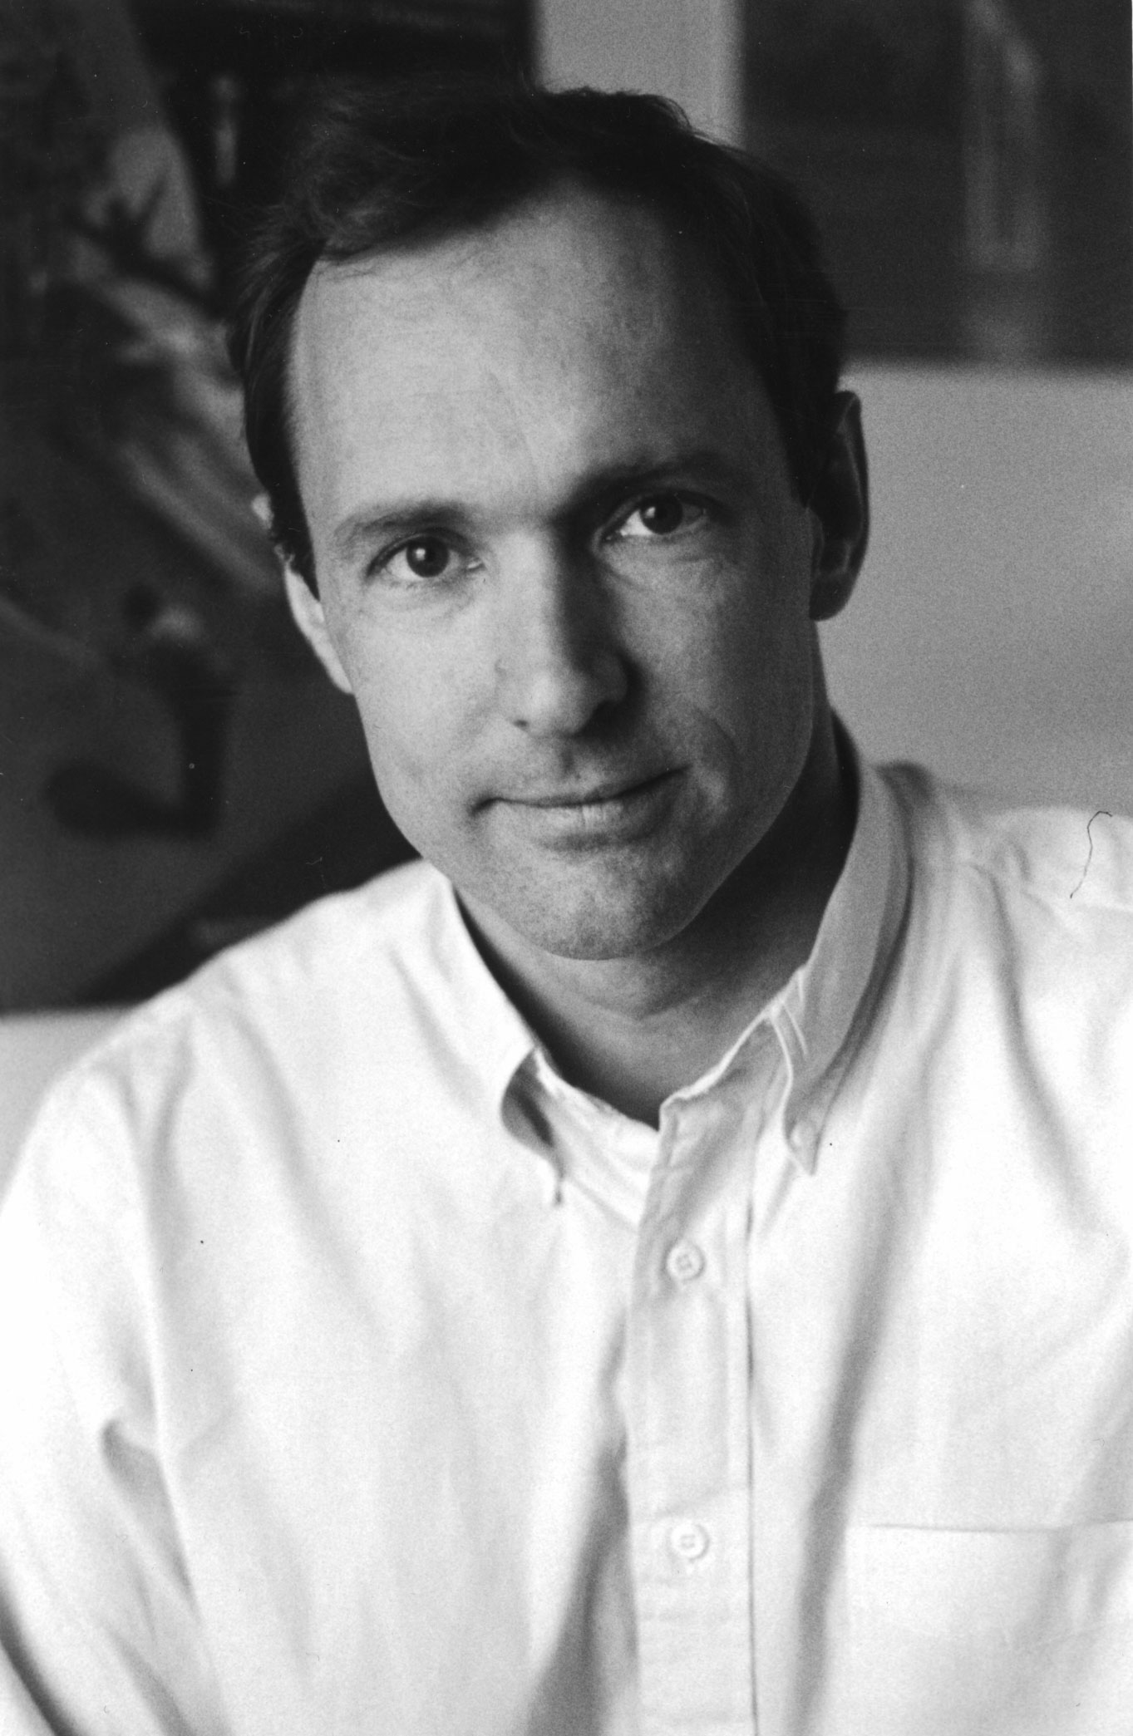
Intro HTML
<html> - Hyper Text Markup Language
The Inventor of Html
1989: Tim Berners-Lee
For information management and publishing language

Slide 5
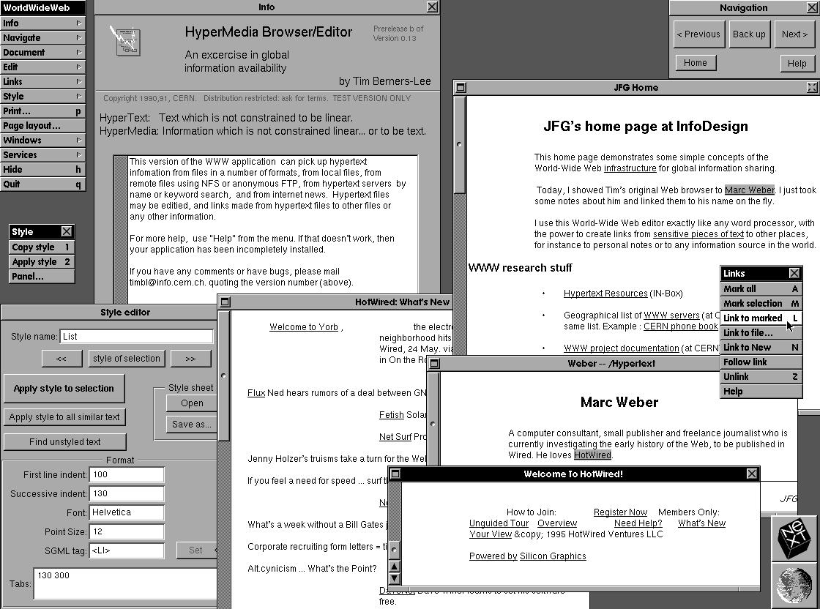
Html Version 1.0
Latest Html Version is
5

Slide 6
Browser <–> HTTP <–> Web Server
What’s Browser for?
Browser vs Microsoft Word / PDF
What is Web Server for?
Http protocol (communication and data transfer)
Client (Browser) side languages (Html, CSS, JavaScript)
Server side languages (Java, ASP.NET, PHP, Ruby on Rail, Python, NodeJS, etc)

Slide 7
Html - CSS – Javascript
HTML – Structure
CSS – For Styling
Javascript – programming language for creating dynamic interaction within web browser

Slide 8
HTML Terminologies Elements (a.k.a Tags) and Attributes
Html document is formed by elements (a.k.a tags)
a – anchor element
<a> Click here </a> - anchor tag
href is an attribute of “<a>”
<a href="http://www.google.com"> Go To Google </a>

Slide 9
Html Attributes
Global Attributes
Example: id, class, style
<p id=“first_paragraph”>This is first paragraph</p>
Elements Specific Attributes
Example: href is only applicable for “a” element
<a href=“http://map.google.com”>Go To Google Map</a>

Slide 10
Html Syntax is not case-sensitive
Html syntax is NOT case-sensitive – a and A is the same
Recommendation
Use “lower case” to make code clean & readable

Slide 11
Most Commonly Used Elements
Headers - h1,h2,h3,h4,h5
Container Elements - div, span, p
Font Styles - font, b, strong, u,I, em
List - ul,ol,li
Table - table
Anchor - a
Image - img
Form Elements – form, input, select, label, textarea, button
blockquote
hr
meta
fieldset, legend
Script
Style
Ref: https://developer.mozilla.org/en-US/docs/Web/HTML/Element
Notes:
https://developer.mozilla.org/en-US/docs/Web/HTML/Element

Slide 12
Demo – Html Part 1
Head/Body set-up
Title, Meta tag
Headers h1-h6
Paragraphs p
Font, Bold, Italic, Underline
Special characters - &, space, >, <, etc

Slide 13
Special Characters
&nbsp; - space
&copy; - ©
$gt; - >
Ref: http://www.w3schools.com/charsets/ref_html_symbols.asp

Slide 14
Meta Tags for Search Engine (Google)
Title,Keywords, description
E.g.,
<title>EventNook – Online Event Registration & Ticketing</title>
<meta name="keywords" content=“…">
<meta name="description" content=“….">

Slide 15
Demo – Html Part 2
div, span
HyperLinks (Anchors)
In-line CSS for title/text color (just 1)-- Text and Background color

Slide 16
A (anchor)
Website
<a href="http://www.google.com">Go To Google</a>
Open in New Window
<a href="http://www.google.com" target="_blank">Go To Google</a>
Document
<a href=“#top">Go To Top</a>
Email
<a href="mailto:kyaw.linoo@eventnook.com?subject=Html%20Class&body=This%20class%20is%20awesome">Email Feedback</a>

Slide 17
Demo – Html Part 3
Lists
Tables
Image
Iframe – (E.g., Youtube, Google Map, EventNook ticket widget)
Facebook Like button embed

Slide 18
table
Row – tr
Cell – td
Padding, Spacing
Border
Rowspan
Colspan

Slide 19
Domain & Hosting Basic
Domain name
Sub domain
Sub directory
Dropbox link / Cloud Hosting
Hosting -- directories
Website builder

Slide 20
Introducing Useful Tools
Color Pixel picker (Chrome plugin)
Color Tool from Adobe https://kuler.adobe.com
Color code hex# to rgb (http://www.colorhexa.com/)
Color selection tool (http://0to255.com/)
Screenshot (Chrome plugin)
Evernote screen comment tool
Chrome developer tool
Firefox Responsive UI tool

