Slide 1
6주차 주말 과제
MVC model2, front controller 실습

Slide 2
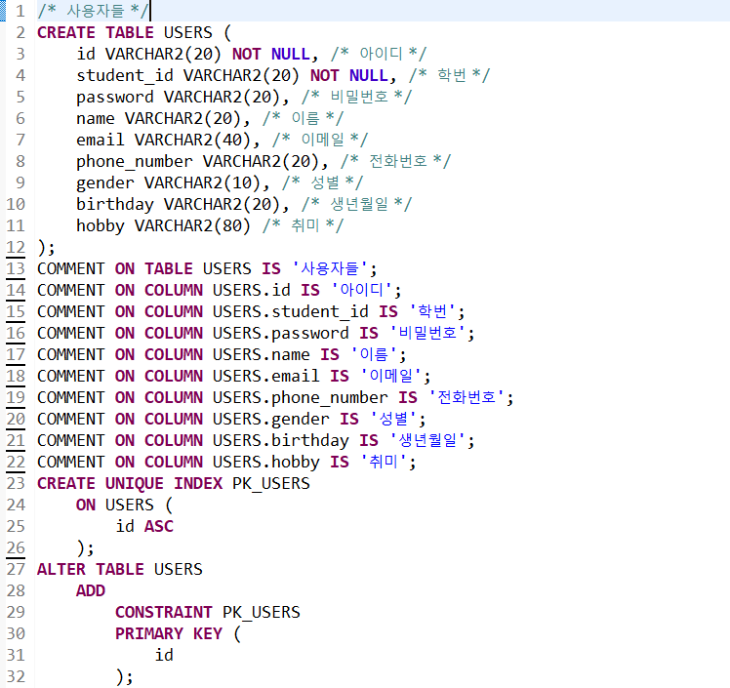
1. Model - oracle dbms 테이블 생성

Slide 3
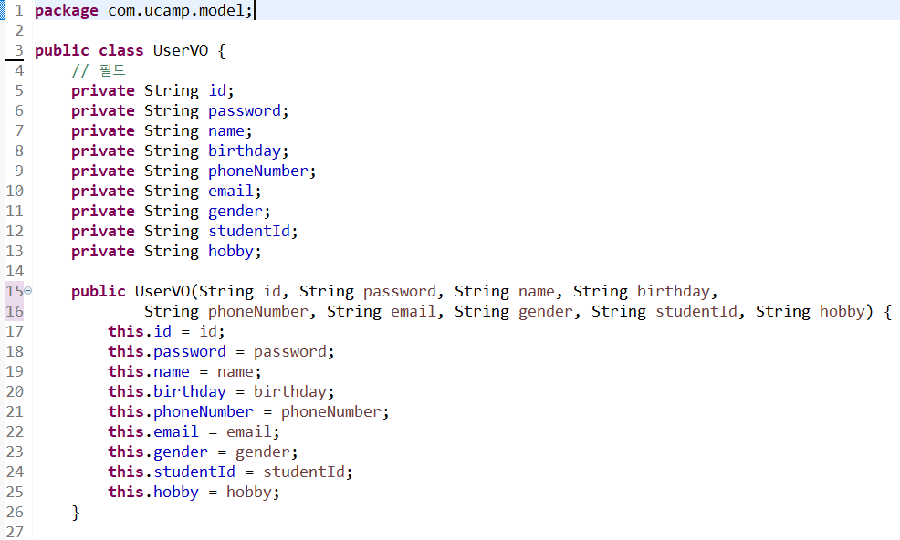
1. Model - UserVO.java

Slide 4
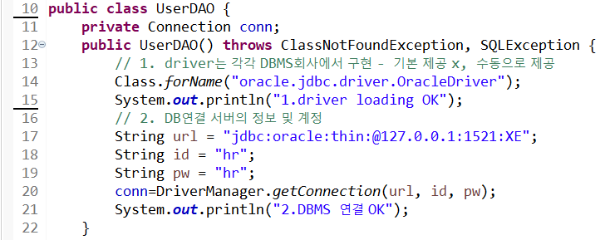
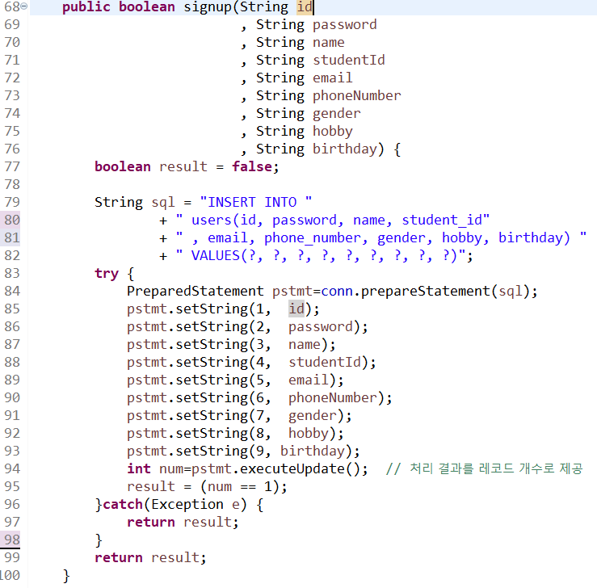
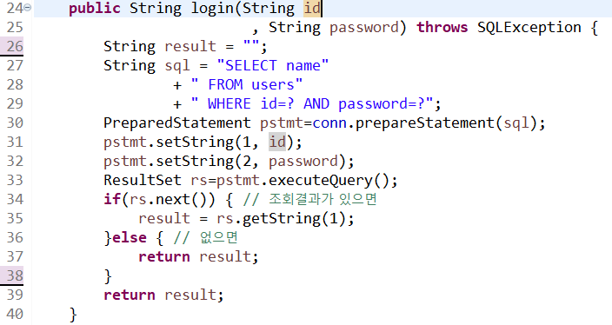
1. Model - UserDAO.java

Slide 5
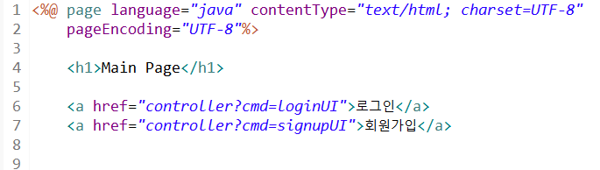
2. View - main.jsp

Slide 6
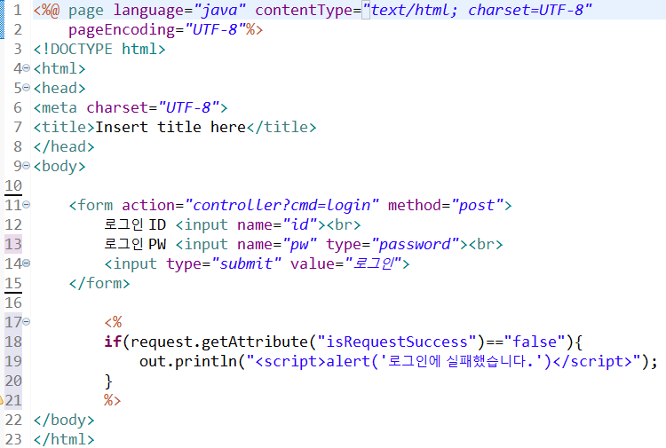
2. View - login.jsp

Slide 7
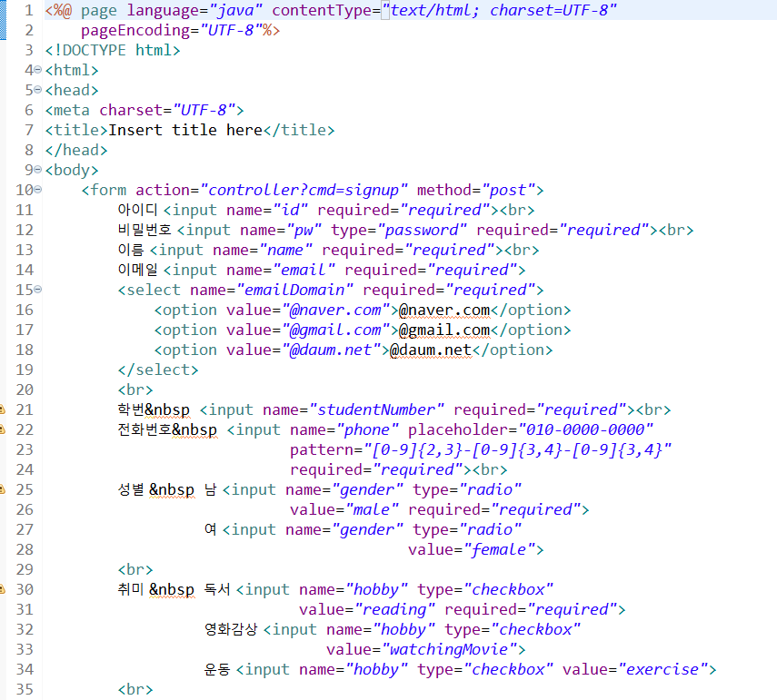
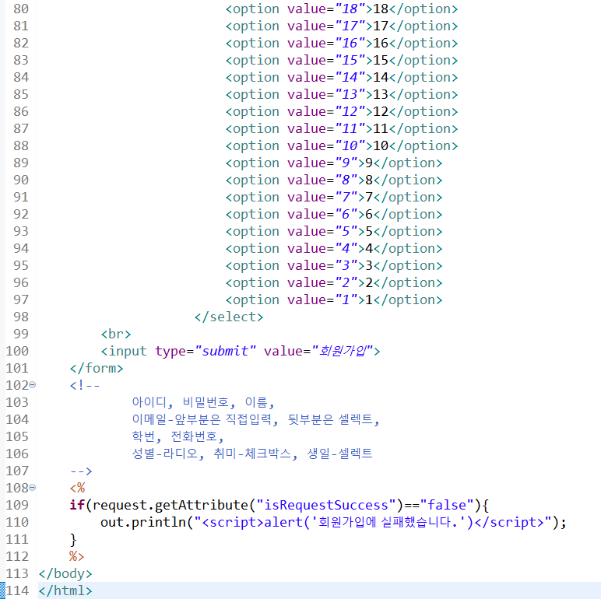
2. View - signup.jsp

Slide 8
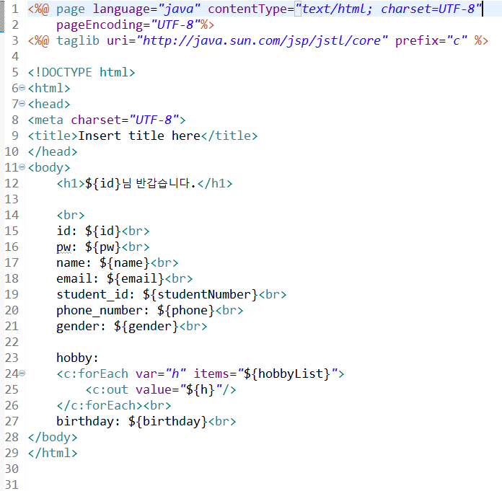
2. View - userInfo.jsp

Slide 9
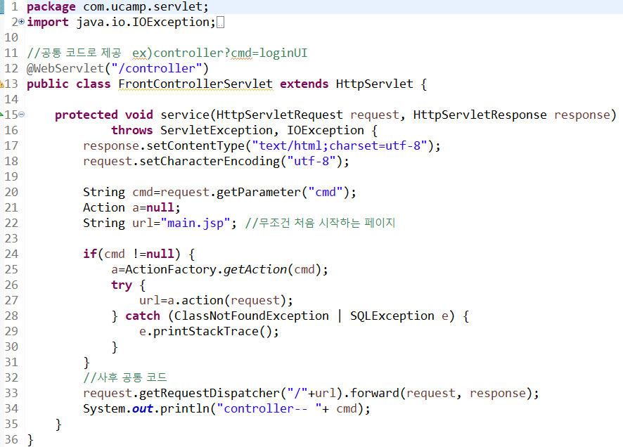
3. Controller - FrontControllerServlet.java

Slide 10
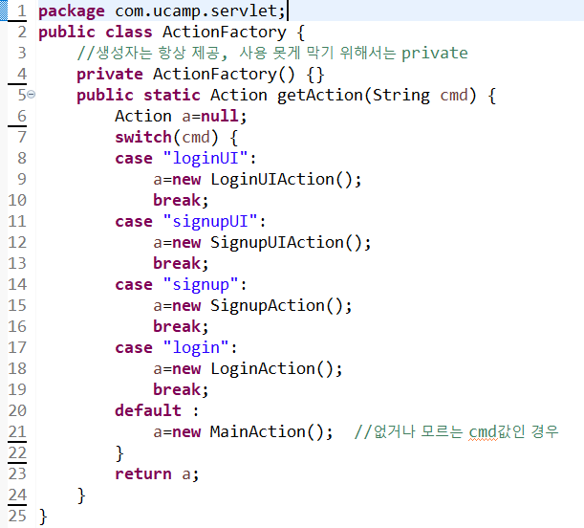
3. Controller - ActionFactory.java

Slide 11
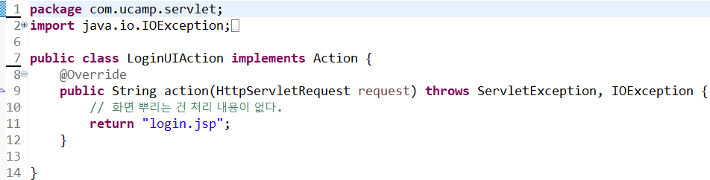
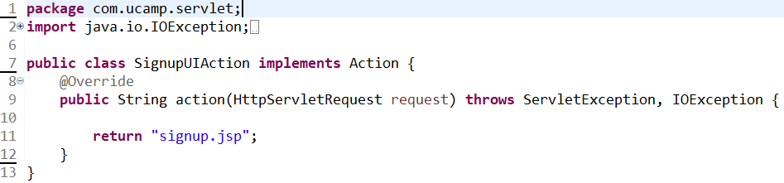
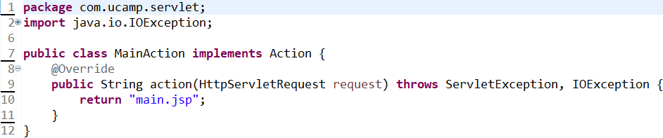
3. Controller - LoginUIAction.java, SignupUIAction.java, MainAction.java

Slide 12
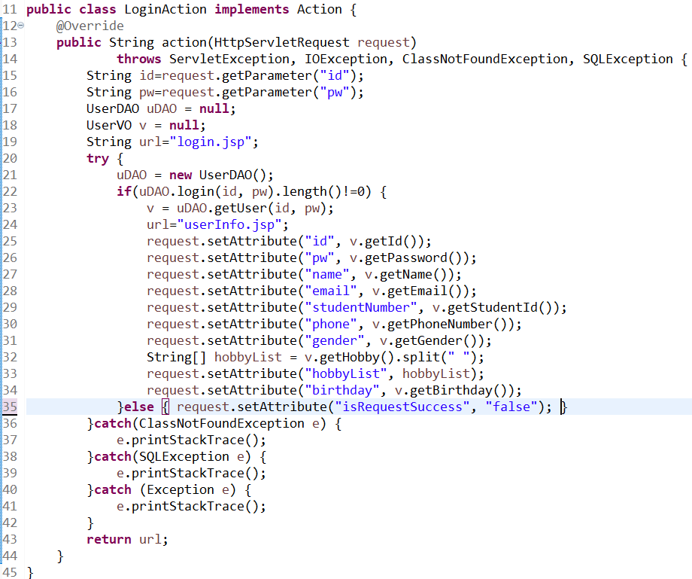
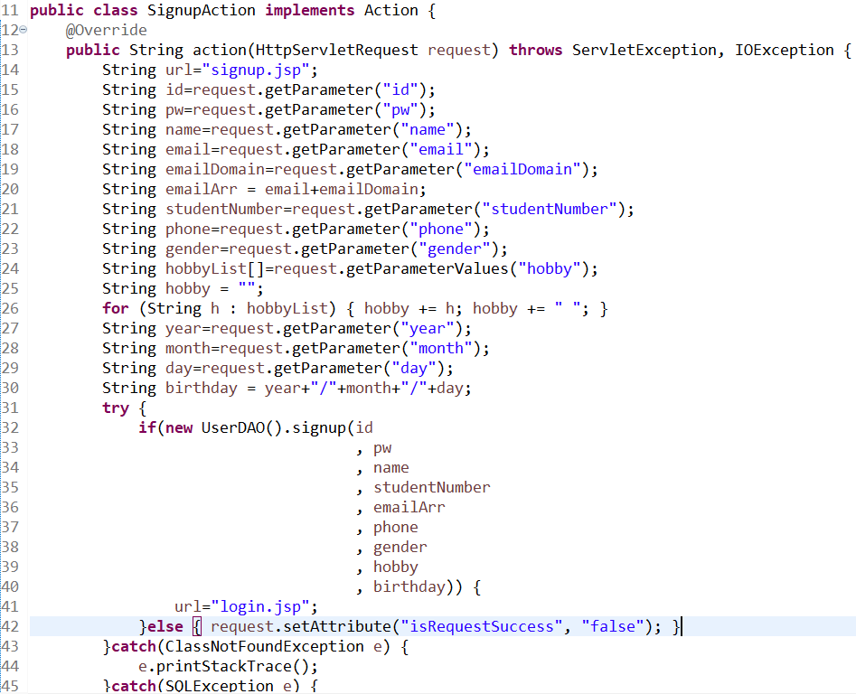
3. Controller - LoginAction.java, SignupAction.java

Slide 13
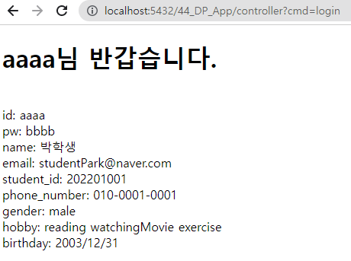
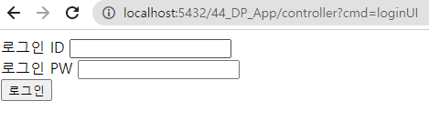
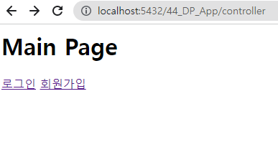
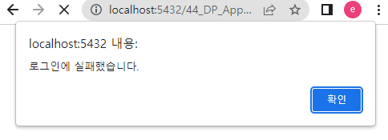
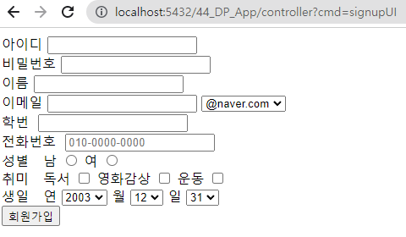
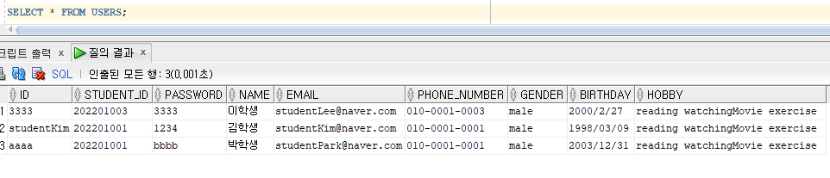
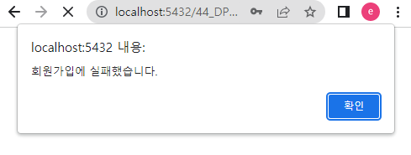
로그인성공
4. 실행
response
: userInfo.jsp
request : LoginUI
response
: login.jsp
로그인실패
request
: SignupUI
회원가입성공
response
: login.jsp
회원가입실패
response
: signup.jsp

