Slide 1
GLOBAL AI + MATERIALS INNOVATION COMPETITION 2026
SecureCoating-Vision
SecureCoating Vision: A High-Throughput and Zero-Trust Edge-Cloud Pipeline for Inline Battery Electrode Defect Inspection and Traceable Quality Decisions
Evidence-Gated Multimodal Inspection for Battery Electrode Manufacturing
TEAM
AFFILIATION
71 · Trịnh Hoàng Tú
HUFLIT
TRACK
ADVISOR
4 · AI + Materials Testing and Characterization
Prof. Kris Singh · SRII / Tsinghua (visiting)
Evidence: real optical detector + fail-closed decision contract · supervised factory pilot is the next gate.
Team 71 · Trịnh Hoàng Tú · HUFLIT · Track 4
TEAM 71 / 1

Slide 2

02 0:35–1:15
The defect is tiny. An automatic PASS is not.
Electrode coating defects become scrap, rework, or untraceable cell risk.
A detector that ranks anomalies well can still be unsafe to act on if sensors disagree, calibration is unverified, or the PLC does not acknowledge.
Academic detection answers how to detect. A factory needs when a detection is safe enough to act on.
MEASURED ON REAL OPTICAL DATA
88 held-out images · mAP50 0.633
Public CoatingVision image-disjoint split, seed 71. Not factory roll-disjoint; HIL and calibration remain pilot gates.
Real coating surface (held-out CoatingVision sample). RGB-only. Not a multimodal plant capture.
Team 71 · Trịnh Hoàng Tú · HUFLIT · Track 4
TEAM 71 / 2

Slide 3
03 1:15–2:00
Two evidence lanes. One fail-closed contract.
LANE A · IMPLEMENTED
RGB YOLO26n detect / ONNX
FastAPI · SQLite PENDING→final · OPC UA / Modbus command+ACK · HMAC certificate
Thermal and profilometry are simulated adapters. They are not plant-instrument measurements.
LANE B · VALIDATION EXTENSION
LIBAD VIS + X-rayL adapter
Official 10-seed ran on a hash-verified mount with the local CPU numpy descriptor (AUROC ~0.70, FPR95 ~0.84). Not DINOv3. Demo cases stay protocol fixtures.
DA-Core is Sui et al. SecureCoating-Vision adds the evidence gate, not a new detector claim.
Team 71 · Trịnh Hoàng Tú · HUFLIT · Track 4
TEAM 71 / 3

Slide 4
04 2:00–2:45
Model output cannot self-release the line.
PASS
REJECT
HOLD
OPTIMAL inference, trained model, verified calibration, healthy traceability, PLC ACK.
Evidence supports a defect and the communication contract completes.
Disagreement, stale/missing sensor, timeout, unverified calibration, DB fault, or unconfirmed PLC.
INDUSTRIAL MEANING
Uncertainty becomes a controlled operational state, not a hidden false-positive rate.
Software E-stop latches local interlock and requests PLC channels. It is not a safety-rated hardwired stop.
Team 71 · Trịnh Hoàng Tú · HUFLIT · Track 4
TEAM 71 / 4

Slide 5
05 2:45–3:35
Readiness is visible before any line decision.
OPERATE
NOT IN PRODUCTION
Recipe sliders
Defect injection
7-stage simulator
LIBAD 90s demo
Send offset to PLC
Sandbox-only features stay isolated from the operating surface.
Control = confirm-audit only.
Line disposition, model hashes, throughput evidence, PLC state, and inspection artifacts — one timestamped API snapshot.
DIAGNOSE
Simulation, mock PLC, or unverified calibration makes the authoritative disposition HOLD_REQUIRED.
TRACEABILITY
Roll ledger, certificate HMAC, control-audit log. Missing data renders as NO DATA, not 0%.
Team 71 · Trịnh Hoàng Tú · HUFLIT · Track 4
TEAM 71 / 5

Slide 6
06 3:35–4:20
Trace first. Command second. ACK or HOLD.
1
2
3
Inspect
PENDING
PLC
RGB path + fail-safe deadline
SQLite claims (batch, part)
One command owner + ACK sequence
4
5
6
Finalize
Certificate
Audit
PASS/REJECT, or HOLD if ACK fails
HMAC-SHA256 over canonical payload
Operator confirm phrase is durable
Team 71 · Trịnh Hoàng Tú · HUFLIT · Track 4
TEAM 71 / 6

Slide 7
07 4:20–5:10
Real optical evidence is reproducible — and bounded.
PRECISION
RECALL
mAP50
mAP50-95
64.5%
64.2%
63.3%
35.4%
88-image real optical test split
measured on configured checkpoint
measured on configured checkpoint
IoU 0.50:0.95
EVIDENCE IDENTITY
88 test images · seed 71 · weights f72a8f2b… · dataset 3c3f2773…
Public real optical image-disjoint split. Not roll-disjoint; not factory qualification.
Team 71 · Trịnh Hoàng Tú · HUFLIT · Track 4
TEAM 71 / 7

Slide 8
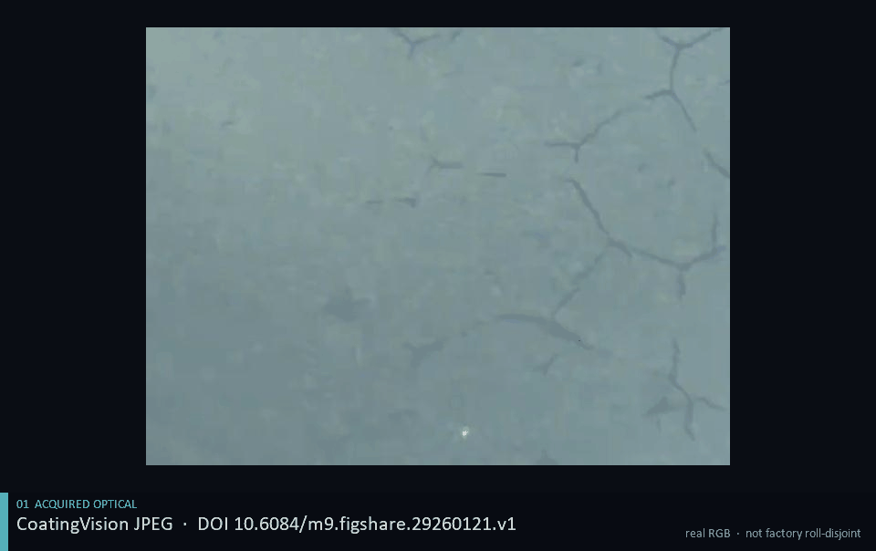
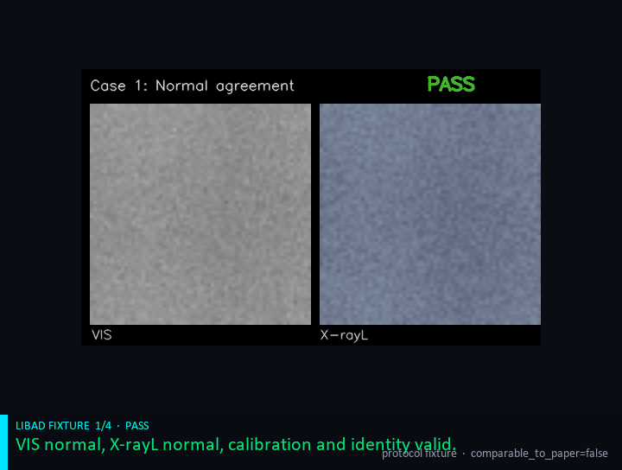
08 5:10–6:00
Let the loops run. Then say the close.
RGB LANE · image_1548 · HOLD
LIBAD GATE · fixture PASS / REJECT / REJECT / HOLD
CLOSE
The model finds defects. The evidence gate controls when the line may act.
GIFs loop checked-in artifacts. RGB HOLD is real optical + mock PLC. LIBAD cases are protocol fixtures, not DINOv3. Next gate: HIL, factory calibration, roll-disjoint data.
Team 71 · Trịnh Hoàng Tú · HUFLIT · Track 4
TEAM 71 / 8

