Slide 1

GLOBAL AI + MATERIALS INNOVATION COMPETITION 2026
TRACK 4
AI + MATERIALS TESTING
AND CHARACTERIZATION
人工智能 + 材料检测与表征
SecureCoating-Vision
Multi-Sensor AI for Inline Battery-Electrode Inspection
多传感器 AI 在线电极检测与闭环诊断平台
Team 71 • Trịnh Hoàng Tú, Ho Chi Minh City Foreign Language and Information Technology (HUFLIT)
Academic Advisor: Prof. Kris Singh — CEO SRII, Visiting Prof. Tsinghua University
Decision objective: prove a defensible inline inspection architecture
0:00–0:35 | Opening thesis
TEAM 71 / 1
Notes:
Good morning, distinguished judges. I am Trịnh Hoàng Tú from Team 71.
SecureCoating-Vision is designed as an inline decision system: it converts physical sensing into a timestamped, spatially traceable quality action. Our contribution is not another vision demo. It is the engineering bridge from photons on a moving electrode to a guarded factory decision.
In six minutes, I will show the physical budget, the multi-modal timing anchor, the measurement guard bands, and the deployment gate we use before claiming production readiness.
[Sources]
Project identity and team details supplied by Team 71.

Slide 2
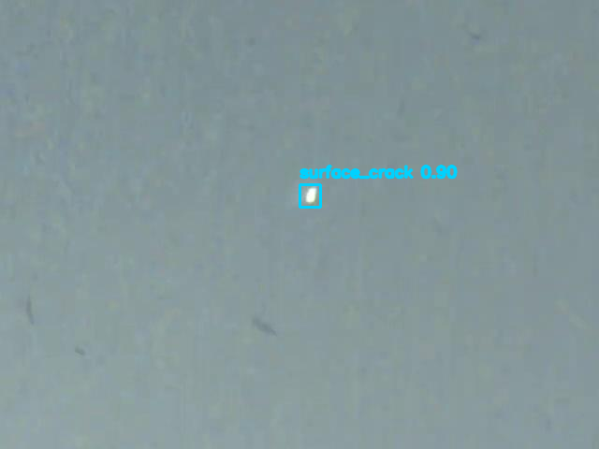
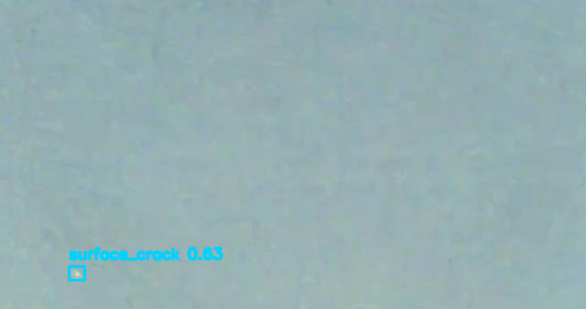
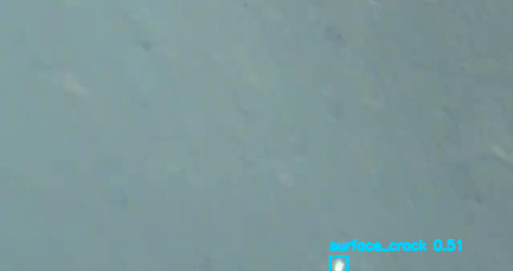
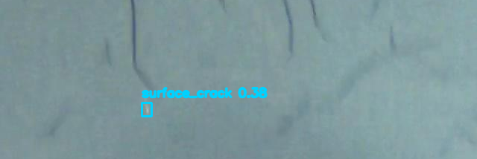
02 | 0:35–1:15
Four held-out frames. One real YOLO26n checkpoint.
微小缺陷，巨大后果
SEPARATOR REFERENCE
INSPECTION GAP
14 µm
Subsurface
Risk boundary for stack design
Surface-only RGB cannot see void physics
Factory consequence
A defect escape is not “one missed box.”
It is an untraceable precursor to rework, yield loss, or an internal-short investigation.
HELD-OUT COATINGVISION — YOLO26N OUTPUT
Four real inputs · four raw overlays · RGB-only evidence mode → HOLD
Four real CoatingVision test images; same YOLO26n checkpoint; RGB-only HOLD mode.
TEAM 71 / 2
Notes:
Each panel is a distinct held-out CoatingVision optical image passed through the same YOLO26n checkpoint. Image 1959 produced a surface-crack candidate at 0.90 confidence; images 1090, 1847 and 565 produced candidates at 0.63, 0.51 and 0.38. This is a visual gallery of raw model outputs, not simulated defects or post-hoc annotations.
The held-out test evaluation contains 88 images and 102 instances: P 64.5%, R 64.2%, mAP50 63.4%, mAP50-95 35.4%. No thermal or profiler data were supplied; every panel therefore runs in RGB-only degraded/HOLD mode and makes no dimensional-metrology or production-release claim.
[Sources]
Input data: Sampath et al., CoatingVision dataset, Figshare DOI 10.6084/m9.figshare.29260121.v1, CC BY 4.0.
Raw model outputs: reports/coatingvision_gallery/image_1959, image_1090, image_1847, image_565.
Checkpoint evaluation: reports/coatingvision_real_test_metrics.json.

Slide 3
03 | 1:15–2:00
An evidence-gated inspection architecture
七工站闭环检测决策
1
2
3
4
5
6
7
Encoder
同步
RGB / Thermal / 3D
采集
5-channel
对齐融合
YOLO26n
detection
Physics
metrology
PLC
interlock
Root-cause
feedback
WEB SPEED
LINE RATE
OPTICS
MOTION BLUR
1.8 m/s
42.6 kHz
M = 0.17
≤ 0.40 px
design operating point
1.8 m/s ÷ 42.24 µm/px
2 × 8K line-scan
exposure design limit
RGB detection is validated; thermal, 3D and closed-loop control remain pilot gates.
Design budget: 50 mm lens, 350 mm WD, 7.04 µm sensor pixels, 650 mm web.
TEAM 71 / 3
Notes:
The architecture separates evidence from aspiration. The current real-data proof is an RGB YOLO26n detector. In the fixed CoatingVision split, it was trained on 406 images, validated on 87 images and evaluated on 88 held-out test images. Thermal/3D fusion, calibrated metrology and PLC release remain gated on physical integration.
[Sources]
reports/coatingvision_real_test_metrics.json; configs/coatingvision_real_detect.yaml; src/inference/multi_stage_pipeline.py.

Slide 4
04 | 2:00–2:45
Fusion is anchored to material coordinates, not arrival time
多模态融合：锚定材料坐标，而非到达时间
RGB
FrameContext
surface texture
roll ID
encoder pulse at capture
monotonic timestamp
5-layer tensor
Decision event
Traveling-wave thermal
[R, G, B, ΔT/phase, Z]
spatial warp + quality flags
X_m · Y_mm · lane
confidence · disposition
phase / subsurface response
Laser 3D
height / topology
FrameContext preserves the web position at photon capture; downstream latency cannot shift the defect coordinate.
Temporal anchoring is implemented in the prototype; real sensor streams remain a pilot integration gate.
TEAM 71 / 4
Notes:
Multi-modal fusion fails if it uses processing time as a coordinate. Our FrameContext records the roll ID, encoder count, material position and monotonic capture time when the photons arrive. Every later operation inherits that anchor.
We fuse RGB, traveling-wave thermal response, and 3D laser height into five channels: R, G, B, thermal phase or differential, and height. Importantly, the current repository validates this logic with simulated secondary streams. The production claim is therefore the architecture and anchoring method; hardware calibration and temporal phase validation are pilot gates.
[Sources]
src/industrial/web_synchronizer.py; src/inference/sensor_fusion.py (mock/simulated secondary feeds).

Slide 5
05 | 2:45–3:35
A detection becomes a measurement only after calibration
从分割掩膜到带防护带的测量记录
1 Geometry
minAreaRect · web angle · area
UNCERTAINTY
GUM k = 2
2 Topography
plane leveling · Ra · volume
expanded uncertainty; 95% coverage
3 Risk index
separator-aware empirical score
DECISION RULE
4 Guard band
limit − expanded uncertainty U
Limit − U
guard band before A/B/C grade
5 Traceability
plant SOP / customer spec mapping
Standards correction: T/CIAPS 0006 and QC/T 743 are not valid coating-metrology compliance claims.
A = A_px · s² | U = 2√Σuᵢ² | accept only if q ≤ L − U
TEAM 71 / 5
Notes:
The visible formula is the decision contract: pixel area A_px is converted by calibrated scale s; expanded uncertainty uses coverage k=2; a quality quantity q can pass only inside the guard-banded limit L−U. This is activated only with a calibrated measurement system. RGB-only evidence mode deliberately returns HOLD, not a dimensional grade.
[Sources]
src/inference/electrode_metrology.py; src/inference/postprocess.py; src/inference/multi_stage_pipeline.py.

Slide 6
06 | 3:35–4:20
Latency is a full physical chain — and currently a design model
时延是完整物理链路——当前为设计模型
Tile formation
DMA
Fusion
AI
Metrology
Network
PLC
Valve + air
+
+
+
+
+
+
+
12.1 ms
1.2 ms
1.8 ms
8.7 ms
1.5 ms
0.8 ms
2.0 ms
4.5 ms
P50 DESIGN MODEL
P99.9 MODEL
DESIGN W/ GUARD
500 mm BUFFER
32.9 ms
35.9 ms
38.9 ms
7.1×
not a hardware measurement
Monte Carlo output
P99.9 + 3.0 ms
at 1.8 m/s; design result
PLC protocol telemetry ≠ deterministic safety interlock. HIL evidence is mandatory before deployment.
Latency engine status in source: MONTE_CARLO_SIMULATED; the P99.9 number is not a measured production SLA.
TEAM 71 / 6
Notes:
A fast neural network is not a fast rejection system. We decompose the chain from tile formation to air-jet propagation. The expected P50 is 32.9 milliseconds, P99.9 is 35.9 milliseconds, and with a three-millisecond guard the design latency is 38.9 milliseconds. At 1.8 metres per second and 500 millimetres camera-to-ejector spacing, that gives a 7.1-times design buffer.
However, these percentiles are Monte Carlo modeled in the current code. Modbus TCP and OPC UA are telemetry/control interfaces, not proof of a deterministic safety layer. The pilot exit criterion is a hardware-in-the-loop trace with encoder, PLC scan, valve response and P99.9 measurement.
[Sources]
src/industrial/latency_budget.py (Monte Carlo status); calculated 500 / (1.8 × 0.0389).

Slide 7
07 | 4:20–5:10
Defects become controlled process experiments
将缺陷转化为受控工艺实验
1,200 m roll map
Root-cause rank
Constrained change
Verify effect
X_m · Y_mm
4 slitting lanes
quality events
Slot-die · Dryer Z1
Vacuum mixer
ΔT1 / Δv / ΔQ
approval + recipe limits
holdout segment
roll-level evidence
PROTOTYPE CERTIFICATE
EXAMPLE INTERVENTION
REPORTED KPI
HMAC-SHA256
ΔT1 = −4 °C
−84.2% scrap
tamper-evident MAC; not non-repudiation
hypothesis to be confirmed by trial
hold claim until raw pilot evidence is supplied
Closed-loop claims require controlled intervention, approval guardrails, and before/after raw logs.
TEAM 71 / 7
Notes:
The digital twin is a map of the material, not a dashboard screenshot. Each event is located by machine direction, transverse position and slitting lane. The diagnostic engine then ranks process hypotheses.
We make an important causal distinction: a correlation is not a root cause. For example, reducing Dryer Zone 1 by four degrees is a controlled hypothesis, not an autonomous action. It must be constrained by the recipe, approved by process engineering, and verified on a holdout segment. The reported 84.2 percent scrap reduction must not be spoken as a result until raw pilot logs, baseline definition and independent roll evidence are available.
[Sources]
src/industrial/web_synchronizer.py; src/traceability/root_cause_engine.py; src/traceability/roll_certificate.py; reported figure appears only in generated dossier.

Slide 8
08 | 5:10–6:00
The upgrade path: benchmark → physical pilot
试点就绪性靠证据获得，而非包装宣称
REAL TEST
88 images · 102 labelled instances
P 64.5% · R 64.2% · mAP50 63.4%
MODEL
YOLO26n detector
406 train · 87 validation · fixed seed 71
NEXT DATA
calibrated RGB + thermal + 3D
timestamp registration · raw-roll labels · held-out lots
PILOT GATE
HIL reject trace + MSA
P99.9 timing · Gage R&R · independent witness
Our ask: approve a supervised pilot to convert benchmark evidence into a trustworthy factory system.
Source: fixed CoatingVision test split; physical pilot gates remain explicit.
TEAM 71 / 8
Notes:
Upgrade sequence: first collect synchronized, calibrated RGB/thermal/height frames with raw-roll labels; then establish measurement-system capability and cross-lot POD; finally execute a hardware-in-the-loop rejection timing trace. The model is not presented as production ready. The deployment decision must be made after those gates pass.
[Sources]
reports/coatingvision_real_test_metrics.json; scripts/prepare_coatingvision_detection_dataset.py; scripts/evaluate_coatingvision_real.py.

