Slide 1
Deep Image Analogy
DOI: 1705.01088

Slide 2
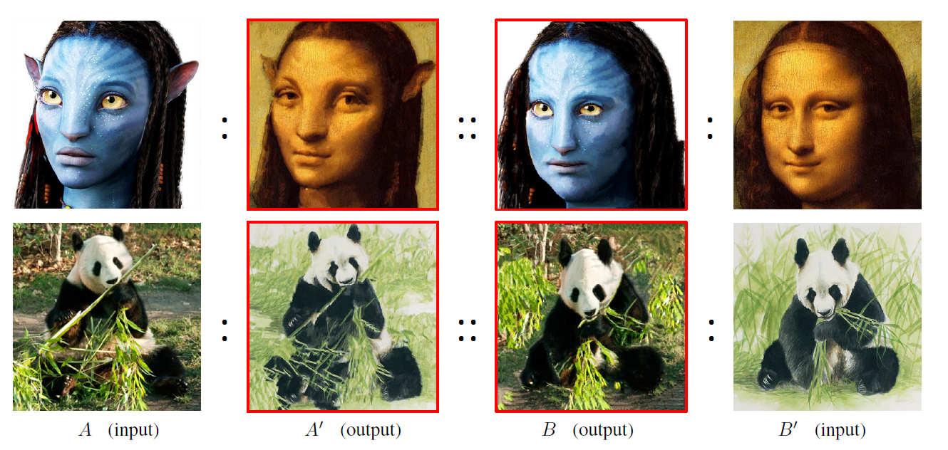
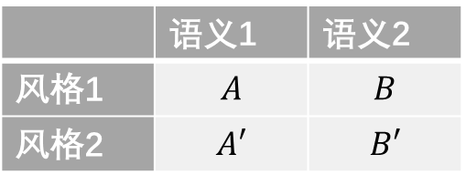
Motivation
 | 语义1 | 语义2
风格1 | $$A$$ | $$B$$
风格2 | $$A′$$ | $$B′$$

Slide 3
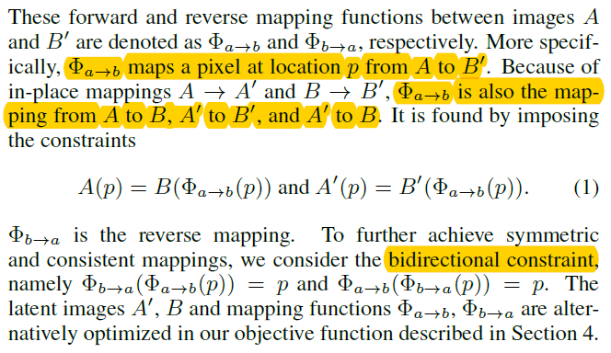
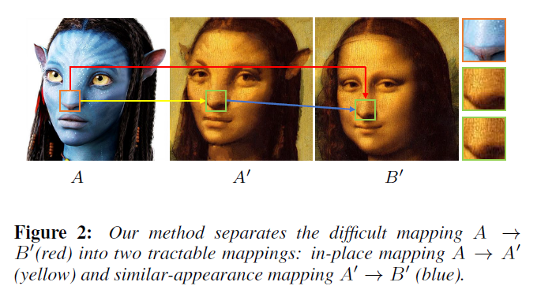

Pixel-to-pixel mapping $Φ_{a→b}$

Slide 4
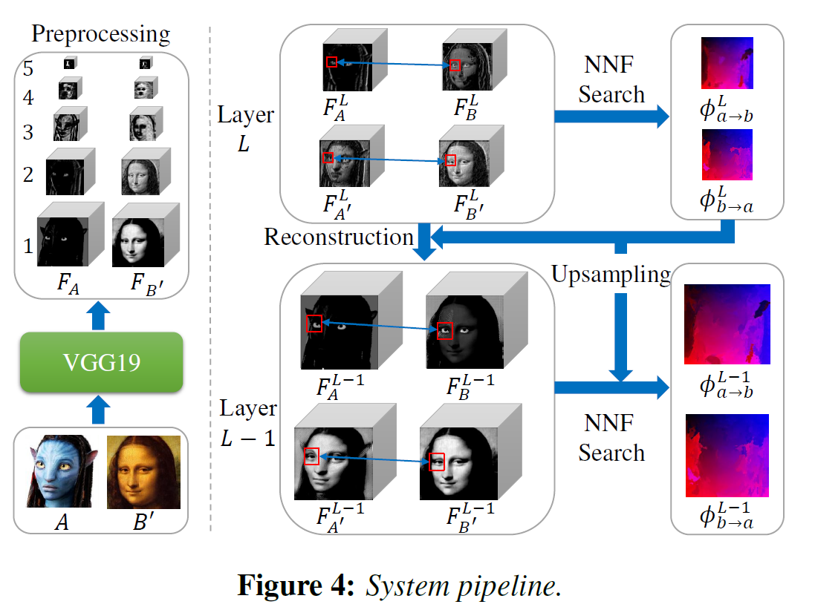

Pre-trained CNN $F$ (VGG-19)

Slide 5
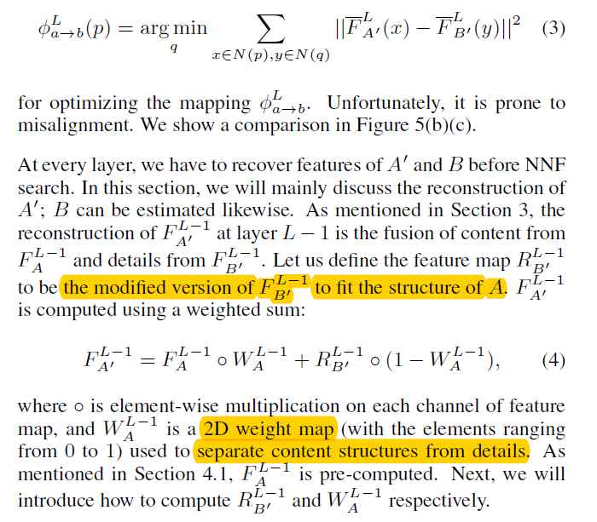

Slide 6
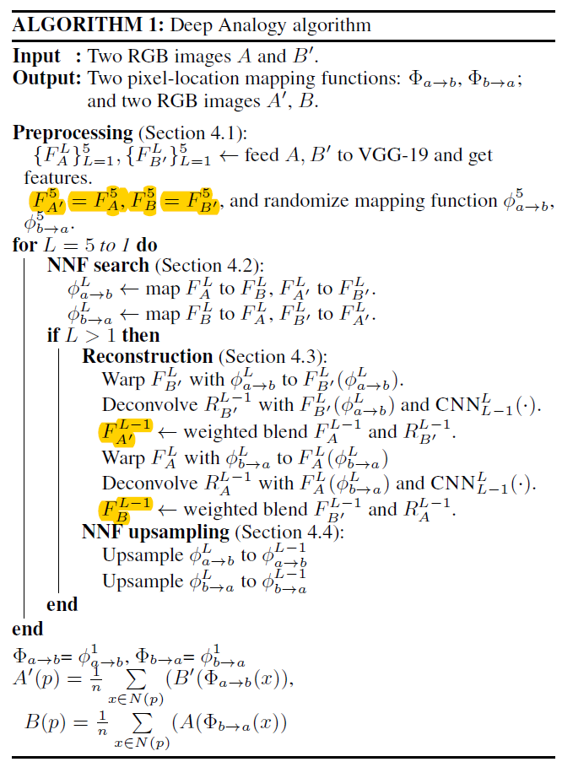
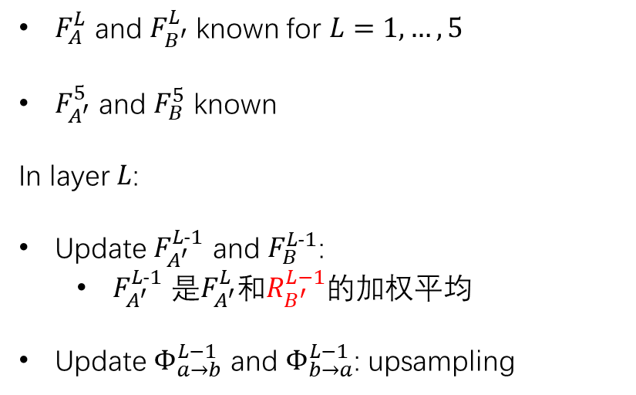
Back from coarse to fine
$F_{A}^{L}$ and $F_{B^{′}}^{L}$ known for $L=1,…,5$
$F_{A^{′}}^{5}$ and $F_{B}^{5}$ known
In layer $L$:
Update $F_{A^{′}}^{L-1}$ and $F_{B}^{L-1}$:
$F_{A^{′}}^{L-1}$ 是$F_{A^{′}}^{L}$和$R_{B^{′}}^{L−1}$的加权平均
Update $Φ_{a→b}^{L−1}$ and $Φ_{b→a}^{L−1}$: upsampling

Slide 7
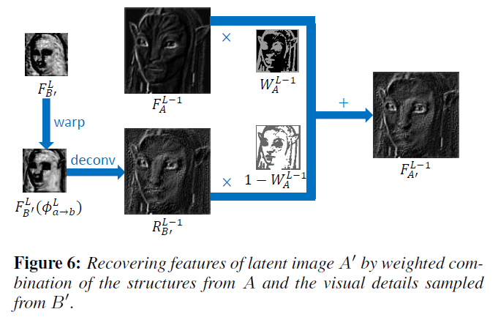
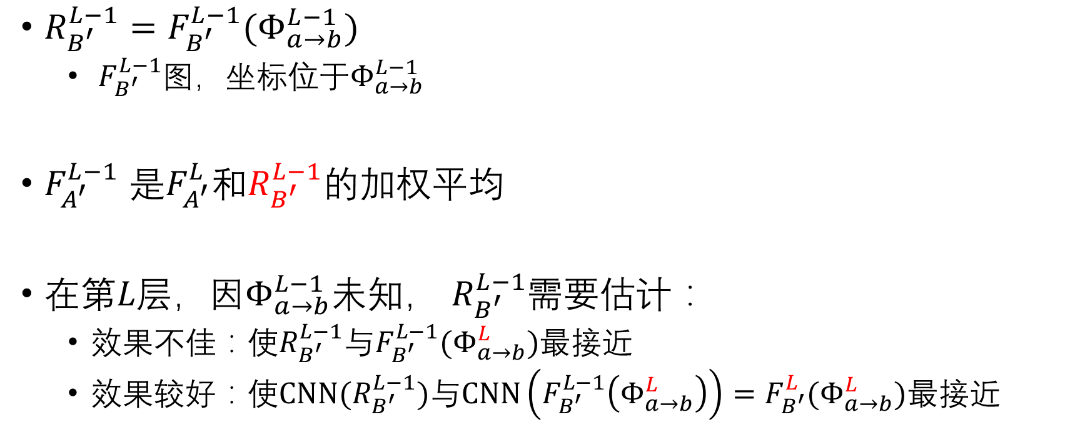

What’s $R_{B^{′}}^{L−1}$?
$R_{B^{′}}^{L−1}=F_{B^{′}}^{L−1}(Φ_{a→b}^{L−1})$
$F_{B^{′}}^{L−1}$图，坐标位于$Φ_{a→b}^{L−1}$
$F_{A^{′}}^{L−1}$ 是$F_{A^{′}}^{L}$和$R_{B^{′}}^{L−1}$的加权平均
在第$L层$，因$Φ_{a→b}^{L−1}$未知， $R_{B^{′}}^{L−1}$需要估计：
效果不佳：使$R_{B^{′}}^{L−1}$与$F_{B^{′}}^{L−1}(Φ_{a→b}^{L})$最接近
效果较好：使$CNN(R_{B^{′}}^{L−1})$与$CNN\left(F_{B^{′}}^{L−1}\left(Φ_{a→b}^{L}\right)\right)=F_{B^{′}}^{L}(Φ_{a→b}^{L})$最接近

