Slide 1
Build your own chrome extension
Thu Tran

Slide 2
Introduction
I learned this at Grace Hopper → I’m a novice
Beginner friendly

Slide 3
Agenda
Background
Build a Chrome theme
Build a Chrome extension

Slide 4


What is a Chrome extension?
Program that runs in Chrome browser
JavaScript, CSS, HTML
Customize and extend the functionality of Chrome
Some examples:

Slide 5
Tools
Clone/Download the repository: https://z.umn.edu/wits-chrome
Google Chrome - https://www.google.com/chrome/
Text editor:
VS Code – https://code.visualstudio.com/
Atom – https://atom.io/

Slide 6
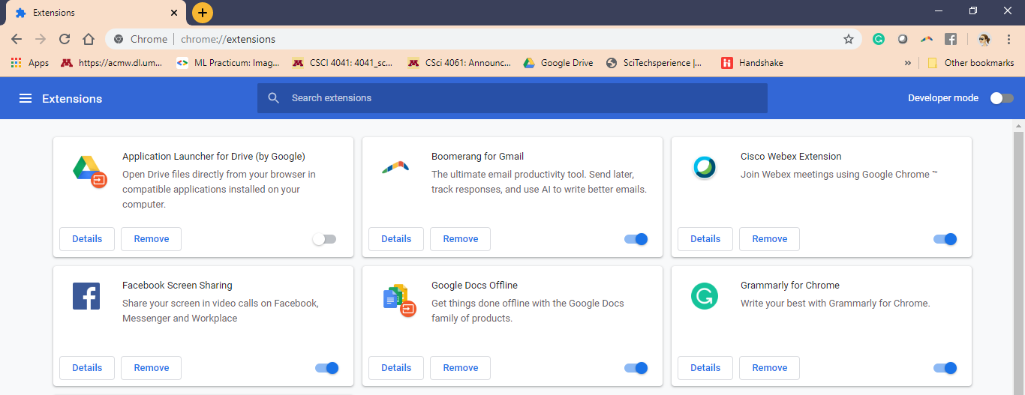
Chrome developer mode
chrome://extensions/

Slide 7
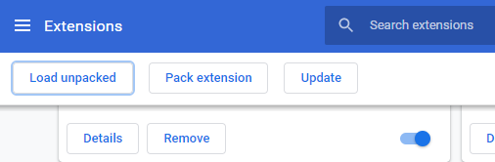
Load your theme
Click “Load unpacked” and select the “Theme” folder

Slide 8
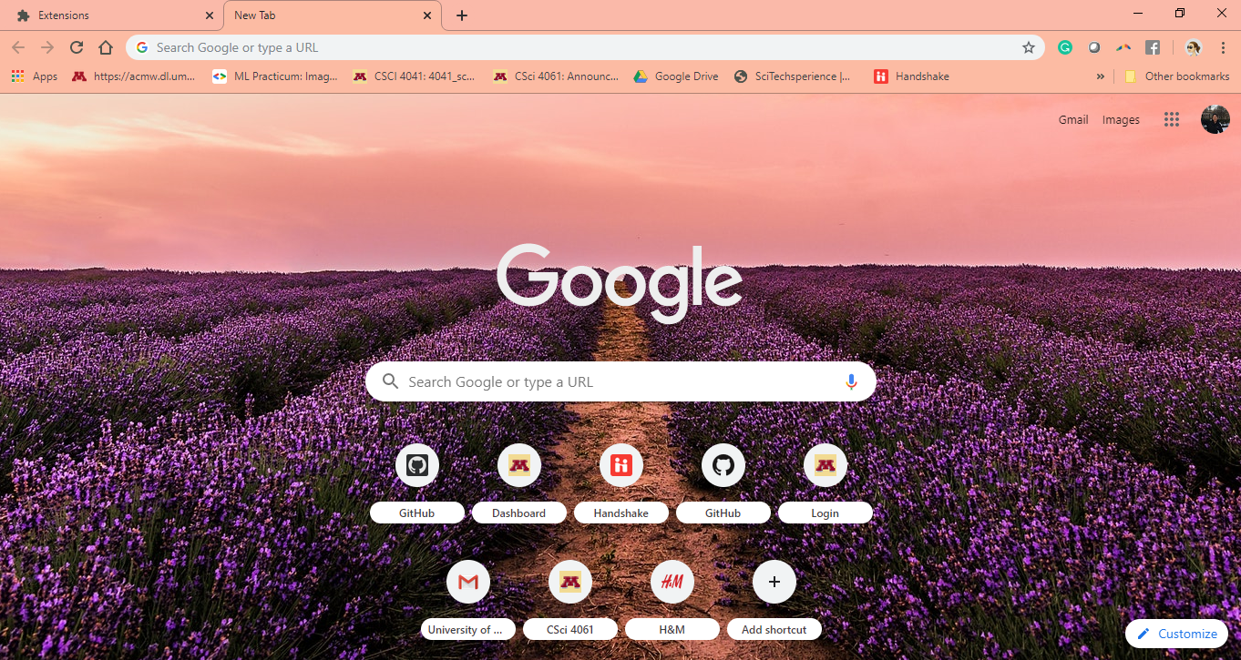
Beautiful!

Slide 9
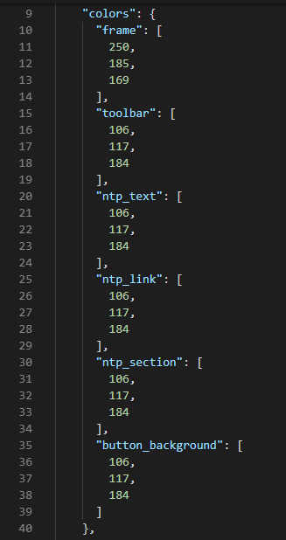

Change the theme
Go to “Theme” folder, and open “manifest.json” in your text editor of choice
Red, Green, Blue number
Some suggestion:
197, 141, 177
252, 187, 163
249, 141, 70
Want your own combo? I used Microsoft Paint to look for colors

Slide 10
JSON file
JavaScript Object Notation – data-interchange format
Attribute-value pairs and array data type
Easy for human to read/write, for machine to parse

Slide 11
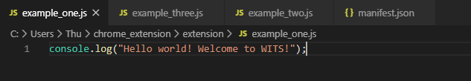
Build our own extension
Something functional?
How ‘bout print something to the log?
Open “extension” folder and “example_one.js”

Slide 12
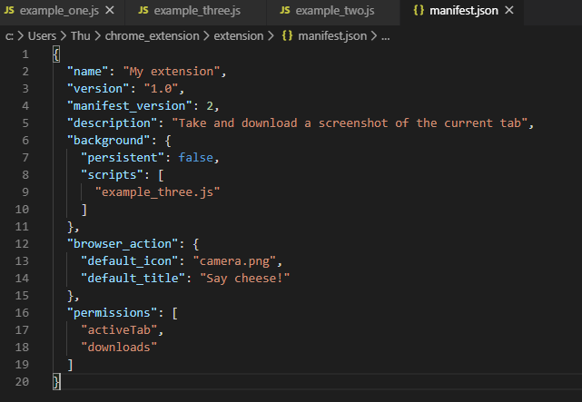
Build our own extension
Change the script to example_one.js
Unpack your extension again, this time, using the extension folder, on chrome://extensions/

Slide 13
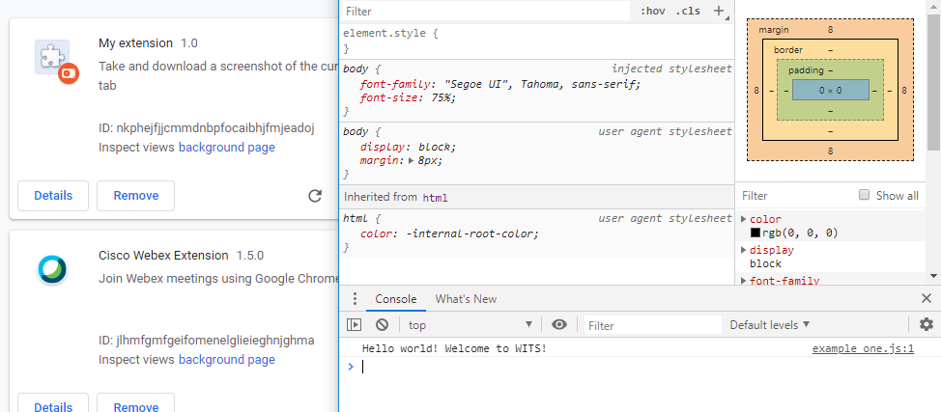
Build our own extension

Slide 14
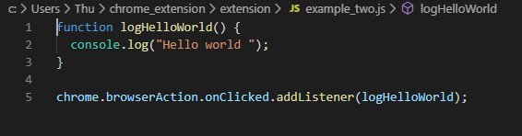
Build our own extension
But when we use chrome extension, we need to click on some kind of buttons, right?
Examine “example_two.js”
Callback functions – a function that is passed as a parameter to another function

Slide 15
Build our own extension
Change the “scripts” value to “example_two.js” in manifest.json
Re-unpack the folder on chrome://extensions/
Notice the button created … Click on it to see what happens

Slide 16
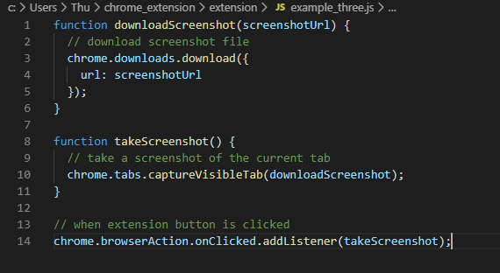
An extension that screenshot current tab and download it

Slide 17
Build our own extension
Change the “scripts” value to “example_two.js” in manifest.json
Re-unpack the folder on chrome://extensions/
Click the button!

Slide 18
Documentation
https://developer.chrome.com/extensions/overview

