Slide 1
GenX
problem: we would like to predict the clinical response of immunotherapy, and identify the most relevant genetic pathways.
Approaches (two 'pathways')
Classification results
Pathway visualisation?
Suggestions

Slide 2
Approaches
Pathway-focused: find graphs directly → aborted on day 2: need metabolic pathways to create intraset connections..
Classification-focused: create classifiers per layer..then
  Combo 1: meta-classifier on top of individual estimations
  Combo 2: create classifier with the most important features per classifer
Caveat: we did not explictly introduce any first principles in the dataset connectivity..

Slide 3
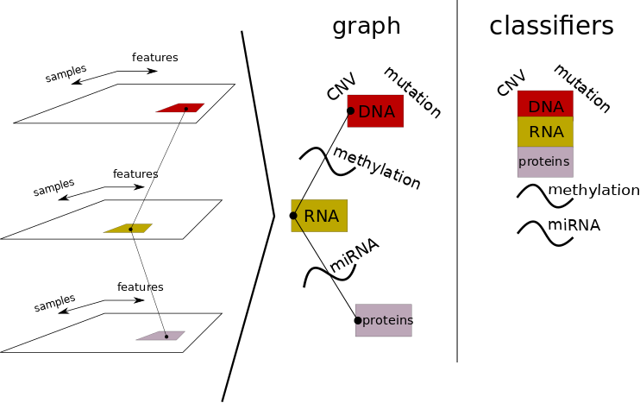
Approaches

Slide 4
Classification results
Per omics the predictors are weak (max 70% acc)
Combining the omic’s based on the most important features wins. (does not include methylation data yet)
 | precision | recall | f1-score | support
response | 1 | 0.89 | 0.94 | 19
No response | 0.9 | 1 | 0.95 | 19
avg / total | 0.95 | 0.95 | 0.95 | 38

Slide 5
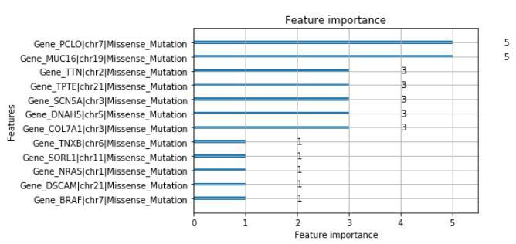
Classification results
We find BRAF pv600e in the mutation classification as the single most important gene for the less important mutations
miRNA and RNA data contributed the most, protein the least
Strand matters

Slide 6
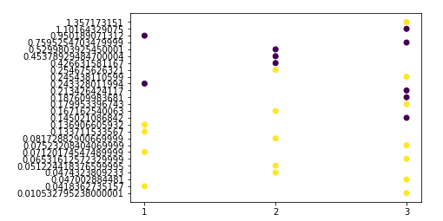
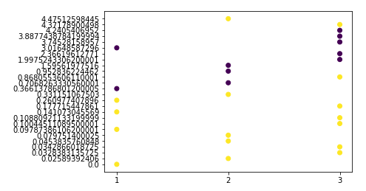
Classification results
MMRN1, +strand
TFF3, -strand
Similar for: LRRC2, MFAP4, FAM151A

Slide 7
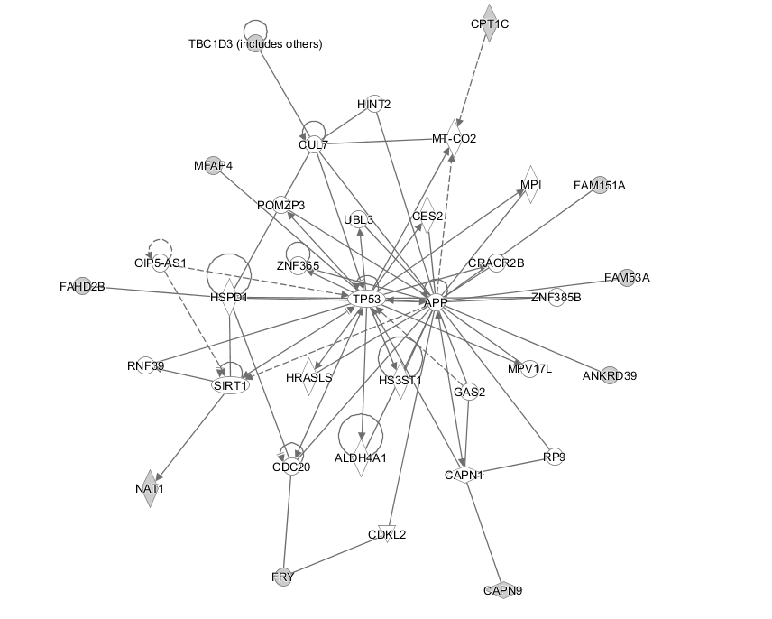
Classification results
Confirmation of sorts with IPA tool..TP53 and APP were important in our final model

Slide 8
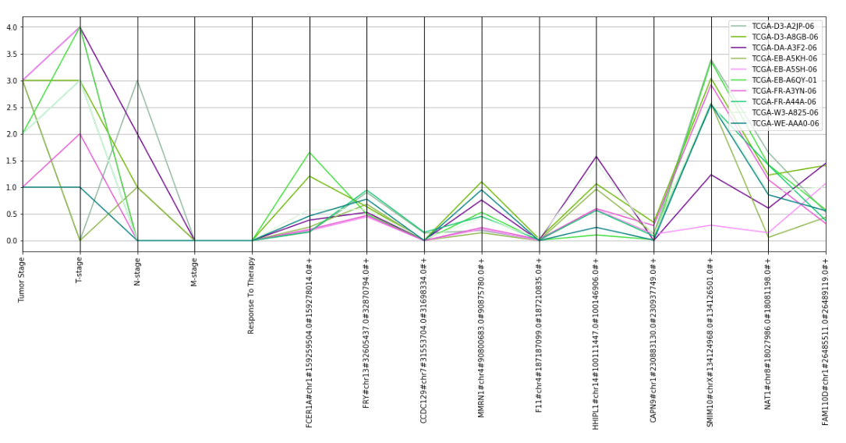
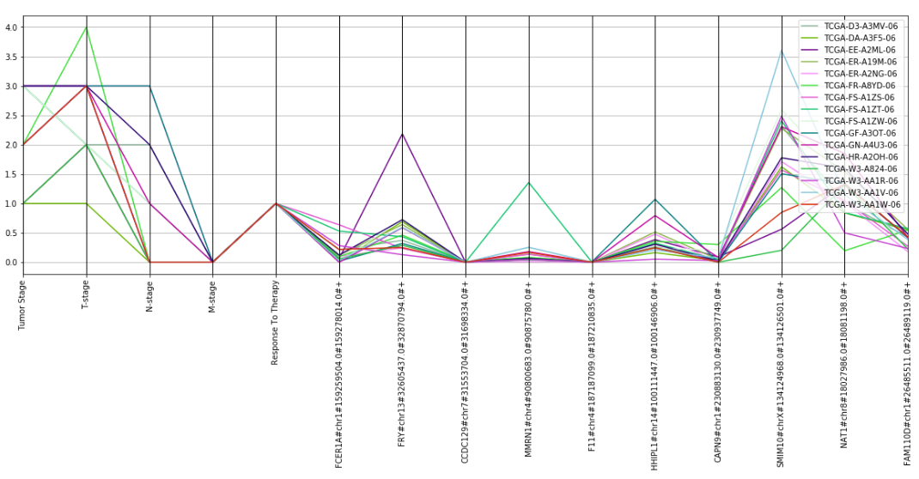
Pathway visualisation?
We take the most important features per omic, per patients and connect the omics per patient.

Slide 9
Suggestions
Add metabolic pathway information: focus on pathways directly
Specifically find the model that connects the omics
In general: try to ‘prime’ the model with first principles
Perform similarity analysis per omics over all features, per patient group
Apply methylation and RNA expression to mutations, i.e. merge by element with a transformation function f(meth, rna)

Slide 10
Concluding
It is possible to predict immunotherapy response
  but...further research is needed
We can identify elements of the pathways
  but…not yet how they are connected

