Slide 1

Hercules: Reproducing Crashes in Real-World Application Binaries
Van-Thuan Pham, Wei Boon Ng, Konstantin Rubinov, Abhik Roychoudhury
22/05/2015 – ICSE 2015 – Florence, Italy

Slide 2
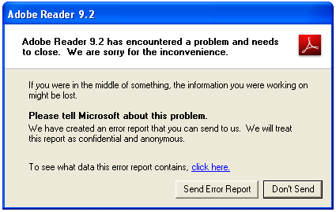

Problem Statement
Crash reproducing supports
In-house debugging and fixing
Vulnerability checking

Slide 3

Related work [ICSE’12, ASE’14]
Deploy in the field
Application
Instrumen-tation
Crash input
Symbolic Execution - Analyzer
Crash report
Capture and Replay

Slide 4
Hercules features
NO instrumentation
Selective Symbolic Execution with the support of a novel targeted search strategy and heuristics on loops and string functions
Work with multi-module application binaries
Target on application binaries that accept complex input files as program inputs

Slide 5
Outline
High level design of Hercules toolset
Technical contributions
Implementation
Experimental evaluation

Slide 6




Hercules toolset
Hercules
Targeted Search Strategy
String & Loops manipulation
Program binary
Hercules toolset
(Crash address, loaded modules, call stack, register values)
Dynamic Module Selection
Optimization
(Hybrid Symbolic file, Path Pruning)
Crash input files
Benign input files

Slide 7


Experimental Evaluation Summary
Case studies | White-box Fuzzing | Black-box Fuzzing | Hercules
CVE-2010-2204 (Adobe Reader) Memory Access Violation
CVE-2010-3000 (Real Player) Integer Overflow
CVE-2014-2671 (Windows Media Player) Division by Zero
CVE-2010-0718 (Windows Media Player) Buffer overflow
CVE-2010-0688 (Orbital Viewer) Buffer overflow
CVE-2011-0502 (MAM player) Null pointer reference

Slide 8
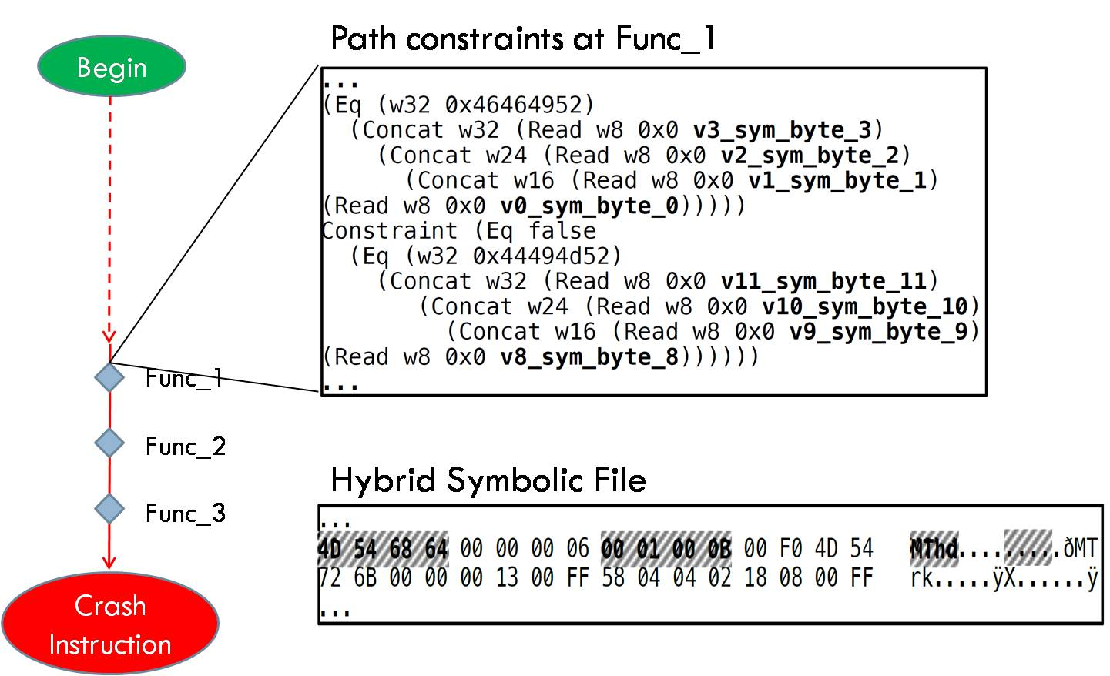
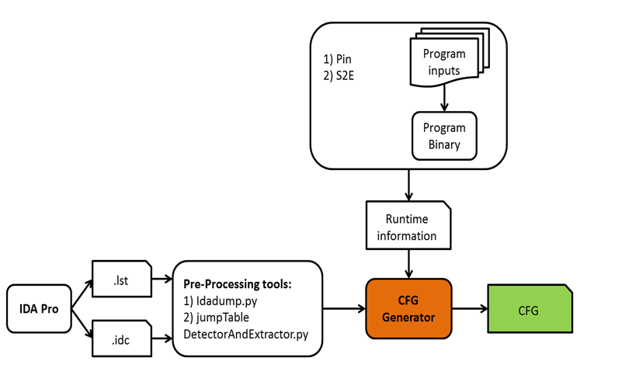

Hercules workflow
- Step 1
- Step 2
Test input selection
&
Control Flow Graph (CFG) generation
Precise Taint Tracking
Targeted concolic exploration
benign
Input file
Hybrid
Input file

Slide 9
Reproduce a crash
Reach crash instruction
Satisfy a
crash condition
PC ^ CC
Challenges:
Incomplete program structures
Multi-module program
The input file formats are complex
Operands of the Crash instruction is “not tainted”
Example: div ecx

Slide 10
Targeted Search Strategy – Step 3 (intuition-1: Using Unsat Core for Backtracking)
Begin
Check_Sat(PC ^ CC) == Unsat
Unsat_core = Get_Unsat{PC ^ CC}
Next_State = Find_State(Unsat_core)
Run(Next_State)
Check_Sat(PC’ ^ CC) == Sat
Crash
Instruction

Slide 11
Targeted Search Strategy – Step 3 (intuition-2: Selective Symbolic Execution – S2E)
Concolic execution
Enable Forking
Concolic execution
Disable Forking
Concrete execution
Begin
Begin
Begin
br₁
br₁
br₁
br₂
br₂
br₂
br₃
br₃
br₃
PC=true
PC=bc₁^bc₂^bc₃
PC=bc₁^bc₂^bc₃

Slide 12
Targeted Search Strategy – Step 3 (intuition-2: Selective Symbolic Execution)
Module Dependency Graph (MDG)
Vertices: executable modules (.exe, .dll, …)
Edges: A->B is an edge <=> f calls g
(f is a function of A, g is a function of B)
A.exe
(Main module)
B.dll
D.dll
C.dll
(Crash module)
E.dll

Slide 13
Targeted Search Strategy – Step 3 (intuition-3: Using Call Stack to reduce search space)
Start symbolic exploration
From a function close to crash location
Begin
Using benign input files
Huge Search Space
Func_1
Smaller
Search Space
Func_2
Func_3
Crash

Slide 14
Bounded random exploration
Drive the search towards “exit points” that lead to modules in module dependency chain – Path Pruning
Exit points:
Extract statically from IDA Pro output
Collect dynamically
in run-time
A.exe
D.dll
B.dll
C.dll
E.dll
F.dll
Crash
module

Slide 15
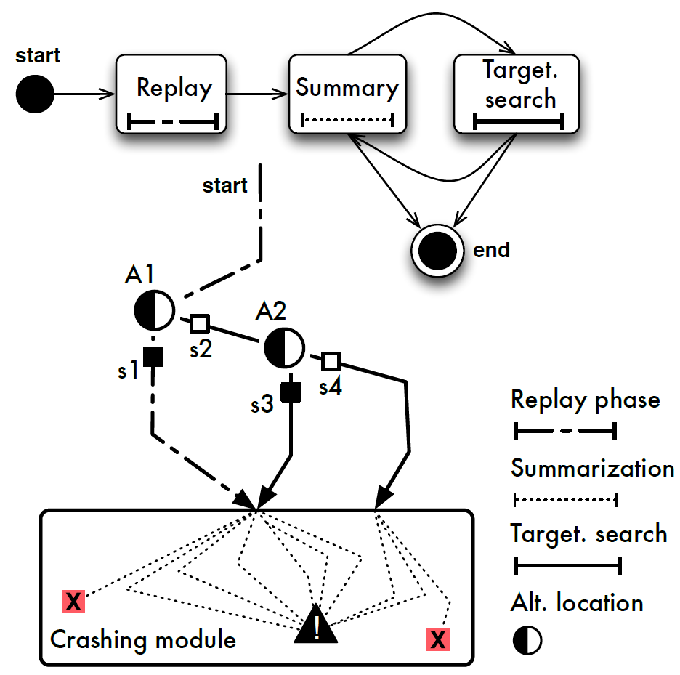
Hercules Targeted Search – Step 3

Slide 16
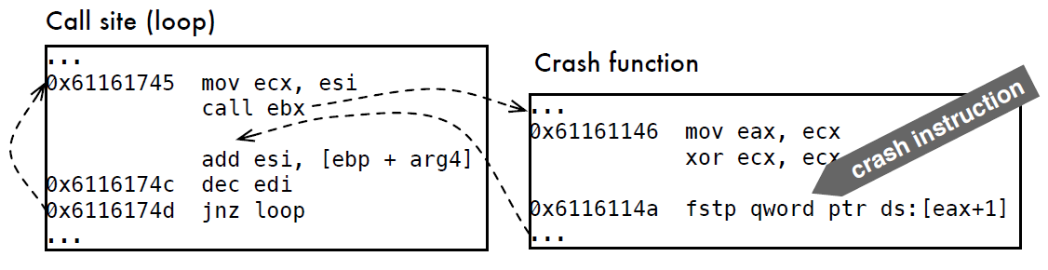
Define crash condition Using Loop-controlled variables analysis
Crash condition (CC): eax==eax_{crash}
HOW to reproduce the crash IF eax is CONCRETE and eax ≠ eax_{crash} ?

Slide 17
Crash condition transformation
Collected data
iteration # | ESI and EDI values
0 | ESI_{0,} EDI₀
1 | ESI += 0x23 EDI -= 1
2 | ESI += 0x23 EDI -= 1
…
9 | ESI += 0x23 EDI -= 1
Data fitting results
ESI = ESI₀ + 0x23 * it
EDI = EDI₀ – 1 * it
Original Crash Condition
EAX = EAX_{crash}
Data dependency
EAX = ESI
EAX_{crash} = ESI₀ + 0x23 * it_{crash}
Transformed Crash Condition
EDI₀ = EDI_{crash} + it_{crash}

Slide 18
String Functions Exploration and Grouping
Intuition:
Many more feasible paths than semantically distinct paths
Idea:
Dynamically explore and group feasible paths based on the semantic of string functions
stricmp(symbolic,concrete)
2¹³ * length
. . .
Group 1
(Equal)
Group 2
(E.length)
Group 3
(diff)

Slide 19
Implementation
CFG generator/
refinement
Standard Plugins
Custom Plugins
WindowsMonitor
S2E core
system
ExecutionTracker
ModuleMonitor
CrashDetector
FunctionMonitor
DynCodeSelector
CorePlugins
TargetedSearcher
IDA Pro
StrFuncInterceptor
CondSynthesizer
Z3 Solver
Integration
LoopExplorer
BAP
EdgeKiller

Slide 20
Experimental Evaluation
Case studies | Selected modules | S2E (DFS and Random) | Peach Fuzzer - mutation | Hercules
CVE-2010-2204 (Adobe Reader) Memory Access Violation | 2 / 78 |  |  | (*)
CVE-2010-3000 (Real Player) Integer Overflow | 2 / 129
CVE-2014-2671 (Windows Media Player) Division by Zero | 4 / 84
CVE-2010-0718 (Windows Media Player) Buffer overflow | 3 / 86
CVE-2010-0688 (Orbital Viewer) Buffer overflow | 2 / 49
CVE-2011-0502 (MAM player) Null pointer reference | 1 / 51 |  |  | (*)
(*) The crashes have been reproduced on both Windows XP and Windows 7

Slide 21
Experimental Evaluation
Case studies | CVE-2010-0688 (Orbital Viewer) | CVE-2011-0502 (MAM player)
S2E |  | 2 min
Peach Fuzzer | 10 hr | 10 min
Hercules | 3 hr | 1.5 min

Slide 22
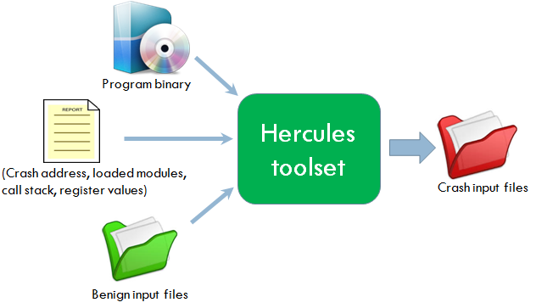
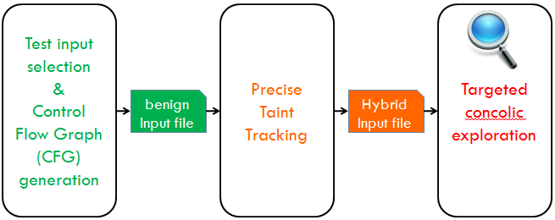
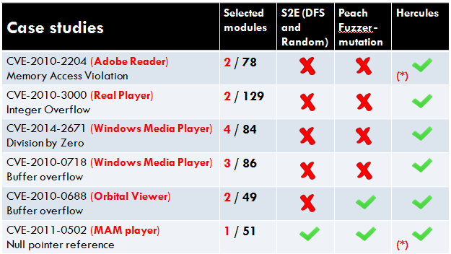
Summary

Slide 23
Questions & Answers

Slide 24
Backup slides
Crash condition transformation
Data fitting models
Sample crash report

Slide 25
Regression based loop invariant inference
Loop Exploration
values of registers/memory locations
it=0 (Before starting the loop)
EAX = …; EBX = …
Address_1 = …; Address_2 = …
it=1 (First Iteration)
EAX = …; EBX = …
Address_1 = …; Address_2 = …
Register_write (name, value)
Mem_write (address, value)
Data Fitting
Original
Crash Condition
Crash Condition Transformation
New Crash Condition

Slide 26
Data Fitting models
Single Loops
Nested Loops
y = a
for( … )
y= y+b
y = a
for( … )
y = y*b
y = a
for( … )
y = y + b
for( … )
y = y + c
y = a+b*it
y = ab^{it}
log(y)=log(a)+ it*log(b)
y = a + b*it1 + c*it1*it2
y = a + b*it1 + c*it’
Simple Linear Regression
Multiple Linear Regression

Slide 27
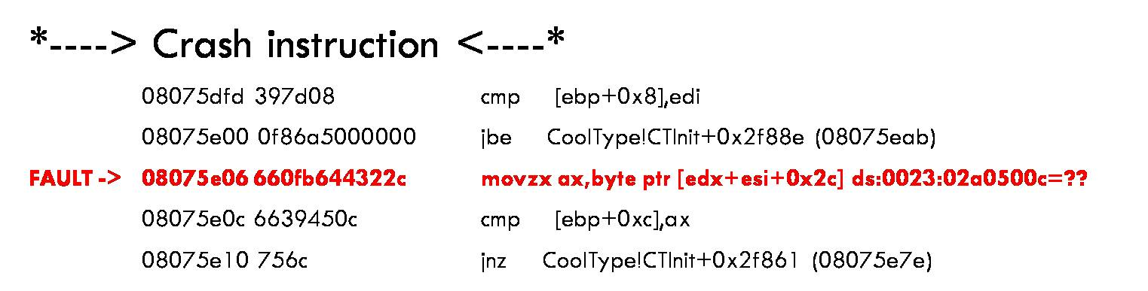
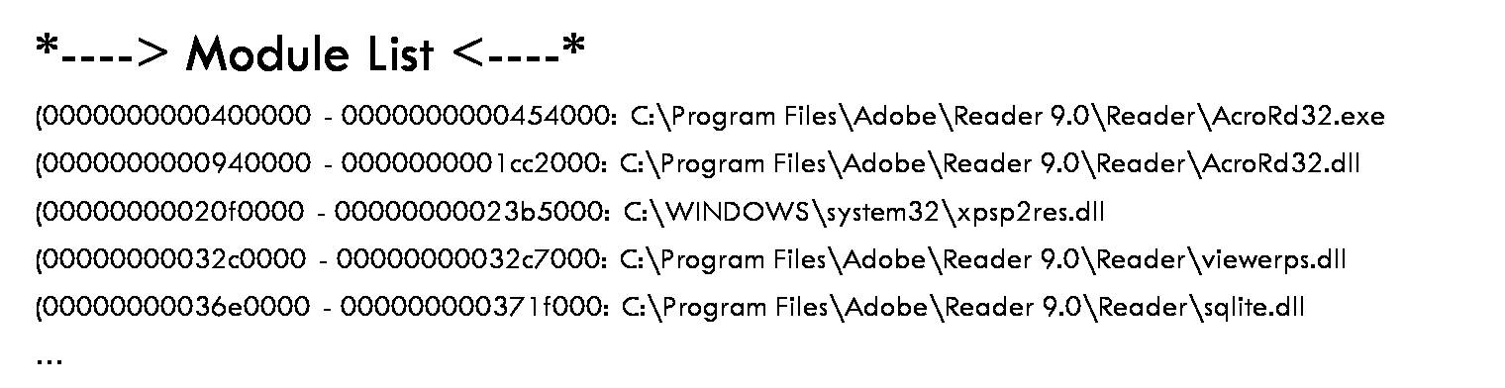
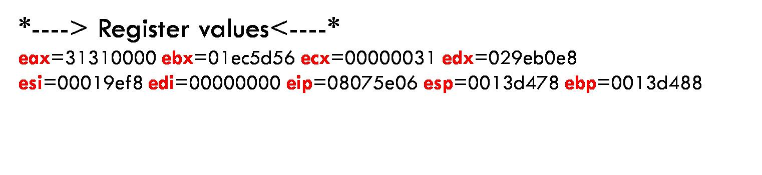
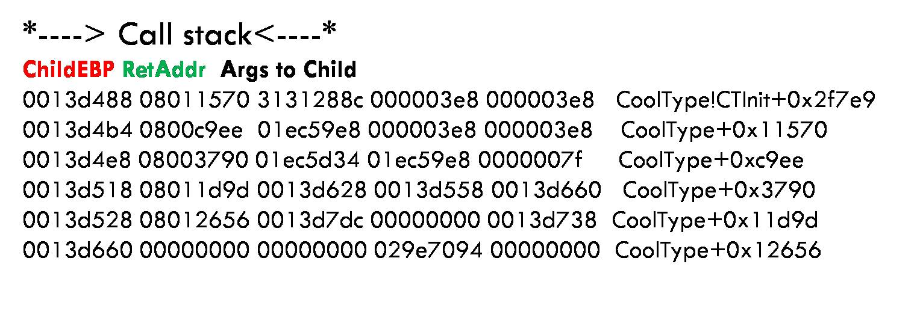
Windows Error Reporting’s crash report

