Slide 1
Decoding the Subsurface: Lithology Segmentation and Clustering
Michelle Iskander @HTB

Slide 2
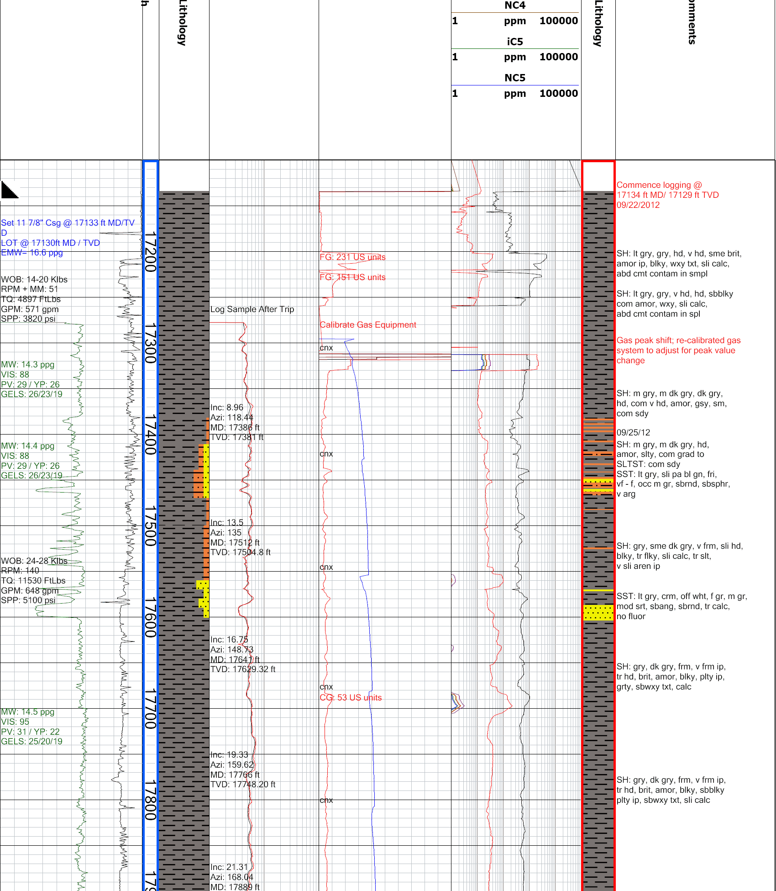
Understanding Lithology Columns
What is lithology?
Lithology refers to the physical characteristics of rocks, including their composition, texture and colour.
What are lithology columns?
Visual representations of geological formations at different depths.
Use colours, symbols and patterns to represent different rock types.
Commonly found in geological well logs to help understand subsurface formations.

Slide 3
Why Automate Lithology Extraction?
Geological reports contain valuable information about subsurface rock formations.
Much of this information is stored in PDFs and other unstructured or semi-structured formats.
Extracting lithological information often involves repetitive, time-consuming manual work.

Slide 4
The Challenge
Develop an automated solution that can:
Identify individual lithological intervals and their boundaries.
Group intervals containing the same or similar visual patterns.
Determine the top and base depths corresponding to each interval.
Map each group of intervals to their corresponding legend to give the lithology name.
(Bonus) Automatically locate the depth column, interpreted lithology column, and lithology legend without using the supplied bounding boxes.
top_y | bottom_y | lithology | cluster_id | top_depth | base_depth
300 | 450 | Siltstone | A | 100 | 115
450 | 620 | Shale | B | 115 | 132
620 | 700 | Siltstone | A | 132 | 140

Slide 5
Example Approach
Segment the Column
  Identify individual intervals and their boundaries
Cluster Similar Patterns
  Group the visually similar intervals
  Match them to their legends
Estimate Depths
  Convert pixel values to depth values
top_y
top
depth
bottom_y
bottom
depth
This is one possible approach, not a prescribed method. Teams may use any technique or combination of techniques, provided their solution meets the task requirements and submission format.

Slide 6
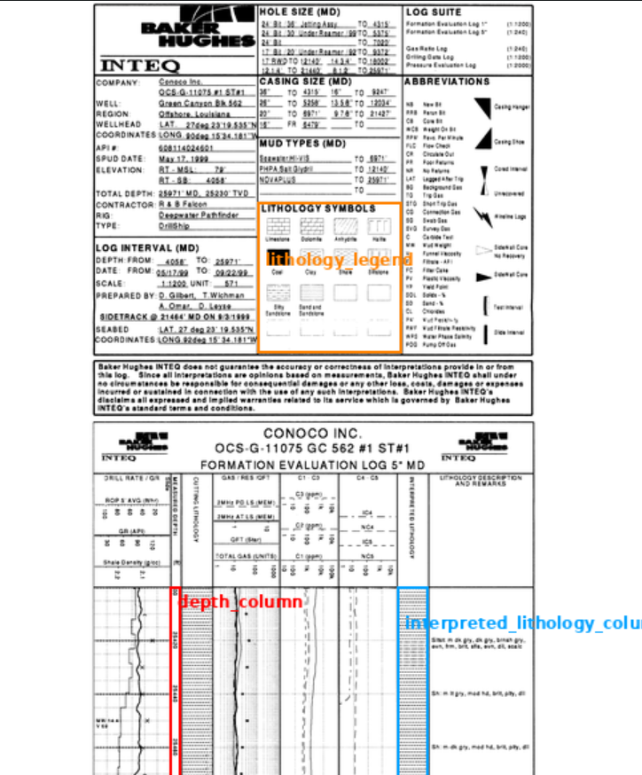
Dataset
50 Document Images
Annotation files with bboxes
  Depth Column
  Interpreted Lithology Column
  Lithology Legend
Manual annotation of development images is allowed for training, tuning, and validation.
Held out evaluation images will be released near the end

Slide 7
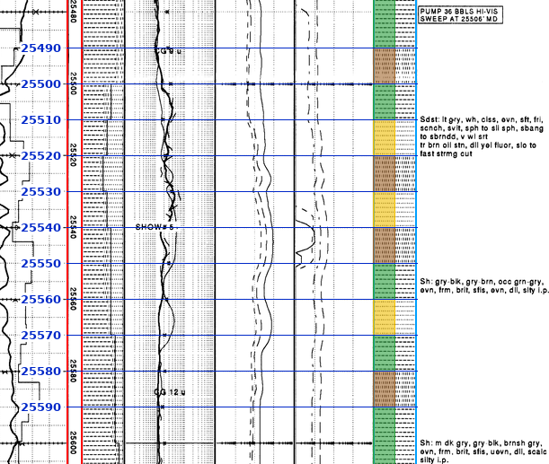
Expected Outputs
For each document:
1. Structured Results — CSV
  One row per detected interval containing:
  top_y — top boundary in pixels
  bottom_y — bottom boundary in pixels
  cluster_id — identifier for visually similar patterns within the column
  lithology — name obtained by matching the pattern to the supplied legend
  top_depth, base_depth — boundary depth values
2. Annotated Image
  Show the original lithology column with:
  Predicted interval boundaries
  Depth estimates
  Cluster labels/Lithology labels

Slide 8
Things to Consider
Correctness: Will your solution work on challenging cases?
Generalisation: Does it work on unseen documents, not just your development examples?
Efficiency: Consider processing time, memory, hardware requirements, and running costs.
Simplicity: Use complexity where it improves results, not for its own sake.
Automation: Final predictions should be generated without manual correction.
In your demo: explain your approach, show results and limitations, and report runtime and resource requirements. Solutions will be judged on correctness, and efficiency.

