Slide 1
Decoding the subsurface: automation and visualisation
Romoli, Nguyen, Howbrook
8/11/2026

Slide 2
01 Introduction

Slide 3
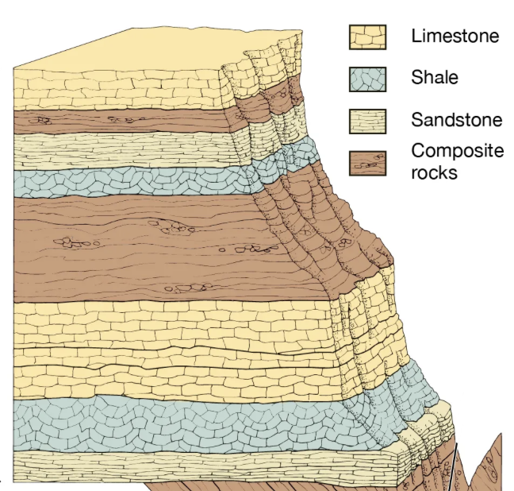
Introduction
Lithology columns describe the type of rocks found at different depths.
Lithology
Lithology is a term used to describe type of rocks.

Slide 4
Introduction
Problem statement
Lithology columns contain useful information
Information is stored in images or PDFs
Extracting this information is repetitive and time-consuming
Opportunity for automation!

Slide 5
02 Turning an image into structured data

Slide 6
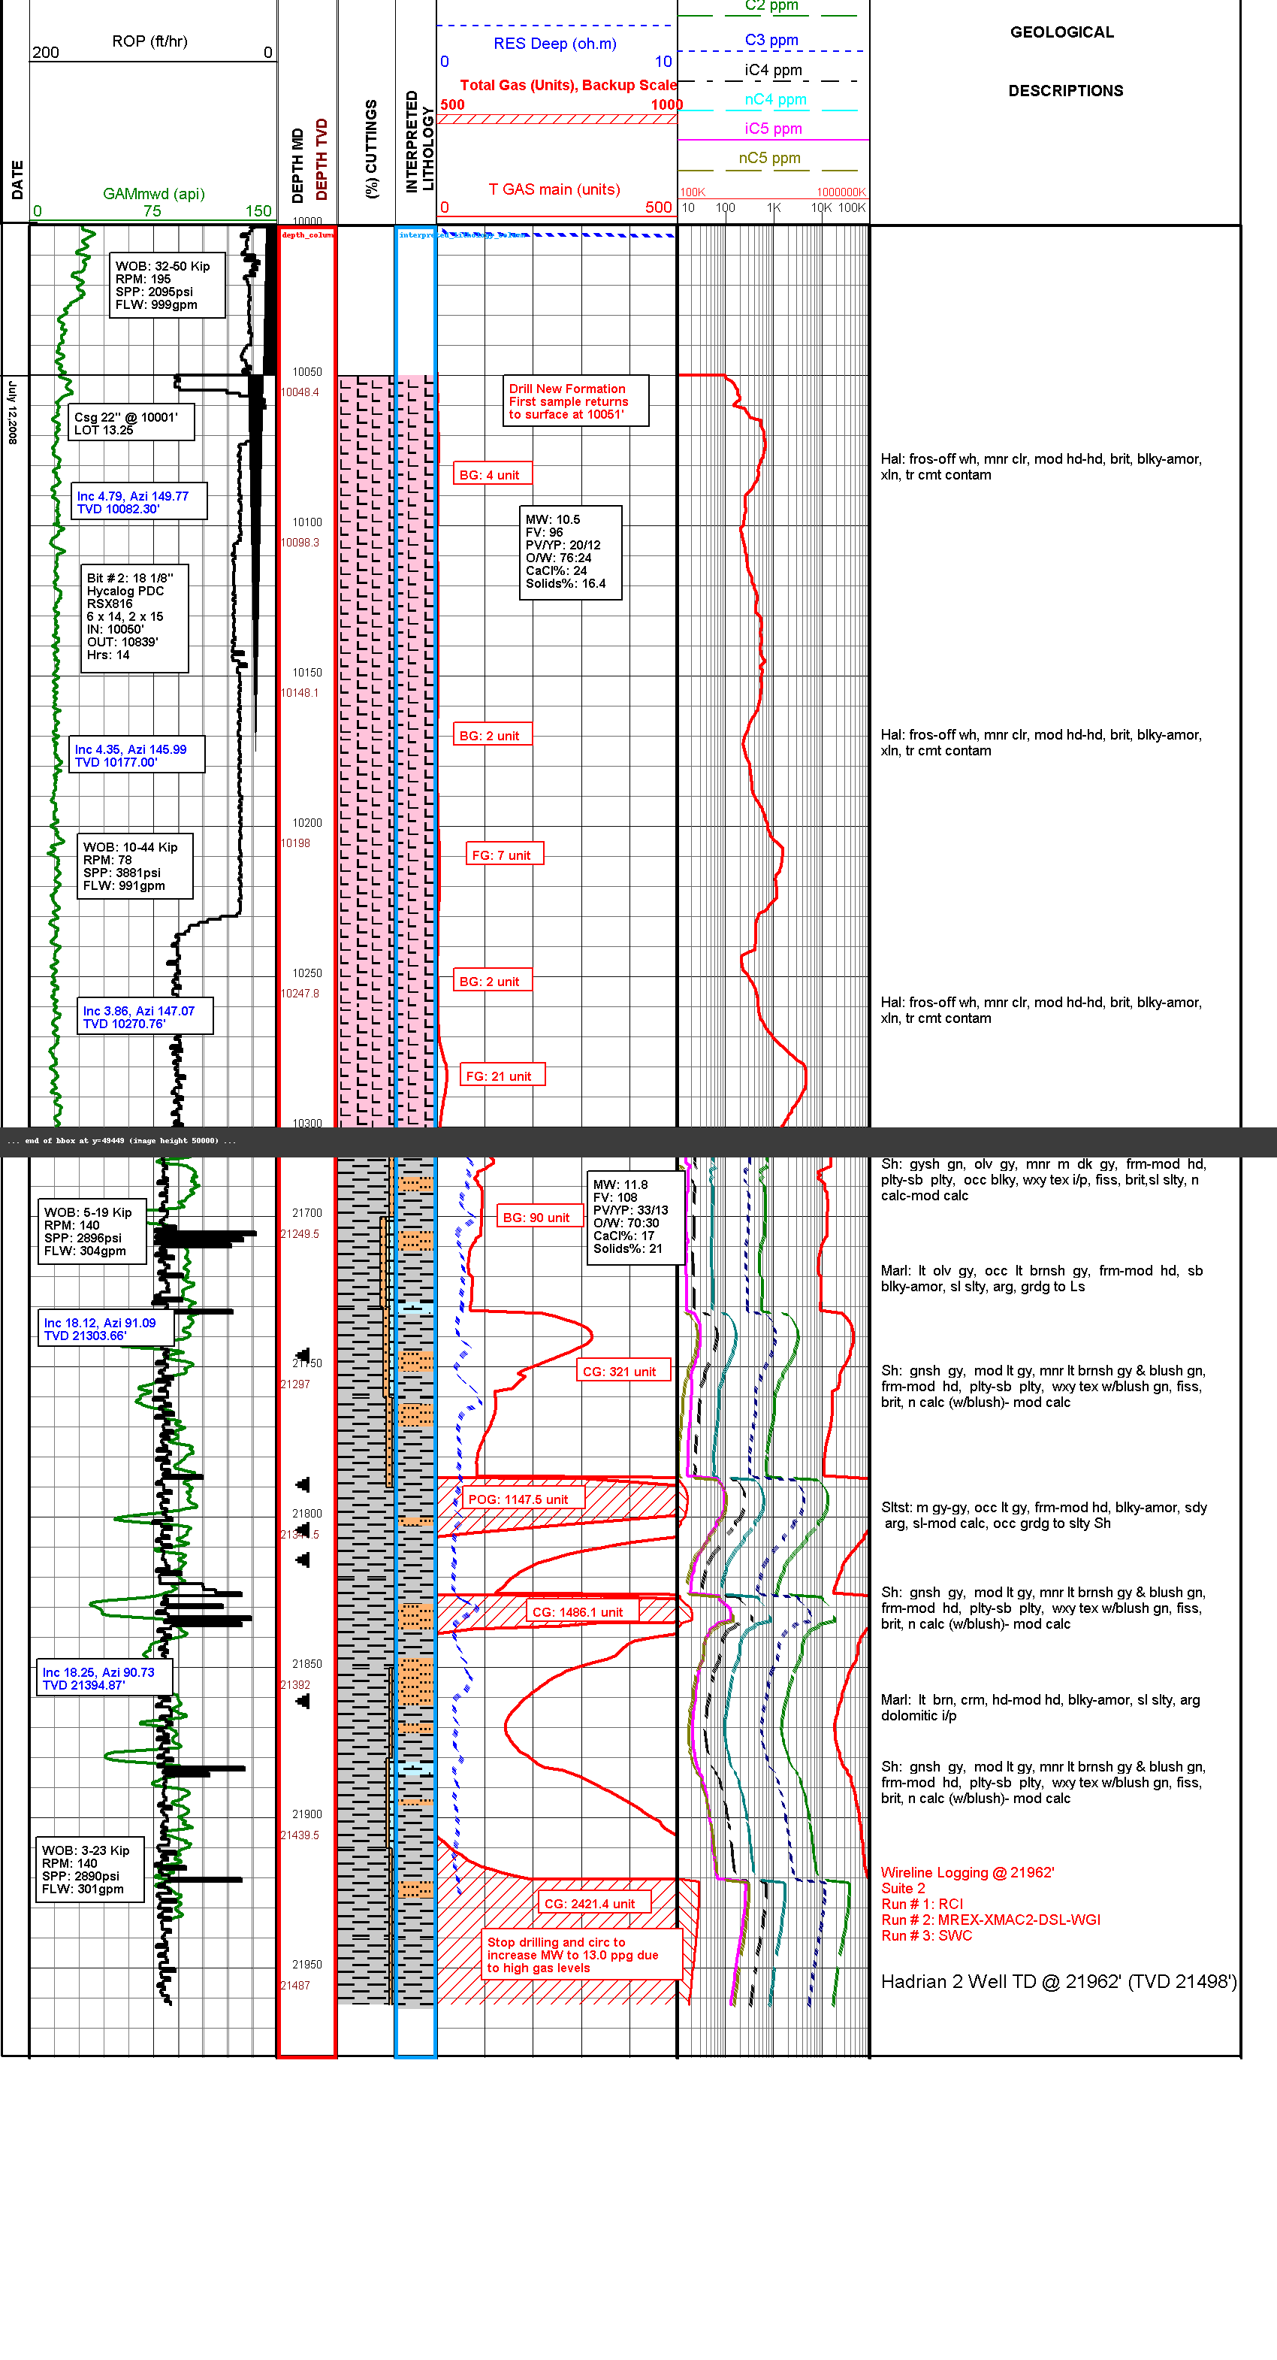
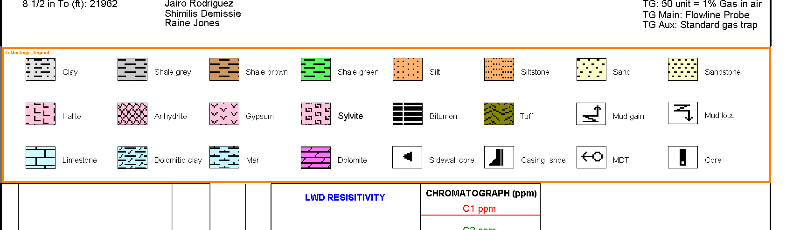
Turning an image into structured data
Input data
Image
Boxes coordinates
Legend
Lithography column
Depth column

Slide 7
Turning an image into structured data
Depth
Interpolation
Uses pixel numbers, dpi, and depth numbers
Aim
Allows us to translate from pixels to distance
Depth column

Slide 8
Turning an image into structured data
Segmentation
Row score
Score based by number of black and white pixels, spacing, etc.
Segmentation
Compare scores in each row, at the boundary the difference is going to be maximal.
Lithography column

Slide 9
Turning an image into structured data
Clustering
Cluster
Different segments and legends
Legend
Segmentation of
lithography column

Slide 10
03 Demo

Slide 11
Thank you
Romoli, Nguyen, Howbrook
8/11/2026

