Slide 1

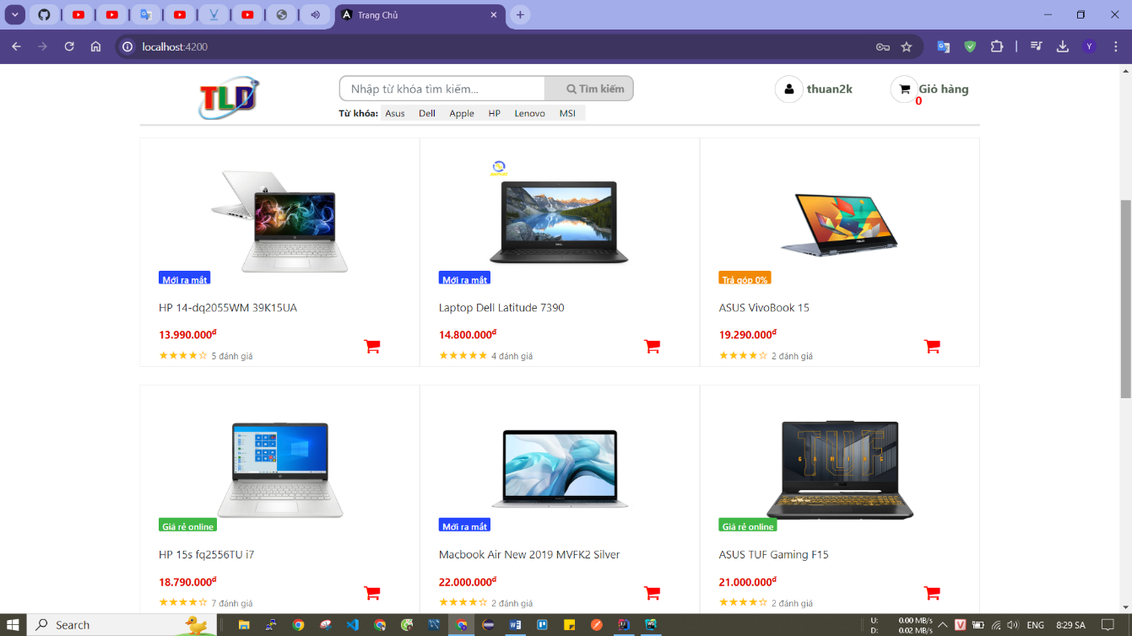
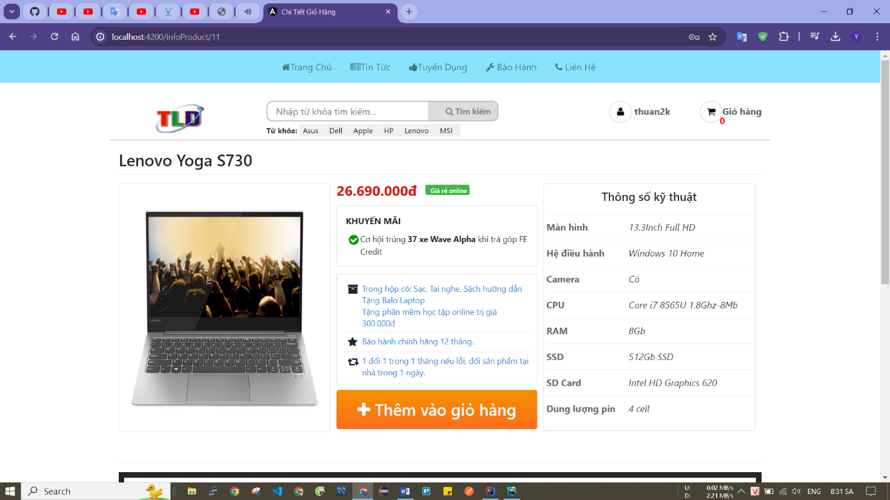
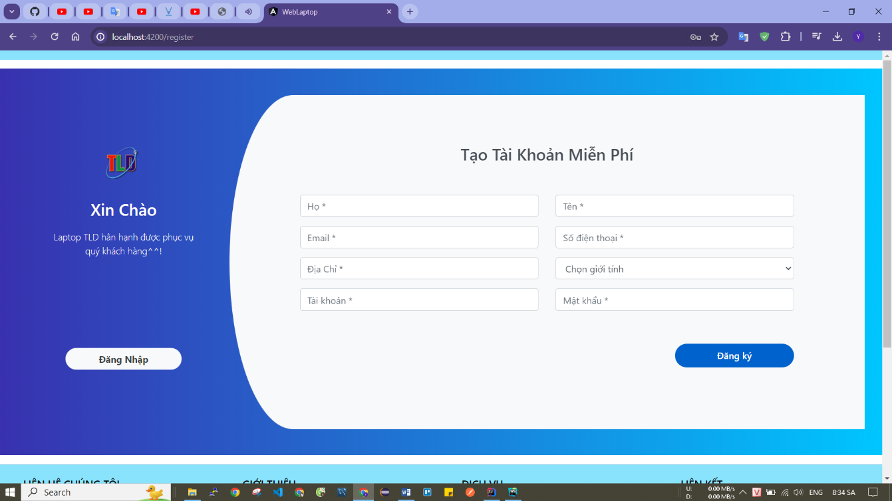
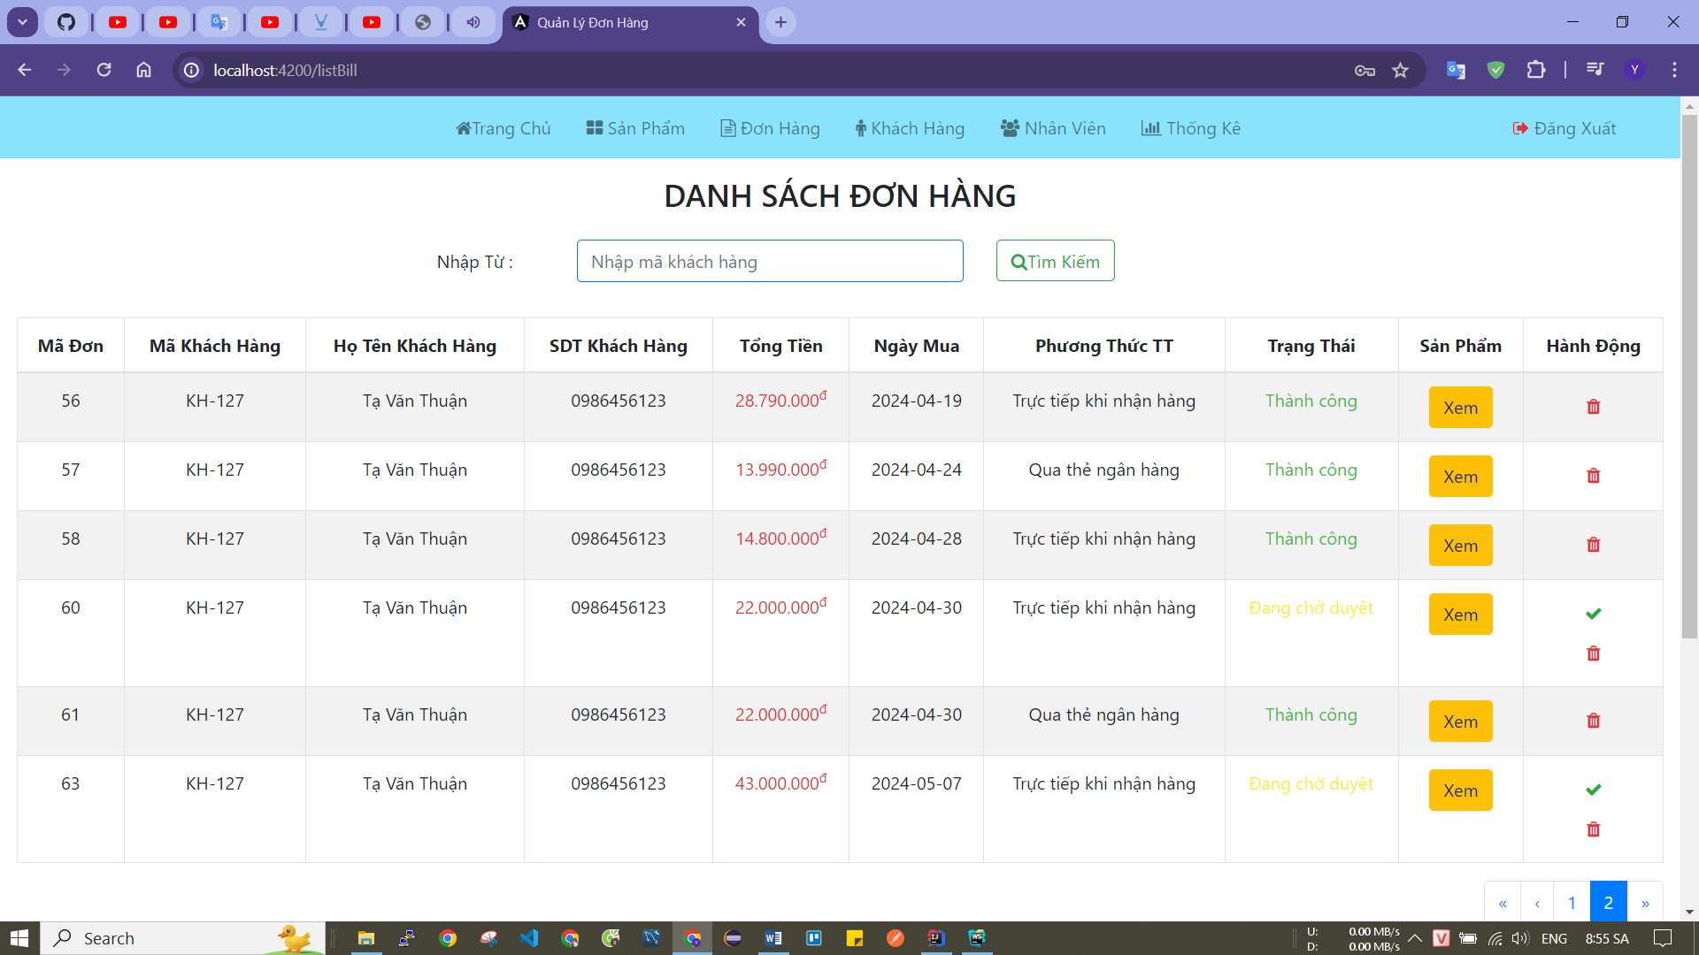
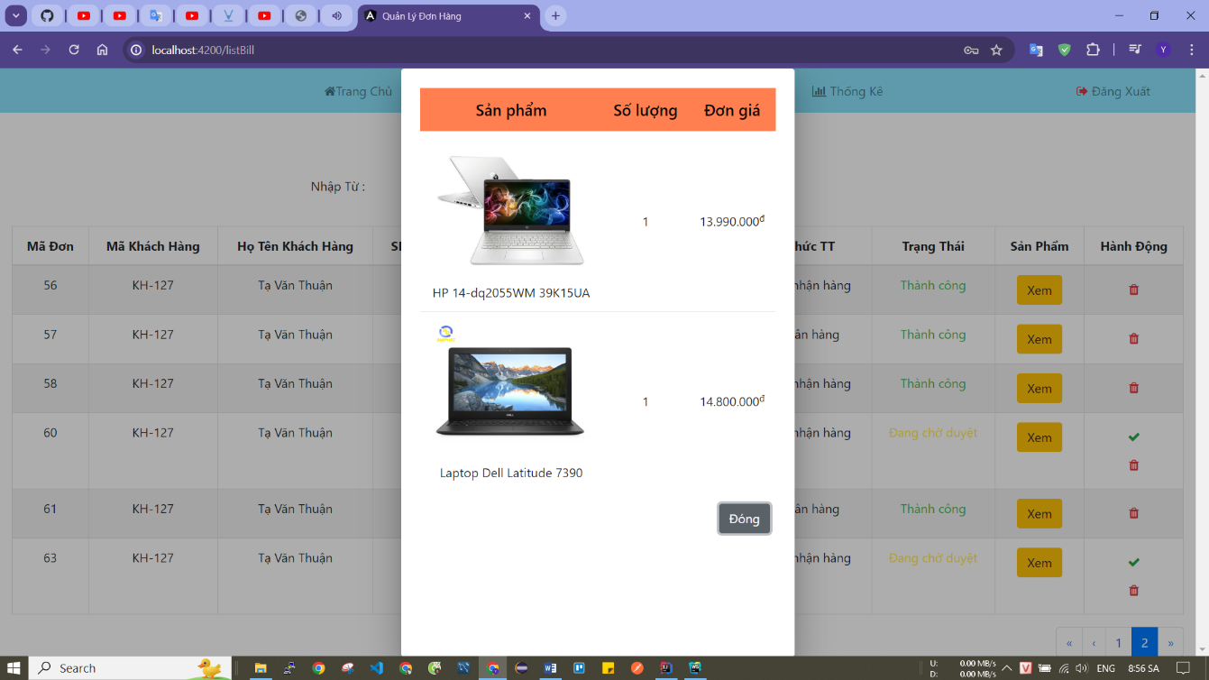
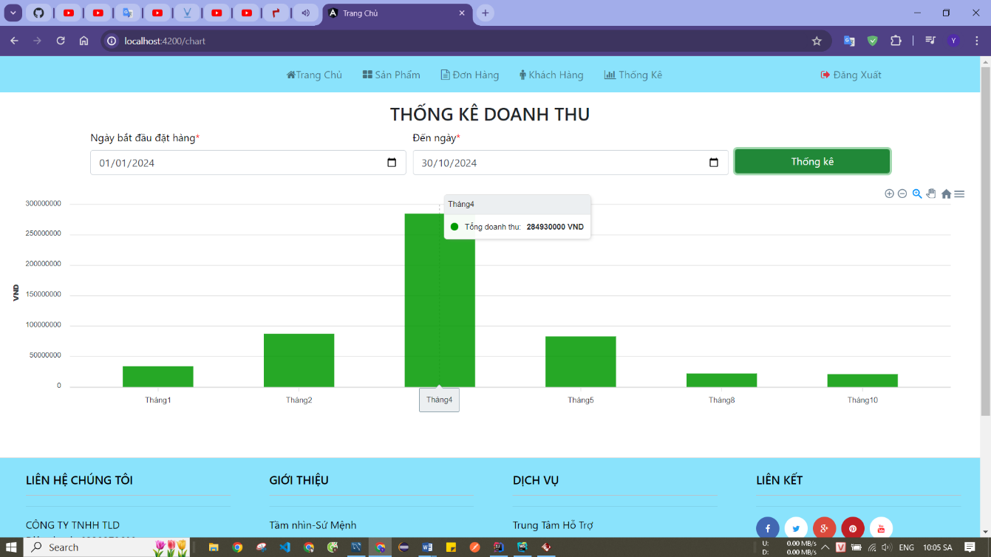
BUILDING A LAPTOP SELLING WEBSITE APPLICATION FOR TLD STORE USING JAVA SPRING BOOT
Student: Ta Van Thuan
Instructor: ThS. Nguyen Duc Luu
INTRODUCTION
Nowadays, with the explosion of information technology, buying and selling goods has been digitized and has become more popular than ever. For the convenience of both stores and customers, TLD store has entered e-commerce with the goal of providing a modern and convenient shopping platform. This website not only helps customers easily search and shop for laptops quickly, but also supports stores in managing products, orders and interacting with customers. In addition, the website brings outstanding convenience, ease of use and quick processing of user operations, while ensuring high security for user accounts and information, creating trust and satisfaction. please customers.
TECHNOLOGIES
Java Spring Boot is a powerful framework that helps build web applications quickly and efficiently. Spring Boot can create applications that are highly secure, clearly structured, easy to manage, maintain, and scalable in the future.
Angular is a client-side framework developed by Google, allowing the creation of user-friendly interfaces that are easy to use and provide a smooth experience to help customers easily search and shop for products.
MySQL is a powerful database management system, suitable for Website applications. MySQL manages data efficiently, provides high security features, and is capable of handling complex queries.
RESULTS
Build a Website that meets management requirements for administrators such as: order management, product management, customer management, employee management, and revenue statistics.
Meet requirements for customers using the Website such as: viewing products, adding products to cart, ordering, logging in, registering.
Some customer screen interfaces
Home page interface
Product detail interface
Registration page interface
Some admin screen interfaces
Order management interface
Order information interface
Revenue statistics interface
DEVELOPMENT
Deploy website to server
Design a more beautiful and luxurious interface

