Slide 1
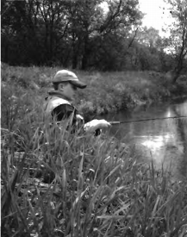

Slide 2
(A) The boy is taking a nap.
(B) The boy is fishing.
(C) The boy is eating a snack.
(D) The boy is drawing a picture.

Slide 3
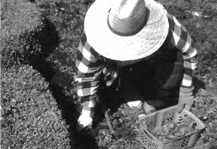

Slide 4
(A) The man is picking flowers.
(B) The man is standing up.
(C) The man is talking to his neighbor.
(D) The man is working in the garden.

Slide 5
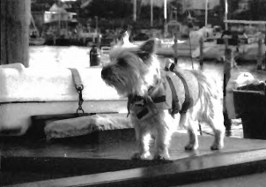

Slide 6
(A) The dog is sitting on a boat.
(B) The dog is eating on the boat.
(C) The dog is standing on a boat.
(D) The dog is swimming to a boat.

Slide 7
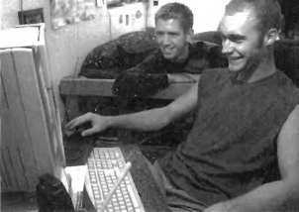

Slide 8
(A) The men are looking at a computer.
(B) The men are making a phone call.
(C) The men are having lunch.
(D) One man is asleep.

Slide 9
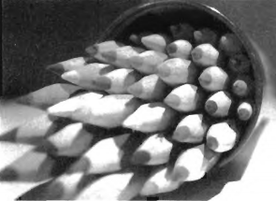

Slide 10
(A) The can of pencils is full.
(B) The pencils are on the can.
(C) The can of pencils is empty.
(D) The pencils are broken

